Slide 1
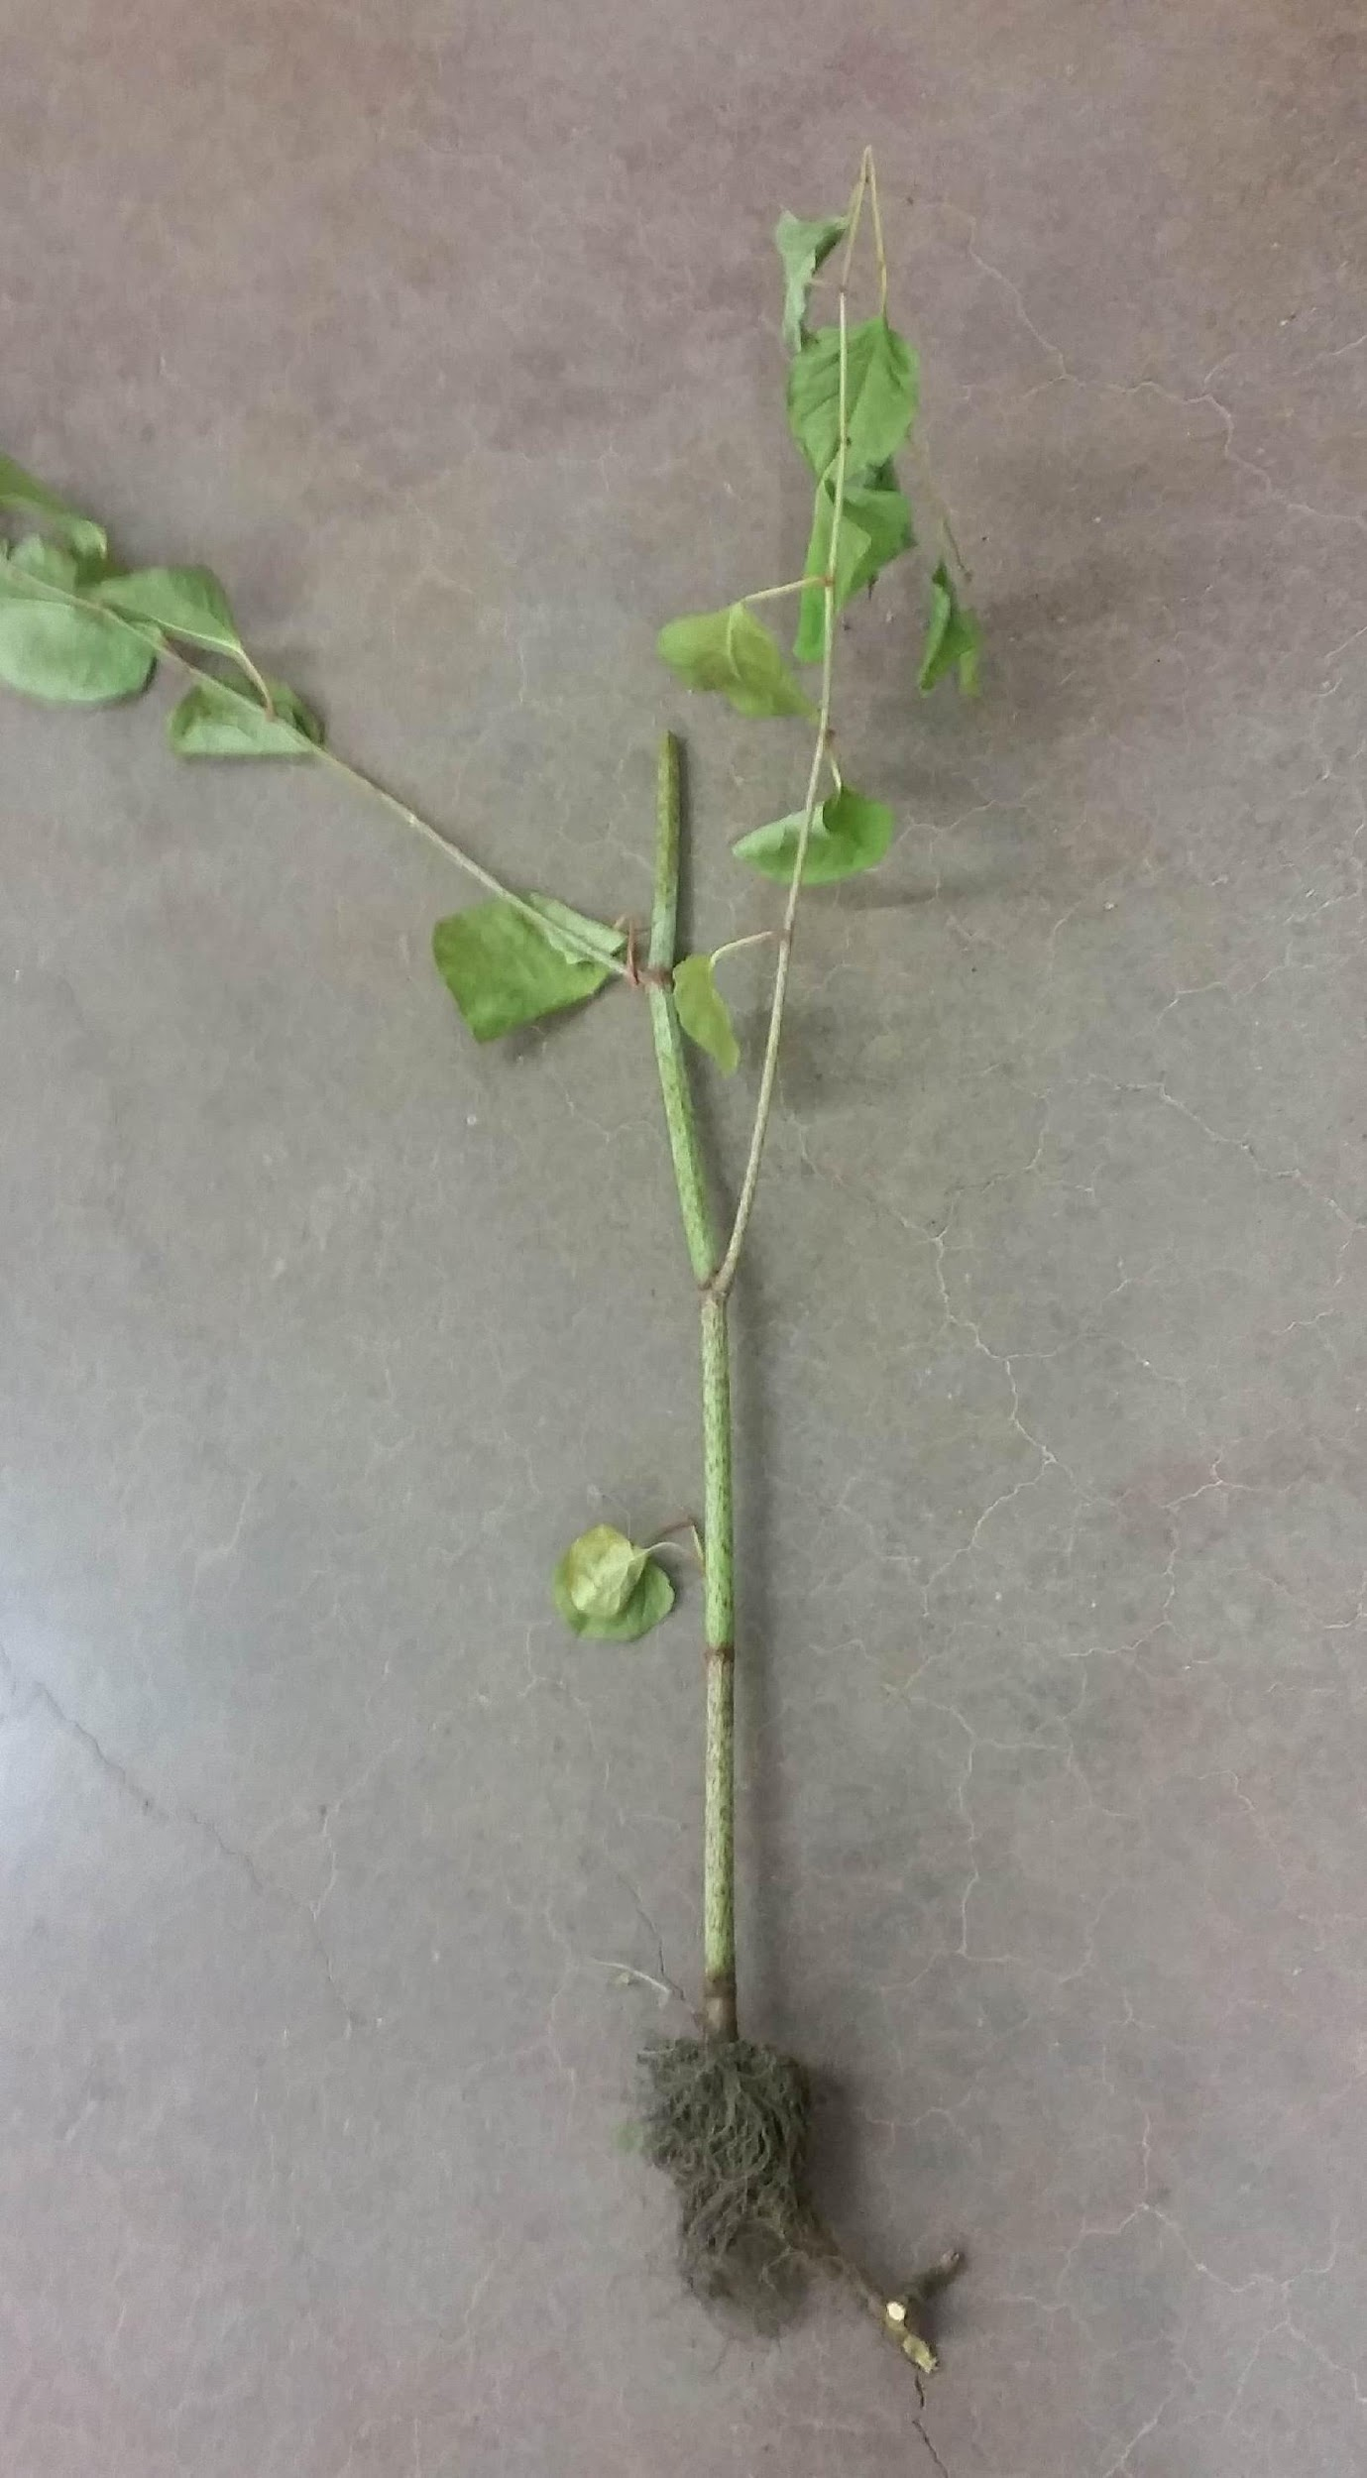
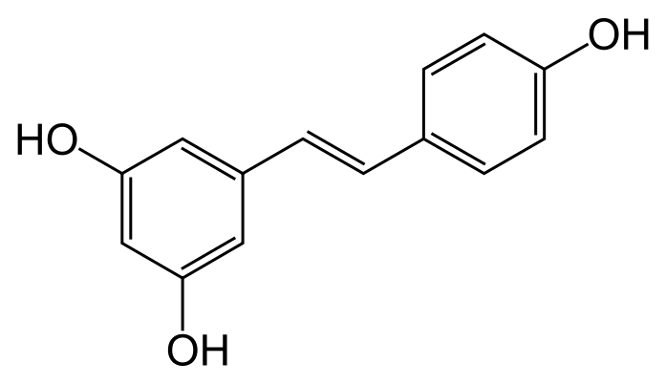
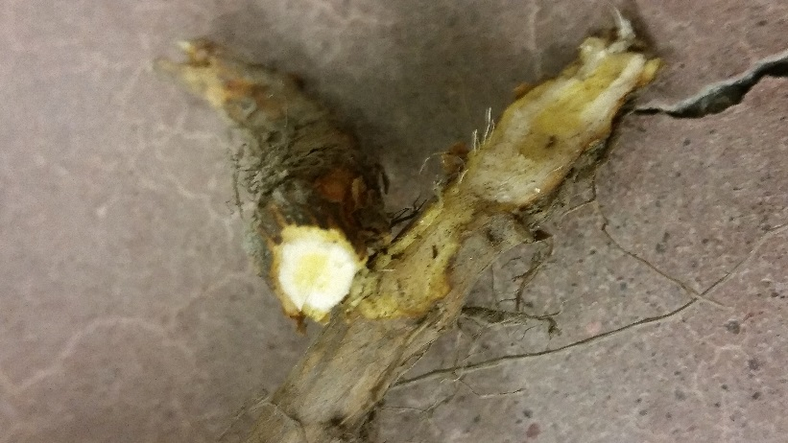
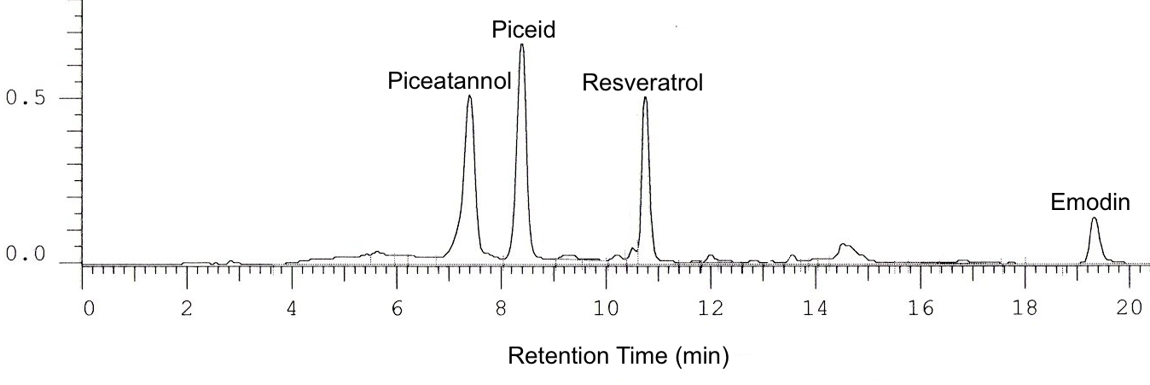
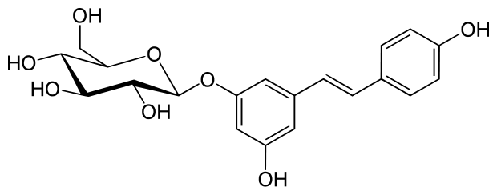
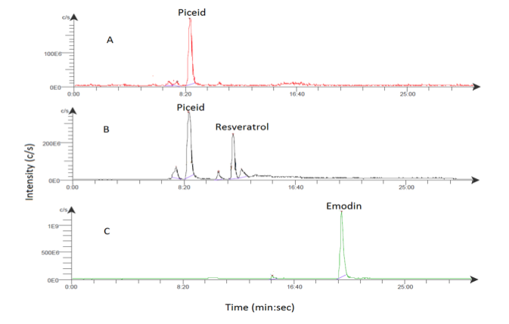
Studying Resveratrol and Piceid Production by Japanese Knotweed M. Yatison¹, J. Luchetta¹, A. Mikolon¹, D. Pupaza¹, Y. Patel¹, K. Klemow¹, D. Mencer², W. Terzaghi¹ ¹Dept. of Biology, Wilkes University, Wilkes-Barre, PA 18766; ²Dept. of Chemistry, Wilkes University, Wilkes-Barre, PA 18766
400-080-Y
Abstract
Resveratrol is a natural compound which has been shown to extend the lifespan of various organisms. Japanese Knotweed (Fallopia japonica) and its close relative Giant Knotweed are known to store large quantities of resveratrol and its glycosylated derivative piceid. Male and female samples were collected from Trucksville and Nuangola, PA. The plants were divided into six sections: leaf, stem, shoot, dermis cortex, and pith. Resveratrol and Piceid extractions using 80% ethanol and analyzed them using HPLC followed by MS. It was very clear that both males and females build up both resveratrol and piceid in the rhizome. Resveratrol concentrations increased from pith to cortex to dermis in both genders while piceid increased from the pith to the dermis to the cortex. Male knotweed appeared to have higher concentrations of resveratrol and piceid in the cortex compared to females while female knotweed had larger concentrations of both compounds in the dermis relative to males. Samples collected across the Wyoming valley were analyzed using primers that amplified genomic and plastidic DNA polymorphisms. Four of the primers (KW4, KW6, atpB-1/rbcL-1, trn-T/TRN-L) showed differing patterns between BB10, K2, K3, and DNA1. Sample BB10 had 19 fold higher resveratrol content than sample K2 whereas there was no significant deviation in piceid content, suggesting that BB10 may have less piceid synthesis or a more active glycosylase. We also found that post-harvest storage at room temperature enhanced resveratrol content in many samples but had little effect on piceid content, and that piceid was 3 fold higher in the pith than in the cortex, whereas resveratrol increased moving from the pith to the epidermis.
Conclusions
Gender based tissue analysis
The amount of trans-resveratrol per gram of plant tissue differed in the shoot by a factor of 7, cortex by a factor of 1.4, and the female leave was the only leaf tissue between the two genders to have trans-resveratrol.
Trans-piceid, on the other hand, had relatively similar mass ratios in all tissues but the leaf, which differed between genders by a factor of 1.6.
Piceid concentrations were highest in the cortex, lowest in the pith, then had an intermediate level in the dermal tissue, whereas resveratrol was lowest in the pith, intermediate in the cortex and highest in the dermal tissue for both males and females
This could be consistent with resveratrol being stored in an inactive form in the cortex and pith, then mobilized in the dermal tissues where it will encounter potential pathogens.
Genetic analysis
K2 seems genetically distinct from the others since it lacked a KW4 sequence and a KW6 sequence and its copy of the atpB-1/rbcL-1 sequence did not cut with the HypCH4 restriction enzyme
This genetic variation corresponded with a 1.5 fold higher emodin content compared with the other samples
BB10 also showed to be genetically different based on the incomplete digest of the atpB-1/rbcL-1 sequence and it produced slightly shorter bands with the KW6 primer
This genetic variation corresponded with the19 fold higher resveratrol content
In the future, we plan to grows clones of these samples in controlled conditions in order to more accurately determine
if the observed genetic deviance correlates with varying amounts of resveratrol, piceid, and emodin in the rhizome
Section | Trans- resveratrol (mg/g) | Trans- piceid (mg/g)
Leaf | – | 0.1375
Stem | – | –
Shoot | 0.0226 | –
Pith | – | 0.9576
Cortex | 0.2231 | 1.7460
Dermis | 0.4910 | 1.1275
Section | Trans- Resveratrol (mg/g) | Trans- Piceid (mg/g)
Leaf | 0.1717 | 0.2250
Stem | – | –
Shoot | 0.0032 | 0
Pith | – | 0.8579
Cortex | 0.1603 | 1.6439
Dermis | 0.7038 | 1.1823
A
B
C
Table 1: Trans-piceid and trans-resveratrol contents in the tissues of male knotweed: Data was acquired using HPLC-MS. The units are in milligrams of resveratrol or piceid per gram of plant tissue. Male plants had the highest concentration of resveratrol in the dermis of the rhizomes and the highest concentration of piceid in the cortex.
F
D
Table 2: Trans-piceid and trans-resveratrol contents in the tissues of female knotweed: The data for the female plant tissues was obtained via HPLC-MS. The units are in milligrams of resveratrol or piceid per gram of plant tissue. Females had the highest concentrations of resveratrol in the dermis of the rhizomes and the highest concentration of piceid in the cortex
Resveratrol
E
Figure 1: Sample of Japanese knotweed: This sample of Japanese knotweed is a female collected from Nuangola, PA. The corresponding tissues are as follows: A = leaf,
B = stem, C = shoot, D = cortex, E = pith, F = dermis. Trans-resveratrol and trans-piceid were extracted from the corresponding tissues of male and female individuals.
Piceid
Figure 4: HPLC tracing of an ethanolic rhizome extract
Peaks at 8.41 (Piceid), 10.77 (Resveratrol), and 19.35 (Emodin) elute at the same time as authentic standards and were verified by mass spectrometry. The peak at 7.42 is tentatively identified as piceatannol.
Introduction
Fallopia japonica, commonly known as Japanese knotweed, is an invasive species throughout North America and Europe
Japanese knotweed produces various organic substances that may be harvested for medicinal use, including resveratrol, a compound that is commonly associated with grapes and red wine.
Resveratrol has antibacterial, antifungal, antioxidant, antimutagenic, anti-inflammatory, neuroprotective, chemoprotective, and anticancer properties.
The richest known source of resveratrol is the rhizome of Japanese knotweed.
Resveratrol (3,5,4'-trihydroxy-trans-stilbene) is a stilbene and phytoalexin
Resveratrol is produced by plants in response to stresses such as wounding or pathogen attack, water deprivation, UV radiation, and fungal infections.
Resveratrol can be synthesized through the conversion of piceid into resveratrol by the hydrolysis of the glycoside component from piceid.
Piceid concentration is correlated with the formation of resveratrol and its production or loss in response to plant stress.
Figure 2: HypCH4 digestion of chloroplast atpB-1/rbcL-1 sequence: HypCH4 cut the atpB-1/rbcL-1 sequence into two fragments except for sample K2 suggesting that K2 lacks that restriction site. BB10 consistently never completely digested into the two fragments after several replicates, indicating that it may be a hybrid between Japanese and Giant knotweed
Figure 3: Polymorphism of the Chloroplast Trn-T/TRN-L sequence : Sample K3 lacks a band suggesting that K3 has changed the Trn-T or the TRN-L primer binding site
Figure 5: ESI-MS tracings of an ethanolic rhizome extract
A represents an XIC: 288.5-289.5. B represents an XIC: 226.5-227.5. C represents an XIC: 268.5-269.5.
Acknowledgements
We would like to thank the NSF for making it possible to use the growth chambers. We would also like to acknowledge prior Wilkes Biology Research Students that worked on Japanese Knotweed projects in the past.

