Slide 1
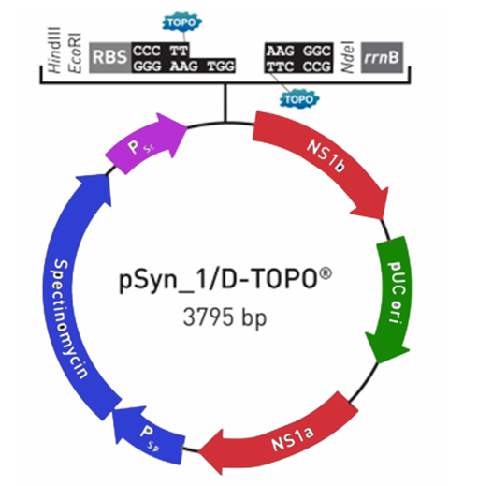
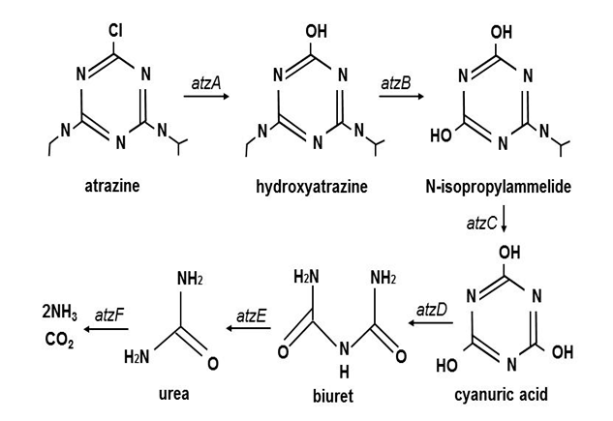
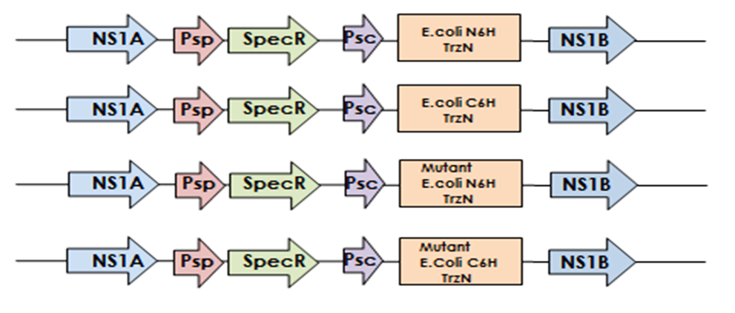
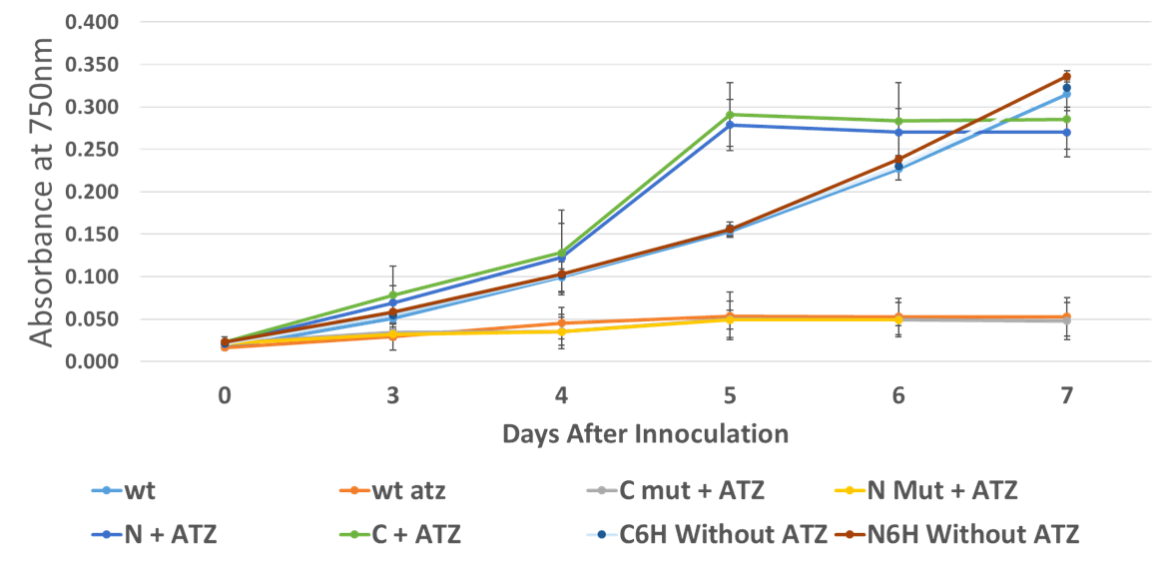
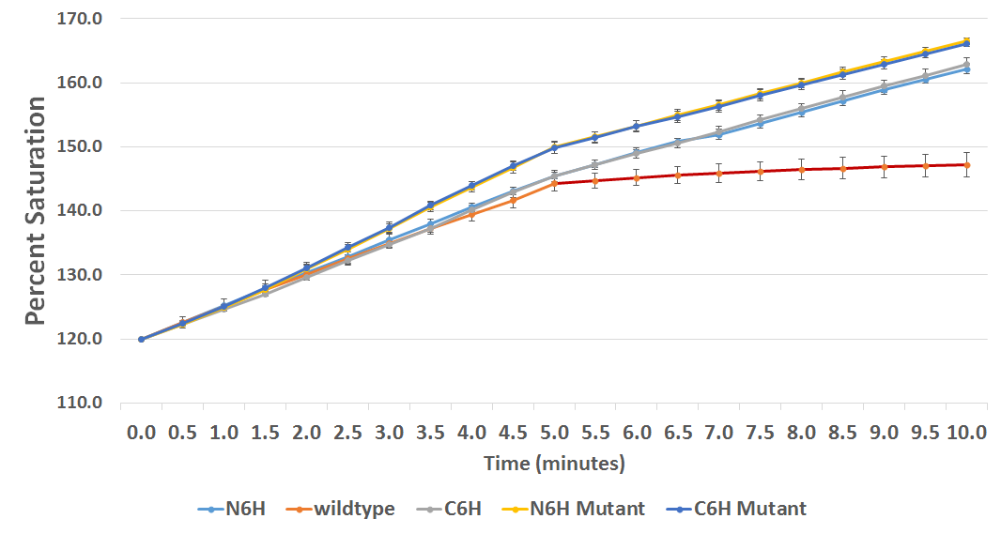
500-075-Z Creating atrazine-resistant Synechococcus elongatus
K. McHale¹, T. Wasiluk¹, C. Morocho², M. Roueinfar¹, K. Abraham¹, L. Bauman¹, D. Lucent¹, W. Terzaghi^{1,2}
Department of Bioengineering¹, Department of Biology², Wilkes University, Wilkes-Barre, PA
Abstract
Conclusions
Atrazine is used to control weeds. Atrazine contamination has become a concern due to its long half-life and action as an endocrine disrupter. Bioremediation with cyanobacteria is a potential way to detoxify atrazine contaminated water sources. AtzA and TrzN are atrazine chlorohydrolases that start atrazine degradation by converting it to hydroxyatrazine. AtzA has been used to confer atrazine resistance to several species of plants, but TrzN has better kinetic properties and broader specificity. The aim of this project was to create transgenic Synechococcus elongatus PCC 7942 expressing TrzN for phytoremediation of atrazine. Genes encoding TrzN with N-(N6H) or C- terminal (C6H) hexa-histidine purification tags were constructed, together with mutant versions of these genes possessing reduced chlorohydrolase activity. They were then transformed into S. elongatus and the transgenic cultures were assayed for atrazine tolerance. S. elongatus cultures expressing N6H and C6H TrzN were found to be significantly more tolerant to 1 uM atrazine than wild type and mutant TrzN cultures in terms of growth and photosynthetic ability, indicating that this tolerance was due to the TrzN transgene. However, the transgenic TrzN cultures did not grow as well as wild type cultures without atrazine, and therefore still need improvement before they can be used for bioremediation.
Transgenic Synechococcus elongatus expressing TrzN grew in atrazine concentrations that arrested wild type.
1 µM atrazine arrested photosynthetic oxygen evolution by wild type but only slowed it 30% in S . elongatus expressing TrzN.
Increasing TrzN expression should make these cells good candidates for cleaning atrazine contamination
TrzN
Results
mRNA and Protein analysis
RT-PCR on RNA extracted from transgenic N6H and C6H cultures detected TrzN mRNA
No prominent band the size of TrzN was seen on protein gels.
Growth:
Transgenic N6H and C6H cultures initially grew faster in the presence of 1µM atrazine than wild type in untreated BG11,
The average increase in A750 from day 4 to 5 for the N6H and C6H TrzN cultures exposed to atrazine was significantly greater than the increase of the wild type without atrazine and the wild type exposed to atrazine (t-test P < 0.01).
Transgenic N6H and C6H TrzN S. elongatus cultures grown 7 days in 1 µM atrazine appeared much more turbid and a paler green than wild type grown in untreated BG11
Cells expressing a mutant TrzN with reduced activity did not grow more than wild type in 1µM atrazine
Photosynthetic Oxygen Evolution
Addintion of 1µM atrazine stopped oxygen evolution by wild-type but only slowed it 31%, 32% 45% and 46% in C6H, N6H, mutant C6H and mutant N6H cultures, respectively
The decreases in all transgenic cultures were significantly different from the wild type culture (T test P < 0.01).
The decreases exhibited by both mutant TrzN cultures were also significantly greater than those of the C6H and N6H cultures (T test P < 0.01).
Introduction
Figure 1
Figure 2
What is Atrazine?
2nd most widely used herbicide in US
Disrupts photosynthesis by inhibiting Photosystem II
Used on tolerant crops (corn, sorghum, sugarcane) to control weeds
Problems with Atrazine:
Can persist in environment for up to 1 year
Can contaminate aquatic ecosystems and drinking water
Acts as an endocrine disruptor in amphibians and mammals
May harm non-target photosynthetic organisms
Atrazine-degrading enzyme pathways:
Hydrolase enzymes in some soil bacteria destroy atrazine (Fig 1)
Both TrzN and AtzA dechlorinate atrazine to hydroxyatrazine
Why TrzN?
Active against more substrates
More catalytically efficient
Our Goal:
Create transgenic S. elongatus PCC 7942 expressing TrzN for phytoremediation of atrazine
Atrazine Degradation Pathway. Source Shiomi et al. 2013
Top: Empty linearized pSyn_1/D-TOPO vector. Bottom: Constructs inserted into the S. elongatus genome. SpecR: Spectinomycin gene. Psc: Nickel inducible promoter. NS1A and NS1B: homologous neutral site sequences
Discussion
Transgenic cultures expressing TrzN were more tolerant of 1 uM atrazine than wildtype S. elongatus and mutant TrzN cultures.
Transgenic TrzN cultures did not grow as well on 1 µM aAtrazine as wild type cultures without atrazine,
atrazine is still having a negative impact on the transgenics.
The turbidity of transgenic N6H and C6H TrzN cultures and growth cessation after day 5 could indicate the presence of unpigmented cells. Cells can differentiate into a state known as non-pigmented resting cells from N deprivation. To determine if the cells are using up more N in response to the atrazine, N could be added to the cultures when they hit their plateau.
Expression needs to be improved before transgenics can be used for bioremediation.
Replacing the nickel promoter with a stronger promoter may increase the expression of TrzN which may increase its atrazine tolerance.
Figure 3
Appearance of S. elongatus cell cultures grown in 1µM atrazine for seven days
Methods
Growth Conditions:
Cells were grown in complete BG-11 in an environmental chamber set to 32˚C, 400 ppm CO2, 100 µmol/m2/sec PFD, 16 H light, 8H dark on a shaker rotating at 100 rpm.
Gene Construct Design and Transformation:
TrzN genes were designed with N and C Terminal histidine tags and codon optimized for E.coli
E. coli optimized TrzN and Mutant TrzN sequences were cloned into pSyn_1/D-TOPO vector via topo cloning
Electroporated into XL-1 blue and verified via colony PCR and restriction digestion of extracted plasmid DNA
S. elongatus was transformed via homologous recombination according to manufacturer's protocol
Verification of transformants
Colony PCR
RNA and Protein analysis
Assess Tolerance to 1uM Atrazine:
Growth Measurements at OD750
Photosynthetic ability measured using oxygen electrodes
1uM Atrazine Added
References
Figure 4
Figure 5
Shiomi, Naofumi (2013). A Novel Bioremediation Method for Shallow Layers of Soil Polluted by Pesticides, Applied Bioremediation - Active and Passive Approaches, Dr. Yogesh Patil (Ed.), ISBN: 978-953-51-1200-6, InTech, DOI: 10.5772/56153.
Effect of 1 µM Atrazine on growth of transgenic and wild type S. elongatus. Cells were grown at 32 ˚ C in BG11 medium supplemented with1 µM atrazine and absorbance at 750 nm was measured at the indicated times Wt: wild type, C:C6H TrzN, C Mut: C6H mutant TrzN. N: N6H TrzN, N Mut: N6H Mutant TrzN. ATZ: Atrazine. N=3* T-test P <0.01
Time Course of Photosynthetic Oxygen Evolution by Transgenic and Wild Type S. elongatus cultures before and after atrazine addition. Cultures growing in BG11 medium were placed in a Clark-type oxygen electrode and photosynthesis was measured by the change in oxygen saturation. 1µM atrazine was added at 5 minutes. N=3
Acknowledgements
Additional support from Wilkes University is also gratefully acknowledged.
Notes:
***Notes from DOC***
Move conclusion to top right
Shorten intro (bullets?) “BAM BAM BAM take home message!”
Move green picture up higher (if we can)

