Slide 1
Next Assignment: Wed April 17
Gene editing for fun and profit
Targeted disruptions
Engineering Arabidopsis resistant to Turnip mosaic virus doi: 10.1111/mpp.12417
Engineering plants for gemini virus resistance doi: 10.1016/j.tplants.2016.01.023
Gene Disruption in Toxoplasma gondii Using CRISPR/CAS https://www.ncbi.nlm.nih.gov/pmc/articles/PMC4030483/
Generation of germline ablated male pigs https://www.nature.com/articles/srep40176
Efficient Gene Knockout in Goats https://www.ncbi.nlm.nih.gov/pmc/articles/PMC4154755/
Crispr-CAS9 to fix Hb-S http://www.nature.com/nature/journal/v539/n7629/full/nature20134.html
Crispr-CAS9 to convert fibroblasts to neurons http://www.cell.com/cell-stem-cell/fulltext?S1934-5909(16)30196-5

Slide 2
Targeted improvements
Replacement of an N-efficiency gene with a superior allele doi:10.1111/jipb.12650
Improving tomatoes https://doi.org/10.1016/j.cell.2017.08.030
Improving drought tolerance http://onlinelibrary.wiley.com/doi/10.1111/pbi.12673/full
Improving seed fatty acid composition http://onlinelibrary.wiley.com/doi/10.1111/pbi.12663/full
Editing the maize ALS2gene to yield chlorsulfuron-resistant plants https://doi.org/10.1104/pp.15.00793
Improving cold storage and processing traits in potato https://doi.org/10.1111/pbi.12370
Producing high oleic and low linolenic soybean oil https://doi.org/10.1186/s12870-016-0906-1
Production of gene-corrected adult beta globin protein in human erythrocytes differentiated from patient iPSCs after genome editing of the sickle point mutation https://www.ncbi.nlm.nih.gov/pmc/articles/PMC4628786/

Slide 3
Remaining work
Preparing poster
Preparing MS
Writing 2000 word review on topic of your choice related to molecular biology
Probably easiest to do it on your GMO or Gene-editing topic since have already done a lot of the reading

Slide 4
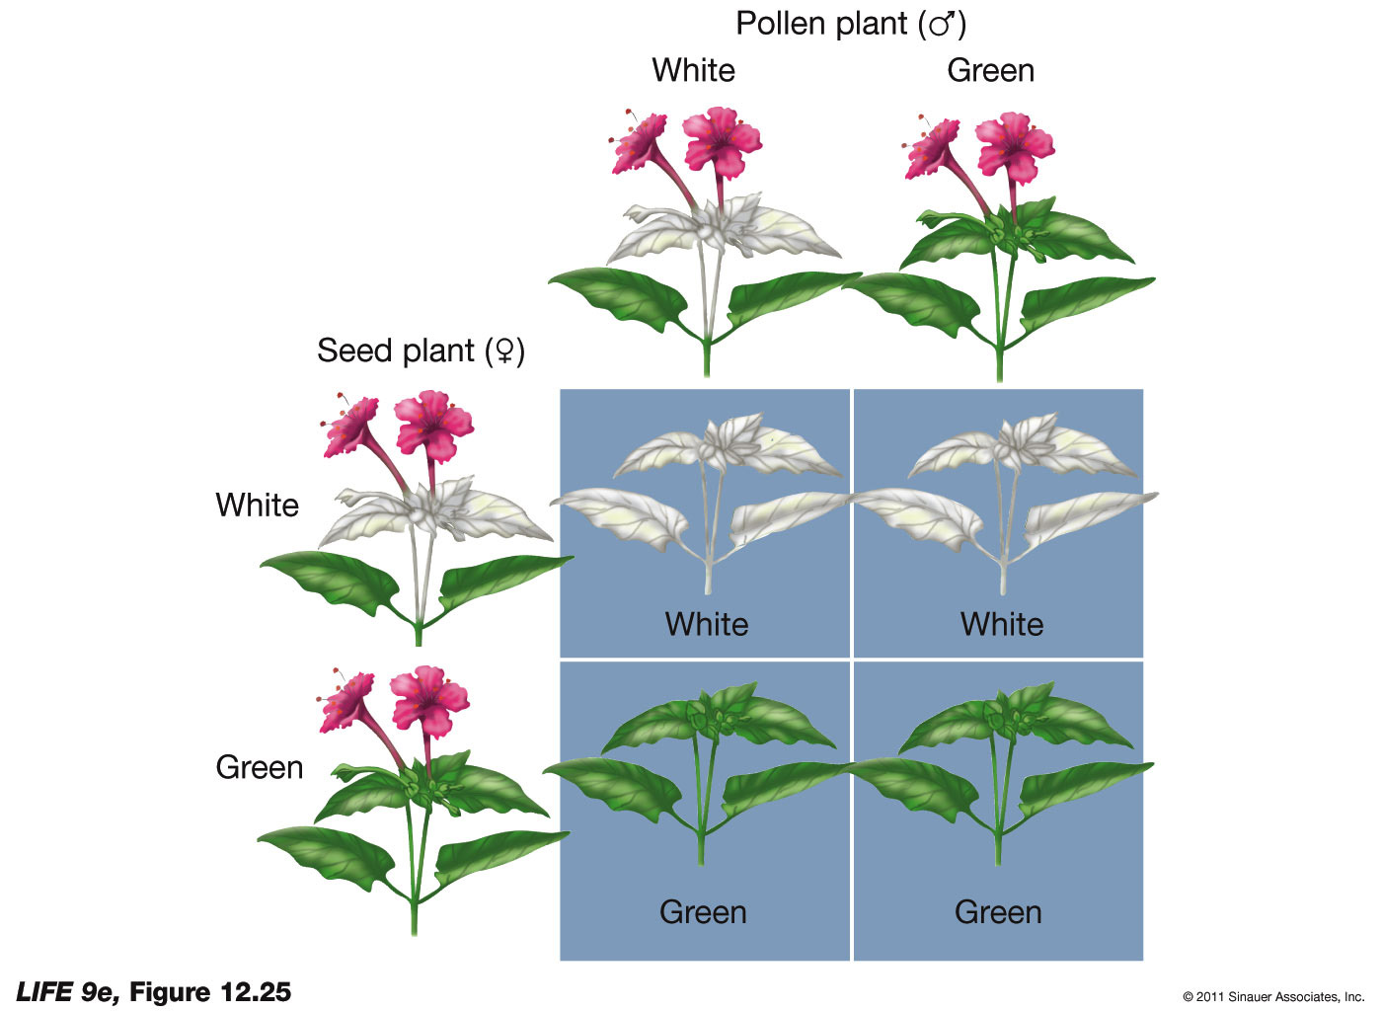
Cytoplasmic inheritance
Variegation arises because have mix of “good” and “bad” cp
Segregate randomly at division
eventually one form predominates
In plants, cytoplasm comes from the egg
most pollen do not have cp or mt
can't study genetically, because no
way to mix parental organelles

Slide 5
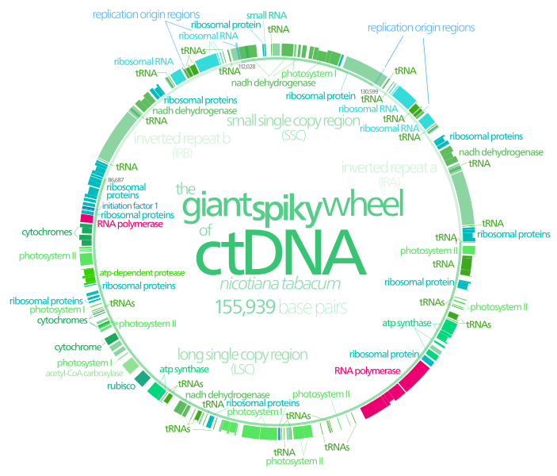
Plastid DNA
encode ~ 100 proteins, 4 rRNA &~30 tRNA
5 classes of proteins
ribosomal & other proteins involved in translation
proteins involved in transcription
proteins involved
in photosynthesis
proteins involved
in respiration
ORFs (open reading
frames)
sequences capable of
encoding proteins but
no product has been
identified

Slide 6
Plastid DNA
encode ~ 100 proteins, 4 rRNA &~30 tRNA
5 classes of proteins
in general, tend to be the more hydrophobic subunits
could have complicated exporting the gene to the nucleus
invariably also have subunits encoded by nuclear genes

Slide 7
Plastid DNA
cp gene expression is regulated at all levels
1) transcriptional
2) mRNA stability
3) Translational: light triggers 100x increase in some proteins but only small increase in transcription

Slide 8
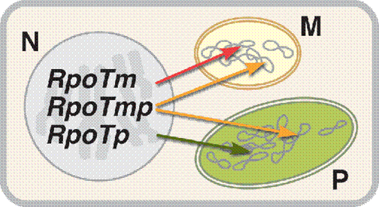
Plastid DNA
Nuclear-encoded RNA polymerases (NEP) are related to bacteriophage RNA pols
1 subunit
Mainly transcribe housekeeping genes & genes encoding the plastid transcriptional machinery
Essential for early development
Not very active in “mature” chloroplasts

Slide 9
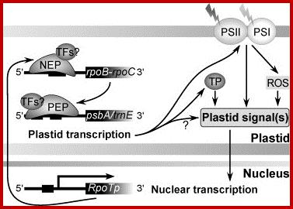
Plastid DNA
NEP are active early in development
plastid-encoded polymerases (PEPs) are mainly active in mature chloroplasts and transcribe genes associated with photosynthesis
Many subunits, > 1,000,000 Da
Rpo subunits encoded by cpDNA, sigma factors and others encoded by nucleus

Slide 10
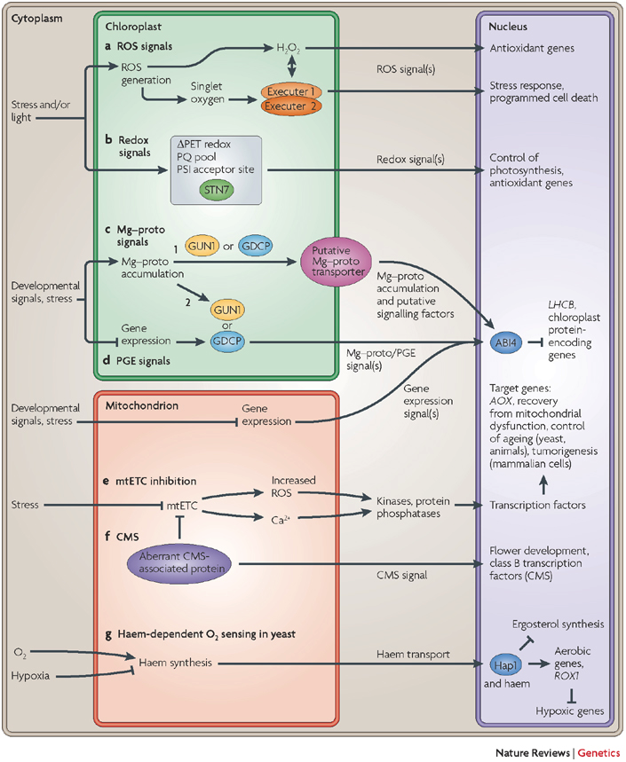
Plastid DNA
coordination with nucleus
CP signals to nucleus:
retrograde signaling
ROS
Redox
Mg-protoporphyrin
Genome-uncoupled
(gun) mutants are
defective in retrograde
signaling

Slide 11
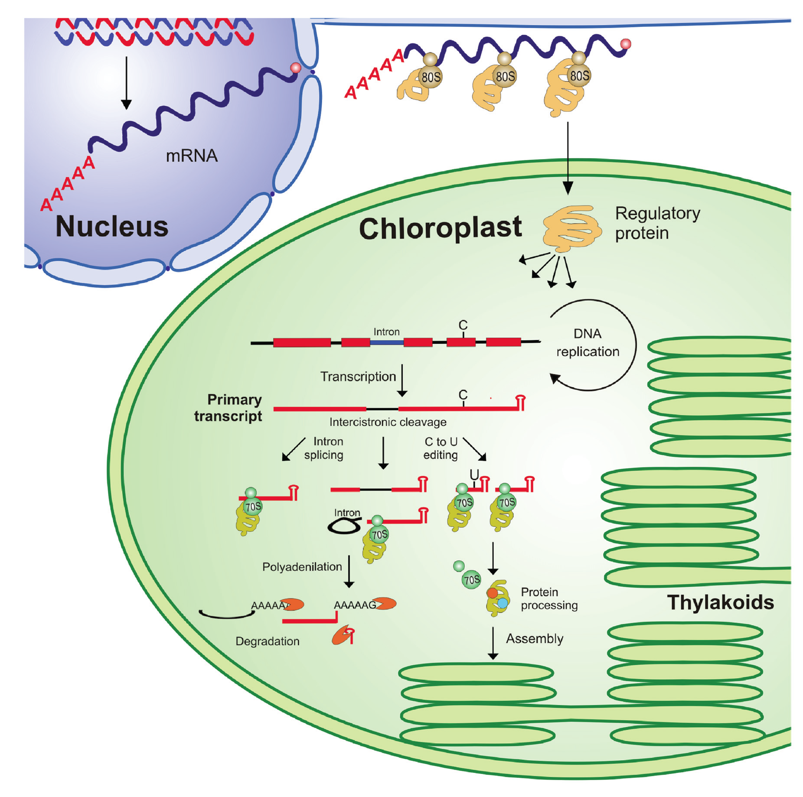
Plastid DNA
Oddities
Plastid mRNA is often polycistronic and extensively processed

Slide 12
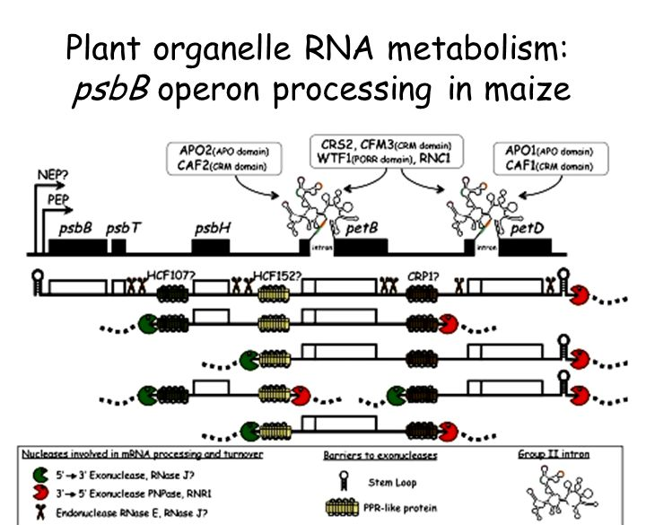
Plastid DNA
Oddities
many cp genes are organized into operons
May be processed into separate RNAs

Slide 13
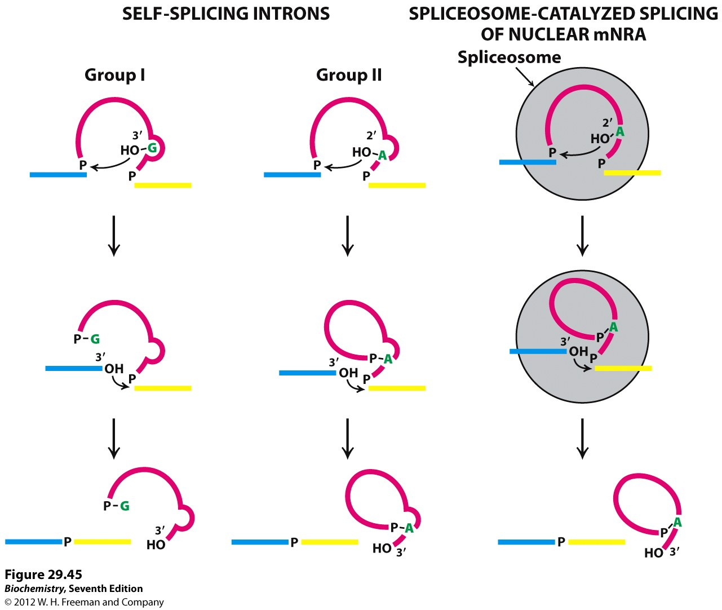
Plastid DNA
Oddities
Many cp genes are organize into operons
many cp genes have introns
introns are self-splicing (type II): no spliceosomes or other enzymes!

Slide 14
Plastid DNA
Oddities
Many cp genes are organized into operons
many cp genes have introns
introns are self-splicing (type II): no spliceosomes or other enzymes!
3) mRNA editing:many cp mRNAs differ from the gene encoding them
an ACG is modified post-transcriptionally to a functional AUG start codon in several tobacco mRNAs; many other post-transcriptional changes have also been identified

Slide 15
Plastid DNA
Oddities
Many cp genes are organized into operons
many cp genes have introns
introns are self-splicing (type II): no spliceosomes or other enzymes!
3) mRNA editing:many cp mRNAs differ from the gene encoding them
an ACG is modified post-transcriptionally to a functional AUG start codon in several tobacco mRNAs; many other post-transcriptional changes have also been identified
editing machinery is encoded by the nucleus

Slide 16
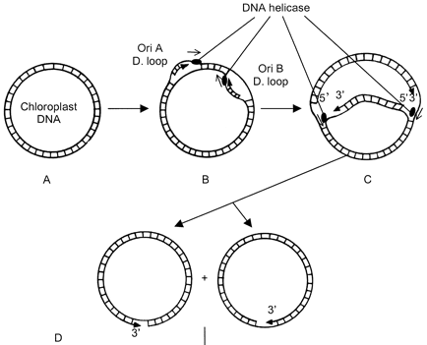
Plastid DNA
Replication
2 nuclear-encoded DNA polymerases similar to Pol I of E.coli
These enzymes might replicate both cp and mt DNA in plants
Replication seems partially coordinated with the cell cycle.

Slide 17
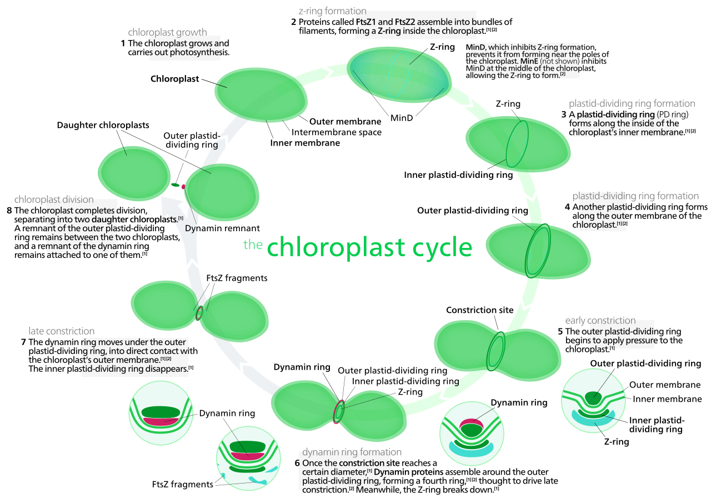
Plastid DNA
Cp division involves both nuclear and cp proteins

Slide 18
Plastid DNA
Cp division involves both nuclear and cp proteins
Requires crosstalk between cp and nucleus but nucleus rules

Slide 19
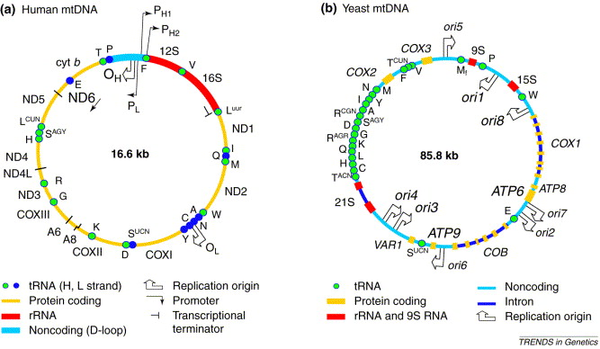
Mito DNA
range from 6 kb in Plasmodium to 2500 kb (muskmelons)

Slide 20
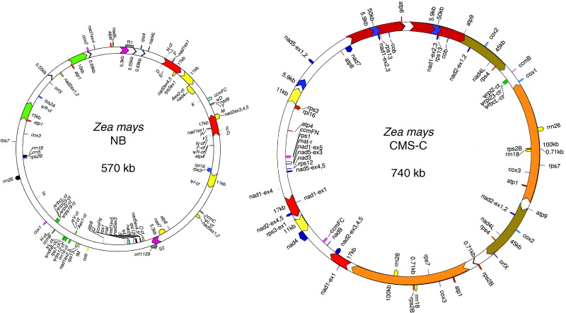
Mito DNA
range from 6 kb in Plasmodium to 2500 kb (muskmelons)
7 fold variation in mt genome size within cucurbit family
watermelon =330 kb, muskmelon = 2500 kb
much variation within same species
5 different cytotopes in maize, vary from 540-700kb

Slide 21
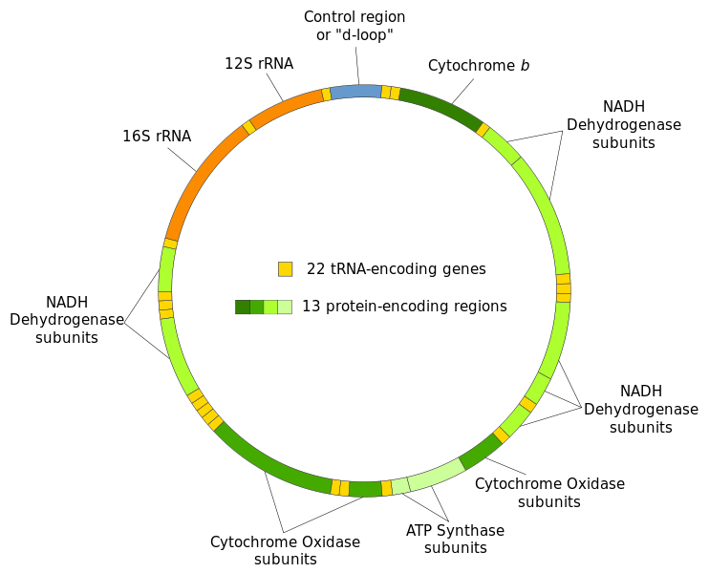
Mito DNA
range from 6 kb in Plasmodium to 2500 kb (muskmelons)
reason for large size is unknown
human mtDNA encodes 13 proteins, also rRNA & tRNA
subunits of ATP synthase, NADHdeH, CytBC1 & COX
Recently identified many
peptides

Slide 22
Mito DNA
human mtDNA encodes 13 proteins, also rRNA & tRNA
defects in mt DNA are nasty!
LHON (Leber's Hereditary Optic Neuropathy is due to defects in mt-encoded subunits of NADH-deH
ND1, ND4 or ND6
mutations all have
same effect = loss of
vision, sometimes
MS-like symptoms

Slide 23
Mito DNA
defects in mt DNA are nasty!
LHON
MELAS (Mitochondrial Encephalomyopathy, Lactic Acidosis, and Stroke-like episodes)
ND1, ND5, TH, TL1
& TV genes can cause it
TH,TL1 & TV encode
tRNA!

Slide 24
Mito DNA
defects in mt DNA are nasty!
LHON
MELAS (Mitochondrial Encephalomyopathy, Lactic Acidosis, and Stroke-like episodes)
Others: cyclic vomiting
syndrome, cox deficiency,
deafness

Slide 25
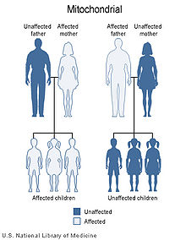
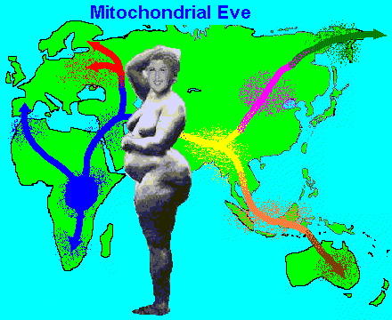
Mito DNA
defects in mt DNA are nasty!
All show maternal inheritance (used to trace human ancestry)

Slide 26
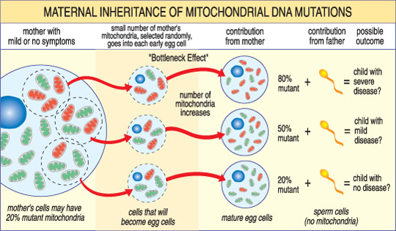
Mito DNA
defects in mt DNA are nasty!
All show maternal inheritance
Penetrance varies depending upon proportion of defective mt

Slide 27
Mito DNA
defects in mt DNA are nasty!
All show maternal inheritance
Penetrance varies depending upon proportion of defective mt: average ~ 5 DNA/mt, 100 mt/cell

Slide 28
Mito DNA
defects in mt DNA are nasty!
All show maternal inheritance
Penetrance varies depending upon proportion of defective mt
Mutations increase with age! Mutate 10x faster than nDNA

Slide 29
Mito DNA
defects in mt DNA are nasty!
All show maternal inheritance
Penetrance varies depending upon proportion of defective mt
Mutations increase with age! Mutate 10x faster than nDNA
By 40 mtDNA is so messed up it isn’t very useful for forensics

Slide 30
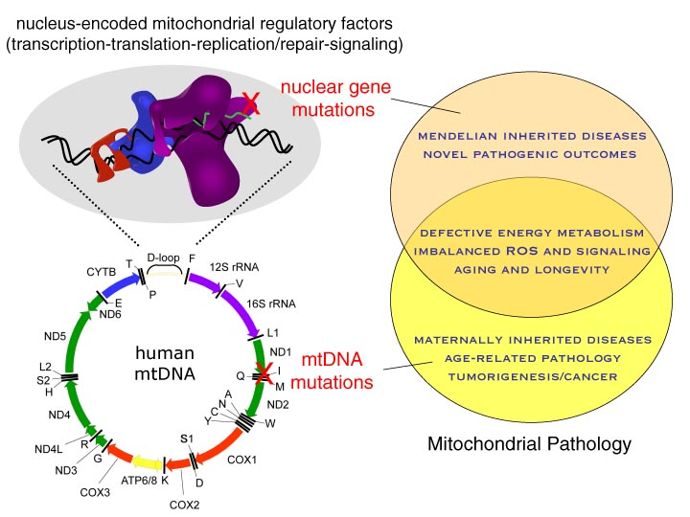
Mito DNA
Mutations increase with age! Mutate 10x faster than nDNA
Defects are associated with cancer & other diseases

Slide 31
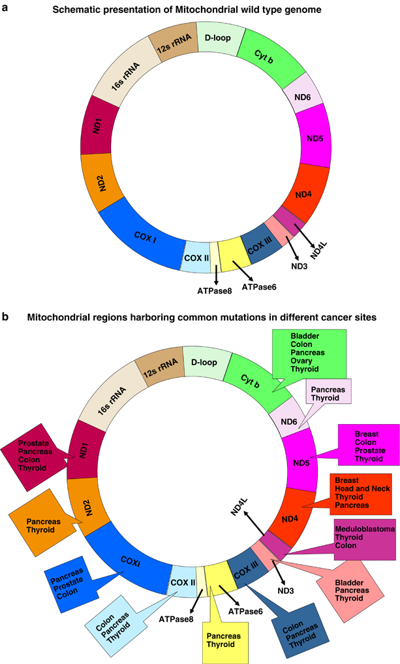
Mito DNA
defects in mt DNA are nasty!
Mutations increase with age
Defects are associated with
cancer & other diseases

Slide 32
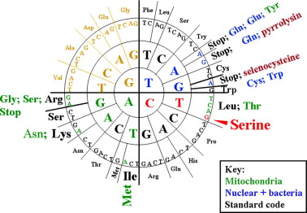
Mito DNA
Oddities
Vertebrates, inverts, protists and & fungi have UGA = trp cf stop
In verts AUA = met cf isoleu
All sorts of other oddities in various groups

Slide 33
Mito DNA
Human Oddities
28 genes on “heavy” strand

Slide 34
Mito DNA
Human Oddities
28 genes on “heavy” strand
9 on “light” strand, ND6 & 8 tRNAs

Slide 35
Mito DNA
Human Oddities
3 promoters: 2 on H strand, one on L
pL transcribes entire light strand; later processed into tRNA & ND6

Slide 36
Mito DNA
Human Oddities
3 promoters: 2 on H strand, one on L
pL transcribes entire light strand; later processed into tRNA & ND6
pH1 transcribes
entire H strand

Slide 37
Mito DNA
Human Oddities
3 promoters: 2 on H strand, one on L
pL transcribes entire light strand; later processed into tRNA & ND6
pH1 transcribes
entire H strand
pH2 may transcribe
12S & 16S rRNA

Slide 38
Mito DNA
Human Oddities
3 promoters: 2 on H strand, one on L
pL transcribes entire light strand; later processed into tRNA & ND6
pH1 transcribes
entire H strand
pH2 may transcribe
12S & 16S rRNA
In vitro only need
TFAM & TFB2M to
transcribe pL & pH1

Slide 39
Mito DNA
Human Oddities
3 promoters: 2 on H strand, one on L
pL transcribes entire light strand; later processed into tRNA & ND6
pH1 transcribes
entire H strand
pH2 may transcribe
12S & 16S rRNA
In vitro only need
TFAM & TFB2M to
transcribe pL & pH1
Uncertain if pH2 is used

Slide 40
Mito DNA
Human Oddities
DNA replication: controlled by nuclear genes

Slide 41
Mito DNA
Human Oddities
DNA replication: controlled by nuclear genes
Separate origins for H and L strands!

Slide 42
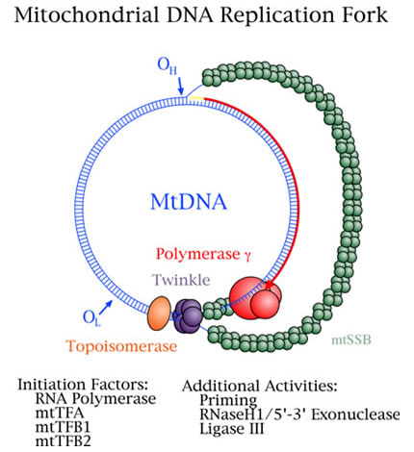
DNA replication: controlled by nuclear genes
Separate origins for H and L strands!
Replicates in D-loop manner: starts at O_{H} & heads towards O_{L} displacing opposite strand until hits O_{L} & new fork starts replicating in opposite direction.

Slide 43
Mito DNA
range from 6 kb in Plasmodium to 2500 kb (muskmelons)
7 fold variation in mt genome size within cucurbit family
watermelon =330 kb, muskmelon = 2500 kb
considerable variation within same species
5 different cytotopes in maize, vary from 540-700kb

Slide 44
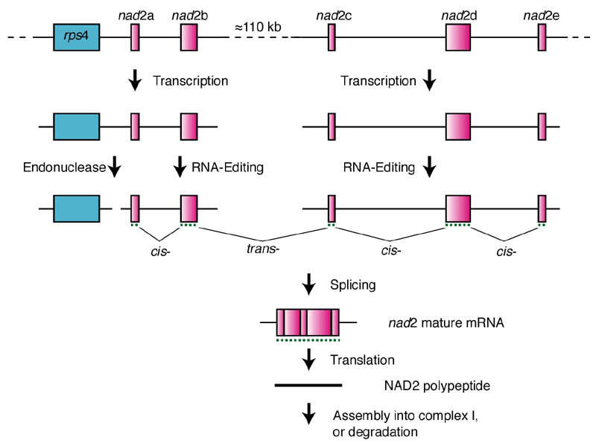
Plant Mito DNA encodes ~20 proteins, also rRNA & tRNA
subunits of ATP synthase & complexes I, II, III & IV
some mRNA are trans-spliced from 2 diff transcripts!

Slide 45
Mito DNA encodes encodes ~20 proteins, also rRNA & tRNA
subunits of ATP synthase & complexes I, II, III & IV
some mRNA are trans-spliced from 2 diff transcripts!
some mRNA are edited: bases changed after synthesis!

Slide 46
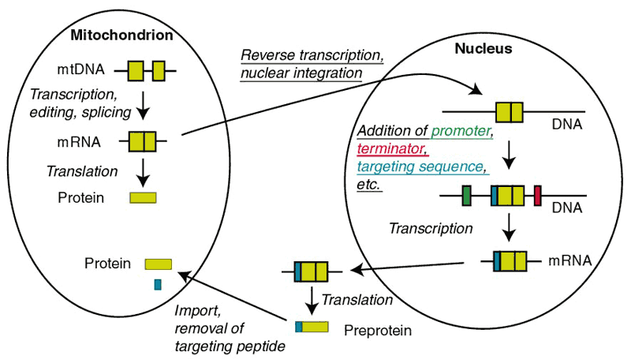
Mito DNA encodes encodes ~20 proteins, also rRNA & tRNA
subunits of ATP synthase & complexes I, II, III & IV
some mRNA are trans-spliced from 2 diff transcripts!
some mRNA are edited: bases changed after synthesis!
Mech to prevent nucleus from stealing genes?
Find cp & nuc genes in mtDNA!

Slide 47
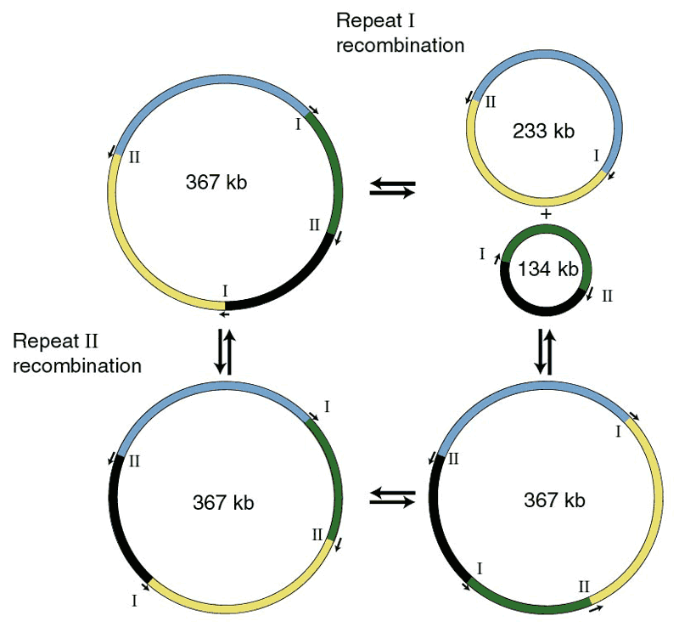
Mitochondrial DNA
some mRNA are trans-spliced from 2 diff transcripts!
some mRNA are edited: bases changed after synthesis!
Mech to prevent nucleus from stealing genes?
mtDNA recombines to form new genes: see many smaller molecules cf one big circle

Slide 48
Mitochondrial DNA
mtDNA recombines to form new genes: see many smaller molecules cf one big circle: some poison pollen development to create cytoplasmic male sterility

Slide 49
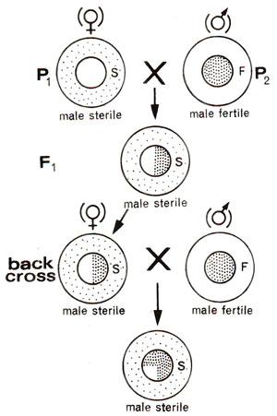
Plant mtDNA
mtDNA recombines to form new genes, some poison pollen development to create cytoplasmic male sterility
Pollen don't transmit mito!
Widely used in plant breeding
Eg hybrid corn, rice

Slide 50
Plant mtDNA
mtDNA recombines to form new genes, some poison pollen development to create cytoplasmic male sterility
Pollen don't transmit mito!
Widely used in plant breeding
Eg hybrid corn, rice
described in over 150 different spp.
Often arises after a wide cross, or
after protoplast fusion

Slide 51
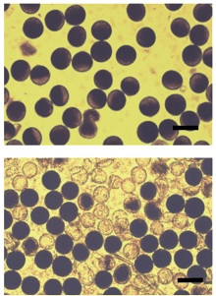
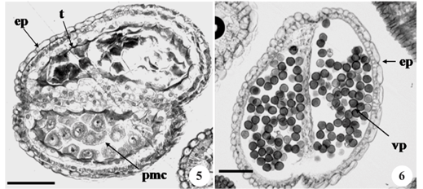
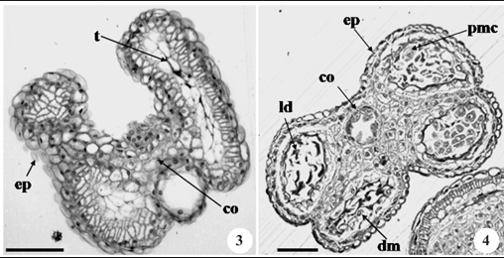
CMS
described in over 150 different spp.
Often arises after a wide cross, or after protoplast fusion
can affect either sporophytic or gametophytic tissue
either pollen or tapetum can blow up

Slide 52
CMS
can affect either sporophytic or gametophytic tissue
either pollen or tapetum can blow up
have major increase in respiration and # mito after meiosis
40 x increase in mt/ cell
in tapetum
20 x increase in mt/ cell
in sporogenous cells

Slide 53
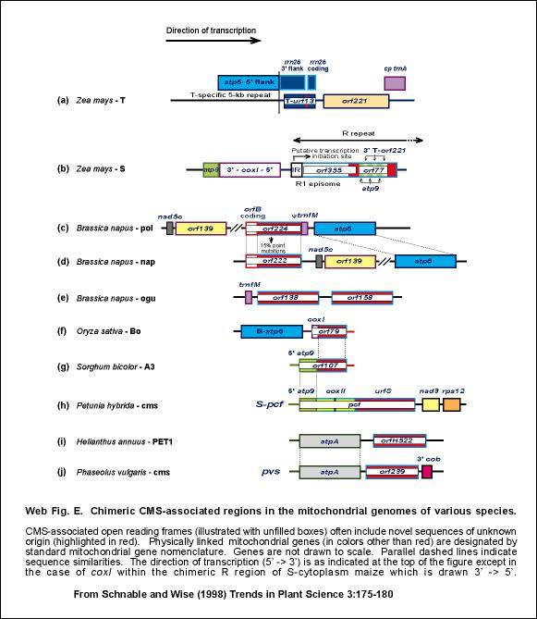
CMS
have major increase in respiration and # mitochondria after meiosis
40 x increase in mt/ cell in tapetum
20x in sporogenous cells
Often arise due to recombination
creating weird fusion encoding
defective protein

Slide 54
CMS
have major increase in respiration and # mitochondria after meiosis
40 x increase in mt/ cell in tapetum
20x in sporogenous cells
Often arise due to recombination
creating weird fusion encoding
defective protein: poisons respiration
Not enough energy to make good pollen

Slide 55
CMS
Often arise due to recombination creating weird fusion encoding
defective protein: poisons respiration
Not enough energy to make good pollen
Gametophytic may arise because defective protein is only expressed in developing pollen: eg cytotoxic orf79 in CMS-Boro II rice
RFµspores leaf cms µspores anther walls

Slide 56
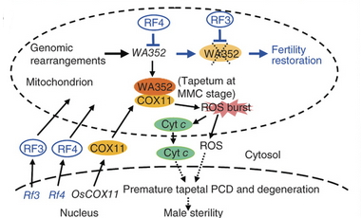
CMS
Gametophytic may arise because defective protein is only expressed in developing pollen: eg cytotoxic orf79 in CMS-Boro II rice
Sporophytic may arise due to programmed cll death triggered by ROS burst, eg Wild Abortive CMS in rice due to WA352 peptide inhibiting COX11

Slide 57
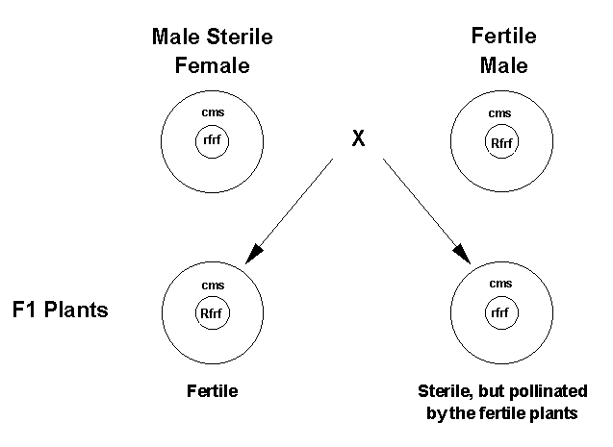
CMS
can (usually) be overcome by nuclear "restorer" genes
usually a single dominant gene

Slide 58
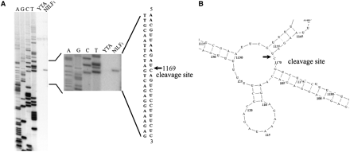
CMS
can (usually) be overcome by nuclear "restorer" genes
usually a single dominant gene
RF genes often encode protein which restores good mRNA eg. by splicing fusion in Hong-Lian cms rice

Slide 59
CMS
can (usually) be overcome by nuclear "restorer" genes
usually a single dominant gene
RF genes often encode protein which restores good mRNA eg. by splicing fusion in Hong-Lian cms rice
Or by blocking WA352 expression in Wild Abortive CMS rice

Slide 60
CMS
RF genes often encode protein which restores good mRNA eg. by splicing fusion in Hong-Lian cms rice
Or by blocking WA352 expression in Wild Abortive CMS rice
Constant battle: mito evolve way to kill pollen and nucleus evolves way to overcome it.

Slide 61
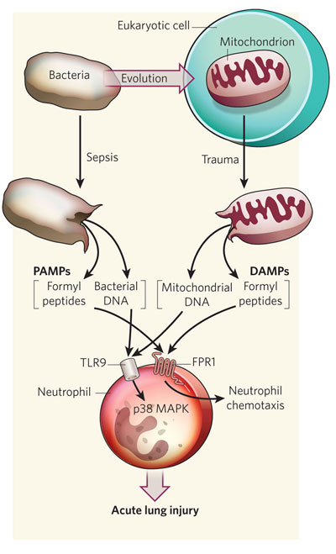
Mitochondria and the immune system
Mitochondria are involved in many
aspects of innate immunity
Pathogens and damaged mito
trigger very similar responses

Slide 62
Mitochondria and the immune system
Mitochondria are involved in many
aspects of innate immunity
Pathogens and damaged mito
trigger very similar responses
pathogen-associated molecular
patterns (PAMPs) are bound by
pattern-recognition receptors (PRRs)
that trigger inflammatory responses

Slide 63
Mitochondria and the immune system
Mitochondria are involved in many
aspects of innate immunity
Pathogens and damaged mito
trigger very similar responses
pathogen-associated molecular
patterns (PAMPs) are bound by
pattern-recognition receptors (PRRs)
that trigger inflammatory responses
damage-associated molecular
patterns (DAMPs) released by broken
mito bind the same receptors & trigger
same responses.

Slide 64
Mitochondria and the immune system
Mitochondria are involved in many
aspects of innate immunity
damage-associated molecular
patterns (DAMPs) released by broken
mito bind the same receptors & trigger
same responses.
Mito play important role in sensing viruses

Slide 65
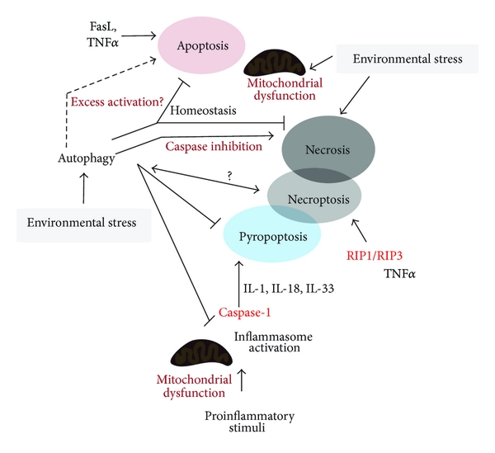
Mitochondria and cell death
Cells die many ways, but
mito are often involved

Slide 66
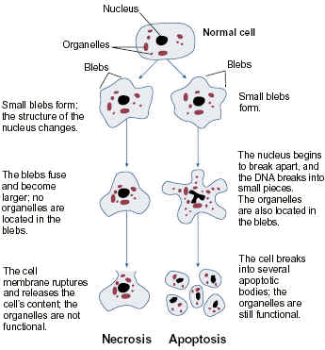
Programmed cell death vs necrosis
Necrosis:
progressive loss of membrane integrity
swelling of cytoplasm, release of cell constituents
Often follows irreversible injury
Passive
Indiscriminate
PCD
Active
Orderly process mediated by
intracellular death programs
May or may not be due to an
external factor
Nuclear condensation
Condensation of PM

Slide 67
Types of programmed cell death
Apoptosis
Autophagy
Pyroptosis
Ferroptosis
Plant programmed cell death

Slide 68
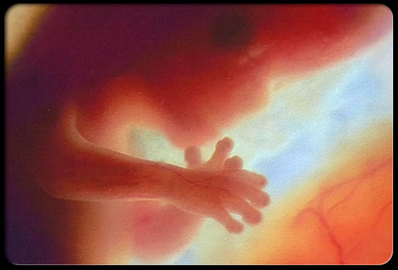
Apoptosis
Occurs as normal part of development
e.g. patterning of hands/feet

Slide 69
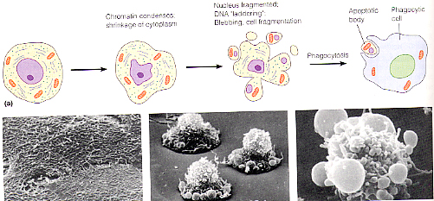
Apoptosis
Occurs as normal part of development
Ordered process that breaks cell into easily recycled
pieces

Slide 70
Apoptosis
Occurs as normal part of development
Is also triggered by many kinds of damage
Especially to DNA
Many cancer cells do not commit apoptosis

Slide 71
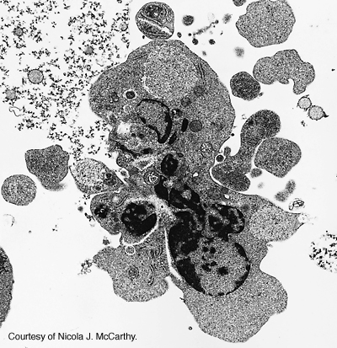
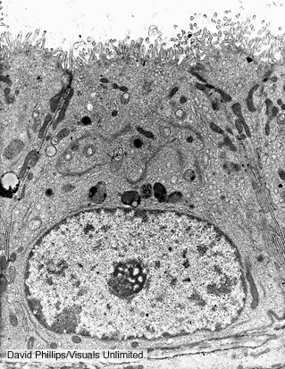
Apoptosis
Occurs as normal part of development
Ordered process that breaks cell into easily recycled pieces
Caspases digest proteins

Slide 72
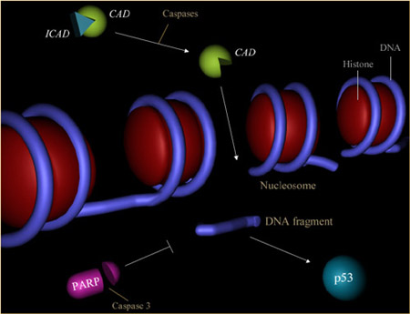
Apoptosis
Ordered process that breaks cell into easily recycled pieces
Caspases digest proteins
CAD digests DNA

Slide 73
Apoptosis
Occurs as normal part of development
Two basic steps: commitment and execution

Slide 74
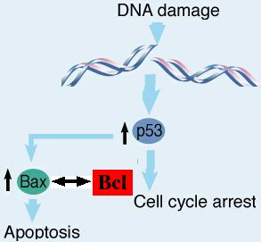
Apoptosis
Occurs as normal part of development
Two basic steps: commitment and execution
Commitment depends on interplay between various signals
Bax & Bcl2 have opposite effects

Slide 75
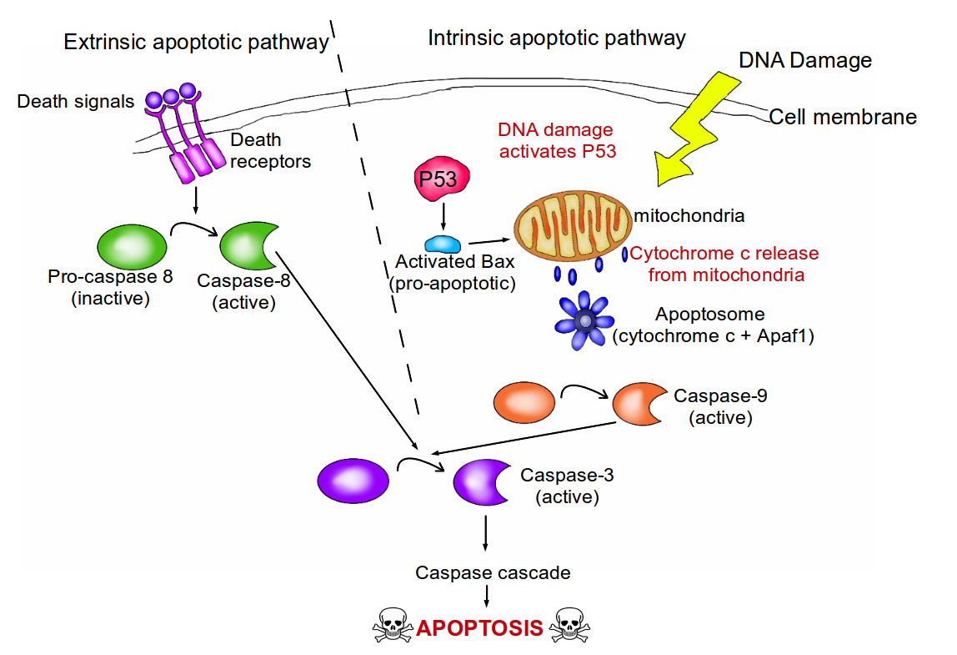
Apoptosis
Two basic steps: commitment and execution
Commitment depends on interplay between various signals
Bax & Bcl2 have opposite effects
2 main pathways: extrinsic & intrinsic

Slide 76
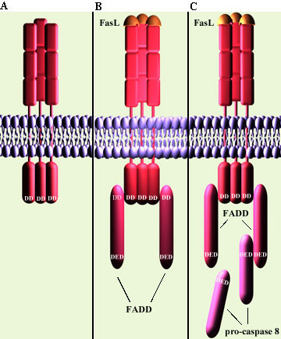
Apoptosis
2 main pathways: extrinsic & intrinsic
Tumor necrosis factor and Fas ligand = extrinsic signals that can trigger apoptosis via death receptor

Slide 77
Apoptosis
2 main pathways: extrinsic & intrinsic
Tumor necrosis factor and Fas ligand = extrinsic signals that can trigger apoptosis via death receptor
Bind receptors in PM (TNFR or fas)

Slide 78
Tumor necrosis factor and Fas ligand = extrinsic signals that can trigger apoptosis via death receptor
Bind receptors in PM (TNFR or fas)
Receptors activate FADD & TRADD: Adaptors with death domains that bind receptor’s DDs

Slide 79
Receptors activate FADD & TRADD: Adaptors with death domains that bind receptor’s DDs
Procaspase 8 binds FADD

Slide 80
Receptors activate FADD & TRADD: Adaptors with death domains that bind receptor’s DDs
Procaspase 8 binds FADD
Procaspase 8 is processed to caspase 8
= initiator caspase

Slide 81
Procaspase 8 binds FADD
Procaspase 8 is processed to caspase 8
= initiator caspase
Caspase 8 converts procaspase 3
to active form = executioner

Slide 82
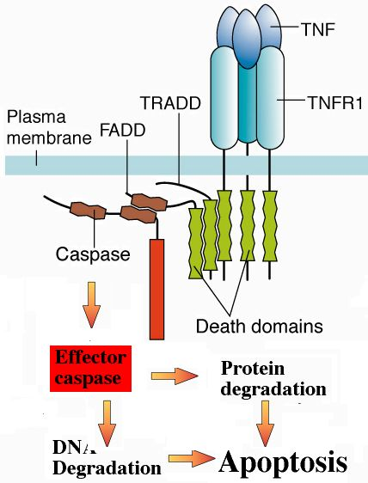
Procaspase 8 binds FADD
Procaspase 8 is processed to caspase 8
= initiator caspase
Caspase 8 converts procaspase 3
to active form = executioner
Caspase-3 & CAD
execute the cell

Slide 83
Intrinsic pathway
Usually Bcl-2 protects mito
Intracellular damage activates Bad or Bax

Slide 84
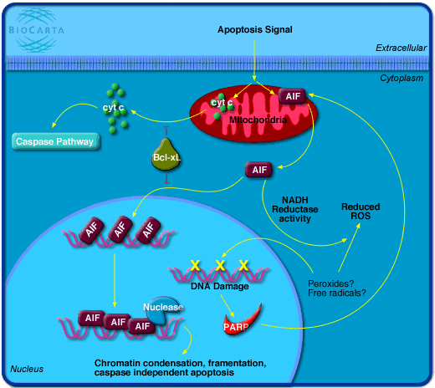
Apoptosis
Usually Bcl-2 protects mito
Intracellular damage activates Bad or Bax
Bad/Bax releases cyt c & AIF

Slide 85
Apoptosis
Intracellular damage activates Bad/Bax
Bad/Bax release cyt c & AIF
Cyt c, Apaf-1 & procaspase-9 form
complex = apoptosome

Slide 86
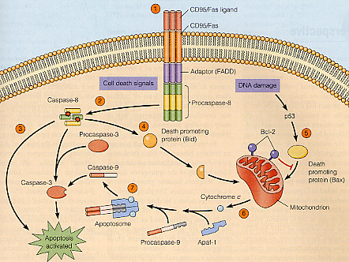
Apoptosis
Intracellular damage activates Bad/Bax
Bad/Bax release cyt c & AIF
Cyt c, Apaf-1 & procaspase-9 form complex = apoptosome
Apoptosome processes procaspase -9 to caspase-9 = initiator caspase

Slide 87
Apoptosis
Intracellular damage activates Bad/Bax
Bad/Bax release cyt c & AIF
Cyt c, Apaf-1 & procaspase-9 form complex = apoptosome
Apoptosome processes procaspase -9 to caspase-9 = initiator caspase
Caspase-9 converts
caspase 3 to active
form = executioner

Slide 88
Apoptosis
Intracellular damage activates Bad/Bax
Bad/Bax release cyt c & AIF
Cyt c, Apaf-1 & procaspase-9 form complex = apoptosome
Apoptosome processes procaspase -9 to caspase-9 = initiator caspase
Caspase-9 converts
caspase 3 to active
form = executioner
Caspase 3 & CAD
execute the cell

Slide 89
Apoptosis
Intracellular damage activates Bad/Bax
Bad/Bax release cyt c & AIF
AIF induces CAD

Slide 90
Apoptosis
Intracellular damage activates Bad/Bax
Bad/Bax release cyt c & AIF
AIF induces CAD
Destroys DNA

Slide 91
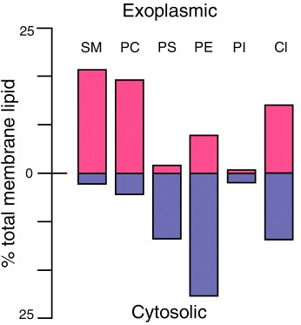
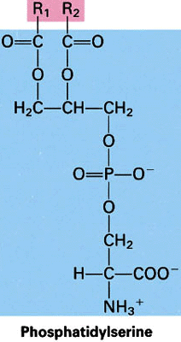
Apoptosis
Intracellular damage activates Bad/Bax
Bad/Bax release cyt c & AIF
AIF induces CAD
Destroys DNA
Flips PS outside

Slide 92
Apoptosis
Intracellular damage activates Bad/Bax
Bad/Bax release cyt c & AIF
AIF induces CAD
Destroys DNA
Flips PS outside
Phagocytic cells eat
vesicles with
external PS

Slide 93
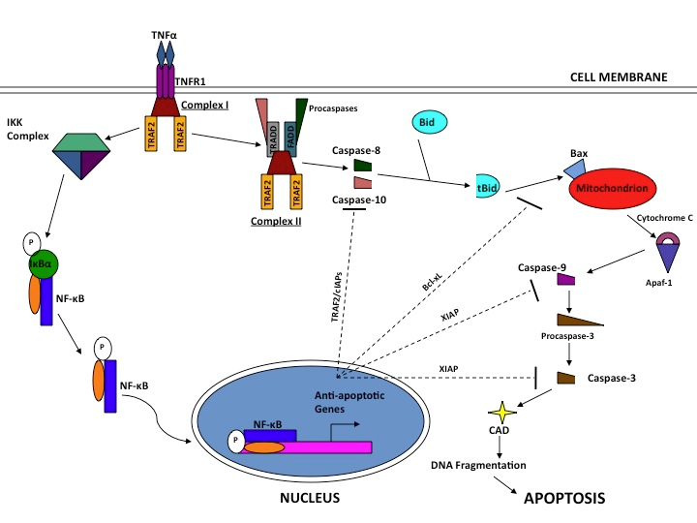
Apoptosis
Two basic steps: commitment and execution
Commitment depends on interplay between various signals
TNF often stimulates recovery instead!

Slide 94
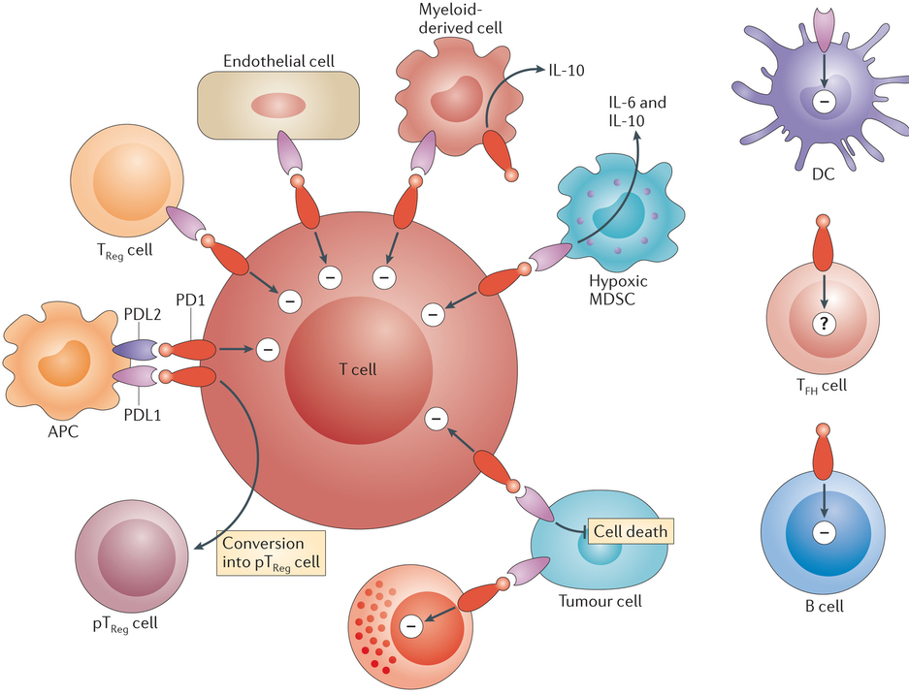
Apoptosis in immunity
PD1 receptor on T cells blocks apoptosis
Binds PDL1 or PDL2 presented by other cells, including tumors

Slide 95
Apoptosis in immunity
PD1 receptor on T cells blocks apoptosis
Binds PDL1 or PDL2 presented by other cells, including tumors
PDL1 inhibitors are a new class of cancer drug

Slide 96
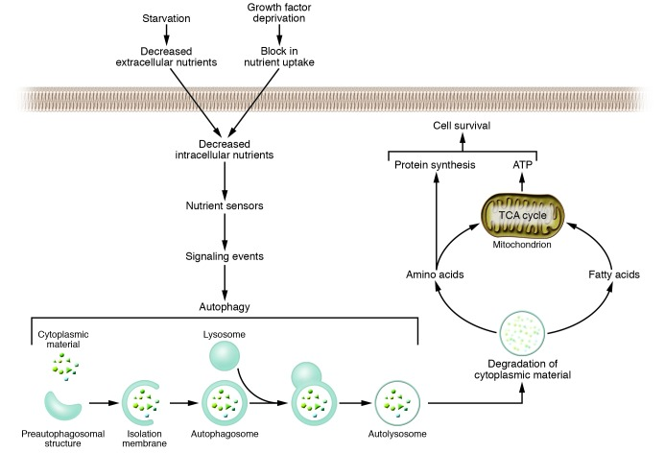
Autophagy
Intracellular recycling process – lysosomes (animals); vacuoles (plants)

Slide 97
Autophagy
Intracellular recycling process – lysosomes (animals); vacuoles (plants)
Removes misfolded proteins, bad organelles, intracell pathogens

Slide 98
Autophagy
Intracellular recycling process – lysosomes (animals); vacuoles (plants)
Removes misfolded proteins, bad organelles, intracell pathogens
Promotes survival!

Slide 99
Autophagy
Intracellular recycling process – lysosomes (animals); vacuoles (plants)
Removes misfolded proteins, bad organelles, intracell pathogens
Promotes survival! Reallocates nutrients to vital processes!

Slide 100
Autophagy
Removes misfolded proteins, bad organelles, intracell pathogens
Promotes survival! Reallocates nutrients to vital processes!
Best way to get rid of bad mito w/o killing cell!

Slide 101
Autophagy
Removes misfolded proteins, bad organelles, intracell pathogens
Promotes survival! Reallocates nutrients to vital processes!
Best way to get rid of bad mito w/o killing cell!
Associated with increased longevity in caloric restriction

Slide 102
Autophagy
Associated with increased longevity in caloric restriction
Upregulated upon nutrient or growth factor deprivation

Slide 103
Autophagy
Associated with increased longevity in caloric restriction
Upregulated upon nutrient or growth factor deprivation
Triggers PCD distinct from apoptosis if can’t cope
No caspase or CAD, chromatin laddering
Occurs inside lysosomes

Slide 104
Autophagy
Triggers PCD distinct from apoptosis if
can’t cope
No caspase or CAD, chromatin laddering
Occurs inside lysosomes
Highly regulated!

Slide 105
Autophagy
Triggers PCD distinct from apoptosis if
can’t cope
No caspase or CAD, chromatin laddering
Occurs inside lysosomes
Highly regulated!
Mis-regulation associated with heart
disease, diabetes and many more

Slide 106
Pyroptosis
PCD associated with
antimicrobial
responses in
inflammation

Slide 107
Pyroptosis
PCD associated with antimicrobial responses in inflammation
Toll-like receptors bind PAMPs, eg bacterial flagellins

Slide 108
Pyroptosis
PCD associated with antimicrobial responses in inflammation
Toll-like receptors bind PAMPs, eg bacterial flagellins
Activated NOD-like receptors (NLRs) initiate assembly of pyroptosome

Slide 109
Pyroptosis
PCD associated with antimicrobial responses in inflammation
Toll-like receptors bind PAMPs, eg bacterial flagellins
Activated NOD-like receptors (NLRs) initiate assembly of pyroptosome
Pyroptosome activates
Caspase-1

Slide 110
Pyroptosis
PCD associated with antimicrobial responses in inflammation
Toll-like receptors bind PAMPs, eg bacterial flagellins
Activated NOD-like receptors (NLRs) initiate assembly of pyroptosome
Pyroptosome activates
Caspase-1
Caspase-1 executes cell,
Releasing PAMPs and
cytokines

Slide 111
Pyroptosis
PCD associated with antimicrobial responses in inflammation
Toll-like receptors bind PAMPs, eg bacterial flagellins
Activated NOD-like receptors (NLRs) initiate assembly of pyroptosome
Pyroptosome activates
Caspase-1
Caspase-1 executes cell,
Releasing PAMPs and
Cytokines
Reason for depletion of
CD4 cells in AIDS

Slide 112
Necroptosis
PCD associated with viral infections

Slide 113
Necroptosis
PCD associated with viral infections
Infected cells release TNF

Slide 114
Necroptosis
PCD associated with viral infections
Infected cells release TNF
TNFR activates RIPK1
RIPK1 binds RIPK3 to form necrosome

Slide 115
Necroptosis
PCD associated with viral infections
Infected cells release TNF
TNFR activates RIPK1
RIPK1 binds RIPK3 to form necrosome
Necrosome activates MLKL
which permeabilizes membranes

Slide 116
Necroptosis vs apoptosis
Tend to inhibit each other, but do have overlap

Slide 117
Necroptosis vs apoptosis
Tend to inhibit each other, but do have overlap
Fail-safe for viruses that block apoptosis

Slide 118
Ferroptosis
PCD dependent on intra-cellular iron
Triggered by inhibition of cystine uptake

Slide 119
Ferroptosis
PCD dependent on intra-cellular iron
Triggered by inhibition of cystine uptake
Reduced cystine uptake leads to the production of lethal lipid ROS

Slide 120
Ferroptosis
PCD dependent on intra-cellular iron
Triggered by inhibition of cystine uptake
Reduced cystine uptake leads to the production of lethal lipid ROS
Erastin etc trigger it

Slide 121
Ferroptosis
PCD dependent on intra-cellular iron
Triggered by inhibition of cystine uptake
Reduced cystine uptake leads to the production of lethal lipid ROS
Erastin etc trigger it
Ferrostatin blocks it

