Slide 1
  Next Assignment: Wed April 17
  Gene editing for fun and profit
Targeted disruptions
  Engineering Arabidopsis resistant to Turnip mosaic virus doi: 10.1111/mpp.12417
  Engineering plants for gemini virus resistance doi: 10.1016/j.tplants.2016.01.023
  Gene Disruption in Toxoplasma gondii Using CRISPR/CAS https://www.ncbi.nlm.nih.gov/pmc/articles/PMC4030483/
  Generation of germline ablated male pigs https://www.nature.com/articles/srep40176
  Efficient Gene Knockout in Goats https://www.ncbi.nlm.nih.gov/pmc/articles/PMC4154755/
  Crispr-CAS9 to fix Hb-S http://www.nature.com/nature/journal/v539/n7629/full/nature20134.html
  Crispr-CAS9 to convert fibroblasts to neurons http://www.cell.com/cell-stem-cell/fulltext?S1934-5909(16)30196-5

Slide 2
Targeted improvements
  Replacement of an N-efficiency gene with a superior allele doi:10.1111/jipb.12650
  Improving tomatoes https://doi.org/10.1016/j.cell.2017.08.030
  Improving drought tolerance http://onlinelibrary.wiley.com/doi/10.1111/pbi.12673/full
  Improving seed fatty acid composition http://onlinelibrary.wiley.com/doi/10.1111/pbi.12663/full
  Editing the maize ALS2gene to yield chlorsulfuron-resistant plants https://doi.org/10.1104/pp.15.00793
  Improving cold storage and processing traits in potato https://doi.org/10.1111/pbi.12370
  Producing high oleic and low linolenic soybean oil https://doi.org/10.1186/s12870-016-0906-1
  Production of gene-corrected adult beta globin protein in human erythrocytes differentiated from patient iPSCs after genome editing of the sickle point mutation https://www.ncbi.nlm.nih.gov/pmc/articles/PMC4628786/

Slide 3
Remaining work
Preparing poster
Preparing MS
Writing 2000 word review on topic of your choice related to molecular biology
  Probably easiest to do it on your GMO or Gene-editing topic since have already done a lot of the reading

Slide 4
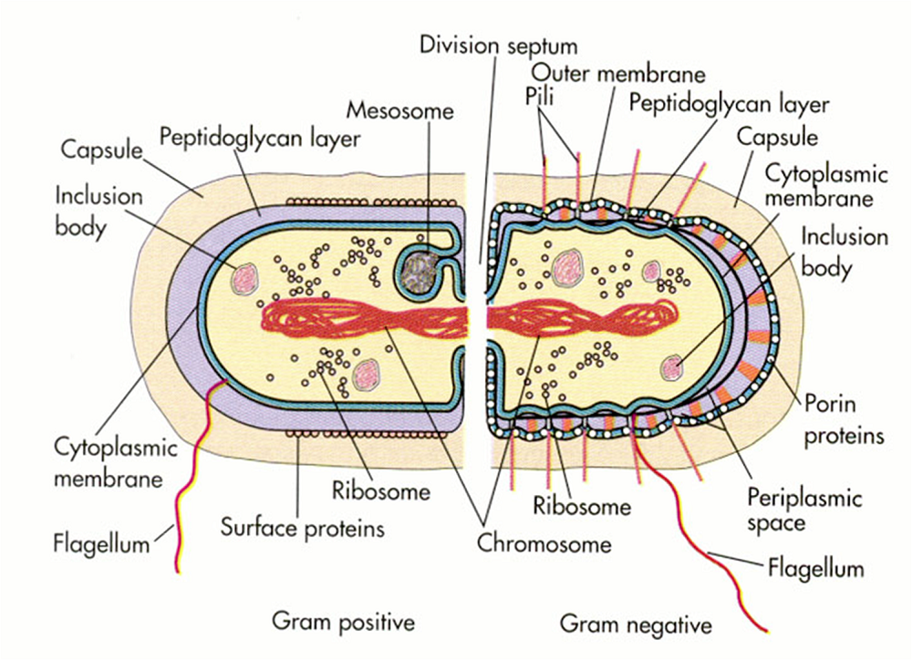
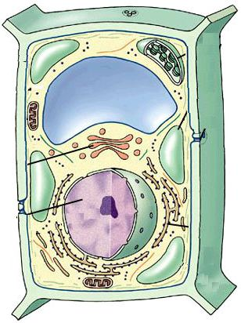
Assembling a cell
Need to make all the right pieces
Need to put them in all the right places, even in bacteria!
Controlling gene expression is about making the right pieces
Protein targeting is about putting them in the right places

Slide 5
PROTEIN TARGETING
All proteins are made with an “address” which determines their final cellular location
Addresses are motifs within proteins

Slide 6
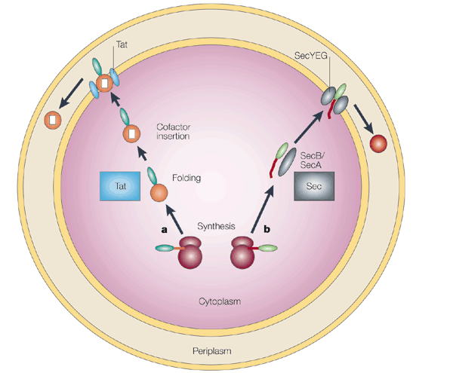
2 Pathways in E.coli http://www.membranetransport.org/
Tat: for periplasmic redox proteins & thylakoid lumen!
Sec pathway
SecB binds preprotein
as it emerges from rib

Slide 7
2 Protein Targeting pathways
Protein synthesis always
begins on free ribosomes
in cytoplasm
1) proteins of plastids,
mitochondria, peroxisomes
and nuclei are imported
post-translationally
2) Endomembrane system
proteins are imported
co-translationally

Slide 8
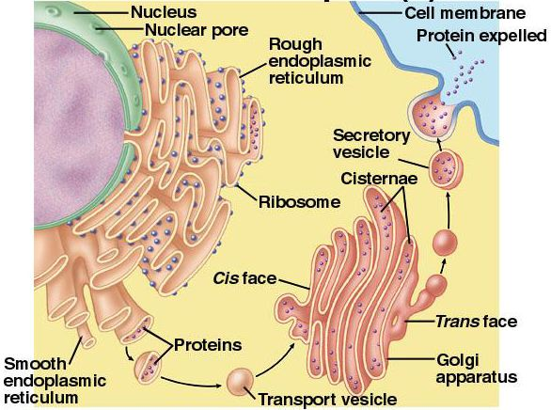
2 pathways for Protein Targeting
1) Post -translational
2) Co-translational: Endomembrane system proteins are imported co-translationally
inserted in RER
as they are made
transported to
final destination
in vesicles

Slide 9
Sorting proteins made on RER
Simplest case: no sorting
proteins in RER lumen
are secreted
embedded proteins
go to plasma membrane
Redirection requires extra motifs and receptors

Slide 10
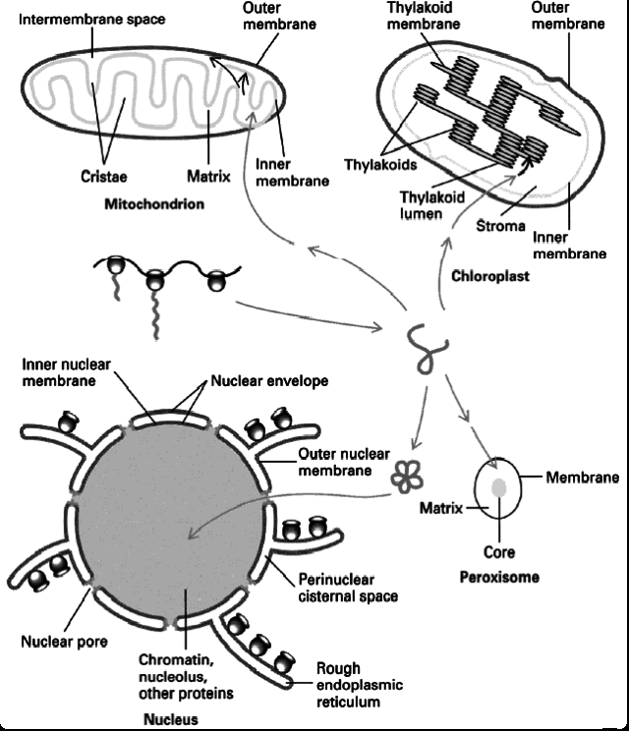
Post-translational protein targeting
Key features
1) imported after synthesis
2) targeting information is motifs in protein
3) Receptors guide it to correct site
4) no vesicles!

Slide 11
Protein import into cp & mito
1) N-terminal transit peptide or presequence
2) both need energy input
3) proteins unfold to enter, then refold inside
  a) need chaperonins on both sides of membrane
    i) chaperonins in cytosol unfold
    ii) chaperonins inside refold
      a) helps draw through membrane

Slide 12
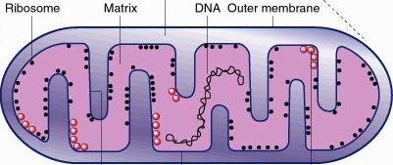
Protein import into mitochondria
Targeting to other parts of mitochondrion requires extra information = another protein sequence
Hypothesis: proteins enter matrix first, then find their final destination
matrix-targeting presequence
inter-membrane-targeting presequence
presequence
mature protein

Slide 13
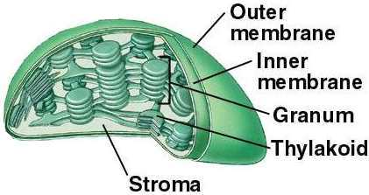
CP protein import
1) OE 4) stroma
2) Inter-membrane space 5) thylakoid
3) IE 6) thylakoid lumen

Slide 14
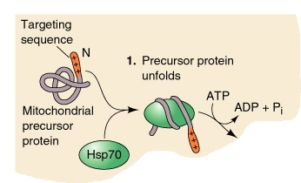
CP protein import
Very similar to mt import
1) chaperones in cytoplasm unfold preprotein

Slide 15
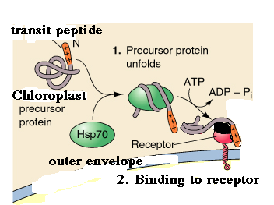
CP protein import
chaperones in cytoplasm unfold preprotein
transit peptide contacts receptor in OE
  transit peptides:longer & less +ve than presequences
  Just a few changes convert transit peptide to presequence

Slide 16
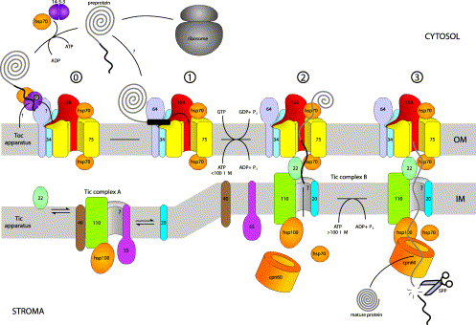
CP protein import
1) chaperones in cytoplasm unfold preprotein
2) transit peptide contacts receptor in OE
3) Unfolded protein is translocated through OE
  requires GTP (difference from mito)

Slide 17
CP protein import
1) chaperones in cytoplasm unfold preprotein
2) transit peptide contacts receptor in OE
3) Unfolded protein is translocated through OE
4) Unfolded protein is translocated through IE

Slide 18
CP protein import
5) Protein is folded on inside by chaperones
6) transit peptide is removed

Slide 19
Energy for cp import
1) GTP hydolysis:crossing OE
2) Refolding (Brownian ratchet)
3) ATP hydrolysis: un- & refolding

Slide 20
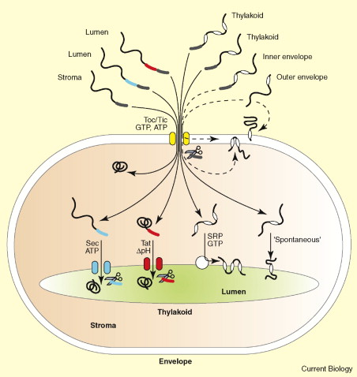
CP Protein import
Targeting to other parts requires another motif
Hypothesis: proteins
enter stroma first, then
find their final
destination

Slide 21
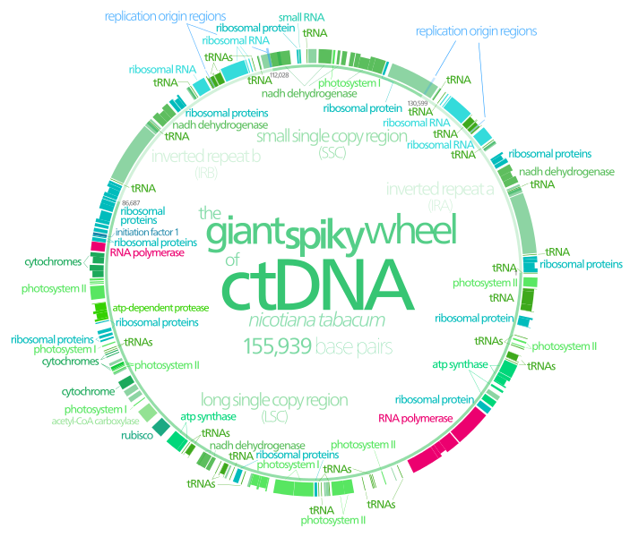
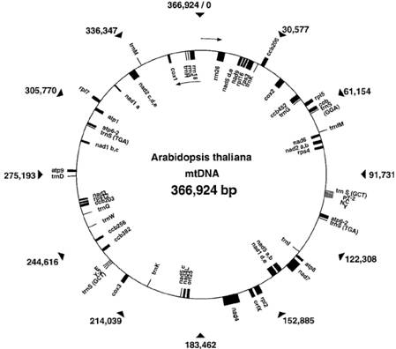
  Some mt & cp proteins contain subunits encoded by organelle’s genome

Slide 22
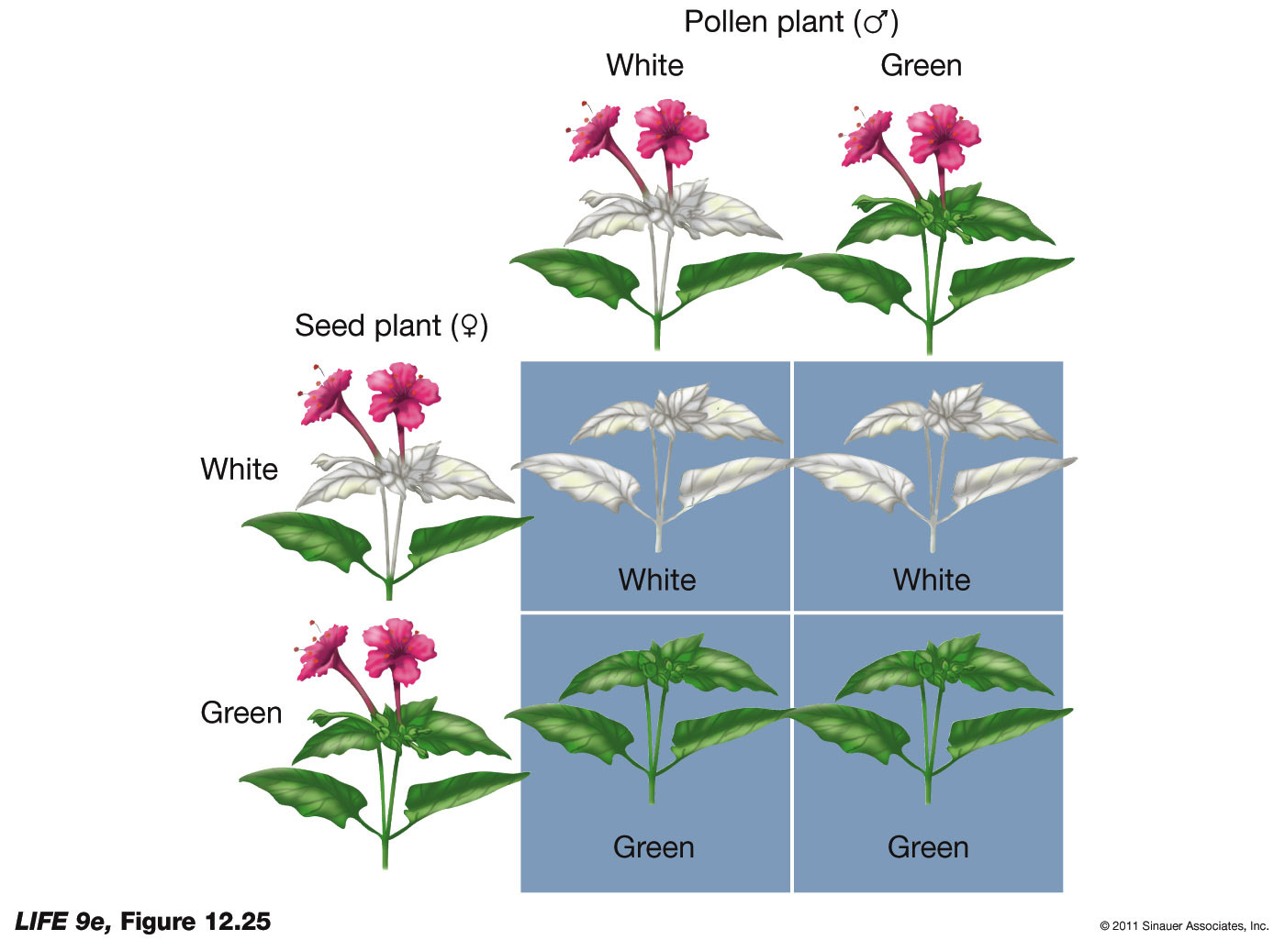
Cytoplasmic inheritance
first seen as strictly maternally-inherited albino variegation
  no linkage to nuclear genes
  albinism strictly determined by the mother

Slide 23
Cytoplasmic inheritance
first seen as strictly maternally inherited albino variegation
  no linkage to nuclear genes
  albinism strictly determined by the mother
  variegation arises because have mix of “good” and “bad” cp
  Segregate randomly at division

Slide 24
Cytoplasmic inheritance
first seen as strictly maternally inherited albino variegation
  no linkage to nuclear genes
  albinism strictly determined by the mother
  variegation arises because have mix of “good” and “bad” cp
  Segregate randomly at division
  eventually one form predominates

Slide 25
Cytoplasmic inheritance
Variegation arises because have mix of “good” and “bad” cp
  Segregate randomly at division
  eventually one form predominates
In plants, cytoplasm comes from the egg
  most pollen do not have cp or mt

Slide 26
Cytoplasmic inheritance
Variegation arises because have mix of “good” and “bad” cp
  Segregate randomly at division
  eventually one form predominates
In plants, cytoplasm comes from the egg
  most pollen do not have cp or mt
  can't study genetically, because no
  way to mix parental organelles

Slide 27
Plastid DNA
vary between 120 & 217 kB, according to species
  most are 120-160 kB

Slide 28
Plastid DNA
vary between 120 & 217 kB, according to species
  most are 120-160 kB
  have >20 copies/chloroplast

Slide 29
Plastid DNA
vary between 120 & 217 kB, according to species
  most are 120-160 kB
  have >20 copies/chloroplast
  encode ~ 100 proteins, 4 rRNA &~30 tRNA

Slide 30
Plastid DNA
encode ~ 100 proteins, 4 rRNA &~30 tRNA
5 classes of proteins
  ribosomal & other proteins involved in translation

Slide 31
Plastid DNA
encode ~ 100 proteins, 4 rRNA &~30 tRNA
5 classes of proteins
  ribosomal & other proteins involved in translation
  proteins involved in transcription

Slide 32
Plastid DNA
encode ~ 100 proteins, 4 rRNA &~30 tRNA
5 classes of proteins
  ribosomal & other proteins involved in translation
  proteins involved in transcription
  proteins involved
  in photosynthesis

Slide 33
Plastid DNA
encode ~ 100 proteins, 4 rRNA &~30 tRNA
5 classes of proteins
  ribosomal & other proteins involved in translation
  proteins involved in transcription
  proteins involved
  in photosynthesis
  proteins involved
  in respiration

Slide 34
Plastid DNA
encode ~ 100 proteins, 4 rRNA &~30 tRNA
5 classes of proteins
  ribosomal & other proteins involved in translation
  proteins involved in transcription
  proteins involved
  in photosynthesis
  proteins involved
  in respiration
  ORFs (open reading
  frames)
  sequences capable of
  encoding proteins but
  no product has been
  identified

Slide 35
Plastid DNA
encode ~ 100 proteins, 4 rRNA &~30 tRNA
5 classes of proteins
  in general, tend to be the more hydrophobic subunits

Slide 36
Plastid DNA
encode ~ 100 proteins, 4 rRNA &~30 tRNA
5 classes of proteins
  in general, tend to be the more hydrophobic subunits
  could have complicated exporting the gene to the nucleus

Slide 37
Plastid DNA
encode ~ 100 proteins, 4 rRNA &~30 tRNA
5 classes of proteins
  in general, tend to be the more hydrophobic subunits
  could have complicated exporting the gene to the nucleus
invariably also have subunits encoded by nuclear genes

Slide 38
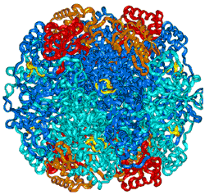
Plastid DNA
  cpDNA encodes rubisco large subunit, nDNA encodes small subunit, holoenzyme has 8 lg & 8 small subunits

Slide 39
Plastid DNA
cp gene expression is regulated at all levels
  1) transcriptional
  2) mRNA stability
  3) Translational: light triggers 100x increase in some proteins but only small increase in transcription

Slide 40
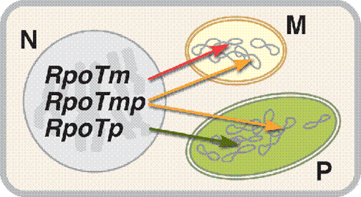
Plastid DNA
Transcriptional regulation
Nuclear-encoded RNA polymerases (NEP) are related to bacteriophage RNA pols
  RpoTp is cp –only
  RpoTmp is dually-targeted to cp and mito
  RpoTm is mito only

Slide 41
Plastid DNA
Nuclear-encoded RNA polymerases (NEP) are related to bacteriophage RNA pols
1 subunit
Mainly transcribe housekeeping genes & genes encoding the plastid transcriptional machinery
Essential for early development
Not very active in “mature” chloroplasts

Slide 42
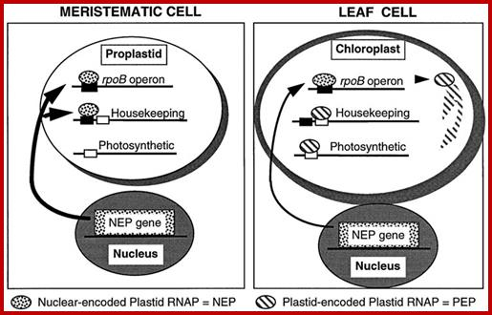
Plastid DNA
NEP are active early in development
plastid-encoded polymerases (PEPs) are mainly active in mature chloroplasts and transcribe genes associated with photosynthesis

Slide 43
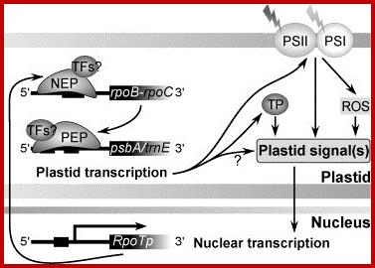
Plastid DNA
NEP are active early in development
plastid-encoded polymerases (PEPs) are mainly active in mature chloroplasts and transcribe genes associated with photosynthesis
  Many subunits, > 1,000,000 Da
  Rpo subunits encoded by cpDNA, sigma factors and others encoded by nucleus

Slide 44
Plastid DNA
plastid-encoded polymerases (PEPs) are mainly active in mature chloroplasts and transcribe genes associated with photosynthesis
  Rpo subunits encoded by cpDNA, sigma factors and others encoded by nucleus
PEP-B is found in etioplasts and young greening cp
  Consists solely of rpoA, rpoB, rpoC1, and rpoC2 core subunits

Slide 45
Plastid DNA
plastid-encoded polymerases (PEPs) are mainly active in mature chloroplasts and transcribe genes associated with photosynthesis
  Rpo subunits encoded by cpDNA, sigma factors and others encoded by nucleus
PEP-B is found in etioplasts and young greening cp
  Consists solely of rpoA, rpoB, rpoC1, and rpoC2 core subunits
As cp mature associates with nuclear factors & becomes PEP-A
  Factors encoded by nucleus include sigma factors (Arabidopsis has 6)
    > 10 proteins seem to aggregate to form active PEP-A (perhaps as many as 46 nuclear-encoded proteins)
    Components vary according to conditions.
    Way for nucleus to control plastid gene expression

Slide 46
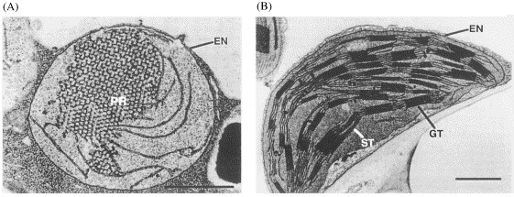
Plastid DNA
coordination with nucleus
  primarily studied during light-regulated cp development
    light triggers development of proplastids
    assemble thylakoids, make nearly all the proteins needed for photosynthesis

Slide 47
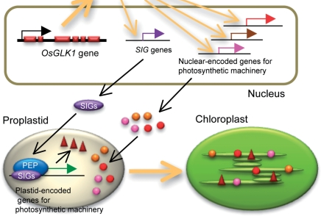
Plastid DNA
coordination with nucleus
  primarily studied during light-regulated cp development
  nucleus controls by sending in proteins including DNA polymerases and proteases
  cp degrade excess subunits

Slide 48
Plastid DNA
coordination with nucleus
  cp degrade excess subunits
  when poison rbcS, rbcL is made but does not accumulate
  same when poison rbcL with chloramphenicol

Slide 49
Plastid DNA
coordination with nucleus
  CP signals to nucleus: retrograde signaling
    ROS

Slide 50
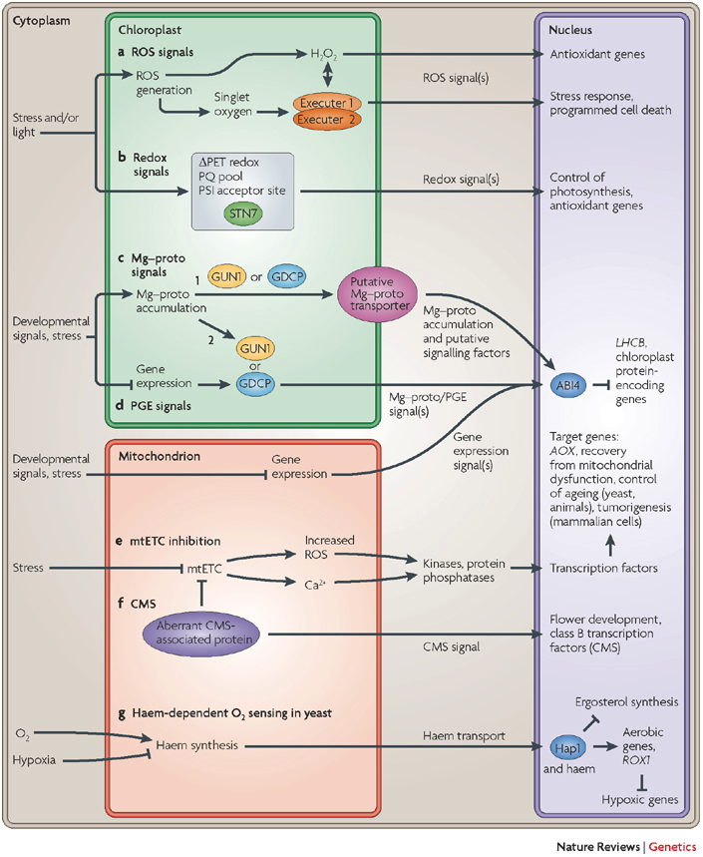
Plastid DNA
coordination with nucleus
  CP signals to nucleus:
  retrograde signaling
    ROS
    Redox

Slide 51
Plastid DNA
coordination with nucleus
  CP signals to nucleus:
  retrograde signaling
    ROS
    Redox
    Mg-protoporphyrin

Slide 52
Plastid DNA
coordination with nucleus
  CP signals to nucleus:
  retrograde signaling
    ROS
    Redox
    Mg-protoporphyrin
    Genome-uncoupled
    (gun) mutants are
    defective in retrograde
    signaling

