Slide 1
  Next Assignment: Wed April 17
  Gene editing for fun and profit
Targeted disruptions
  Engineering Arabidopsis resistant to Turnip mosaic virus doi: 10.1111/mpp.12417
  Engineering plants for gemini virus resistance doi: 10.1016/j.tplants.2016.01.023
  Gene Disruption in Toxoplasma gondii Using CRISPR/CAS https://www.ncbi.nlm.nih.gov/pmc/articles/PMC4030483/
  Generation of germline ablated male pigs https://www.nature.com/articles/srep40176
  Efficient Gene Knockout in Goats https://www.ncbi.nlm.nih.gov/pmc/articles/PMC4154755/
  Crispr-CAS9 to fix Hb-S http://www.nature.com/nature/journal/v539/n7629/full/nature20134.html
  Crispr-CAS9 to convert fibroblasts to neurons http://www.cell.com/cell-stem-cell/fulltext?S1934-5909(16)30196-5

Slide 2
Targeted improvements
  Replacement of an N-efficiency gene with a superior allele doi:10.1111/jipb.12650
  Improving tomatoes https://doi.org/10.1016/j.cell.2017.08.030
  Improving drought tolerance http://onlinelibrary.wiley.com/doi/10.1111/pbi.12673/full
  Improving seed fatty acid composition http://onlinelibrary.wiley.com/doi/10.1111/pbi.12663/full
  Editing the maize ALS2gene to yield chlorsulfuron-resistant plants https://doi.org/10.1104/pp.15.00793
  Improving cold storage and processing traits in potato https://doi.org/10.1111/pbi.12370
  Producing high oleic and low linolenic soybean oil https://doi.org/10.1186/s12870-016-0906-1
  Production of gene-corrected adult beta globin protein in human erythrocytes differentiated from patient iPSCs after genome editing of the sickle point mutation https://www.ncbi.nlm.nih.gov/pmc/articles/PMC4628786/

Slide 3
Remaining work
Preparing poster
Preparing MS
Writing 2000 word review on topic of your choice related to molecular biology
  Probably easiest to do it on your GMO or Gene-editing topic since have already done a lot of the reading

Slide 4
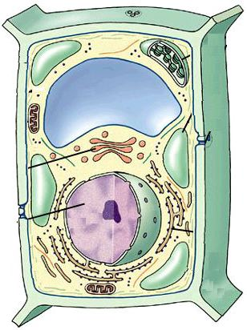
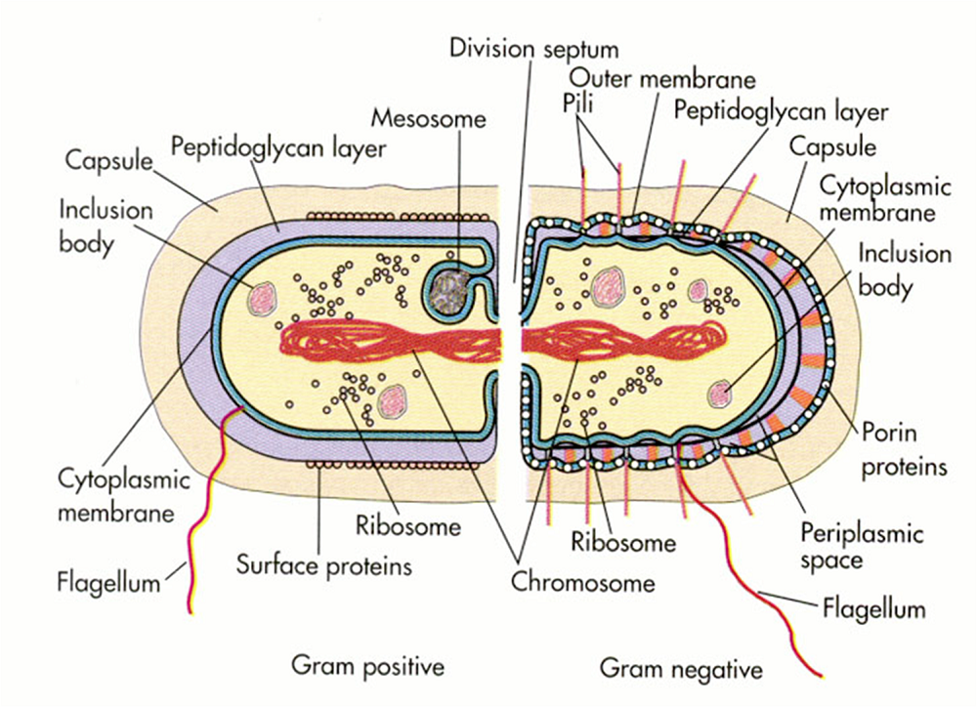
Assembling a cell
Need to make all the right pieces
Need to put them in all the right places, even in bacteria!

Slide 5
Assembling a cell
Need to make all the right pieces
Need to put them in all the right places, even in bacteria!
Controlling gene expression is about making the right pieces

Slide 6
Assembling a cell
Need to make all the right pieces
Need to put them in all the right places, even in bacteria!
Controlling gene expression is about making the right pieces
Protein targeting is about putting them in the right places

Slide 7
PROTEIN TARGETING
All proteins are made with an “address” which determines their final cellular location
Addresses are motifs within proteins

Slide 8
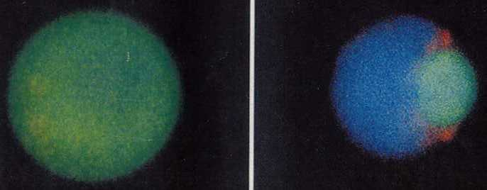
PROTEIN TARGETING
All proteins are made with an “address” which determines their final cellular location
Addresses are motifs within proteins
Remain in cytoplasm unless contain information sending it elsewhere

Slide 9
PROTEIN TARGETING
Targeting sequences are both necessary & sufficient to send reporter proteins to new compartments.

Slide 10
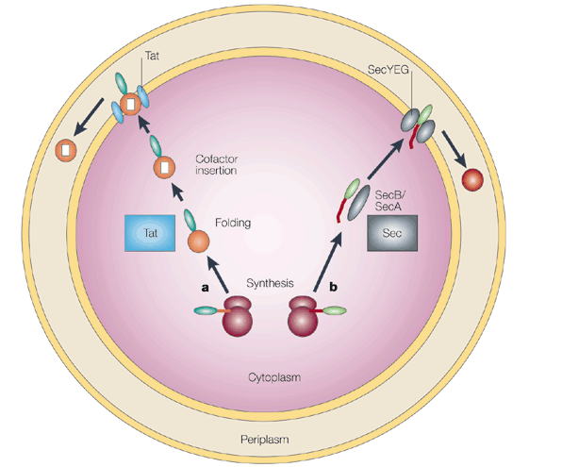
PROTEIN TARGETING
2 Pathways in E.coli http://www.membranetransport.org/
Tat: for periplasmic redox proteins & thylakoid lumen!

Slide 11
2 Pathways in E.coli
Tat: for periplasmic redox proteins & thylakoid lumen!
Preprotein has signal seq S/TRRXFLK

Slide 12
2 Pathways in E.coli
Tat: for periplasmic redox proteins & thylakoid lumen!
Preprotein has signal seq S/TRRXFLK
Make preprotein, folds
& binds cofactor in
cytosol

Slide 13
2 Pathways in E.coli
Tat: for periplasmic redox proteins & thylakoid lumen!
Preprotein has signal seq S/TRRXFLK
Make preprotein, folds
& binds cofactor in
cytosol
Binds Tat in
IM & is sent to
periplasm

Slide 14
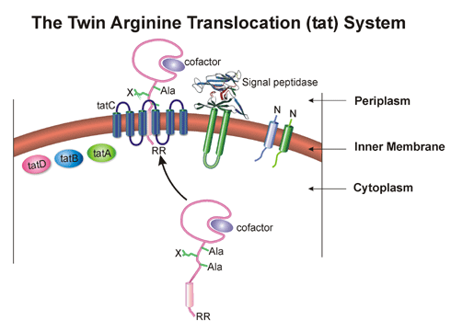
2 Pathways in E.coli
Tat: for periplasmic redox proteins & thylakoid lumen!
Preprotein has signal seq S/TRRXFLK
Make preprotein, folds & binds cofactor in cytosol
Binds Tat in IM & is sent to periplasm
Signal seq is
removed in
periplasm

Slide 15
2 Pathways in E.coli http://www.membranetransport.org/
Tat: for periplasmic redox proteins & thylakoid lumen!
Sec pathway
SecB binds preprotein
as it emerges from rib

Slide 16
Sec pathway
SecB binds preprotein as it emerges from rib & prevents folding

Slide 17
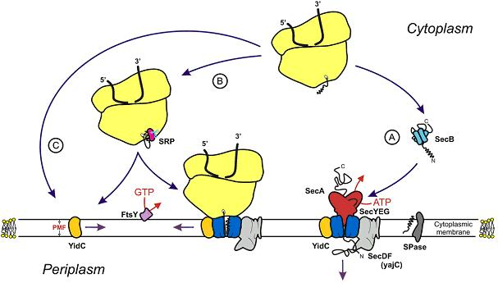
Sec pathway
SecB binds preprotein as it emerges from rib & prevents folding
Guides it to SecA, which drives it through SecYEG into periplasm using ATP

Slide 18
Sec pathway
SecB binds preprotein as it emerges from rib & prevents folding
Guides it to SecA, which drives it through SecYEG into periplasm using ATP
In periplasm signal peptide is removed and protein folds

Slide 19
Sec pathway part deux
SRP binds preprotein as it emerges from rib & stops translation
Guides rib to FtsY
FtsY & SecA guide it to SecYEG , where it resumes translation & inserts protein into membrane as it is made

Slide 20
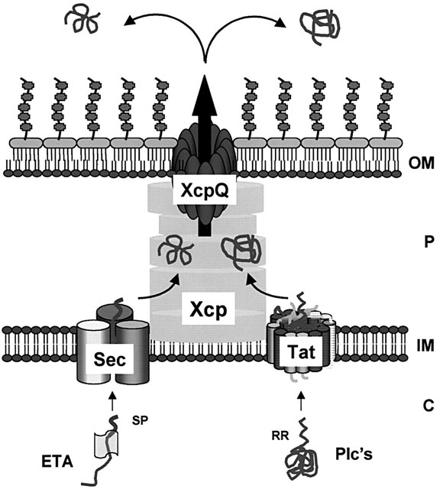
Periplasmic proteins with the correct signals (exposed after cleaving signal peptide) are exported by XcpQ system

Slide 21
PROTEIN TARGETING
Protein synthesis always
begins on free ribosomes
in cytoplasm

Slide 22
2 Protein Targeting pathways
Protein synthesis always
begins on free ribosomes
in cytoplasm
1) proteins of plastids,
mitochondria, peroxisomes
and nuclei are imported
post-translationally

Slide 23
2 Protein Targeting pathways
Protein synthesis always
begins on free ribosomes
in cytoplasm
1) proteins of plastids,
mitochondria, peroxisomes
and nuclei are imported
post-translationally
made in cytoplasm, then
imported when complete

Slide 24
2 Protein Targeting pathways
Protein synthesis always
begins on free ribosomes
in cytoplasm
1) proteins of plastids,
mitochondria, peroxisomes
and nuclei are imported
post-translationally
2) Endomembrane system
proteins are imported
co-translationally

Slide 25
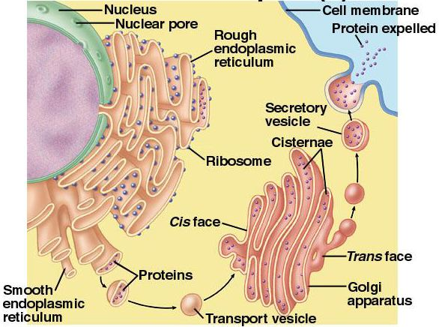
2 Protein Targeting pathways
1) Post -translational
2) Co-translational: Endomembrane system proteins are imported co-translationally
inserted in RER
as they are made

Slide 26
2 pathways for Protein Targeting
1) Post -translational
2) Co-translational: Endomembrane system proteins are imported co-translationally
inserted in RER
as they are made
transported to
final destination
in vesicles

Slide 27
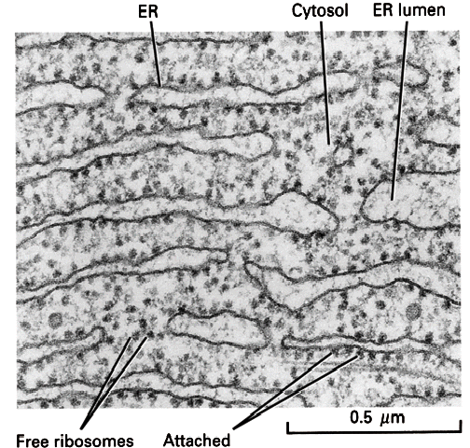
SIGNAL HYPOTHESIS
Protein synthesis always begins on free ribosomes in cytoplasm
in vivo always see
mix of free and
attached ribosomes

Slide 28
SIGNAL HYPOTHESIS
Protein synthesis begins on free ribosomes in cytoplasm
endomembrane proteins have "signal sequence"that directs them to RER
Signal sequence

Slide 29
SIGNAL HYPOTHESIS
Protein synthesis begins on free ribosomes in cytoplasm
endomembrane proteins have "signal sequence"that directs them to RER
“attached” ribosomes are
tethered to RER by
the signal sequence

Slide 30
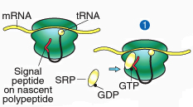
SIGNAL HYPOTHESIS
Protein synthesis begins on free ribosomes in cytoplasm
endomembrane proteins have "signal sequence"that directs them to RER
SRP (Signal Recognition Peptide) binds signal sequence when it pops out of ribosome & swaps GDP for GTP

Slide 31
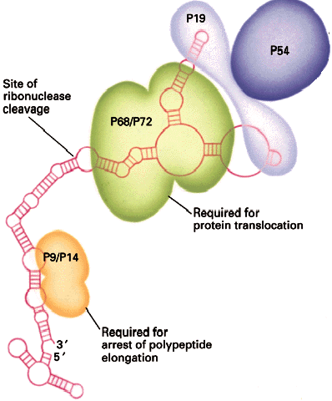
SIGNAL HYPOTHESIS
SRP (Signal Recognition Peptide) binds signal sequence when it pops out of ribosome & swaps GDP for GTP
1 RNA & 7 proteins

Slide 32
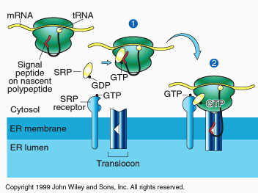
SIGNAL HYPOTHESIS
SRP binds signal sequence when it pops out of ribosome
  SRP stops protein synthesis until it binds “docking protein”(SRP receptor) in RER

Slide 33
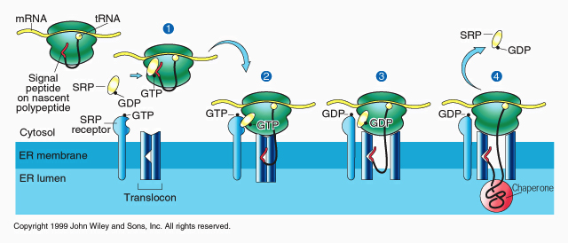
SIGNAL HYPOTHESIS
SRP stops protein synthesis until it binds “docking protein”(SRP receptor) in RER
Ribosome binds Translocon & secretes protein through it as it is made

Slide 34
SIGNAL HYPOTHESIS
SRP stops protein synthesis until it binds “docking protein”(SRP receptor) in RER
Ribosome binds Translocon & secretes protein through it as it is made
BiP (a chaperone) helps the protein fold in the lumen

Slide 35
SIGNAL HYPOTHESIS
Ribosome binds Translocon & secretes protein through it as it is made
secretion must be cotranslational

Slide 36
Subsequent events
Simplest case:
  1) signal is cleaved within lumen by signal peptidase
  2) BiP helps protein fold correctly
  3) protein is soluble inside lumen

Slide 37
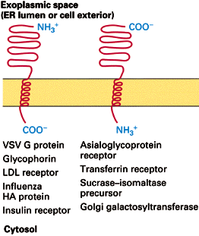
Subsequent events
Complications: proteins embedded in membranes

Slide 38
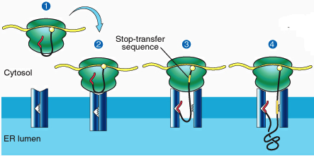
proteins embedded in membranes
protein has a stop-transfer sequence
  too hydrophobic to enter aqueous lumen

Slide 39
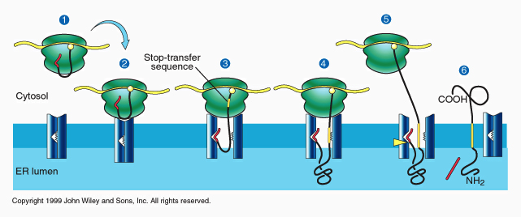
proteins embedded in membranes
protein has a stop-transfer sequence
  too hydrophobic to enter lumen
  therefore gets stuck in membrane
  ribosome releases translocon, finishes job in cytoplasm

Slide 40
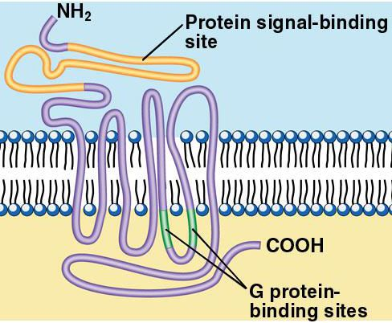
More Complications
Some proteins have multiple trans-membrane domains (e.g. G-protein-linked receptors)

Slide 41
More Complications
Explanation: combinations of stop-transfer and internal signals
-> results in weaving the protein into the membrane

Slide 42
Sorting proteins made on RER
Simplest case: no sorting
proteins in RER lumen
are secreted

Slide 43
Sorting proteins made on RER
Simplest case: no sorting
proteins in RER lumen
are secreted
embedded proteins
go to plasma membrane

Slide 44
Sorting proteins made on RER
Redirection requires extra information:

Slide 45
Sorting proteins made on RER
Redirection requires extra information:
1) specific motif
2) receptors

Slide 46
Sorting proteins made on RER
ER lumen proteins have KDEL (Lys-Asp-Glu-Leu) motif
Receptor in Golgi binds & returns these proteins
ER membrane proteins
have KKXX motif

Slide 47
Sorting proteins made on RER
Golgi membrane proteins
cis- or medial- golgi proteins are
marked by sequences in the
membrane-spanning domain
trans-golgi proteins have a tyrosine-rich sequence in their cytoplasmic C-terminus

Slide 48
Sorting proteins made on RER
Plant vacuolar proteins are zymogens (proenzymes)
signal
VTS
mature protein
Barley aleurain
signal
mature protein
VTS
Barley lectin

Slide 49
Sorting proteins made on RER
Plant vacuolar proteins are zymogens (proenzymes), cleaved to mature form on arrival
targeting motif may be
at either end of protein
signal
VTS
mature protein
Barley aleurain
signal
mature protein
VTS
Barley lectin

Slide 50
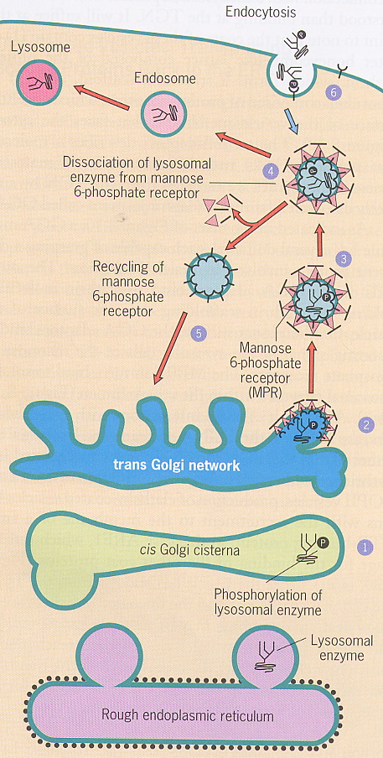
Sorting proteins made on RER
lysosomal proteins are targeted by mannose 6-phosphate
M 6-P receptors in trans-Golgi direct protein to lysosomes (via endosomes)
M 6-P is added in Golgi by enzyme that recognizes lysosomal motif

Slide 51
Glycosylation within ER
All endomembrane proteins are highly glycosylated on lumenal domains.
Glycosylation starts in the ER, continues in the Golgi

Slide 52
Glycosylation within ER
All endomembrane proteins are highly glycosylated on lumenal domains.
Glycosylation starts in the ER, continues in the Golgi
  makes proteins more hydrophilic

Slide 53
Glycosylation within ER
All endomembrane proteins are highly glycosylated on lumenal domains.
Glycosylation starts in the ER, continues in the Golgi
  makes proteins more hydrophilic
  essential for proper function
  tunicamycin poisons cells
  Glycosylation mutants are even sicker

Slide 54
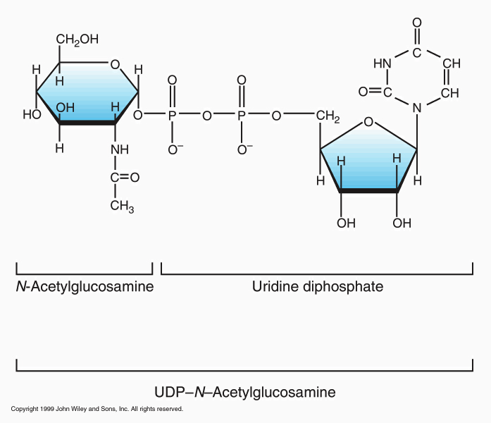
Glycosylation within ER
1) complex (CH₂O)_{n} are assembled stepwise
  substrates are nucleotide sugars

Slide 55
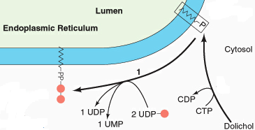
Glycosylation within ER
1) complex (CH₂O)_{n} are assembled stepwise on dolichol phosphate by glycosyltransferases

Slide 56
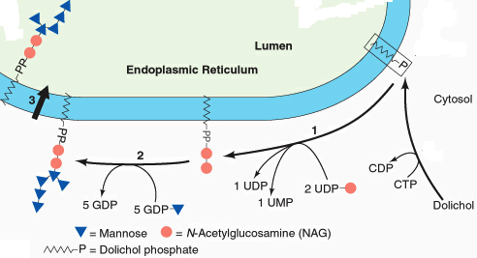
Glycosylation within ER
1) complex (CH₂O)_{n} are assembled stepwise on dolichol phosphate by glycosyltransferases
starts on cytoplasmic face, then flips into lumen

Slide 57
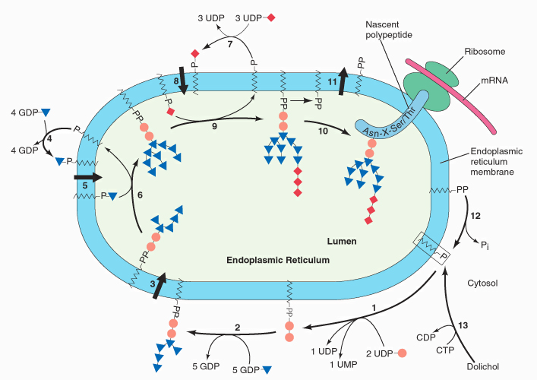
Glycosylation in RER
1)(CH₂O)_{n} are assembled stepwise on dolichol-PO4
2) Transfer (CH₂O)_{n} to target asn

Slide 58
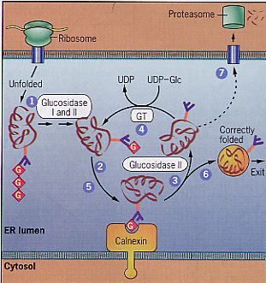
Glycosylation in RER
1)(CH₂O)_{n} are assembled stepwise on dolichol-PO4
2) Transfer (CH₂O)_{n} to target asn
3) remove 2 glucose
& bind chaperone
If good, remove gluc 3
& send to Golgi

Slide 59
Glycosylation in RER
remove 2 glucose & bind to chaperone
If good, remove gluc 3 & send to Golgi
If bad, GT adds glucose
& try again
Eventually, send bad
proteins to cytosol
& eat them

Slide 60
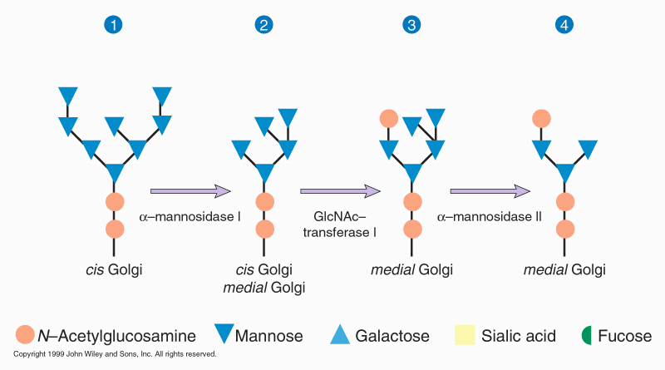
Glycosylation
next modify (CH₂O) _{n} in Golgi
  Remove some sugars & add others

Slide 61
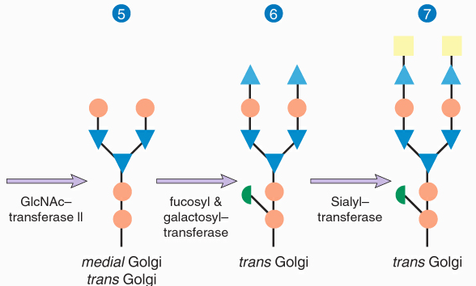
Glycosylation
next modify (CH₂O) _{n} in Golgi
  Remove some sugars & add others
  different rxns occur in different parts of Golgi
  why we separate Golgi into distinct regions

Slide 63
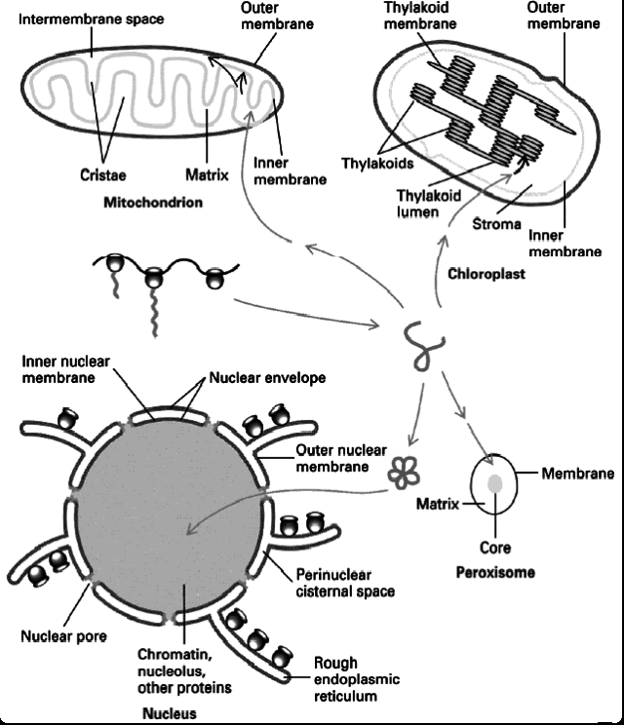
Post-translational protein targeting
Key features
1) imported after synthesis

Slide 64
Post-translational protein targeting
Key features
1) imported after synthesis
2) targeting information is motifs in protein
a) which organelle
b) site in organelle

Slide 65
Post-translational protein targeting
Key features
1) imported after synthesis
2) targeting information is motifs in protein
3) Receptors guide it to correct site
4) no vesicles!

Slide 66
Protein targeting in Post-translational pathway
SKL (ser/lys/leu) at C terminus targets most peroxisomal matrix proteins = PTS1
In humans 3 are targeted by 9 aa at N terminus = PTS2
  Defective PTS2 receptor causes Rhizomelic chondrodysplasia punctata
N
SKL
C
N
PTS2
C

Slide 67
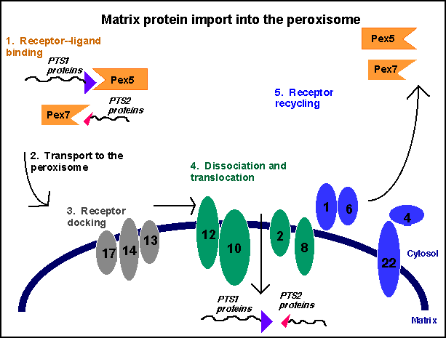
Targeting peroxisomal proteins
Bind receptor in cytoplasm
Dock with peroxisomal receptors
Import
protein w/o
unfolding it!
Recycle
receptors

Slide 68
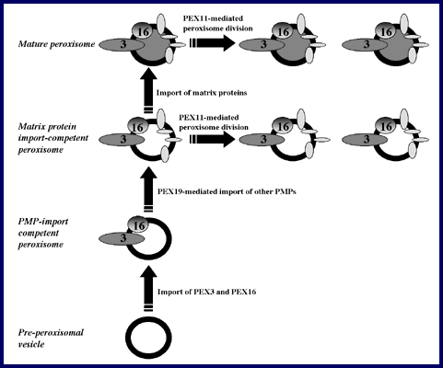
Peroxisomal Membrane Synthesis
Most peroxisomes arise by fission
can arise de novo!
Mechanism is poorly understood/ may involve ER!
Only need PEX 3 & PEX 16 to import pex membrane prot

Slide 69
Protein import into nuclei
nuclear proteins are targeted by internal motifs
  necessary & sufficient to target cytoplasmic proteins to nucleus

Slide 70
Protein import into nuclei
nuclear proteins are targeted by internal motifs
  as in golgi, are not specific
  shapes cf sequences
  Receptors bind objects of the right shape!

Slide 71
  Protein import into nuclei
  3 types of NLS (nuclear localization sequence)
1) basic residues in DNA-binding region
+ + +
LZ

Slide 72
  Protein import into nuclei
  3 types of NLS (nuclear localization sequence)
1) basic residues in DNA-binding region
    2) SV-40 KKKRK
+ + +
LZ
KKKRK

Slide 73
Protein import into nuclei
3 types of NLS (nuclear localization sequence)
  1) basic residues in DNA-binding region
  2) SV-40 KKKRK
  3) bi-partite: 2-4 basic aa,10-20 aa spacer, 2-4 basic aa
+ + +
LZ
KKKRK
+ +
+ +

Slide 74
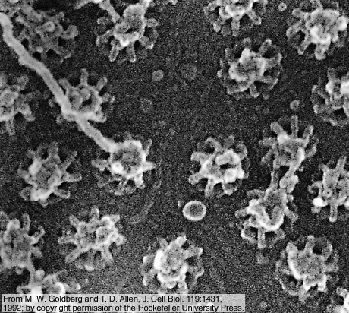
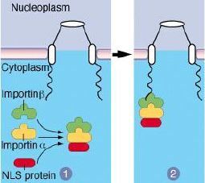
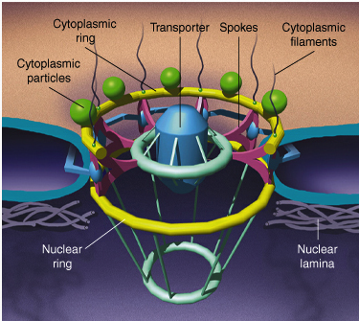
Protein import into nuclei
1) importin−α binds NLS importin−β binds complex
2) escort to nuclear pores
  Pores decide who can enter/exit nucleus

Slide 75
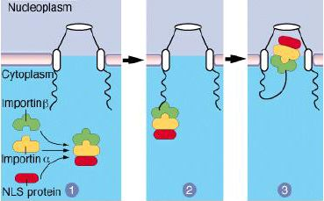
Protein import into nuclei
1) Receptors (importins) bind NLS
2) escort to nuclear pores
3) transporter changes shape, lets complex enter

Slide 76
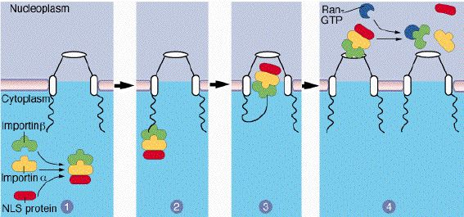
Protein import into nuclei
1) Receptors (importins) bind NLS
2) escort to nuclear pores
3) transporter changes shape, lets complex enter
4) nuclear Ran-GTP dissociates complex

Slide 77
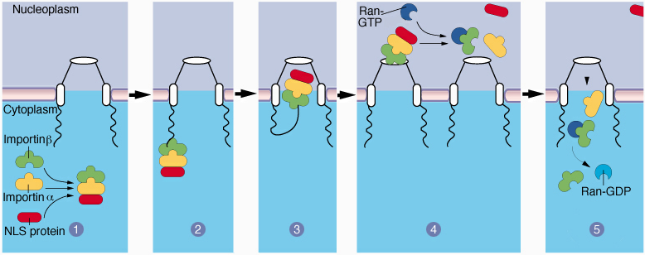
Protein import into nuclei
1) Receptors (importins) bind NLS
2) escort to nuclear pores
3) transporter changes shape, lets complex enter
4) nuclear Ran-GTP dissociates complex
5) Ran-GTP returns importin-β to cytoplasm, becomes Ran-GDP

Slide 78
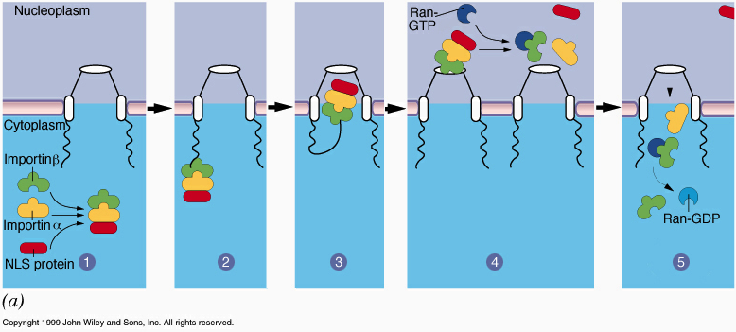
Protein import into nuclei
1) Receptors (importins) bind NLS
2) escort to nuclear pores
3) transporter changes shape, lets complex enter
4) nuclear Ran-GTP dissociates complex
5) Ran-GTP returns β−importin to cytoplasm, becomes Ran-GDP. GTP -> GDP = nuclear import energy source
6) Exportins return α−importin & other cytoplasmic prot

Slide 79
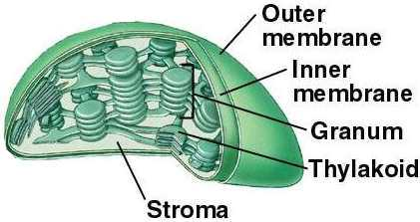
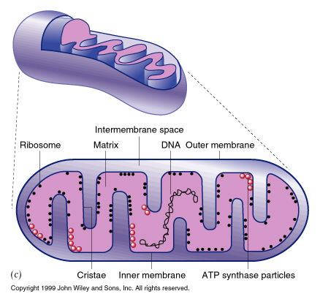
  Making cp & mito

Slide 80
  Making cp & mito
  Most proteins are encoded by nucleus & imported post-translationally
  Most lipids are made in ER & delivered by PLEPS
  Many lipids are made in cp- proportions vary between species

Slide 81
Protein import into cp and mito
Many common features
Pulse-chase experiments show most cp & mt proteins are made in cytoplasm as larger precursor (preprotein)

Slide 82
Protein import into cp and mito
Many common features
1) Pulse-chase experiments show most cp & mt proteins are made in cytoplasm as larger precursor (preprotein)
  both have N-terminal targeting peptide
    transit peptide in cp
    presequence in mito
  necessary & sufficient to target

Slide 83
Protein import into cp &mito
Many common features
1) N-terminal transit peptide or presequence
  necessary & sufficient to target
  usually removed upon arrival

Slide 84
Protein import into cp & mito
Many common features
1) N-terminal transit peptide or presequence
2) both need energy input
  a) ATP for both
  b) Mt also use Proton Motive Force (PMF)
  H⁺ gradient made by electron transport
  c) Cp also use GTP (but not PMF)

Slide 85
Protein import into cp & mito
1) N-terminal transit peptide or presequence
2) both need energy input
3) proteins unfold to enter, then refold inside
  a) need chaperonins on both sides of membrane
    i) chaperonins in cytosol unfold
    ii) chaperonins inside refold
      a) helps draw through membrane

Slide 86
Protein import into mitochondria
Targets?

Slide 87
Protein import into mitochondria
Targets
1) MOM
2) intermembrane
space
3) MIM
4) matrix

Slide 88
Protein import into mitochondria
Precursor has N-terminal targeting presequence
  20 - 70 aa
  1. Many basic a.a (+ charge) = lys, arg
  2. Many hydroxylated a.a. (ser, thr)
  3. Segment can fold into α-helix
+ + +
presequence
mature protein
presequence

Slide 89
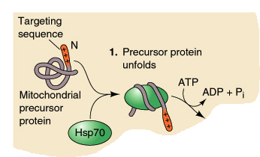
Protein import into mitochondria
1) HSP70 binds & unfolds preprotein

Slide 90
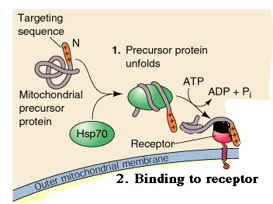
Protein import into mitochondria
1) HSP70 binds & unfolds preprotein
2) Unfolded presequence binds MOM receptors
(MOM19 & MOM72)

Slide 91
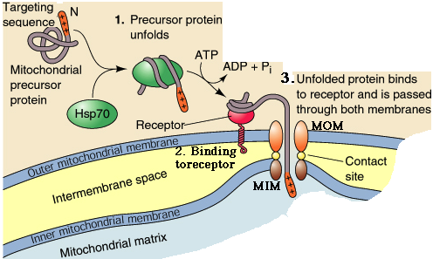
Protein import into mitochondria
1) HSP70 binds & unfolds preprotein
2) Unfolded presequence binds MOM receptors
3) Unfolded protein is translocated through MOM
controversy: do inner and outer membrane contact each other before protein import?

Slide 92
Protein import into mitochondria
1) HSP70 binds & unfolds preprotein
2) Unfolded presequence binds MOM receptors
3) Unfolded protein is translocated through MOM
4) Unfolded protein is translocated through MIM
presequence contacts MIM proteins

Slide 93
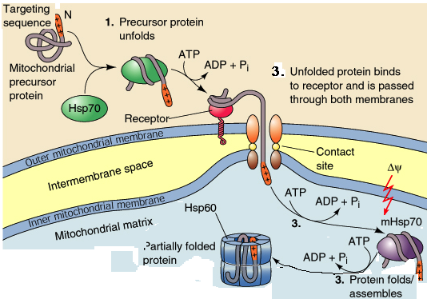
Protein import into mitochondria
5) Chaperones in matrix refold protein
2 different chaperones: mHSP70 & HSP60
consumes ATP

Slide 94
Protein import into mitochondria
Driving forces for import:
1) PMF (on +ve a.a.)
2) Refolding (Brownian ratchet)
3) ATP hydrolysis used to drive unfolding and refolding

Slide 95
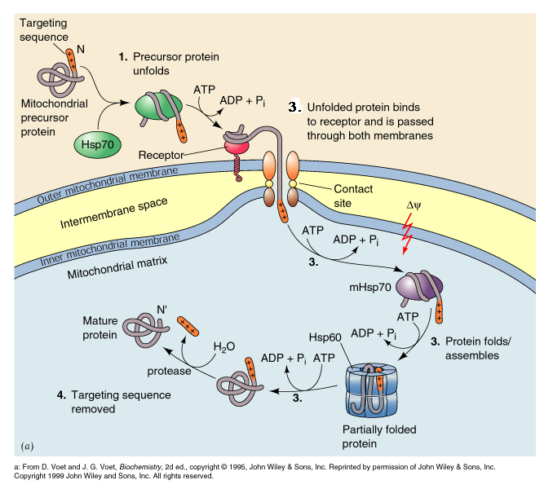
Protein import into mitochondria
6) Once protein is refolded, targeting sequence is removed

Slide 96
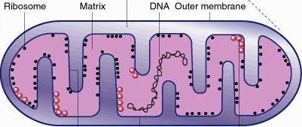
Protein import into mitochondria
Targeting to other parts of mitochondrion?

Slide 97
Protein import into mitochondria
Targeting to other parts of mitochondrion requires extra information = another protein sequence
matrix-targeting presequence
inter-membrane-targeting presequence
presequence
mature protein

Slide 98
Protein import into mitochondria
Targeting to other parts of mitochondrion requires extra information = another protein sequence
Hypothesis: proteins enter matrix first, then find their final destination
matrix-targeting presequence
inter-membrane-targeting presequence
presequence
mature protein

Slide 99
Protein import into mitochondria
Targeting to other parts of mitochondrion requires extra information = another protein sequence
Hypothesis: proteins enter matrix first, then find their final destination
reasoning: protein was
originally made inside
bacterium & sent to
correct location
matrix-targeting presequence
inter-membrane-targeting presequence
presequence
mature protein

Slide 100
Protein import into mitochondria
Targeting to other parts of mitochondrion requires extra information = another protein sequence
Hypothesis: proteins enter matrix first, then find their final destination
reasoning: protein was
originally made inside
bacterium & sent to
correct location
Host stole the gene
matrix-targeting presequence
inter-membrane-targeting presequence
presequence
mature protein

Slide 101
Protein import into mitochondria
Targeting to other parts of mitochondrion requires extra information = another protein sequence
Hypothesis: proteins enter matrix first, then find their final destination
reasoning: protein was
originally made inside
bacterium & sent to
correct location
Host stole the gene
once in matrix contains
info to find its home
matrix-targeting presequence
inter-membrane-targeting presequence
presequence
mature protein

Slide 102
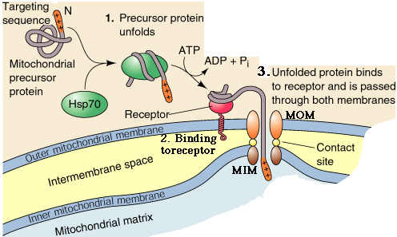
Protein import into mitochondria
Embedding in membranes requires a stop-transfer sequence
Alternative model:
proteins with stop-transfer
sequences get stuck on
their way in

