Slide 1
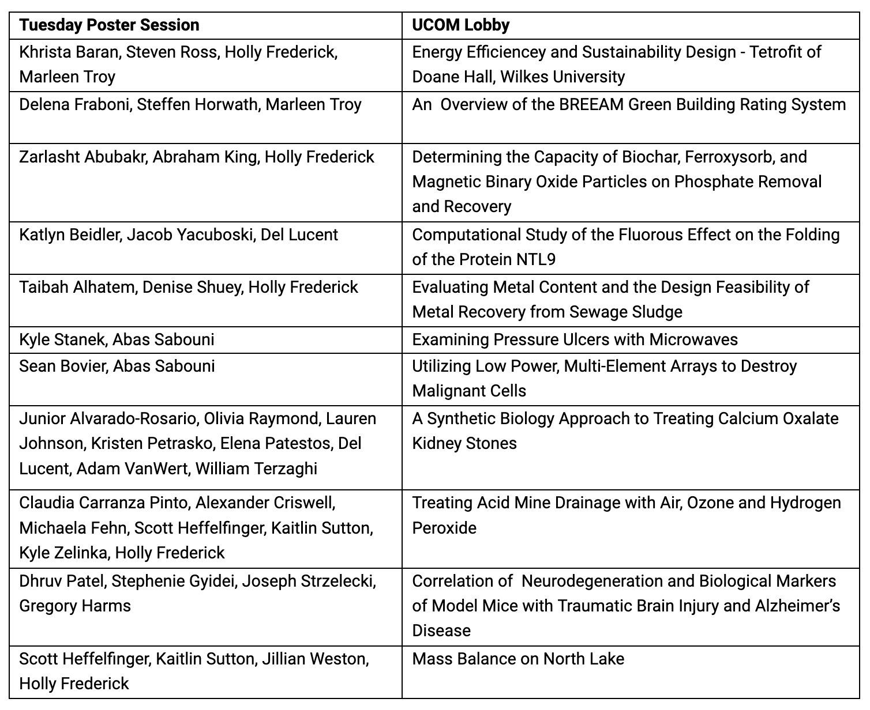
Scholarship Symposium

Slide 2
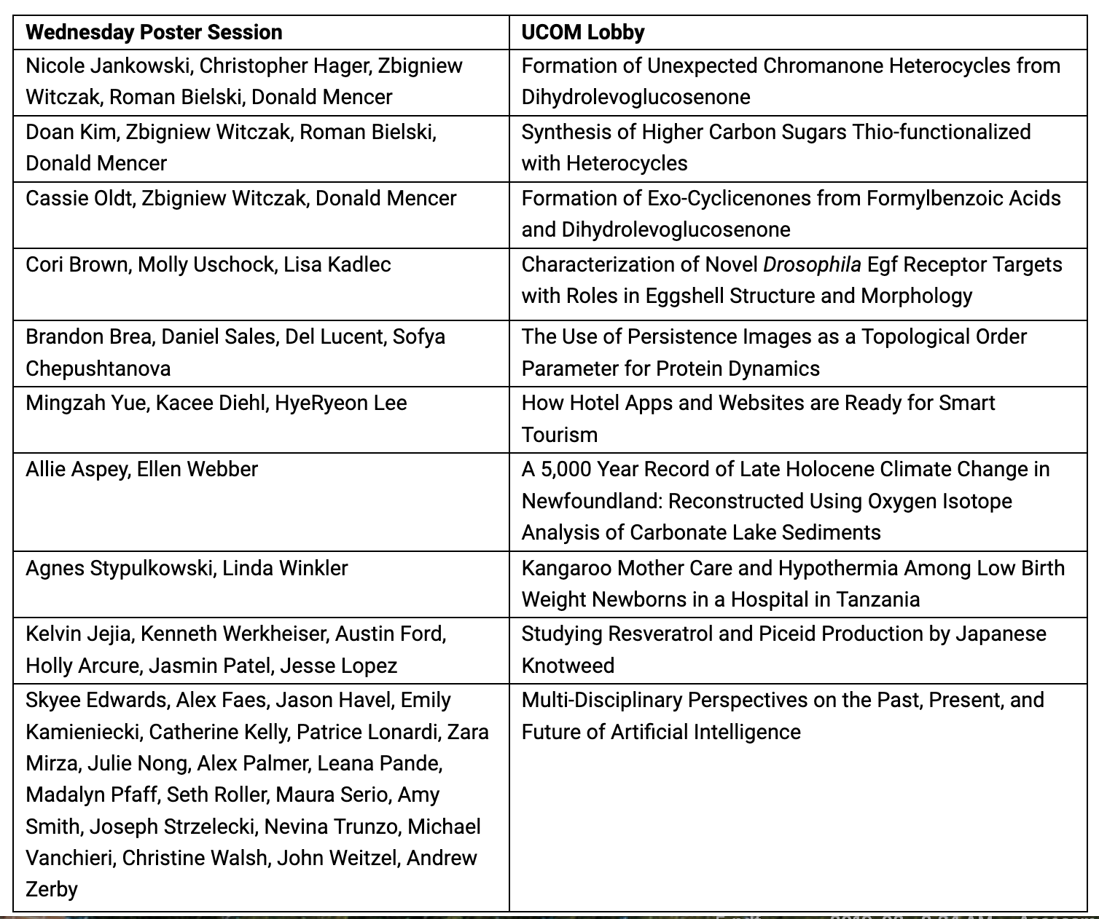
Scholarship Symposium

Slide 3
DNA repair
Need to find the damage, then fix it
3 Ways to fix it
Direct reversal
Removal and resynthesis
Recombination

Slide 4
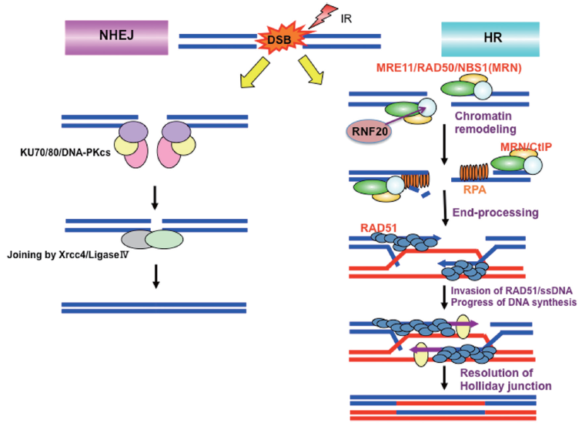
Two options: Homologous & non-homologous end joining

Slide 5
non-homologous end joining
“better than nothing”: join adjacent broken ends hoping they were originally joined
No base-pairing
4 diff. Mechs in yeast

Slide 6
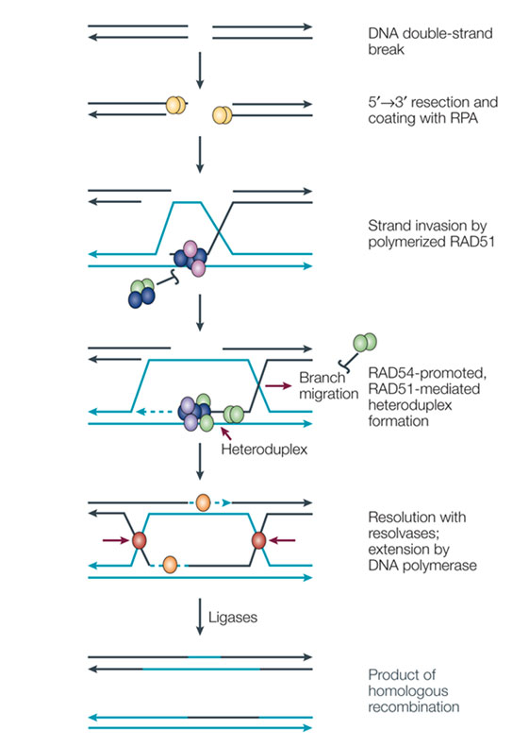
Homologous repair of 2 -strand breaks
MRN finds broken DNA
Several different mechs
depending upon types of
broken ends
All rely on homologous strand to
supply missing info

Slide 7
GMO vs Gene Editing
GMO: adding a new gene from a different organism
Usually also add a selectable marker to select for transgenics
Concerns about transfer to unwanted organisms
Concerns about effects on humans
Concerns about inbreeding
Concerns about unanticipated consequences
Gene editing: modifying a gene that was already there
Not (necessarily) adding extra genes
USDA won’t regulate because thinks that they ”could otherwise have been developed through traditional breeding techniques.”
Notes:
Acquired (learned) versus innate immunity

Slide 8
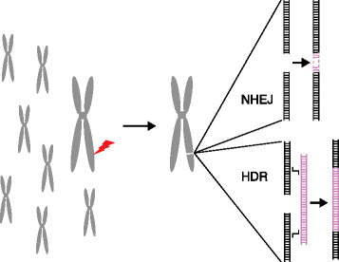
Gene Editing
Gene editing: modifying a gene that was already there
Requires knowledge of the sequence that you wish to modify
Requires way to cut it precisely
Four types of engineered nucleases have been developed that cut specific genomic sequences
DNA repair then creates mutations while fixing the break
Notes:
Acquired (learned) versus innate immunity

Slide 9
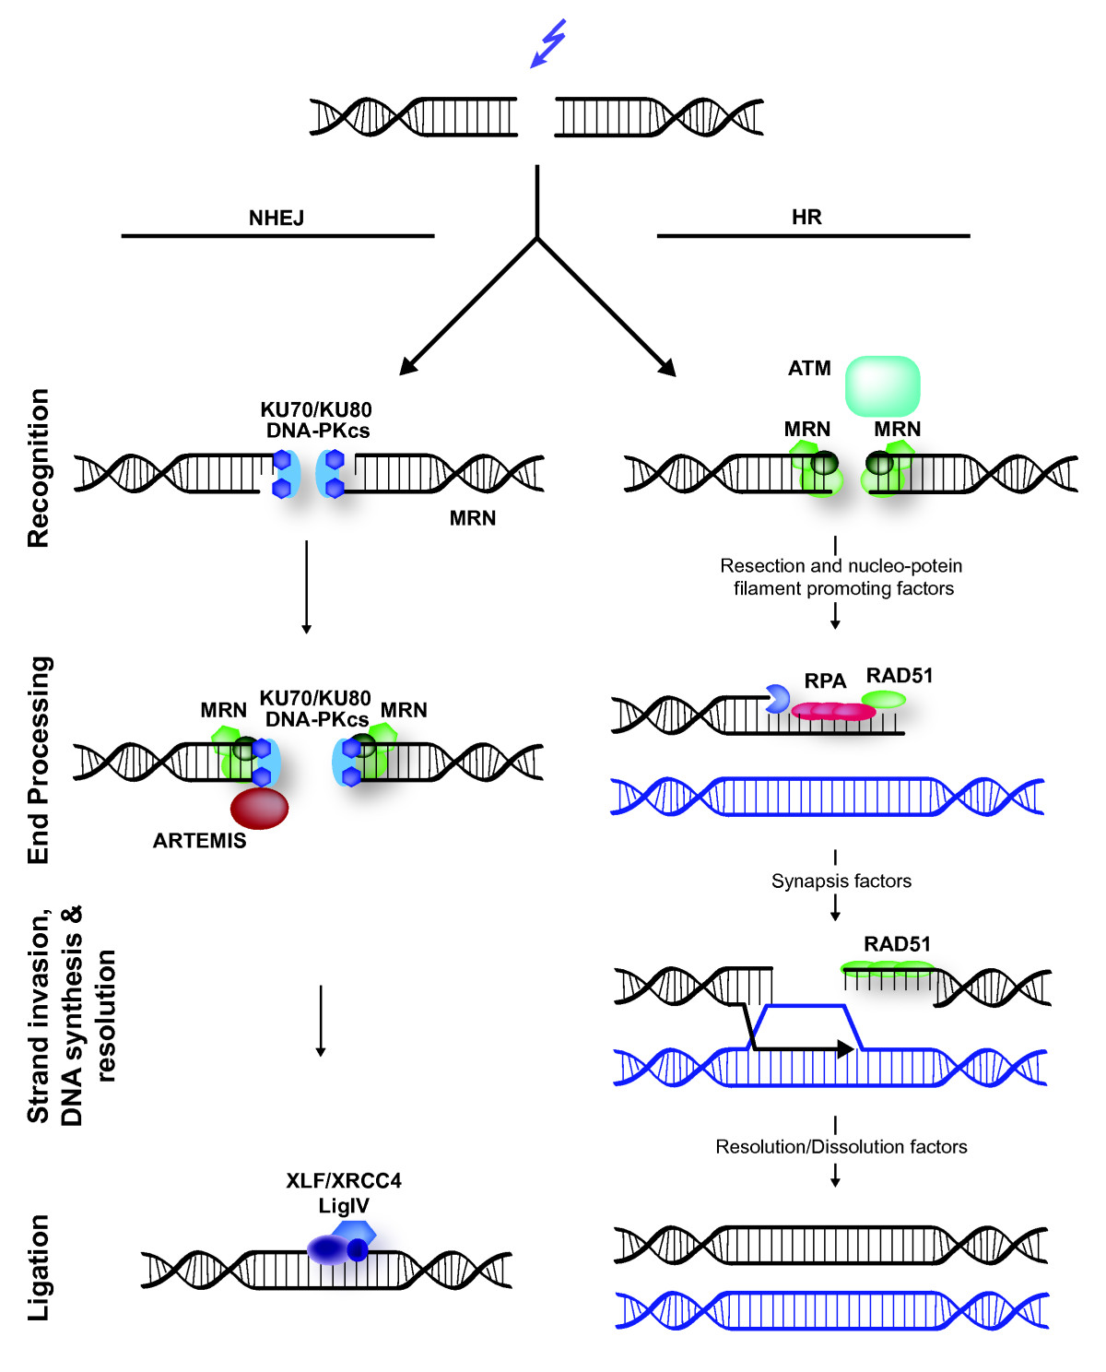
Gene Editing
DNA repair then creates mutations while fixing the break
Non-homologous end-joining is error-prone
Homologous DNA repair can replace DNA if a template is supplied
Notes:
Acquired (learned) versus innate immunity

Slide 10
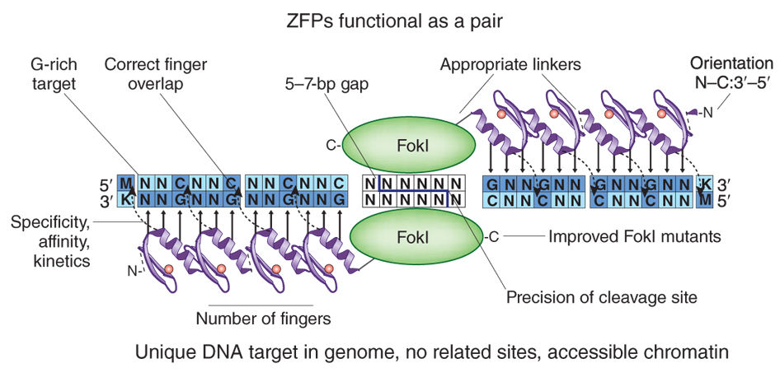
Gene Editing
Four types of engineered nucleases have been developed that cut specific genomic sequences
Zn- finger nucleases came first
Fuse Zn-finger DNA binding domains with a nuclease domain
Each ~30 aa finger binds 3 bp, total monomer is ~ 300 aa
1800 bp of cds to encode a heterodimer pair: small enough to deliver as mRNA or in a virus
Notes:
FokI nuclease domain must dimerise to cleave
Need a spacer of 5-7 bp between binding sites

Slide 11
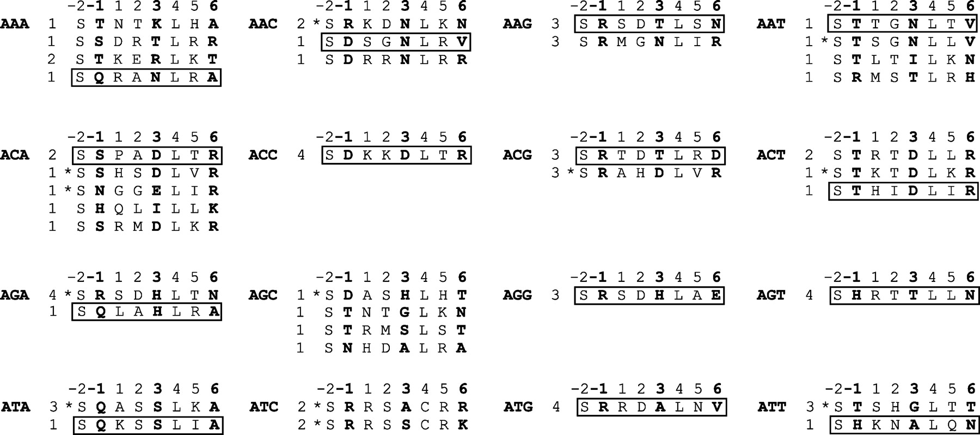
Gene Editing
Four types of engineered nucleases have been developed that cut specific genomic sequences
Zn- finger nucleases came first
Fuse Zn-finger DNA binding domains with a nuclease domain
Each ~30 aa finger binds 3 bp
Can mix and match fingers to target specific sequences
Notes:
FokI nuclease domain must dimerise to cleave
Need a spacer of 5-7 bp between binding sites

Slide 12
Gene Editing
Zn- finger nucleases came first
Problems
Specificity of Zn fingers difficult to predict, must test
Off-target cutting, especially sites that only differ by 1-2 bp
Expensive, laborious & slow to make constructs
Low efficiency, chromatin accessibility?
Notes:
Sepcificity varies by context

Slide 13
Gene Editing
Four types of engineered nucleases have been developed that cut specific genomic sequences
Zn- finger nucleases came first
Meganucleases
R.E.s that bind and cut sites 12-40 bp long
Only ~165 aa: can easily deliver
Difficult to engineer to bind new sites
Binding & cleavage sites overlap
Need to mutagenize & screen for desired specificities
Notes:
First that were tried in plants

Slide 14
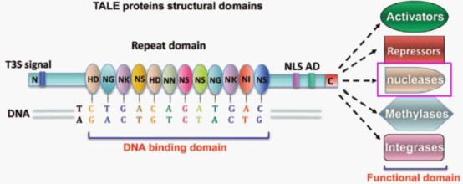
Gene Editing
TALENS (Transcription activator-like effector nucleases)
Bind and activate specific plant host genes
Have 34 aa repeats that each bind a single base
Binding sites are > 30bp!
Variable residues 12 & 13 determine specificity
Can mix and match to bind any site you want!
Can fuse DNA binding domain to many functional domains
Notes:
First that were tried in plants

Slide 15
Gene Editing
TALENS (Transcription activator-like effector nucleases)
Pro
Very specific: very few offsite mutations
Can target any sequence
Con
Protein is huge: difficult to deliver, usually needs transgenics
Design & synthesis is very time-consuming
Sensitive to methylation of target DNA
Inefficient
Notes:
Last November reported genome editing in potato by transient expression after Agro-infiltration. Got editing without stable integration.

Slide 16
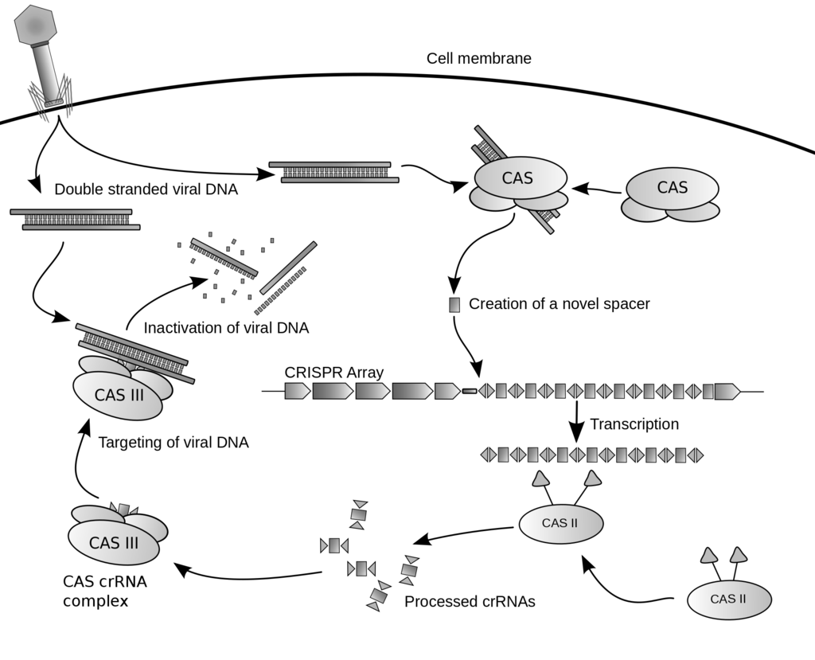
CRISPR/Cas9 Overview
CRISPR = Clustered Regularly Interspaced Short Palindromic Repeats
Now is the preferred tool for genome editing because specificity determined by RNA which is much easier to modify than protein
Notes:
Acquired (learned) versus innate immunity (restriction enzymes)

Slide 17
CRISPR/Cas9 Overview
CRISPR = Clustered Regularly Interspaced Short Palindromic Repeats
Now is the preferred tool for genome editing because specificity determined by RNA which is much easier to modify than protein
Bacterial
viral defense
Notes:
Acquired (learned) versus innate immunity (restriction enzymes)

Slide 18
CRISPR/Cas9 Overview
CRISPR = Clustered Regularly Interspaced Short Palindromic Repeats
Bacterial
viral defense
“remembers”
foreign DNA

Slide 19
CRISPR/Cas9 Overview
CRISPR = Clustered Regularly Interspaced Short Palindromic Repeats
Bacterial viral defense
“remembers”
foreign DNA
Inserts short
fragments of target
in genome

Slide 20
CRISPR/Cas9 Overview
CRISPR = Clustered Regularly Interspaced Short Palindromic Repeats
Bacterial viral defense
“remembers”
foreign DNA
Inserts short
fragments of target
in genome
Transcribes target
and gRNA binds
CAS protein

Slide 21
CRISPR/Cas9 Overview
CRISPR = Clustered Regularly Interspaced Short Palindromic Repeats
Bacterial viral defense
“remembers”
foreign DNA
Inserts short
fragments of target
in genome
Transcribes target
and gRNA binds
CAS protein
Cuts target
dsDNA @ specific
sites bound by gRNA

Slide 22
CRISPR/Cas9 Overview
CRISPR = Clustered Regularly Interspaced Short Palindromic Repeats
Bacterial viral defense
“remembers” foreign DNA
Cuts target dsDNA @ specific sites
CRISPR were accidentally discovered as part of iap gene cloned by Yoshizumi Ishino in 1987

Slide 23
CRISPR/Cas9 Overview
CRISPR = Clustered Regularly Interspaced Short Palindromic Repeats
Bacterial viral defense
“remembers” foreign DNA
Cuts target dsDNA @ specific sites
CRISPR were accidentally discovered as part of iap gene cloned by Yoshizumi Ishino in 1987
Similar clusters of interrupted direct repeats were described in Mycobacterium tuberculosis in 1993
Notes:
Since have been found in 40% of eubacteria and 90% o archaebacteria
characterized by short direct repeats interrupted at regular intervals by unique spacer sequences.

Slide 24
CRISPR/Cas9 Overview
CRISPR were accidentally discovered as part of iap gene cloned by Yoshizumi Ishino in 1987
Similar clusters of interrupted direct repeats were described in Mycobacterium tuberculosis in 1993
2002 Jansen et al identify homologous cas (CRISPR-associated) genes
Contained nuclease and helicase motifs
Proposed that it is an adaptive immune system
Notes:
Can “vaccinate” themselves by integrating new sequences into the pre-existing CRISPR locus

Slide 25
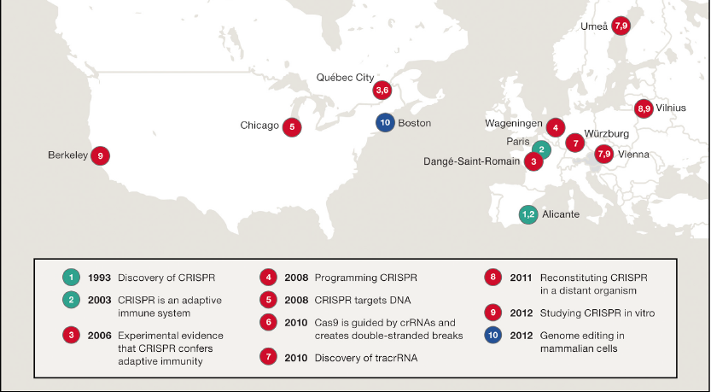
CRISPR/Cas9 Overview

Slide 26
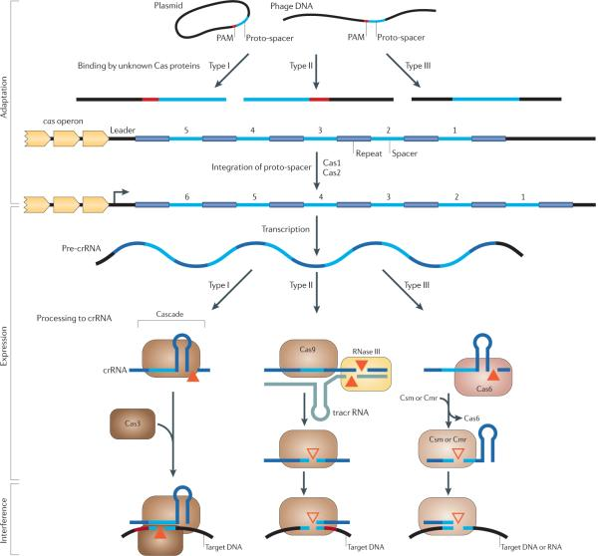
3 stages:
Adaptation
Inserting fragments of target in CRISPR locus

Slide 27
Adaptation
Inserting fragments of target in CRISPR locus
Expression: transcribing the CRISPR locus, processing crRNA & associating with CAS proteins

Slide 28
Adaptation
Inserting fragments of target in CRISPR locus
Expression: transcribing the CRISPR locus, processing crRNA & associating with CAS proteins

Slide 29
Adaptation
Inserting fragments of target in CRISPR locus
Expression: transcribing the CRISPR locus and processing cRNA
Interference: cleaving the
target

Slide 30
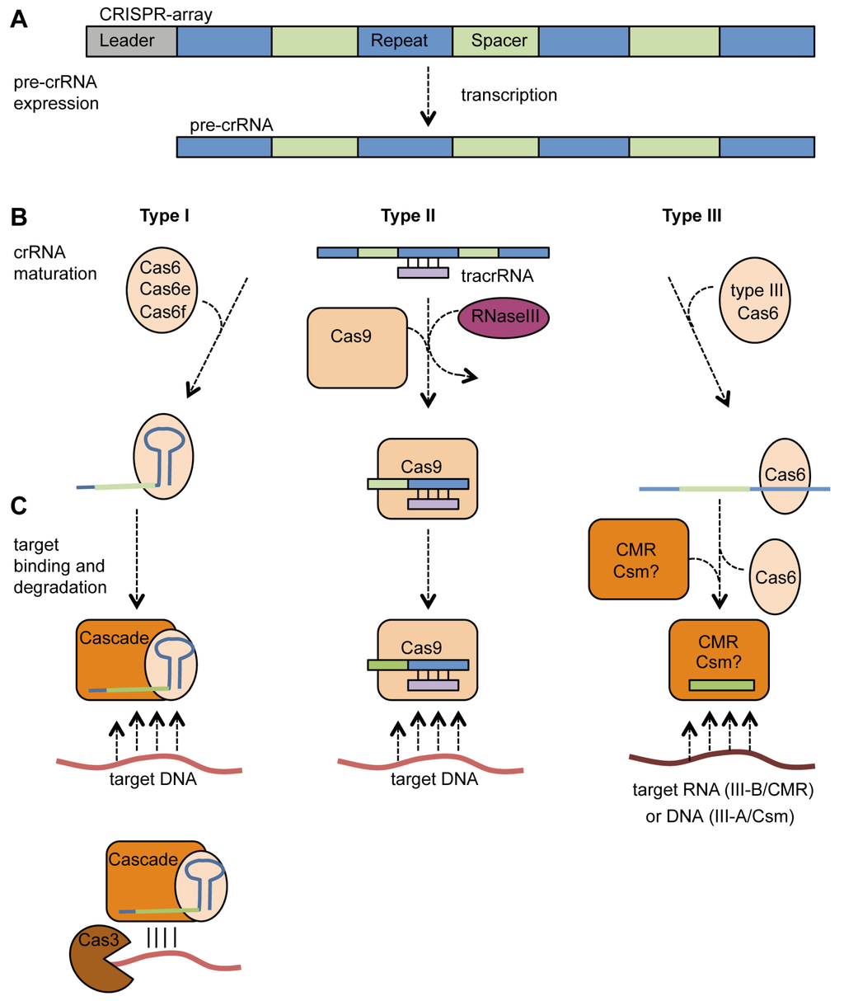
CRISPR/Cas9
3 types identified
Class II type 2 is simplest

Slide 31
CRISPR/Cas9
3 types identified
Class II type 2 is simplest
Others have ≥ 8 proteins
(but only 1 crRNA)

Slide 32
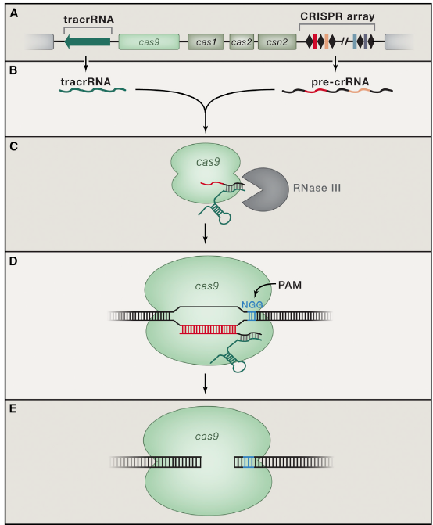
CRISPR/Cas9
3 types identified
Class II type 2 is
simplest
Transcribe tracRNA & pre-crRNA then process with RnaseIII & Cas9

Slide 33
CRISPR/Cas9
3 types identified
Class II type 2 is
simplest
Transcribe tracRNA & pre-crRNA then process with RnaseIII & Cas9
Complex binds target that matches crRNA
PAM (protospacer adjacent motif) must be 3’ to crRNA
Handle for Cas9

Slide 34
CRISPR/Cas9
3 types identified
Class II type 2 is
simplest
Transcribe tracRNA & pre-crRNA then process with RnaseIII & Cas9
Complex binds target that matches crRNA
PAM (protospacer adjacent motif) must be 3’ to crRNA
Handle for Cas9
Upon binding Cas9 cleaves target 3 bp 5’ to PAM site

Slide 35
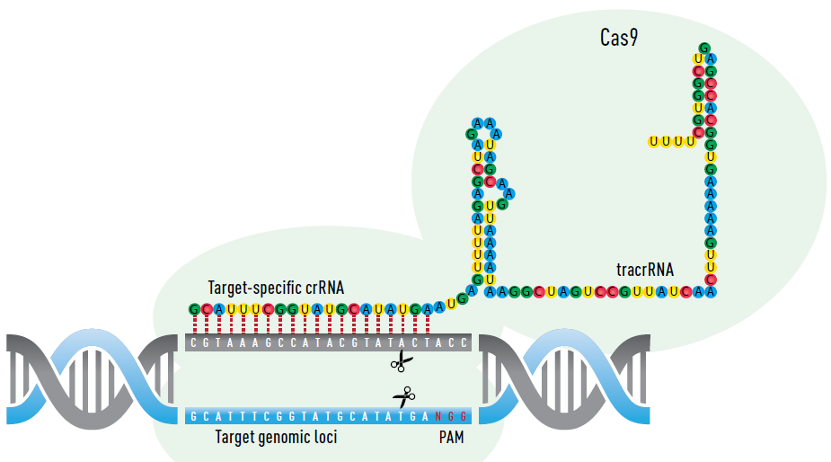
CRISPR/Cas9
Can fuse crRNA & tracrRNA into a single RNA & still works
Call the crRNA the gRNA
Design it to bind target sequence

Slide 36
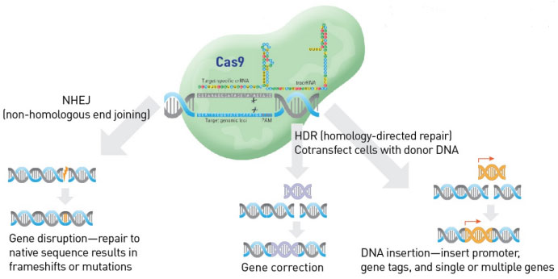
CRISPR/Cas9
Fuse crRNA & tracrRNA into a single RNA & still works
Call the crRNA the gRNA
Design it to bind target sequence
Can then destroy or replace target depending on type of cut & way it is repaired

Slide 37
CRISPR/Cas9
Can then destroy or replace target depending on type of cut & way it is repaired
Native Cas9 makes “blunt” ds-breaks – usually repaired by error-prone NHEJ

Slide 38
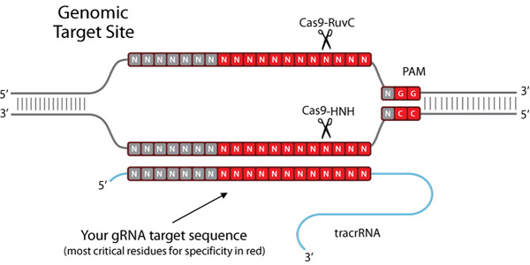
CRISPR/Cas9
Native Cas9 makes “blunt” ds-breaks – usually repaired by error-prone NHEJ
HNH domain cuts the complementary strand
Ruv-C domain cuts the other strand

Slide 39
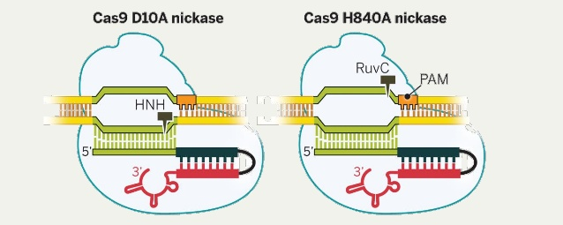
CRISPR/Cas9
Native Cas9 makes “blunt” ds-breaks – usually repaired by error-prone NHEJ
HNH domain cuts the complementary strand
Ruv-C domain cuts the other strand
Can modify Cas9 so only cuts one strand (nickase)

Slide 40
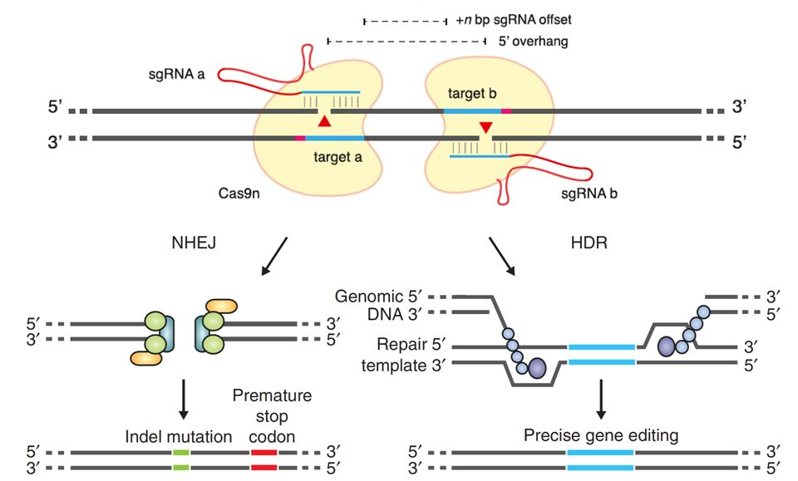
CRISPR/Cas9
Can modify Cas9 so only cuts one strand (nickase)
Can then target ds-breaks for gene replacement by homologous recombination

Slide 41
CRISPR/Cas9
Can modify Cas9 so only cuts one strand (nickase)
Can then target ds-breaks for gene replacement by homologous recombination
But must design 2 sgRNAs with correct offset

Slide 42
CRISPR/Cas9
Can modify Cas9 so only cuts one strand (nickase)
Can then target ds-breaks for gene replacement by homologous recombination
But must design 2 sgRNAs with correct offset. PAM complicates!

Slide 43
CRISPR/Cas9
HNH domain cuts the complementary strand
Ruv-C domain cuts the other strand
Can modify Cas9 so doesn’t cut at all (dCas9)
Will then bind sequences complementary to gRNA

Slide 44
CRISPR/Cas9
HNH domain cuts the complementary strand
Ruv-C domain cuts the other strand
Can modify Cas9 so doesn’t cut at all (dCas9)
Will then bind sequences complementary to gRNA
Can fuse many different functional domains

Slide 45
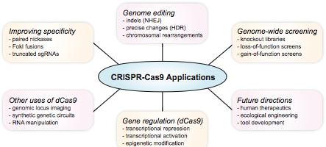
CRISPR/Cas9

Slide 46
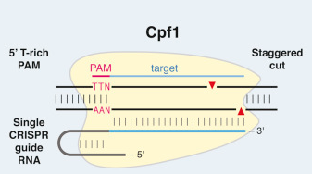
CRISPR/Cpf1
Identified by bioinformatics DOI: http://dx.doi.org/10.1016/j.cell.2015.09.038
Only one RNA
5 nt staggered cuts
Different PAM
Notes:
5 nt stagger means don’t need separate nickase

Slide 47
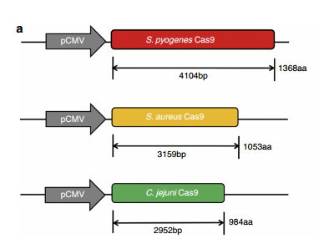
Expanding to smaller Cas9, with new PAM sequences:
ortholog from Campylobacter jejuni is 984 aa, 2.95 kb cf Streptococcus pyogenes is 1,368 aa, 4.10 kbp
Has never been shown to induce targeted mutagenesis in humans or other Eukaryotes

Slide 48
CRISPR/Cas9
Pro
Very easy
Can target multiple sequences

Slide 49
CRISPR/Cas9
Pro
Very easy (and fast)
Can target multiple sequences
High efficiency

Slide 50
CRISPR/Cas9
Pro
Very easy (and fast)
Can target multiple sequences
High efficiency
Cons:
PAM sequence limits potential targets

Slide 51
CRISPR/Cas9
Cons:
PAM sequence limits potential targets
CAS9 is fairly large

Slide 52
CRISPR/Cas9
Cons:
PAM sequence limits potential targets
CAS9 is fairly large
Offsite targets

Slide 53
CRISPR/Cas9
Cons:
PAM sequence limits potential targets
CAS9 is fairly large
Offsite targets
Usually use transgenes to express gRNA &Cas9

Slide 54
CRISPR/Cas9
Cons:
PAM sequence limits potential targets
CAS9 is fairly large
Offsite targets
Usually use transgenes to express gRNA &Cas9
Many recent studies have used RNA and protein: no DNA!
Immature wheat embryos, lettuce

Slide 55
CRISPR/Cas9
Results:
Lots of plants have been edited to knockout genes
Increased lycopene in tomato
5x by knocking out 5
carotenoid metabolism genes
Knocking out barley MORC1
increased resistance to fungi
Notes:
Including sugar transporters, ADH, etc

Slide 56
CRISPR/Cas9
Results:
Lots of plants have been edited to knockout genes
Increased lycopene in tomato
5x by knocking out 5
carotenoid metabolism genes
Knocking out barley MORC1
increased resistance to fungi
Knocking out rice Sweet14
sugar transporter increased
resistance to Xanthomonas
Notes:
Including sugar transporters, ADH, etc

Slide 57
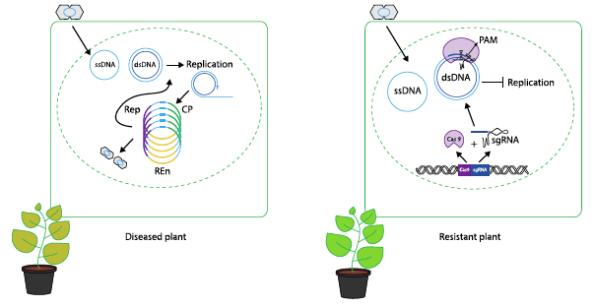
CRISPR/Cas9
Results:
Lots of plants have been edited to knockout genes
Also used to knockout virus genes
Notes:
Including sugar transporters, ADH, etc

Slide 58
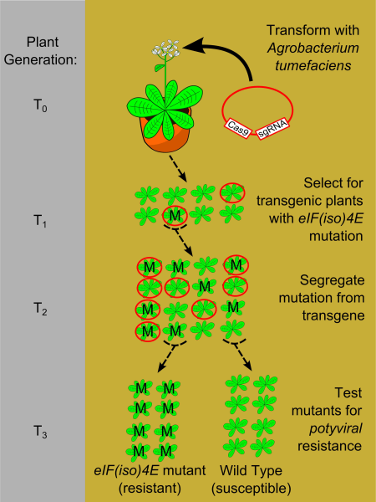
CRISPR/Cas9
Results:
Lots of plants have been edited to knockout genes
Also used to knockout virus genes
Or host genes needed by virus
Potyviruses need host eIF(iso)4E
Notes:
Including sugar transporters, ADH, etc

Slide 59
CRISPR/Cas9
Results:
Lots of plants have been edited to knockout genes
Some have been engineered to add a superior allele
Round-up resistance in cassava
N-efficiency in rice

Slide 60
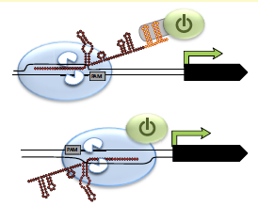
CRISPR/Cas9
Results:
Lots of plants have been edited to knockout genes
Some have been engineered to add a superior allele
Experimentally have made synthetic transcriptional activators
Fused to Cas9 (d)
Interacting with tracR

Slide 61
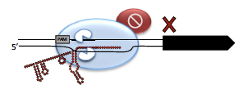
CRISPR/Cas9
Results:
Lots of plants have been edited to knockout genes
Some have been engineered to add a superior allele
Experimentally have made synthetic transcriptional activators
Experimentally have made synthetic transcriptional repressors
Fused to Cas9 (d)
Interacting with tracR

Slide 62
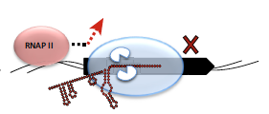
CRISPR/Cas9
Results:
Lots of plants have been edited to knockout genes
Some have been engineered to add a superior allele
Experimentally have made synthetic transcriptional activators
Experimentally have made synthetic transcriptional repressors
Fused to Cas9 (d)
Interacting with tracR
Also have Crispr-Cas9(d) that bind cds and block elongation

Slide 63
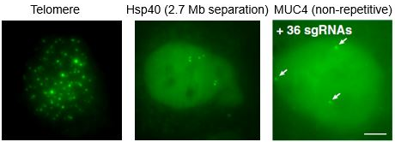
CRISPR/Cas9
Results:
Lots of plants have been edited to knockout genes
Some have been engineered to add a superior allele
Experimentally have made synthetic transcriptional activators
Experimentally have made synthetic transcriptional repressors
Experimentally have made synthetic fluorescent reporters
Used to track DNA in living cells

Slide 64
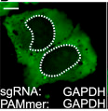
CRISPR/Cas9
Results:
Lots of plants have been edited to knockout genes
Some have been engineered to add a superior allele
Experimentally have made synthetic transcriptional activators
Experimentally have made synthetic transcriptional repressors
Experimentally have made synthetic fluorescent reporters
Used to track DNA in living cells
Used to track RNA in living cells

Slide 65
Getting rid of transgenes
Cross them out
OK for getting rid of gene-editor
Very tricky for getting rid of GMO

Slide 66
Getting rid of transgenes
Cross them out
OK for getting rid of gene-editor
Very tricky for getting rid of GMO
Edit without a transgene
Deliver DNA by transient expression (hit and run)
Express protein that does its job before DNA is degraded
Use Agrobacterium, biolistics, protoplasts

Slide 67
Getting rid of transgenes
Cross them out
OK for getting rid of gene-editor
Very tricky for getting rid of GMO
Edit without a transgene
Deliver DNA by transient expression (hit and run)
Deliver DNA with a virus
in plants are rarely integrated into the genome
Reason for concern about the size of the Cas9 protein

Slide 68
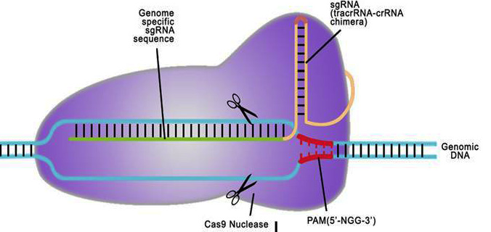
Getting rid of transgenes
Cross them out
OK for getting rid of gene-editor
Very tricky for getting rid of GMO
Edit without a transgene
Deliver DNA by transient expression (hit and run)
Deliver DNA with a virus
Deliver pre-assembled crispr-Cas9 complex

