Slide 1
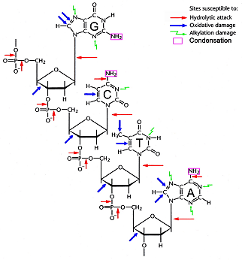
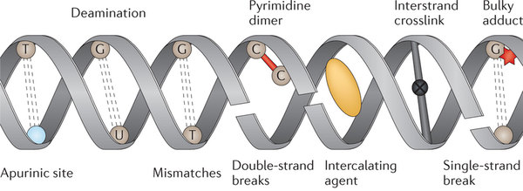
DNA damage
DNA gets damaged a lot!

Slide 2
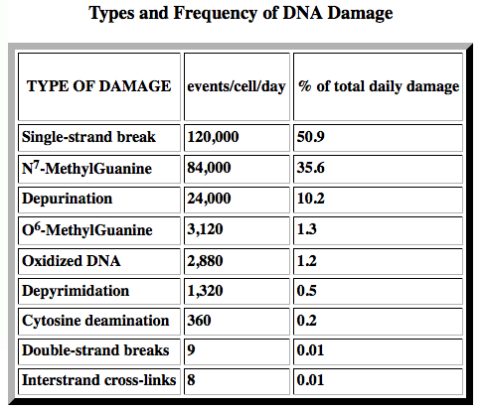
DNA damage
DNA gets damaged a lot! >200,000 events/human cell/day

Slide 3
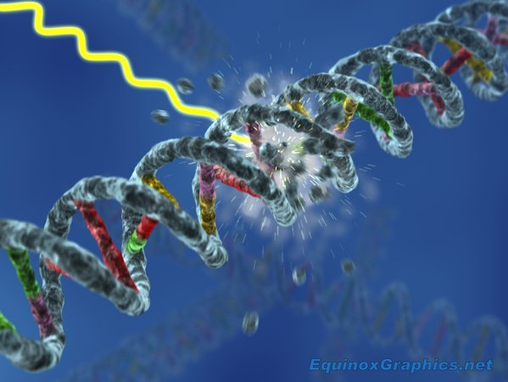
DNA damage
Occurs 2 ways
1) spontaneously
2) mutagens : damage DNA

Slide 4
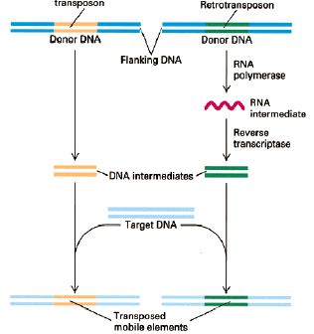
Transposons
Discovered by Barbara McClintock
~ 50% of human genome!
2 types
1)Transposable elements
use DNA intermediates
2) Retrotransposons use
RNA intermediates

Slide 5
DNA repair
Need to find the damage, then fix it
3 Ways to fix it
Direct reversal
Removal and resynthesis
Recombination

Slide 6
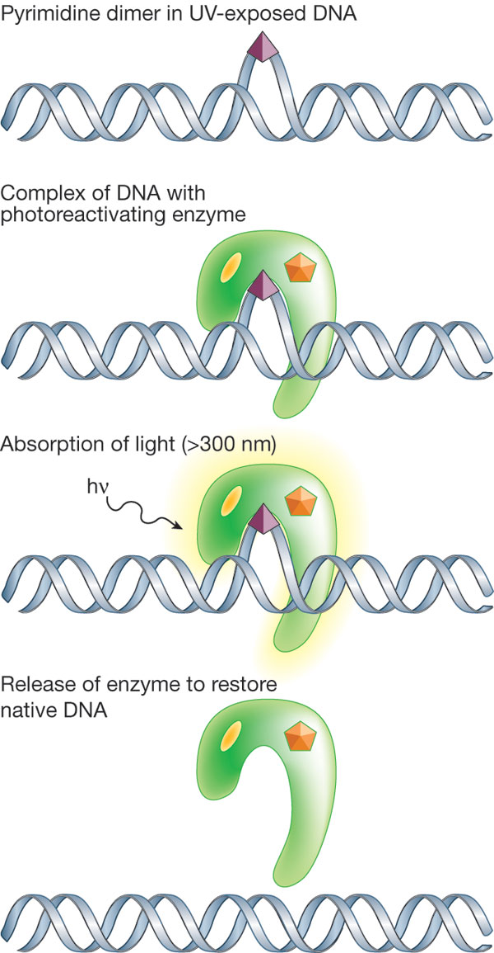
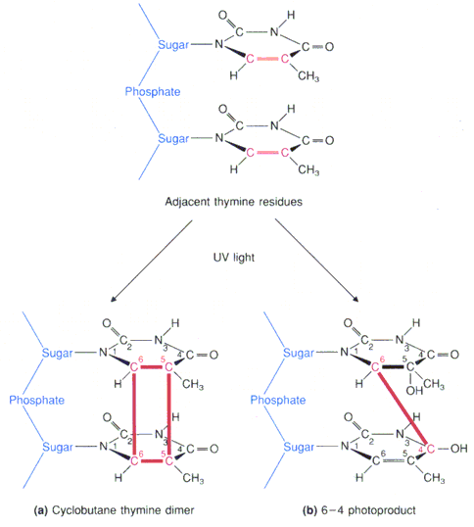
DNA repair
Direct Reversal
UV makes pyrimidine dimers
Photolyase finds & uses light energy
to cleave dimers

Slide 7
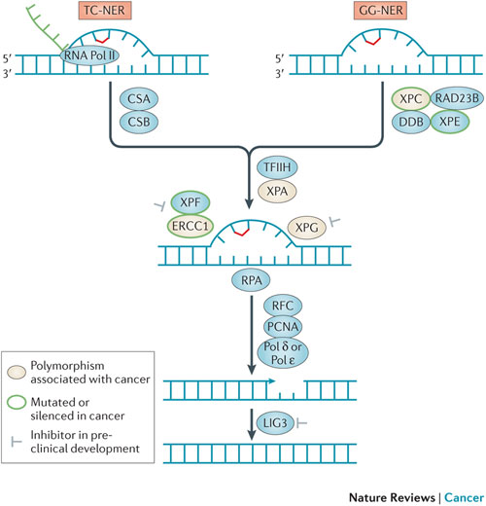
NER
global genomic NER (GG-NER)
Transcription-coupled NER (TC-NER)
Once DNA damage is found repair mech is ± identical

Slide 8
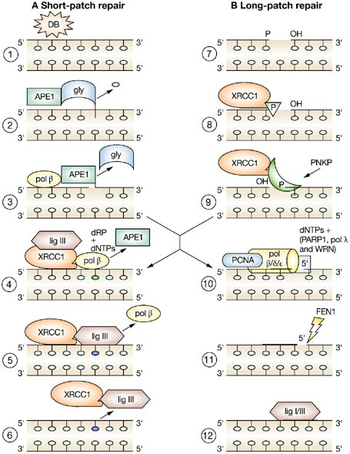
base excision repair fixes
altered and missing bases
1) Enzymes find & remove
bad bases
2) Cell decides on short-patch
vs long-patch repair
Type of lesion?
Type of cell?
3) Short-patch uses pol β to
replace just one base
4) Long-patch uses pol β/δ/ε
to replace 20-30 bases

Slide 9
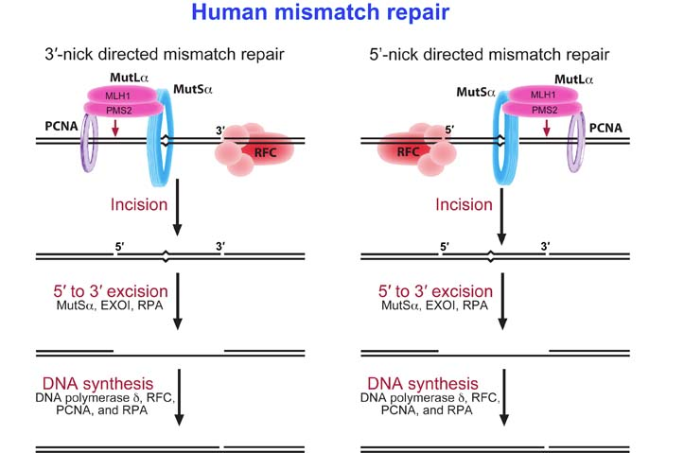
DNA repair
mismatch repair : conserved in ± all organisms
fix new DNA to match old DNA
DNA is modified t/o cell cycle so old DNA has more mods
MutS or homolog recognizes mismatch

Slide 10
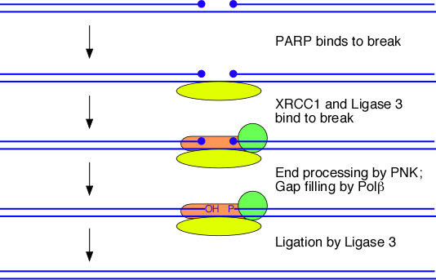
DNA repair
Single-strand break repair
poly (ADP-ribose) polymerase (PARP) binds break
Recruits XRCC1, which recruits Ligase 3
Polynucleotide kinase processes ends
Pol β fills in any resulting gaps, ligase 3 ligates the ends

Slide 11
DNA repair
3 Ways to fix it
Direct reversal
Removal and resynthesis
Recombination : mainly used to repair DS breaks Two options: Homologous & non-homologous end joining

Slide 12
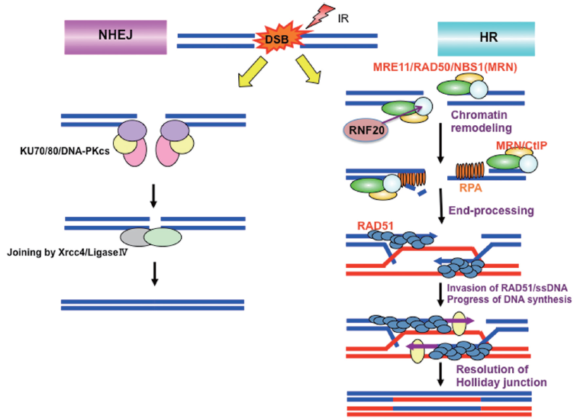
Two options: Homologous & non-homologous end joining

Slide 13
non-homologous end joining
“better than nothing”: join adjacent broken ends hoping they were originally joined
No base-pairing
4 diff. Mechs in yeast

Slide 14
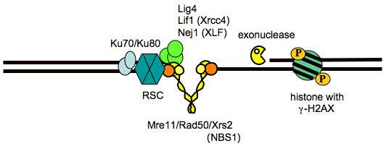
non-homologous end joining
“better than nothing”: join adjacent broken ends hoping they were originally joined
Ku detects & binds DSB

Slide 15
non-homologous end joining
“better than nothing”: join adjacent broken ends hoping they were originally joined
Ku detects & binds DSB
Recruits MRX complex to process ends and make them ligatable

Slide 16
non-homologous end joining
“better than nothing”: join adjacent broken ends hoping they were originally joined
Ku detects & binds DSB
Recruits MRX complex to process ends and make them ligatable
XLF/Xrcc4/Ligase4 joins the ends

Slide 17
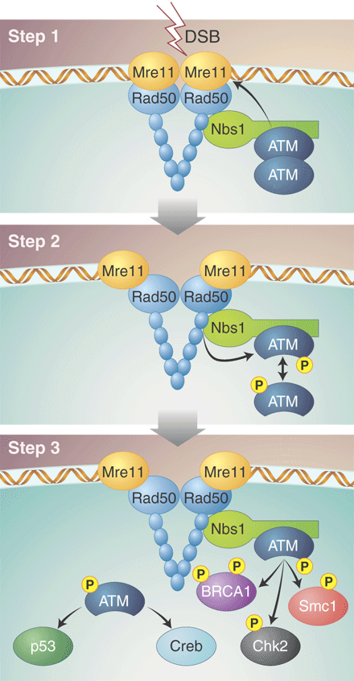
Homologous repair of 2 -strand breaks
MRN finds broken DNA

Slide 18
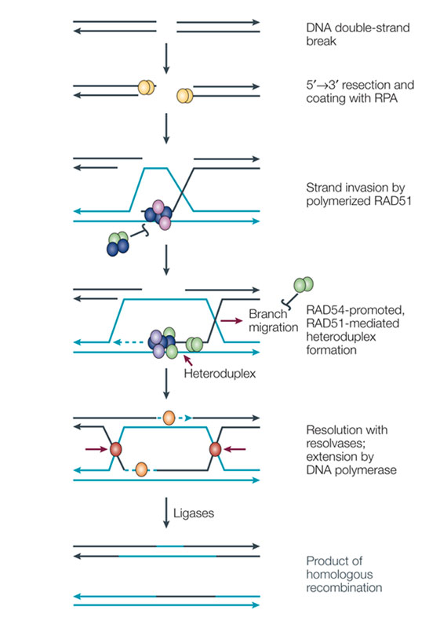
Homologous repair of 2 -strand breaks
MRN finds broken DNA
Several different mechs
depending upon types of
broken ends
All rely on homologous strand to
supply missing info

Slide 19
Homologous repair of 2 -strand breaks
MRN finds broken DNA
Several different mechs
depending upon types of
broken ends
All rely on homologous strand to
supply missing info
3) Resect broken DNA to provide
SS overhangs

Slide 20
Homologous repair of 2 -strand breaks
MRN finds broken DNA
Several different mechs
depending upon types of
broken ends
All rely on homologous strand to
supply missing info
3) Resect broken DNA to provide
SS overhangs
4) SS-DNA (with help of many proteins)
invades homologous strand & uses it
as template

Slide 21
Homologous repair of 2 -strand breaks
MRN finds broken DNA
Several different mechs
depending upon types of
broken ends
All rely on homologous strand to
supply missing info
3) Resect broken DNA to provide
SS overhangs
4) SS-DNA (with help of many proteins)
invades homologous strand & uses it
as template
5) Replicate past missing section

Slide 22
Homologous repair of 2 -strand breaks
MRN finds broken DNA
Several different mechs
depending upon types of
broken ends
All rely on homologous strand to
supply missing info
3) Resect broken DNA to provide
SS overhangs
4) SS-DNA (with help of many proteins)
invades homologous strand & uses it
as template
5) Replicate past missing section
D-loop binds top strand & forms
template for missing information

Slide 23
Homologous repair of 2 -strand breaks
MRN finds broken DNA
Several different mechs
depending upon types of
broken ends
All rely on homologous strand to
supply missing info
3) Resect broken DNA to provide
SS overhangs
4) SS-DNA (with help of many proteins)
invades homologous strand & uses it
as template
5) Replicate past missing section
D-loop binds top strand & forms
template for missing information
6) Resolvases cut & ligate the x-overs

Slide 24
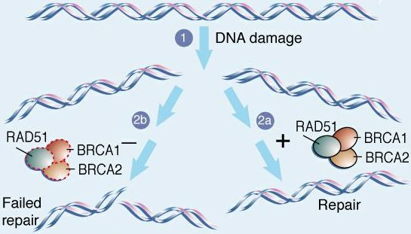
DNA Repair
Clinical significance
Important for preventing cancers
Many genetic disorders are due to bad DNA repair
bad BRCA1 or BRCA2 predispose to cancer

Slide 25
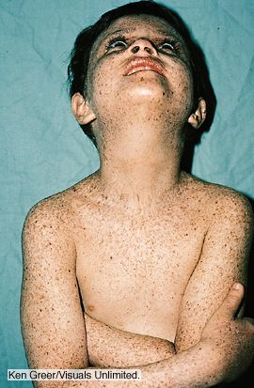
DNA Repair
Many human genetic disorders are due to DNA repair
bad BRCA1 or BRCA2 predispose to
cancer
GG-NER defects cause
Xeroderma Pigmentosum
11 genes have "same"
Phenotype
TC-NER defects cause Cockayne
Syndrome

Slide 26
DNA Repair
Many genetic disorders are due to bad DNA repair
bad BRCA1 or BRCA2 predispose to cancer
bad NER causes Xeroderma Pigmentosum
11 genes have
"same” effect
bad mismatch
repair causes
hereditary
nonpolyposis
colon cancer

Slide 27
GMO vs Gene Editing
GMO: adding a new gene from a different organism
Usually also add a selectable marker to select for transgenics
Concerns about transfer to unwanted organisms
Concerns about effects on humans
Concerns about inbreeding
Concerns about unanticipated consequences
Gene editing: modifying a gene that was already there
Not (necessarily) adding extra genes
USDA won’t regulate because thinks that they ”could otherwise have been developed through traditional breeding techniques.”
Notes:
Acquired (learned) versus innate immunity

Slide 28
Gene Editing
Gene editing: modifying a gene that was already there
Requires knowledge of the sequence that you wish to modify
Requires way to cut it precisely
Notes:
Acquired (learned) versus innate immunity

Slide 29
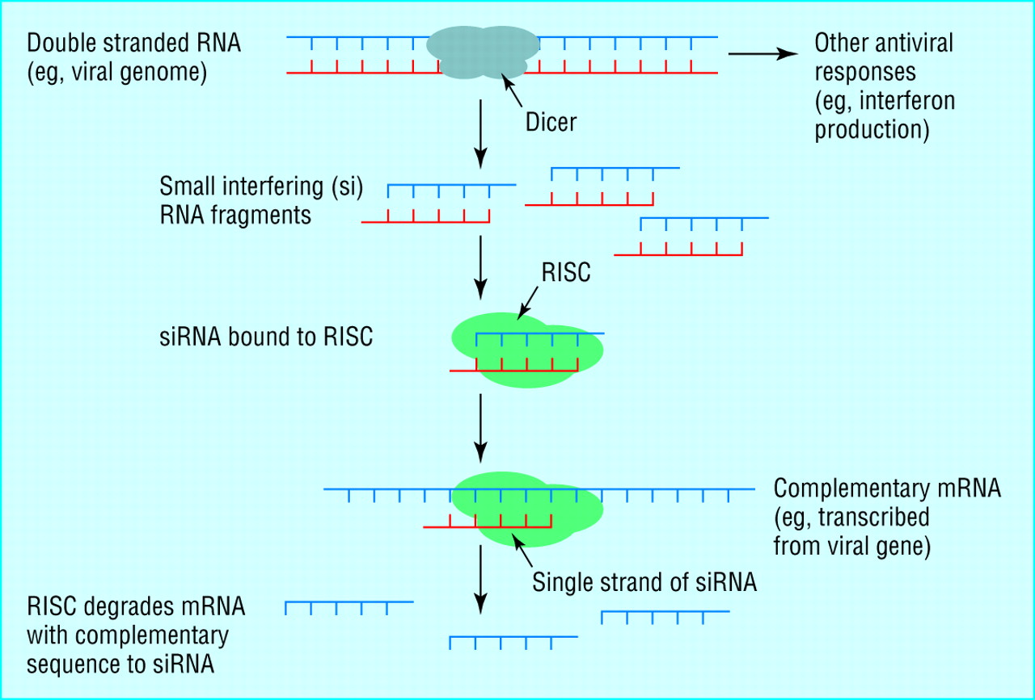
Gene Editing
Gene editing: modifying a gene that was already there
Requires knowledge of the sequence that you wish to modify
Requires way to cut it precisely
RNA interference was original approach for targeting genes
Virus defense
Notes:
Acquired (learned) versus innate immunity

Slide 30
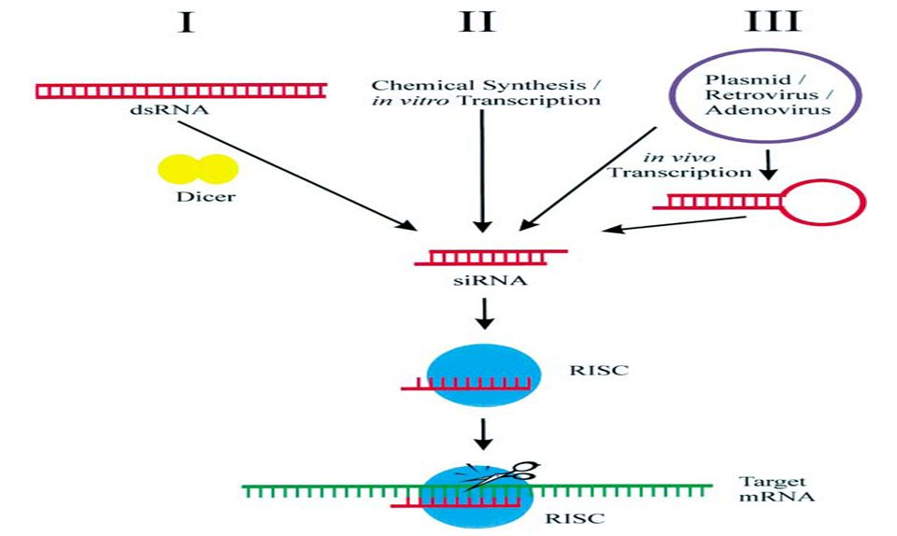
Gene Editing
Gene editing: modifying a gene that was already there
Requires knowledge of the sequence that you wish to modify
Requires way to cut it precisely
RNA interference was original approach for targeting genes
Virus defense
Can target any gene by making dsRNA: in cell or in vitro
Way to silence gene families
Notes:
Acquired (learned) versus innate immunity

Slide 31
Gene Editing
RNA interference was original approach for targeting genes
Virus defense
Can target any gene by making dsRNA: in cell or in vitro
Way to silence gene families
Used to create many mutants by co-suppression
Notes:
Also created many mutants by co-suppresson

Slide 32
Gene Editing
RNA interference was original approach for targeting genes
Virus defense
Can target any gene by making dsRNA: in cell or in vitro
Way to silence gene families
Used to create many mutants by co-suppression
Has been used to modify rice starch composition
Notes:
Also created many mutants by co-suppresson

Slide 33
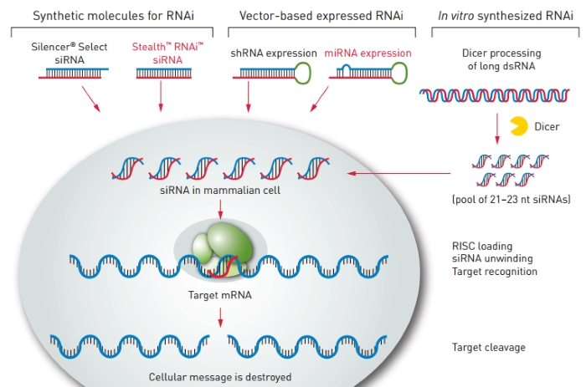
Gene Editing
RNA interference was original approach for targeting genes
Can target any gene by making dsRNA: in cell or in vitro
Way to silence gene families
Knocks genes down but not out
Must deliver RNA
Requires transgene or regular application of ds RNA
Notes:
Acquired (learned) versus innate immunity

Slide 34
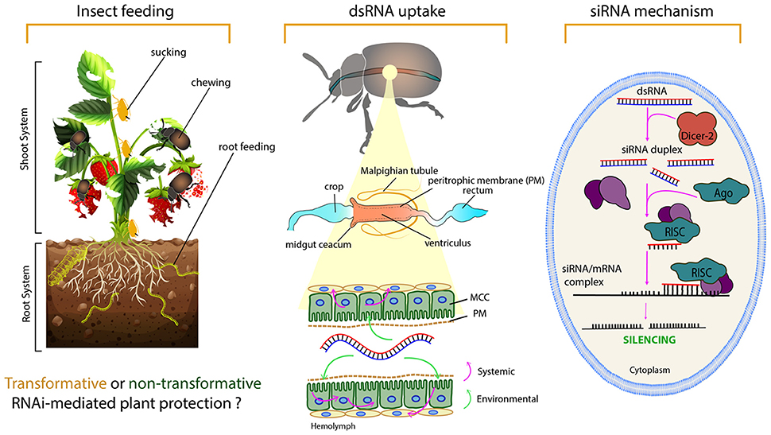
Gene Editing
RNA interference was original approach for targeting genes
Can target any gene by making dsRNA: in cell or in vitro
Way to silence gene families
Knocks genes down but not out
Must deliver RNA
Propose spraying plants with dsRNA as alternative to GMO
Notes:
Acquired (learned) versus innate immunity

Slide 35
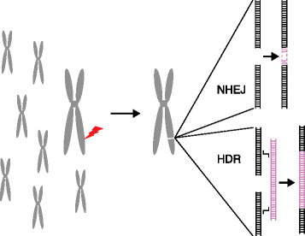
Gene Editing
Gene editing: modifying a gene that was already there
Requires knowledge of the sequence that you wish to modify
Requires way to cut it precisely
Four types of engineered nucleases have been developed that cut specific genomic sequences
DNA repair then creates mutations while fixing the break
Notes:
Acquired (learned) versus innate immunity

Slide 36
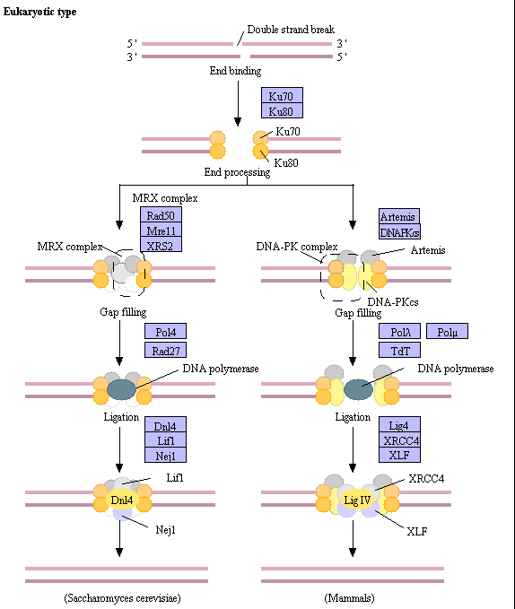
Gene Editing
DNA repair then creates mutations while fixing the break
Non-homologous end-joining is error-prone
Notes:
Acquired (learned) versus innate immunity

Slide 37
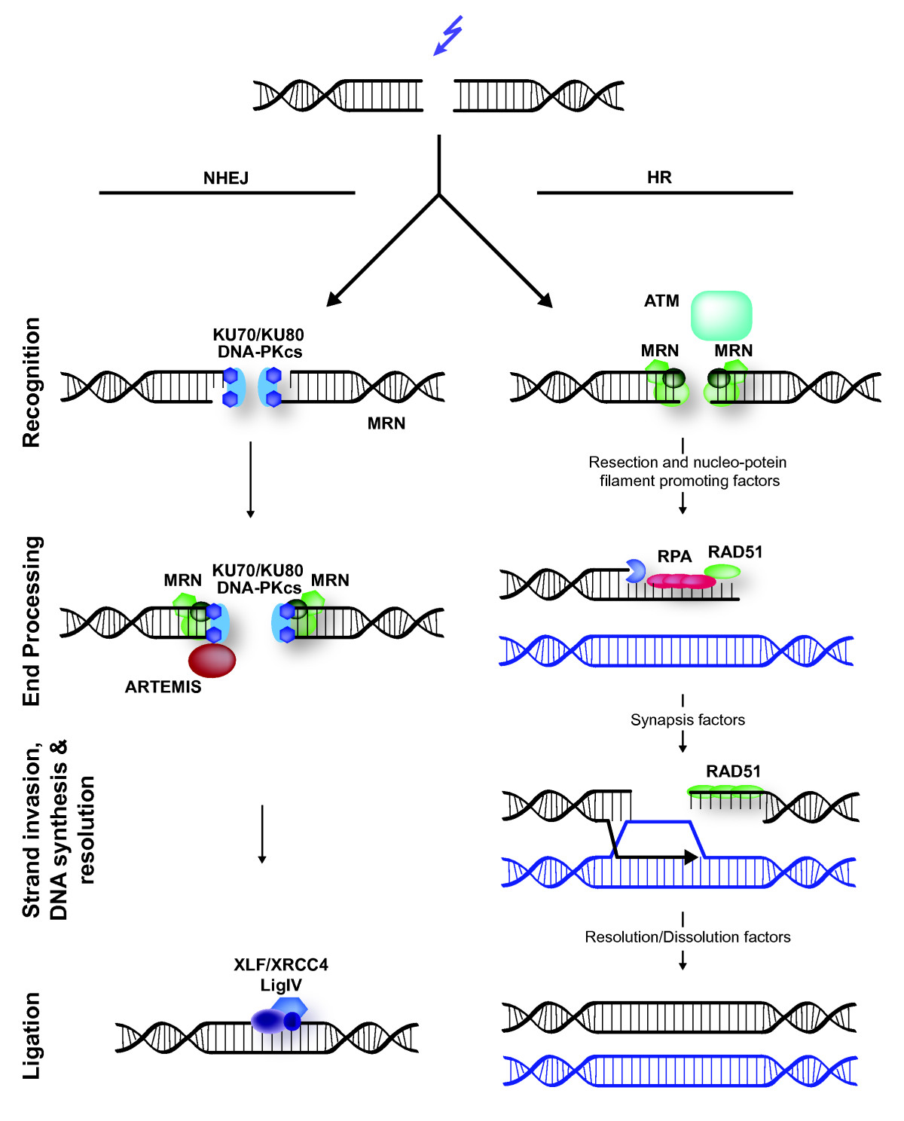
Gene Editing
DNA repair then creates mutations while fixing the break
Non-homologous end-joining is error-prone
Homologous DNA repair can replace DNA if a template is supplied
Notes:
Acquired (learned) versus innate immunity

Slide 38
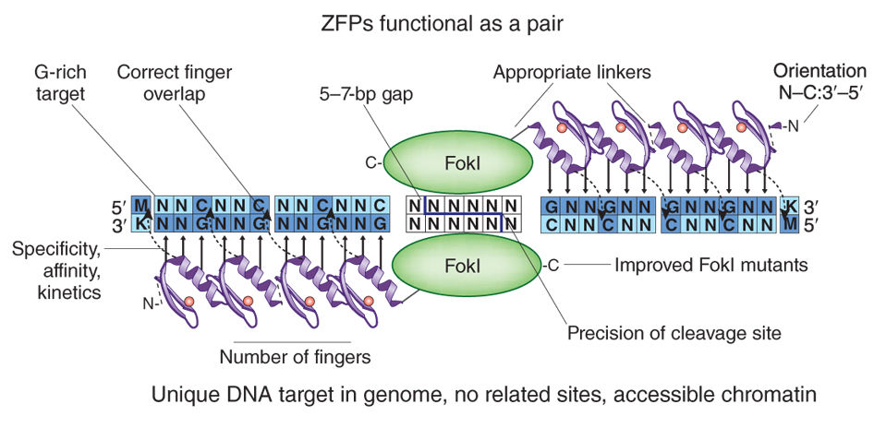
Gene Editing
Four types of engineered nucleases have been developed that cut specific genomic sequences
Zn- finger nucleases came first
Fuse Zn-finger DNA binding domains with a nuclease domain
Each ~30 aa finger binds 3 bp, total monomer is ~ 300 aa
Notes:
Remarkable ability to mix and match domains! Can swap DNA-binding domain of FokI for Zn finger and works
FokI nuclease domain must dimerise to cleave
Need a spacer of 5-7 bp between binding sites

Slide 39
Gene Editing
Four types of engineered nucleases have been developed that cut specific genomic sequences
Zn- finger nucleases came first
Fuse Zn-finger DNA binding domains with a nuclease domain
Each ~30 aa finger binds 3 bp, total monomer is ~ 300 aa
1800 bp of cds to encode a heterodimer pair: small enough to deliver as mRNA or in a virus
Notes:
FokI nuclease domain must dimerise to cleave
Need a spacer of 5-7 bp between binding sites

Slide 40
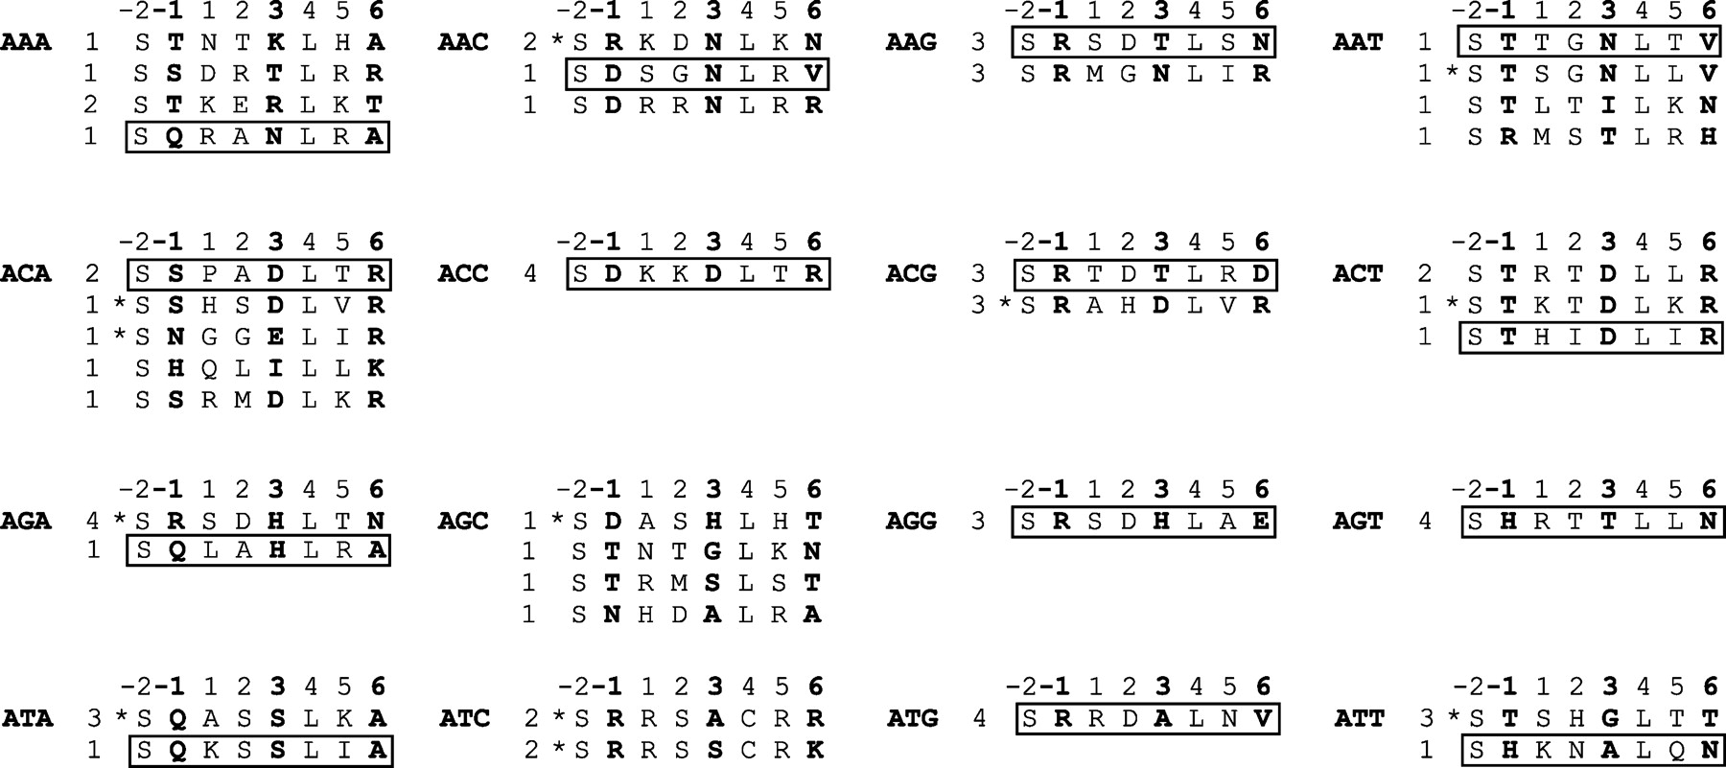
Gene Editing
Four types of engineered nucleases have been developed that cut specific genomic sequences
Zn- finger nucleases came first
Fuse Zn-finger DNA binding domains with a nuclease domain
Each ~30 aa finger binds 3 bp
Can mix and match fingers to target specific sequences
Notes:
FokI nuclease domain must dimerise to cleave
Need a spacer of 5-7 bp between binding sites

Slide 41
Gene Editing
Zn- finger nucleases came first
Fuse Zn-finger DNA binding domains with a nuclease domain
Each ~30 aa finger binds 3 bp
Can mix and match fingers to target specific sequences
Can substitute activation or repression domains
Notes:
Acquired (learned) versus innate immunity

Slide 42
Gene Editing
Zn- finger nucleases came first
Can mix and match fingers to target specific sequences
Can substitute activation or repression domains
Can create nickases by inactivating a nuclease domain
Notes:
Disrupted myostatin gene that is a negative regulator of muscle development

Slide 43
Gene Editing
Zn- finger nucleases came first
Can mix and match fingers to target specific sequences
Can substitute activation or repression domains
Can create nickases by inactivating a nuclease domain
Has been used to edit glyphosate resistance genes
Notes:
Glyphosate = roundup

Slide 44
Gene Editing
Zn- finger nucleases came first
Can mix and match fingers to target specific sequences
Can substitute activation or repression domains
Can create nickases by inactivating a nuclease domain
Has been used to edit glyphosate resistance genes
Has been used to create super-muscly pigs & cattle
Notes:
Disrupted myostatin gene that is a negative regulator of muscle development

Slide 45
Gene Editing
Zn- finger nucleases came first
Has been used to edit glyphosate resistance genes
Has been used to create super-muscly pigs & cattle
Has been used to control AIDS by disrupting CCR5
Notes:
Disrupted myostatin gene that is a negative regulator of muscle development

Slide 46
Gene Editing
Zn- finger nucleases came first
Has been used to edit glyphosate resistance genes
Has been used to create super-muscly pigs & cattle
Has been used to control AIDS by disrupting CCR5
Problems
Specificity of Zn fingers difficult to predict, must test
Notes:
Sepcificity varies by context

Slide 47
Gene Editing
Zn- finger nucleases came first
Problems
Specificity of Zn fingers difficult to predict, must test
Off-target cutting, especially sites that only differ by 1-2 bp
Notes:
Sepcificity varies by context

Slide 48
Gene Editing
Zn- finger nucleases came first
Problems
Specificity of Zn fingers difficult to predict, must test
Off-target cutting, especially sites that only differ by 1-2 bp
Expensive, laborious & slow to make constructs
Notes:
Sepcificity varies by context

Slide 49
Gene Editing
Zn- finger nucleases came first
Problems
Specificity of Zn fingers difficult to predict, must test
Off-target cutting, especially sites that only differ by 1-2 bp
Expensive, laborious & slow to make constructs
Low efficiency
Notes:
Sepcificity varies by context

Slide 50
Gene Editing
Zn- finger nucleases came first
Problems
Specificity of Zn fingers difficult to predict, must test
Off-target cutting, especially sites that only differ by 1-2 bp
Expensive, laborious & slow to make constructs
Low efficiency, chromatin accessibility?
Notes:
Sepcificity varies by context

Slide 51
Gene Editing
Zn- finger nucleases came first
Specificity of Zn fingers difficult to predict, must test
Off-target cutting, especially sites that only differ by 1-2 bp
Expensive, laborious & slow to make constructs
Low efficiency, chromatin accessibility?
Sigma-Aldritch offers custom service for animals
Notes:
Sepcificity varies by context

Slide 52
Gene Editing
Four types of engineered nucleases have been developed that cut specific genomic sequences
Zn- finger nucleases came first
Meganucleases
R.E.s that bind and cut sites 12-40 bp long
Notes:
First that were tried in plants

Slide 53
Gene Editing
Four types of engineered nucleases have been developed that cut specific genomic sequences
Zn- finger nucleases came first
Meganucleases
R.E.s that bind and cut sites 12-40 bp long
Only ~165 aa: can easily deliver
Notes:
First that were tried in plants

Slide 54
Gene Editing
Four types of engineered nucleases have been developed that cut specific genomic sequences
Zn- finger nucleases came first
Meganucleases
R.E.s that bind and cut sites 12-40 bp long
Only ~165 aa: can easily deliver
Difficult to engineer to bind new sites
Binding & cleavage sites overlap
Need to mutagenize & screen for desired specificities
Notes:
First that were tried in plants

Slide 55
Gene Editing
Four types of engineered nucleases have been developed that cut specific genomic sequences
Zn- finger nucleases came first
Meganucleases
R.E.s that bind and cut sites 12-40 bp long
Only ~165 aa: can easily deliver
Difficult to engineer to bind new sites
Binding & cleavage sites overlap
Need to mutagenize & screen for desired specificities
Can work backwards: engineer site into transgene & use it to “stack” more transgenes at same site
Notes:
First that were tried in plants

Slide 56
Gene Editing
Four types of engineered nucleases have been developed that cut specific genomic sequences
Zn- finger nucleases came first
Meganucleases
TALENS (Transcription activator-like effector nucleases)
Derived from Xanthomonas TAL effectors
DNA-binding proteins excreted by Xanthomonas
Notes:
First that were tried in plants

Slide 57
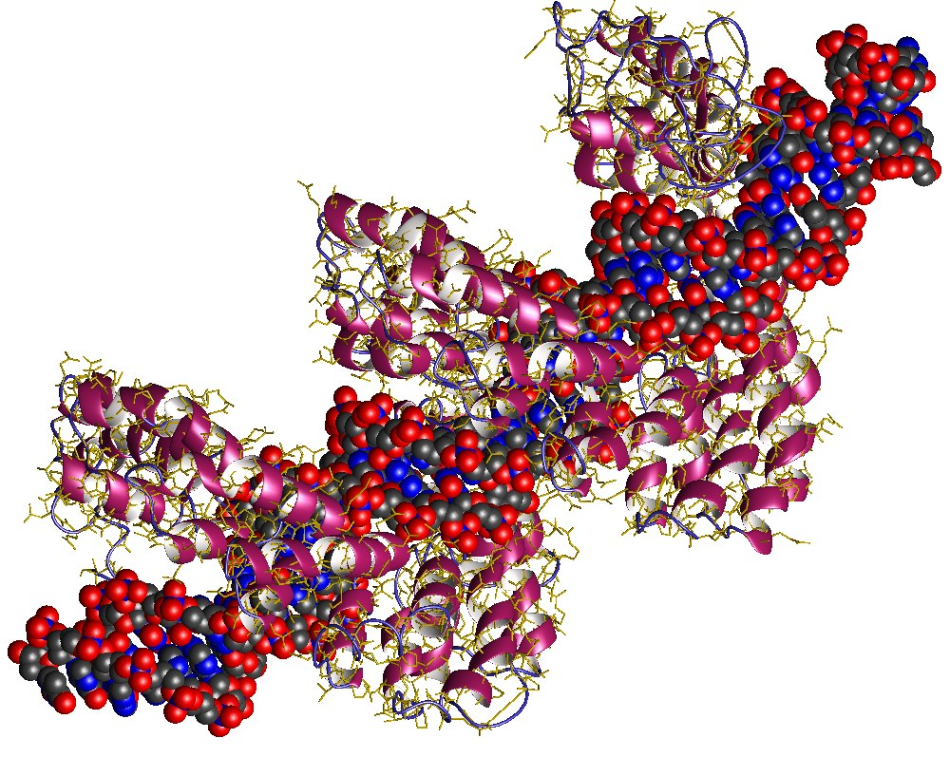
Gene Editing
TALENS (Transcription activator-like effector nucleases)
Derived from Xanthomonas TAL effectors
DNA-binding proteins excreted by Xanthomonas
Bind and activate specific plant host genes
Notes:
First that were tried in plants

Slide 58
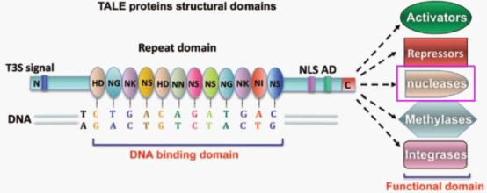
Gene Editing
TALENS (Transcription activator-like effector nucleases)
Derived from Xanthomonas TAL effectors
DNA-binding proteins excreted by Xanthomonas
Bind and activate specific plant host genes
Have 34 aa repeats that each bind a single base
Binding sites are > 30bp!
Notes:
But have engineered TALENS with 22 aa and 27 aa repeats

Slide 59
Gene Editing
TALENS (Transcription activator-like effector nucleases)
Derived from Xanthomonas TAL effectors
DNA-binding proteins excreted by Xanthomonas
Bind and activate specific plant host genes
Have 34 aa repeats that each bind a single base
Binding sites are > 30bp!
Variable residues 12 & 13 determine specificity
Notes:
First that were tried in plants

Slide 60
Gene Editing
TALENS (Transcription activator-like effector nucleases)
DNA-binding proteins excreted by Xanthomonas
Bind and activate specific plant host genes
Have 34 aa repeats that each bind a single base
Binding sites are > 30bp!
Variable residues 12 & 13 determine specificity
Can mix and match to bind any site you want!
Notes:
First that were tried in plants

Slide 61
Gene Editing
TALENS (Transcription activator-like effector nucleases)
Bind and activate specific plant host genes
Have 34 aa repeats that each bind a single base
Binding sites are > 30bp!
Variable residues 12 & 13 determine specificity
Can mix and match to bind any site you want!
Can fuse DNA binding domain to many functional domains
Notes:
First that were tried in plants

Slide 62
Gene Editing
TALENS (Transcription activator-like effector nucleases)
Bind and activate specific plant host genes
Have 34 aa repeats that each bind a single base
Binding sites are > 30bp!
Variable residues 12 & 13 determine specificity
Can mix and match to bind any site you want!
Can fuse DNA binding domain to many functional domains
TALENS fuse to Fok I nuclease
Notes:
First that were tried in plants

Slide 63
Gene Editing
TALENS (Transcription activator-like effector nucleases)
TALENS fuse to Fok I nuclease
Have been used to genetically engineer many plant species
Notes:
First that were tried in plants

Slide 64
Gene Editing
TALENS (Transcription activator-like effector nucleases)
TALENS fuse to Fok I nuclease
Have been used to genetically engineer many plant species
Pro
Very specific: very few offsite mutations
Notes:
First that were tried in plants

Slide 65
Gene Editing
TALENS (Transcription activator-like effector nucleases)
TALENS fuse to Fok I nuclease
Have been used to genetically engineer many plant species
Pro
Very specific: very few offsite mutations
Can target any sequence
Notes:
First that were tried in plants

Slide 66
Gene Editing
TALENS (Transcription activator-like effector nucleases)
Pro
Very specific: very few offsite mutations
Can target any sequence
Con
Protein is huge: difficult to deliver, usually needs transgenics
Notes:
Last November reported genome editing in potato by transient expression after Agro-infiltration. Got editing without stable integration.

Slide 67
Gene Editing
TALENS (Transcription activator-like effector nucleases)
Pro
Very specific: very few offsite mutations
Can target any sequence
Con
Protein is huge: difficult to deliver, usually needs transgenics
Design & synthesis is very time-consuming
Notes:
Last November reported genome editing in potato by transient expression after Agro-infiltration. Got editing without stable integration.

Slide 68
Gene Editing
TALENS (Transcription activator-like effector nucleases)
Pro
Very specific: very few offsite mutations
Can target any sequence
Con
Protein is huge: difficult to deliver, usually needs transgenics
Design & synthesis is very time-consuming
Sensitive to methylation of target DNA
Notes:
Last November reported genome editing in potato by transient expression after Agro-infiltration. Got editing without stable integration.

Slide 69
Gene Editing
TALENS (Transcription activator-like effector nucleases)
Pro
Very specific: very few offsite mutations
Can target any sequence
Con
Protein is huge: difficult to deliver, usually needs transgenics
Design & synthesis is very time-consuming
Sensitive to methylation of target DNA
Inefficient
Notes:
Last November reported genome editing in potato by transient expression after Agro-infiltration. Got editing without stable integration.

