Slide 1
Runners/walkers needed for “Relay for Heat “ on Saturday
Continues all day
Run/walk when you feel like it
Help needed for Chester Street Elementary School's STEAM Day
Science stuff with 1st – 5th graders
10-3:30 on Friday March 29
Help needed for dissecting frogs with 7th graders on Friday April 5
8:30- 10:30 in CSC223

Slide 2
Next Assignment: Wed March 27?
GMO organisms for fun and profit
Animals making useful biochemicals
Intrinsic antimicrobial properties of silk spun by genetically modified silkworm strains https://link.springer.com/article/10.1007/s11248-018-0059-0
Double knockout pigs deficient in N‐glycolylneuraminic acid and Galactose α‐1,3‐Galactose reduce the humoral barrier to xenotransplantation https://doi.org/10.1111/xen.12019
Super-muscly sheep and cattle by genome editing; https://link.springer.com/article/10.1007%2Fs11248-014-9832-x
The transgenic expression of human follistatin-344 increases skeletal muscle mass in pigs https://link.springer.com/article/10.1007/s11248-016-9985-x
Goats that make human antithrombin in their milk. doi:10.1051/rnd:2006029.

Slide 3
GMO organisms for fun and profit
First set the stage: what was previously known, and what did they set out to learn?
Will probably need to read other papers or review articles
Next describe what they did and how the did it
Next describe their results
Finish by discussing their results: what does this mean? What should they do next?

Slide 4
/ 18 Content
/ 2 Organization?
/ 1 Introduction?
/ 5 Quantity of material presented?
/ 5 Quality of material presented?
/ 2 Clarity?
/ 1 Understanding?
/ 2 use of images
/ 7 Mechanics
/ 1 Confidence
/1 Diction & volume
/ 1 Interaction with audience
/ 1 Pace
/ 1 poise, mannerisms
/ 1 Time?
/ 1 Quality of answers
Total: /25 = pts

Slide 5
Why bioengineer a gene to function in a new host?
1. Produce a useful chemical in a more tractable host
Often eukaryotic protein eg insulin in prokaryotes

Slide 6
Why bioengineer a gene to function in a new host?
1. Produce a useful chemical in a more tractable host
Often eukaryotic protein eg insulin in prokaryotes
Sometimes eukaryotic protein in another eukaryote

Slide 7
Why bioengineer a gene to function in a new host?
1. Produce a useful chemical in a more tractable host
Often eukaryotic protein eg insulin in prokaryotes
Sometimes eukaryotic protein in another eukaryote
2. Add a useful attribute to a commercially important organism
Herbicide resistance to crops

Slide 8
Why bioengineer a gene to function in a new host?
1. Produce a useful chemical in a more tractable host
Often eukaryotic protein eg insulin in prokaryotes
Sometimes eukaryotic protein in another eukaryote
2. Add a useful attribute to a commercially important organism
Herbicide resistance to crops
Insect resistance to crops

Slide 9
Why bioengineer a gene to function in a new host?
1. Produce a useful chemical in a more tractable host
Often eukaryotic protein eg insulin in prokaryotes
Sometimes eukaryotic protein in another eukaryote
2. Add a useful attribute to a commercially important organism
Herbicide resistance to crops
Insect resistance to crops
World of other possibilities

Slide 10
How to bioengineer a gene to function in a new host?
1. Must be able to transform DNA into new host
2. Sequences must function in the new host
Must be replicated
New host must be able to “read” the sequence
Functional promoters &
terminators
Functional capping and
splice sites
Correct codon usage

Slide 11
How to bioengineer a gene to function in a new host?
1. Must be able to transform DNA into new host
2. Sequences must function in the new host
3. Protein must function in the new host
Must be translated
Must be modified correctly
Glycosylation
Fatty-acylation
Proteolysis
Di-sulfide bond formation
Must go to correct organelle

Slide 12
How to bioengineer a gene to function in a new host?
1. Must be able to transform DNA into new host
2. Sequences must function in the new host
3. Protein must function in the new host
4. Identify suitable gene(s), then obtain or have synthesized, add suitable promoters and terminators, then transform into new host.
5. Also need to add selectable marker, or other way to recognize hosts that have taken it up.

Slide 13
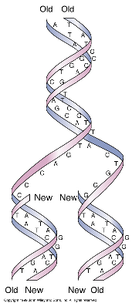
DNA REPLICATION
WC: DNA replication is
semi-conservative
strands melt: form templates
for copy
Copy is reverse &
complement of template
Copy of other strand

Slide 14
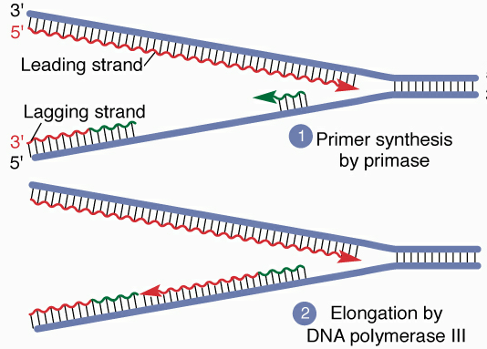
DNA replication
1) where to begin?
2) “melting”
3) “priming”
4) DNA replication

Slide 15
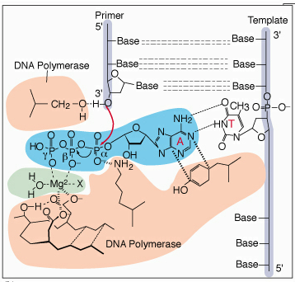
DNA replication
Template holds next base
until make bond
only correct base fits
- energy comes from 2 PO₄

Slide 16
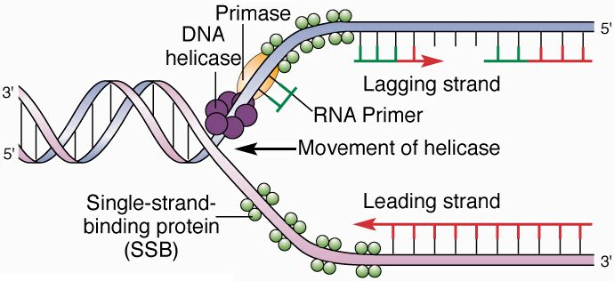
Leading and Lagging Strands
Make lagging strand opposite way
wait for DNA to melt, then make Okazaki fragments
each Okazaki fragment has its own primer
made discontinuously

Slide 17
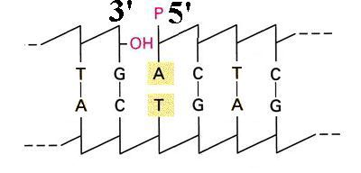
Okazaki fragments grow until hit one in front
RNAse H removes primer & gap is filled
DNA ligase joins fragments

Slide 18
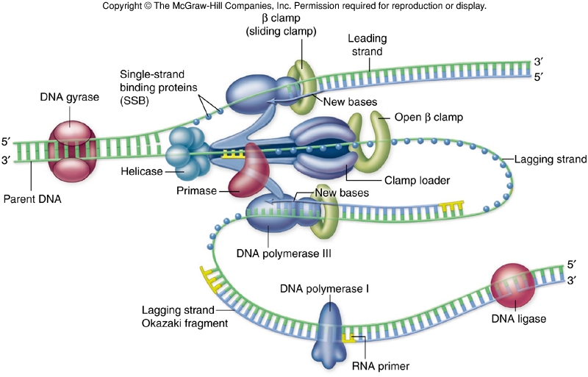
DNA replication
Proteins replicating both strands are in replisome: feed DNA through it
lagging strand loops out so make both strands in same direction

Slide 19
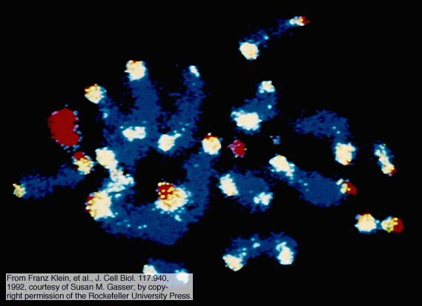
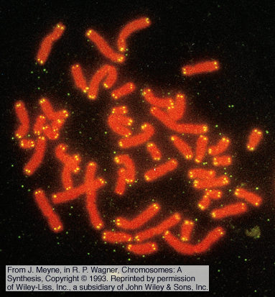
Telomeres
sequences at chromosome ends
humans have 250-7,000 repeats of CCCTAA
special proteins bind them

Slide 20
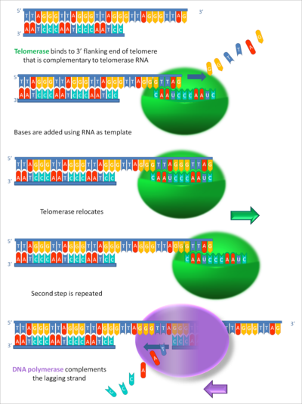
Telomerase
RNA bonds leading strand
2) Forms template to
extend leading strand
3) Translocates
6 bases & repeats
4) Extend lagging strand
with primer & DNA pol

Slide 21
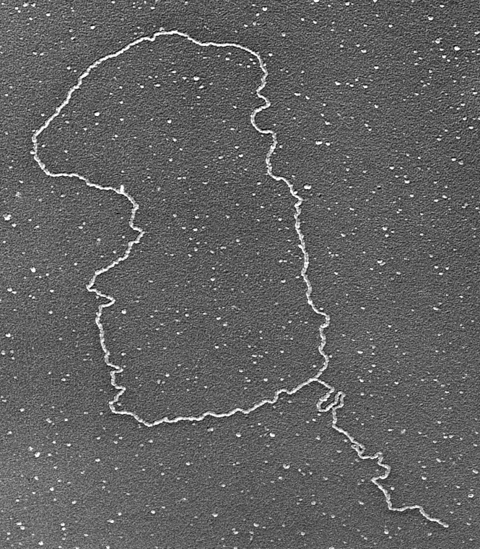
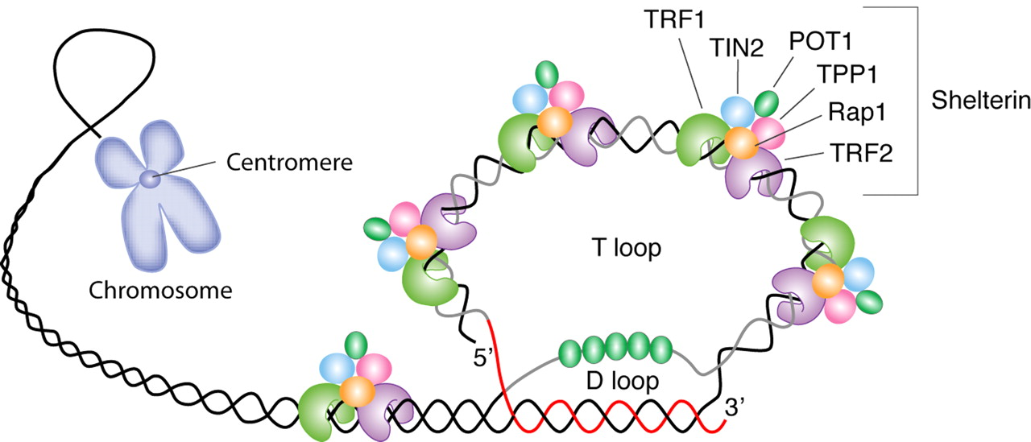
Telomere structure
Bound by complex called the telosome
Proposed to form T-loop structure IF
long enough
G-rich SS-DNA invades and displaces
C-rich strand
POT1 binds & protects D-loop
If can’t form T-loop trigger apoptosis

Slide 22
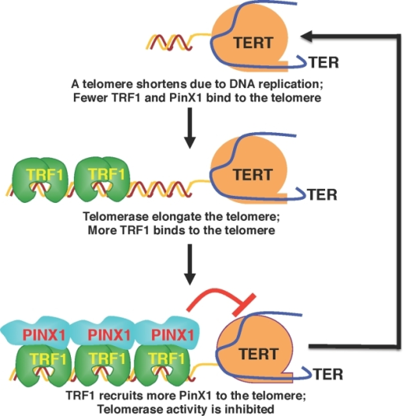
Telomere Length Maintenance
Telomere length proposed to be regulated by TRF1 & PINX1
If too short, not enough TRF1
bind so telomerase is active
Once long enough TRF1 binds
telomere
PINX1 then binds TRF1 &
stops telomerase

Slide 23
Telomeres
Cancer cells must maintain telomere length
90% reactivate telomerase
[serum telomerase] can diagnose cancer
Inhibiting telomerase kills most cancer cells
Telomerase is symptom cf cause of cancer
not viewed as good target for cancer therapy

Slide 24
Telomeres
10 % of cancer cells lengthen telomeres by alternative mechanism involving homologous recombination
See high frequency of SCE at telomeres in ALT cells
Also see high frequency of telomere fragments
Substrates for HR and telomere elongation
Key common feature = chromatin remodeling allowing HR
Perhaps due to depletion of shelterin, especially TRF2

Slide 25
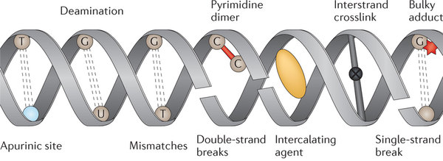
DNA damage
DNA gets damaged a lot!

Slide 26
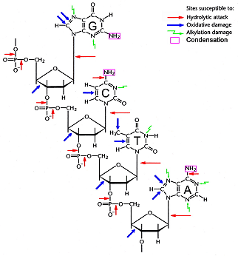
DNA damage
DNA gets damaged a lot!

Slide 27
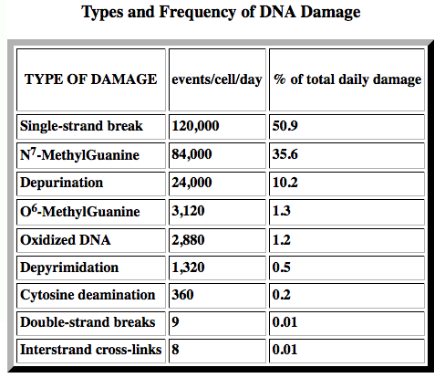
DNA damage
DNA gets damaged a lot! >200,000 events/human cell/day

Slide 28
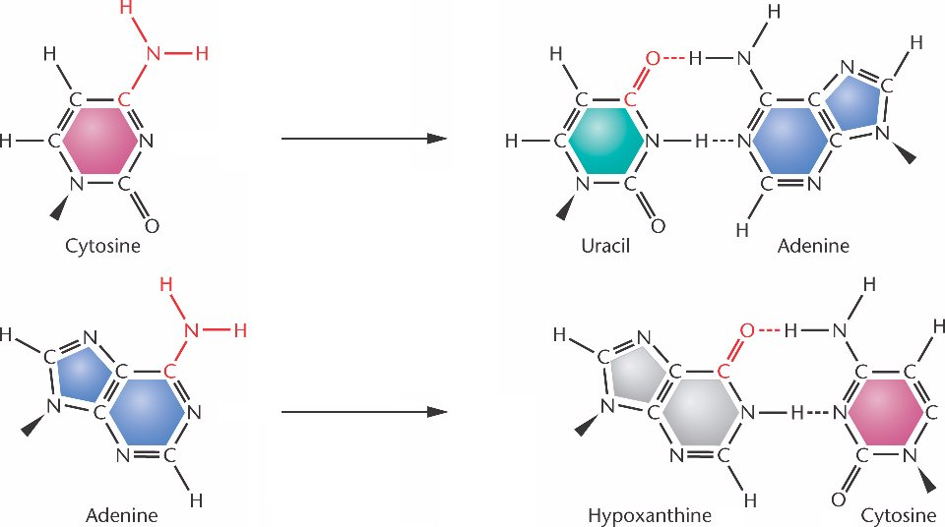
DNA damage
Occurs 2 ways
1) spontaneously

Slide 29
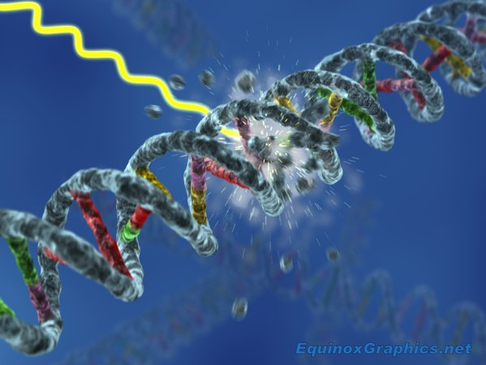
DNA damage
Occurs 2 ways
1) spontaneously
2) mutagens : damage DNA

Slide 30
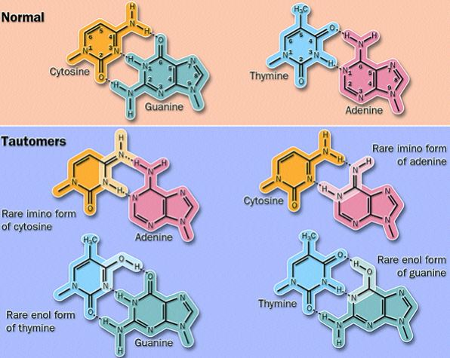
Spontaneous mutations
1) In S
a) mispairs
C tautomers
bind A
T tautomers
bind G

Slide 31
Spontaneous mutations
1) In S
a) mispairs
C tautomers
bind A
T tautomers
bind G
1/10⁶

Slide 32
Spontaneous mutations
1) In S
a) mispairs
C tautomers
bind A
T tautomers
bind G
1/10⁶
6000/S

Slide 33
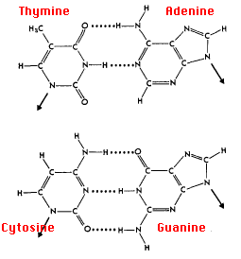
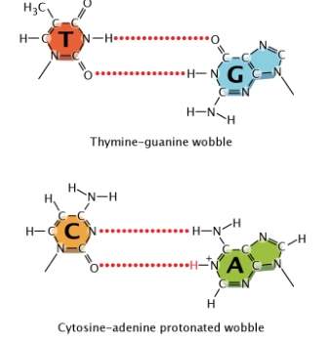
Spontaneous mutations
Wobbling: no numbers!

Slide 34
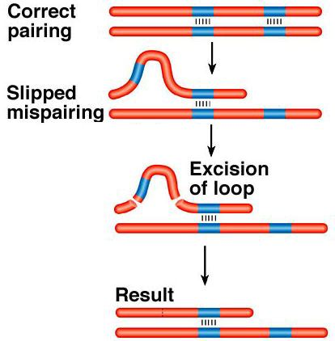
Spontaneous mutations
1) In S
a) mispairs
b) misaligned bases

Slide 35
Spontaneous mutations
1) In S
a) mispairs
b) misaligned bases
-> indels

Slide 36
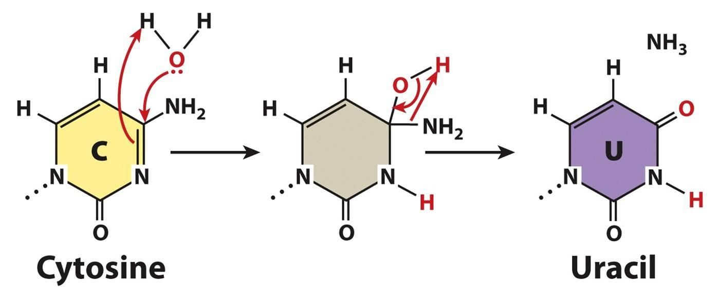
Spontaneous mutations
1) In S
a) mispairs
b) misaligned bases -> indels
2) Hydrolysis
a) C deaminates to U

Slide 37
Spontaneous mutations
2) Hydrolysis
a) C deaminates to U
100-500/cell/day

Slide 38
Spontaneous mutations
2) Hydrolysis
C deaminates to U
5-meC deaminates to T!

Slide 39
Spontaneous mutations
2) Hydrolysis
C deaminates to U
5-meC deaminates to T!
Adenine deaminates to hypoxanthine: bonds C!

Slide 40
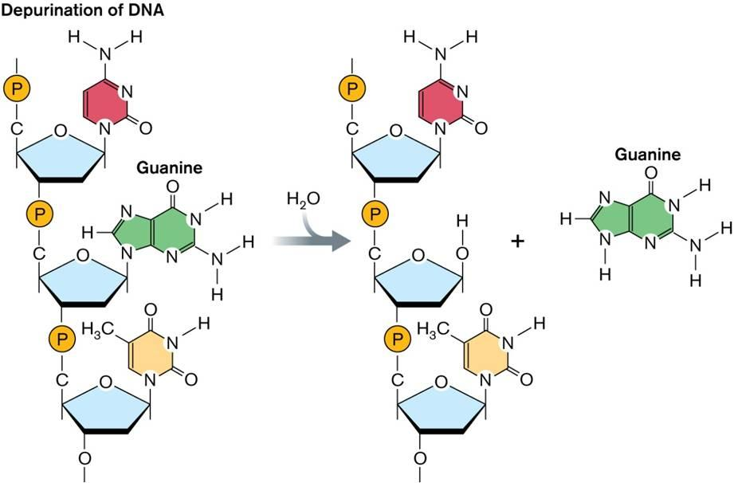
Spontaneous mutations
2) Hydrolysis
a) C deaminates to U
100-500/cell/day
b) Depurination (lose A or G) (also depyrimidation, but 20 x less)

Slide 41
Spontaneous mutations
2) decomposition
a) C deaminates to U
100-500/cell/day
b) Depurination (lose A or G) (also depyrimidation, but 20 x less)
Replace missing base randomly

Slide 42
decomposition
a) C deaminates to U 100-500/cell/day
b) Depurination (lose A or G) (also depyrimidation, but 20 x less)
Replace missing base randomly
10,000 – 50,000 depurinations /cell / day
1,000 – 3,000 depyrimidations /cell / day

Slide 43
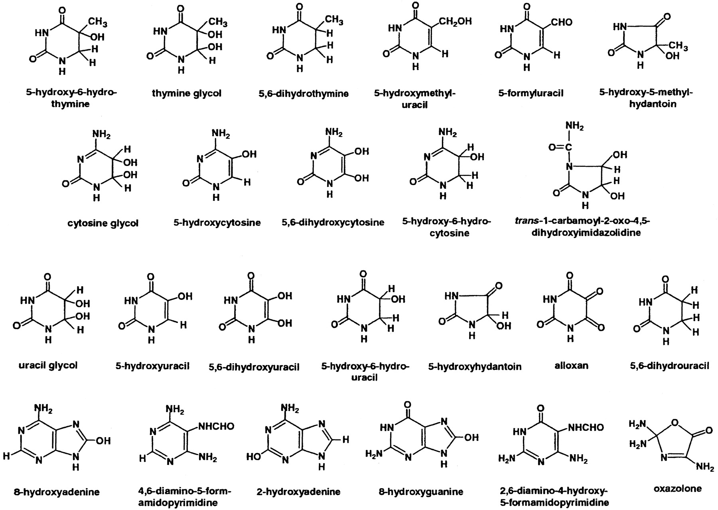
Spontaneous mutations
2) decomposition
3) Oxidation: > 20 base lesions due to oxidation have been identified

Slide 44
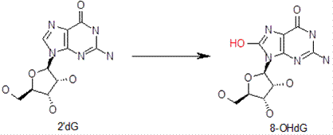
Spontaneous mutations
2) decomposition
3) Oxidation: > 20 base lesions due to oxidation have been identified
G is most reactive: most frequent lesion is 8-hydroxy G

Slide 45
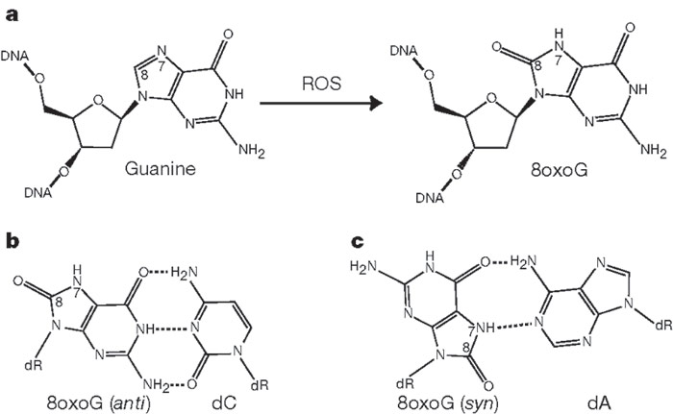
Spontaneous mutations
2) decomposition
3) Oxidation: > 20 base lesions due to oxidation have been identified
G is most reactive: most frequent lesion is 8-hydroxy G
8oxoG (syn) bonds A well enough to evade proofreading!

Slide 46
Spontaneous mutations
3) Oxidation: > 20 base lesions due to oxidation have been identified
G is most reactive: most frequent lesion is 8-hydroxy G
8oxoG (syn) bonds A well enough to evade proofreading!
(8oxoG (anti) bonded to C gets removed!)

Slide 47
Mutagens harm DNA
2 classes
1) Radiation

Slide 48
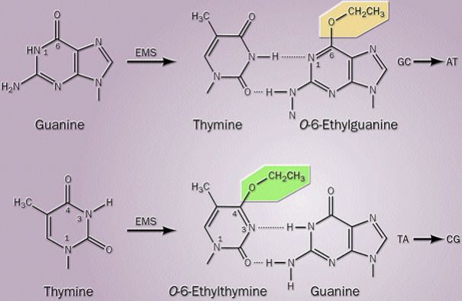
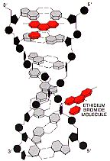
Mutagens harm DNA
2 classes
1) Radiation
2) chemicals

Slide 49
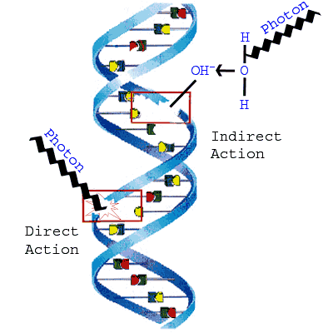
Mutagens harm DNA
1) X-rays break DNA

Slide 50
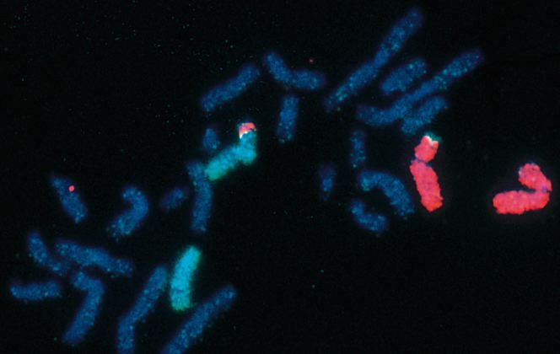
Mutagens harm DNA
1) X-rays break DNA
indels & rearrangements

Slide 51
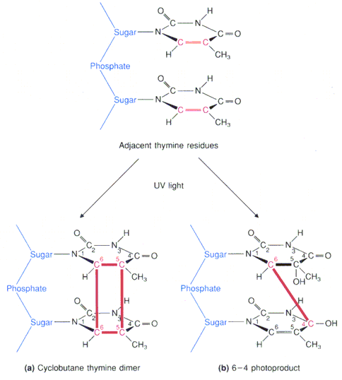
Mutagens harm DNA
1) X-rays break DNA
indels & rearrangements
2) UV forms T dimers
point mutations

Slide 52
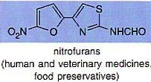
Mutagens harm DNA
1) Radiation
2) chemicals

Slide 53
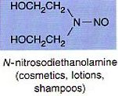
Mutagens harm DNA
1) Radiation
2) chemicals

Slide 54
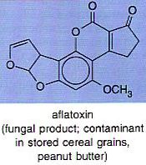
Mutagens harm DNA
1) Radiation
2) chemicals

Slide 55
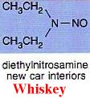
Mutagens harm DNA
1) Radiation
2) chemicals

Slide 56
Mutagens harm DNA
1) Radiation
2) chemicals

Slide 57
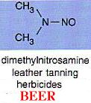
Mutagens harm DNA
1) Radiation
2) chemicals

Slide 59
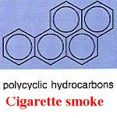
Mutagens harm DNA
1) Radiation
2) chemicals

Slide 60
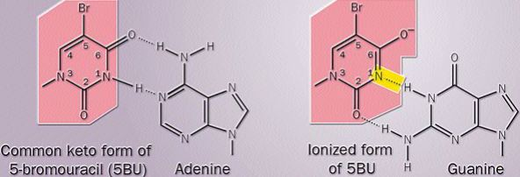
Mutagens harm DNA
1) Radiation
2) chemicals: most cause point mutations
base analogs mispair
5BU bonds A & G

Slide 61
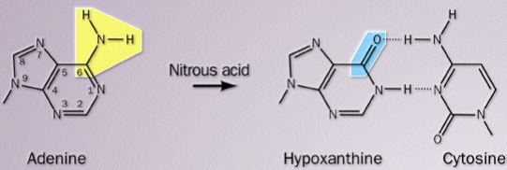
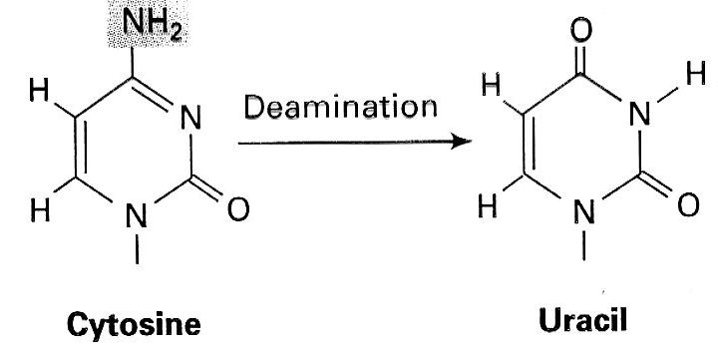
Mutagens harm DNA
2) chemicals: most cause point mutations
base analogs mispair
5BU bonds A & G
Some deaminate A or C -> mispairs

Slide 62
Mutagens harm DNA
Some deaminate A or C -> mispairs
alkylators change bases -> mispairs

Slide 63
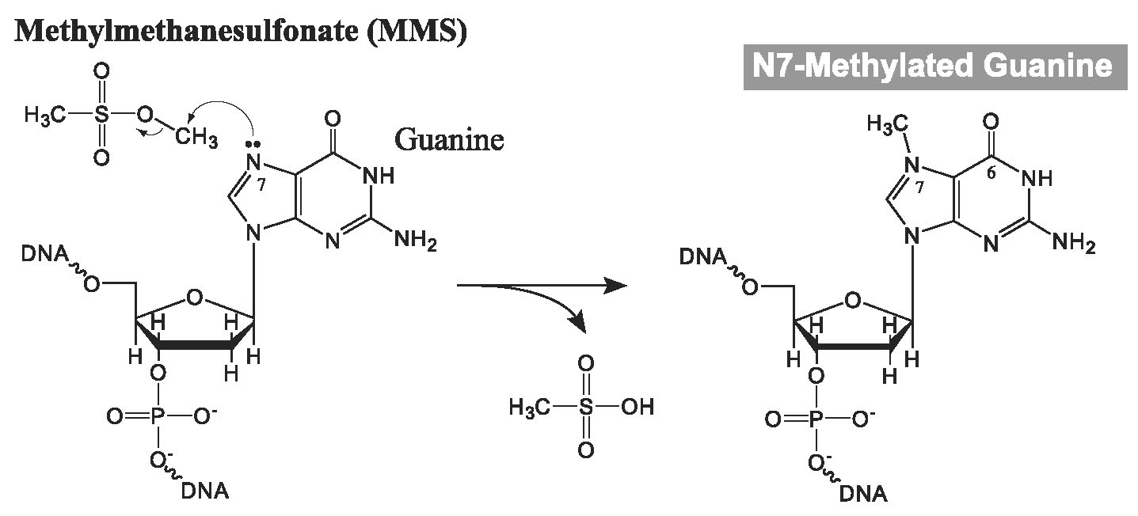
Mutagens harm DNA
Some deaminate A or C -> mispairs
alkylators change bases -> mispairs
Most common alkylation is 7-methyl-guanine
~100,000/cell/day
doesn’t mispair

Slide 64
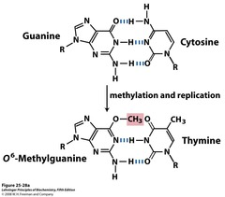
Mutagens harm DNA
Some deaminate A or C -> mispairs
alkylators change bases -> mispairs
Most common is 7-methyl-guanine, doesn’t mispair
6-methyl-guanine does! 3,000/human cell/day

Slide 65
Mutagens harm DNA
alkylators change bases -> mispairs
Intercalators cause
frameshifts

Slide 66
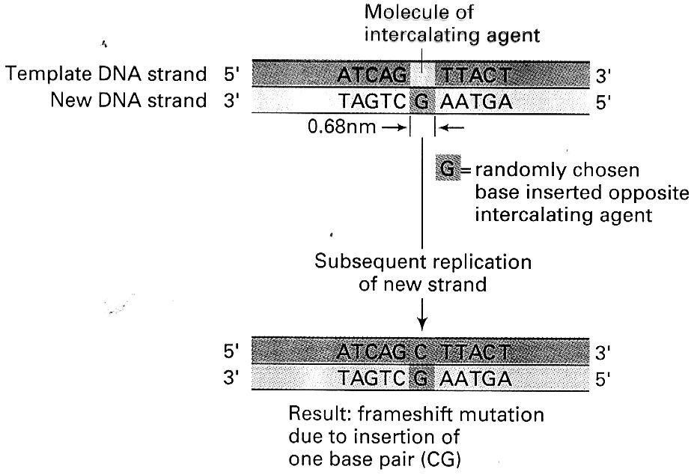
Mutagens harm DNA
intercalators cause frameshifts
In S add a base

Slide 67
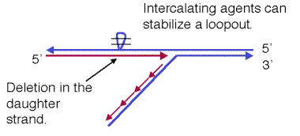
Mutagens harm DNA
intercalators cause frameshifts
In S add a base
Can also stabilize loopouts resulting in deletions

Slide 68
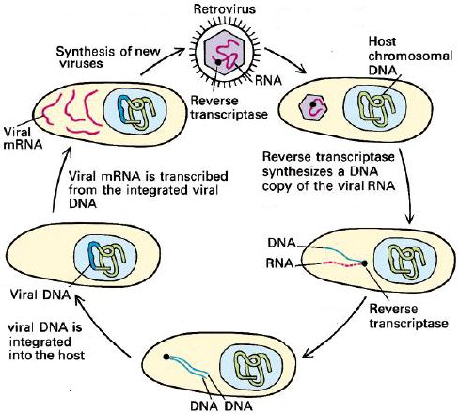
Mutagens harm DNA
3) Biological
Viruses: some accidentally insert DNA or cDNA copies of their genome into host
Retroviruses (HIV)
put their genes in host
DNA on purpose

Slide 69
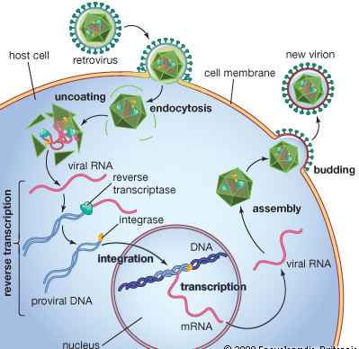
Mutagens harm DNA
Retroviruses (HIV) put their genes in host DNA on purpose
Reverse transcriptase makes cDNA copy of RNA genome

Slide 70
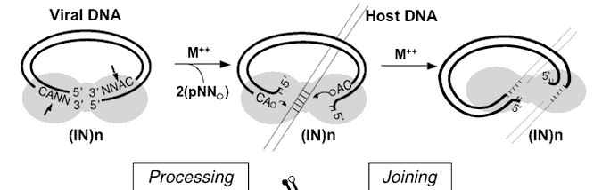
Mutagens harm DNA
Retroviruses (HIV) put their genes in host DNA on purpose
Reverse transcriptase makes cDNA copy of RNA genome
Integrase inserts copy at new site
Processes cDNA to produce 3’ A

Slide 71
Mutagens harm DNA
Retroviruses (HIV) put their genes in host DNA on purpose
Reverse transcriptase makes cDNA copy of RNA genome
Integrase inserts copy at new site
Processes cDNA to produce 3’ A
Cuts host DNA and ligates to 3’ As

Slide 72
Mutagens harm DNA
Integrase inserts copy at new site
Processes cDNA to produce 3’ As
Cuts host DNA and ligates to 3’ As

Slide 73
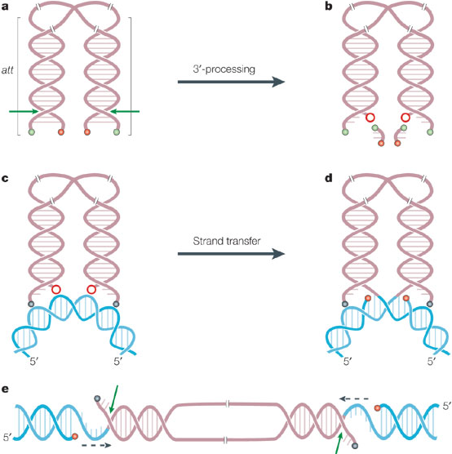
Mutagens harm DNA
Integrase inserts copy at new site
Processes cDNA to produce 3’ As
Cuts host DNA and ligates to 3’ As
Host factors fill and
repair the gaps

Slide 74
Mutagens harm DNA
Retroviruses (HIV) put their genes in host DNA on purpose
Reverse transcriptase makes cDNA copy of RNA genome
Integrase inserts copy
at new site
host makes viral
mRNA, assembles into
virions

Slide 75
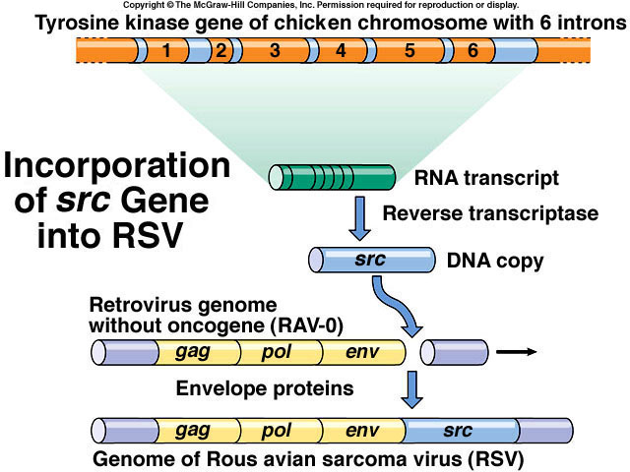
Mutagens harm DNA
Retroviruses ( HIV) put their genes in host DNA
host makes retroviral mRNA
Many retroviruses add oncogenes: give to next host

Slide 76
Mutagens harm DNA
Retroviruses ( HIV) put their genes in host DNA
host makes retroviral mRNA
Many retroviruses add
oncogenes: give to
next host
Also mutate host
DNA

Slide 77
Viruses cause >15% of cancers
many retroviruses add oncogenes
give to next host
also mutate host DNA
many DNA viruses also cause cancer
hepatitis B virus : liver cancer
papilloma virus : cervical & penile cancer
Epstein-Barr virus : Burkitt's lymphoma

Slide 78
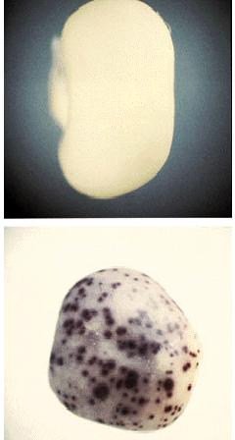
Transposition
Transposons : DNA that moves
Discovered by Barbara McClintock

Slide 79
Transposition
Transposons : DNA that moves
Discovered by Barbara McClintock
~ 50% of human genome!

Slide 80
Transposons
Discovered by Barbara McClintock
~ 50% of human genome!
2 types
1)Transposable elements
use DNA intermediates

Slide 81
Transposons
1)Transposable elements use DNA intermediates: “cut and paste”
Transposase cuts host DNA target site to make staggered ends
Cuts out transposon leaving blunt ends

Slide 82
Transposons
1)Transposable elements use DNA intermediates: “cut and paste”
Transposase cuts host DNA target site to make staggered ends
Cuts out transposon leaving blunt ends
Ligates in blunt transposon, then host fixes gaps
Duplicates target site!

Slide 83
Retrotransposons
transcribe RNA copy

Slide 84
Retrotransposons
transcribe RNA copy
reverse transcriptase makes DNA copy of RNA

Slide 85
Retrotransposons
transcribe RNA copy
reverse transcriptase makes DNA copy of RNA
integrase inserts copy at new site

Slide 86
Retrotransposons
transcribe RNA copy
reverse transcriptase makes DNA copy of RNA
integrase inserts copy at new site
Like retroviruses: same genes & life

Slide 87
Retrotransposons
Like retroviruses: same genes & life
Transposons mutate genes they enter

Slide 88
Retrotransposons
Like retroviruses: same genes & life
Transposons mutate genes they enter
Also break & rearrange DNA

Slide 89
Transposons
Transposons mutate genes they enter
Also break & rearrange DNA
most mutations in corn

Slide 90
Transposons
most mutations in corn
some human disorders

Slide 91
Transposons
most mutations in corn
some human disorders: another cause of aging?

Slide 92
DNA repair
2 problems:

Slide 93
DNA repair
2 problems:
Finding a problem

Slide 94
DNA repair
2 problems:
Finding a problem
Fixing it

Slide 95
DNA repair
3 Ways to fix it
Direct reversal
Removal and resynthesis
Recombination

Slide 96
DNA repair
Direct Reversal
UV makes pyrimidine dimers
Photolyase finds & uses light energy
to cleave dimers

Slide 97
DNA repair
Direct Reversal
UV makes pyrimidine dimers
Photolyase finds & uses light energy to cleave dimers
methyl guanine methyl transferase demethylates O⁶-meG
“suicide reaction”: inactivates the “enzyme”!

Slide 98
DNA repair
Direct reversal
Removal and resynthesis
Thymine dimers are also fixed by Nucleotide Excision Repair
NER also fixes chemical damage that creates
bulky adducts that distort DNA

Slide 99
NER
NER also fixes chemical damage that creates bulky adducts that distort DNA
Two classes
global genomic NER (GG-NER)
Repairs distorted DNA t/o genome
Uses XPC-Rad23B to identify distortion
DDB1 & DDB2 recognize UV dimers
XPA recognizes other, poorly defined DNA damage

Slide 100
NER
global genomic NER (GG-NER)
Repairs distorted DNA t/o genome
Uses XPC-Rad23B to identify distortion
DDB1 & DDB2 recognize UV dimers
XPA recognizes other, poorly defined DNA damage
transcription coupled NER (TC-NER)
Primarily repairs damaged DNA that is being transcribed
Uses stalled RNA polymerase to identify damage, CSA & CSB to start the process

Slide 101
NER
global genomic NER (GG-NER)
Transcription-coupled NER (TC-NER)
Once DNA damage is found repair mech is ± identical

Slide 102
Nucleotide excision repair
Damage is identified
2) Cut bad strand on each side of lesion, then remove it

Slide 103
Nucleotide excision repair
Damage is identified
2) Cut bad strand on each side of lesion, then remove it
3) Fill in gap with DNA
Pol δ or Pol ε

Slide 104
Nucleotide excision repair
Damage is identified
2) Cut bad strand on each side of lesion, then remove it
3) Fill in gap with DNA
Pol δ or Pol ε
4) Ligase seals it

Slide 105
DNA repair
base excision repair fixes damaged and missing bases

Slide 106
DNA repair
base excision repair fixes altered and missing bases
1) Enzymes find & remove bad bases
One for each type of lesion!

Slide 107
DNA repair
base excision repair fixes
altered and missing bases
1) Enzymes find & remove
bad bases
2) Cell decides on short-patch
vs long-patch repair
Type of lesion?
Type of cell?

Slide 108
DNA repair
base excision repair fixes
altered and missing bases
1) Enzymes find & remove
bad bases
2) Cell decides on short-patch
vs long-patch repair
Type of lesion?
Type of cell?
3) Short-patch uses pol β to
replace just one base

Slide 109
DNA repair
base excision repair fixes
altered and missing bases
1) Enzymes find & remove
bad bases
2) Cell decides on short-patch
vs long-patch repair
Type of lesion?
Type of cell?
3) Short-patch uses pol β to
replace just one base
4) Long-patch uses pol β/δ/ε
to replace 20-30 bases

Slide 110
DNA repair
base excision repair fixes
altered and missing bases
1) Enzymes find & remove
bad bases
2) Cell decides on short-patch
vs long-patch repair
Type of lesion?
Type of cell?
3) Short-patch uses pol β to
replace just one base
4) Long-patch uses pol β/δ/ε
to replace 20-30 bases
5) Ligase repairs the nick

Slide 111
DNA repair
mismatch repair : conserved in ± all organisms
fix new DNA to match old DNA

Slide 112
DNA repair
mismatch repair : conserved in ± all organisms
fix new DNA to match old DNA
DNA is modified t/o cell cycle so old DNA has more mods

Slide 113
DNA repair
mismatch repair : conserved in ± all organisms
fix new DNA to match old DNA
DNA is modified t/o cell cycle so old DNA has more mods
MutS or homolog recognizes mismatch

Slide 114
DNA repair
mismatch repair : conserved in ± all organisms
fix new DNA to match old DNA
DNA is modified t/o cell cycle so old DNA has more mods
MutS or homolog recognizes mismatch
Nick new DNA 5’ to mismatch

Slide 115
DNA repair
mismatch repair : conserved in ± all organisms
fix new DNA to match old DNA
DNA is modified t/o cell cycle so old DNA has more mods
MutS or homolog recognizes mismatch
Nick new DNA 5’ to mismatch then excise new mismatched DNA

Slide 116
DNA repair
mismatch repair : conserved in ± all organisms
fix new DNA to match old DNA
DNA is modified t/o cell cycle so old DNA has more mods
MutS or homolog recognizes mismatch
Nick new DNA 5’ to mismatch then excise new mismatched DNA
Replace with DNA pol λ and ligate

Slide 117
DNA repair
Single-strand break repair
poly (ADP-ribose) polymerase (PARP) binds break

Slide 118
DNA repair
Single-strand break repair
poly (ADP-ribose) polymerase (PARP) binds break
Recruits XRCC1, which recruits Ligase 3

Slide 119
DNA repair
Single-strand break repair
poly (ADP-ribose) polymerase (PARP) binds break
Recruits XRCC1, which recruits Ligase 3
Polynucleotide kinase processes ends

Slide 120
DNA repair
Single-strand break repair
poly (ADP-ribose) polymerase (PARP) binds break
Recruits XRCC1, which recruits Ligase 3
Polynucleotide kinase processes ends
Pol β fills in any resulting gaps, ligase 3 ligates the ends

Slide 121
DNA repair
3 Ways to fix it
Direct reversal
Removal and resynthesis
Recombination : mainly used to repair DS breaks

