Slide 1
Next Assignment: Wed March 27?
GMO organisms for fun and profit
Animals making useful biochemicals
Intrinsic antimicrobial properties of silk spun by genetically modified silkworm strains https://link.springer.com/article/10.1007/s11248-018-0059-0
Double knockout pigs deficient in N‐glycolylneuraminic acid and Galactose α‐1,3‐Galactose reduce the humoral barrier to xenotransplantation https://doi.org/10.1111/xen.12019
Super-muscly sheep and cattle by genome editing; https://link.springer.com/article/10.1007%2Fs11248-014-9832-x
The transgenic expression of human follistatin-344 increases skeletal muscle mass in pigs https://link.springer.com/article/10.1007/s11248-016-9985-x
Goats that make human antithrombin in their milk. doi:10.1051/rnd:2006029.

Slide 2
Plants making useful biochemicals
Transgenic plants against malaria doi:10.1111/tpj.13509
Delayed treatment of Ebola virus infection with plant-derived monoclonal antibodies provides protection in rhesus macaques https://www.ncbi.nlm.nih.gov/pmc/articles/PMC3497800/
A Plant-Derived Recombinant Human Glucocerebrosidase Enzyme https://www.ncbi.nlm.nih.gov/pmc/articles/PMC2652073/
Recombinant Anthrax Toxin Receptor-Fc Fusion Proteins Produced in Plants http://aac.asm.org/content/55/1/132.full
Hepatitis C vaccine made in potatoes http://www.pnas.org/content/102/9/3378
Development of rubber-enriched dandelion varieties by metabolic engineering of the inulin pathway http://onlinelibrary.wiley.com/doi/10.1111/pbi.12672/full
Doubling artemisin production http://www.isaaa.org/kc/cropbiotechupdate/article/default.asp?ID=15295

Slide 3
Microbes making useful biochemicals
Brewing cannabinoids in yeast. Nature 567, pages123–126 (2019) https://doi.org/10.1038/s41586-019-0978-9
Hoppy beer without the hops. Nature Communications 9, Article number: 965 (2018) doi:10.1038/s41467-018-03293-x
Engineering Yarrowia lipolytica to enhance lipid production from lignocellulosic materials https://doi.org/10.1186/s13068-018-1010-6
Synthesis of the Human Insulin Gene: https://www.tandfonline.com/doi/abs/10.1080/10826060701774312
Yeast that make resveratrol http://aem.asm.org/content/76/10/3361.full
Human insulin DOI: 10.1126/science.6337396
Human thrombin http://www.jbc.org/content/270/1/163.full
Human growth factors https://www.sciencedirect.com/science/article/pii/S1570023202010358

Slide 4
Modifying crops to improve nutrition
Golden rice http://www.nature.com/nbt/journal/v23/n4/full/nbt1082.html
Rice NICOTIANAMINE SYNTHASE 2 expression improves dietary iron and zinc levels in wheat http://link.springer.com/article/10.1007/s00122-016-2808-x
Significant enhancement of fatty acid composition in seeds of the allohexaploid, Camelina sativa, using CRISPR/Cas9 gene editing http://onlinelibrary.wiley.com/doi/10.1111/pbi.12663/full
Potato: reducing acrylamide: Innate potatoes http://pubs.acs.org/doi/pdf/10.1021/jf062477l

Slide 5
Modifying crops to improve stress tolerance
Herbicide resistance
Bromoxynil DOI: 10.1126/science.242.4877.419
Glyphosate (roundup) https://www.ncbi.nlm.nih.gov/pmc/articles/PMC1559744/
Glufosinate (Basta) https://www.ncbi.nlm.nih.gov/pmc/articles/PMC1062058/pdf/plntphys00645-0252.pdf
Isoxaflutole (Balance, Corvus, Prequel) http://onlinelibrary.wiley.com/doi/10.1111/j.1467-7652.2006.00226.x/full
Dicamba/2,4-D http://science.sciencemag.org/content/316/5828/1185

Slide 6
Modifying crops to improve stress tolerance
Pathogen/herbivore resistance
BT (Bacillus thuringiensis toxin)
BT sweet corn DOI:10.1603/0022-0493-96.1.71
BT potatoes http://hortsci.ashspublications.org/content/37/2/275.full.pdf+html
Cotton resistance to Boll weevils doi/10.1111/pbi.12694
Virus resistance
Cross-resistance to multiple viruses http://www.sciencedirect.com/science/article/pii/S0042682200904306
Papaya Ring Spot Virus Resistant Papaya http://oregonstate.edu/instruct/bi430-fs430/Documents-2004/3B-BIOTECH%20METH/Gonsalves-papaya-story-AmPhytopSoc2004.pdf
Maize streak virus http://onlinelibrary.wiley.com/doi/10.1111/j.1467-7652.2007.00279.x/full

Slide 7
Modifying crops to improve stress tolerance
Overexpression of wheat ferritin gene TaFER-5B enhances tolerance to heat stress and other abiotic stresses associated with the ROS scavenging http://bmcplantbiol.biomedcentral.com/articles/10.1186/s12870-016-0958-2
The rice OsNAC6 transcription factor orchestrates multiple molecular mechanisms involving root structural adaptions and nicotianamine biosynthesis for drought tolerance http://onlinelibrary.wiley.com/doi/10.1111/pbi.12673/full

Slide 8
Increasing yield
Seed-Specific Overexpression of the Pyruvate Transporter BASS2 Increases Oil Content in Arabidopsis Seeds http://journal.frontiersin.org/article/10.3389/fpls.2017.00194/full
Improving shelf-life
FlavrSavr tomato. http://hortsci.ashspublications.org/content/43/3/962.full.pdf+html
Preventing browning in apple slices Preventing browning in apples https://doi.org/10.1271/bbb.65.383

Slide 9
GMO organisms for fun and profit
First set the stage: what was previously known, and what did they set out to learn?
Will probably need to read other papers or review articles

Slide 10
GMO organisms for fun and profit
First set the stage: what was previously known, and what did they set out to learn?
Will probably need to read other papers or review articles
Next describe what they did and how the did it

Slide 11
GMO organisms for fun and profit
First set the stage: what was previously known, and what did they set out to learn?
Will probably need to read other papers or review articles
Next describe what they did and how the did it
Next describe their results

Slide 12
GMO organisms for fun and profit
First set the stage: what was previously known, and what did they set out to learn?
Will probably need to read other papers or review articles
Next describe what they did and how the did it
Next describe their results
Finish by discussing their results: what does this mean? What should they do next?

Slide 13
/ 18 Content
/ 2 Organization?
/ 1 Introduction?
/ 5 Quantity of material presented?
/ 5 Quality of material presented?
/ 2 Clarity?
/ 1 Understanding?
/ 2 use of images
/ 7 Mechanics
/ 1 Confidence
/1 Diction & volume
/ 1 Interaction with audience
/ 1 Pace
/ 1 poise, mannerisms
/ 1 Time?
/ 1 Quality of answers
Total: /25 = pts

Slide 14
PNAS 112: 1041-1046 (Jan 27, 2015)

Slide 15
Basic question: How do euk ribosomes find start codon?

Slide 16
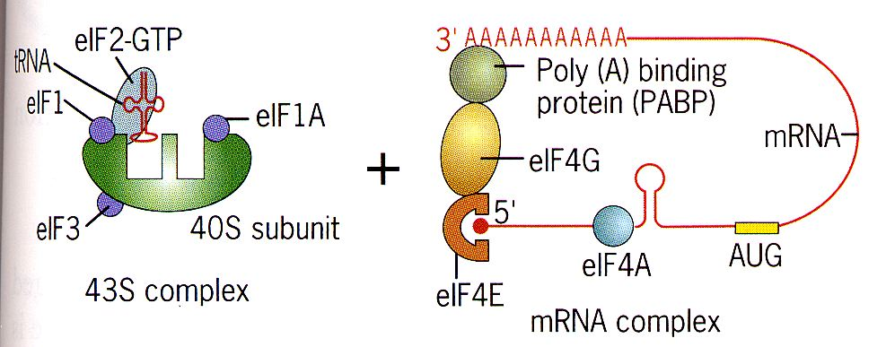
Basic question: How do euk ribosomes find start codon?
Current model = ribosomal scanning: euk assemble 43S complex at 5’ cap and scan down to first AUG

Slide 17
Basic question: How do euk ribosomes find start codon?
Current model = ribosomal scanning: euk assemble 43S complex at 5’ cap and scan down to first AUG
Why don’t 40% of mRNA start at first AUG?

Slide 18
Basic question: How do euk ribosomes find start codon?
Current model = ribosomal scanning: euk assemble 43S complex at 5’ cap and scan down to first AUG
Why don’t 40% of mRNA start at first AUG?
How do IRES (internal ribosome entry sites) work?
Found in many viral mRNAs eg polio, picornavirus

Slide 19
Basic question: How do euk ribosomes find start codon?
Current model = ribosomal scanning: euk assemble 43S complex at 5’ cap and scan down to first AUG
Why don’t 40% of mRNA start at first AUG?
How do IRES (internal ribosome entry sites) work?
Found in many viral mRNAs eg polio, picornavirus
Authors propose RNA-looping finds initiator AUG

Slide 20
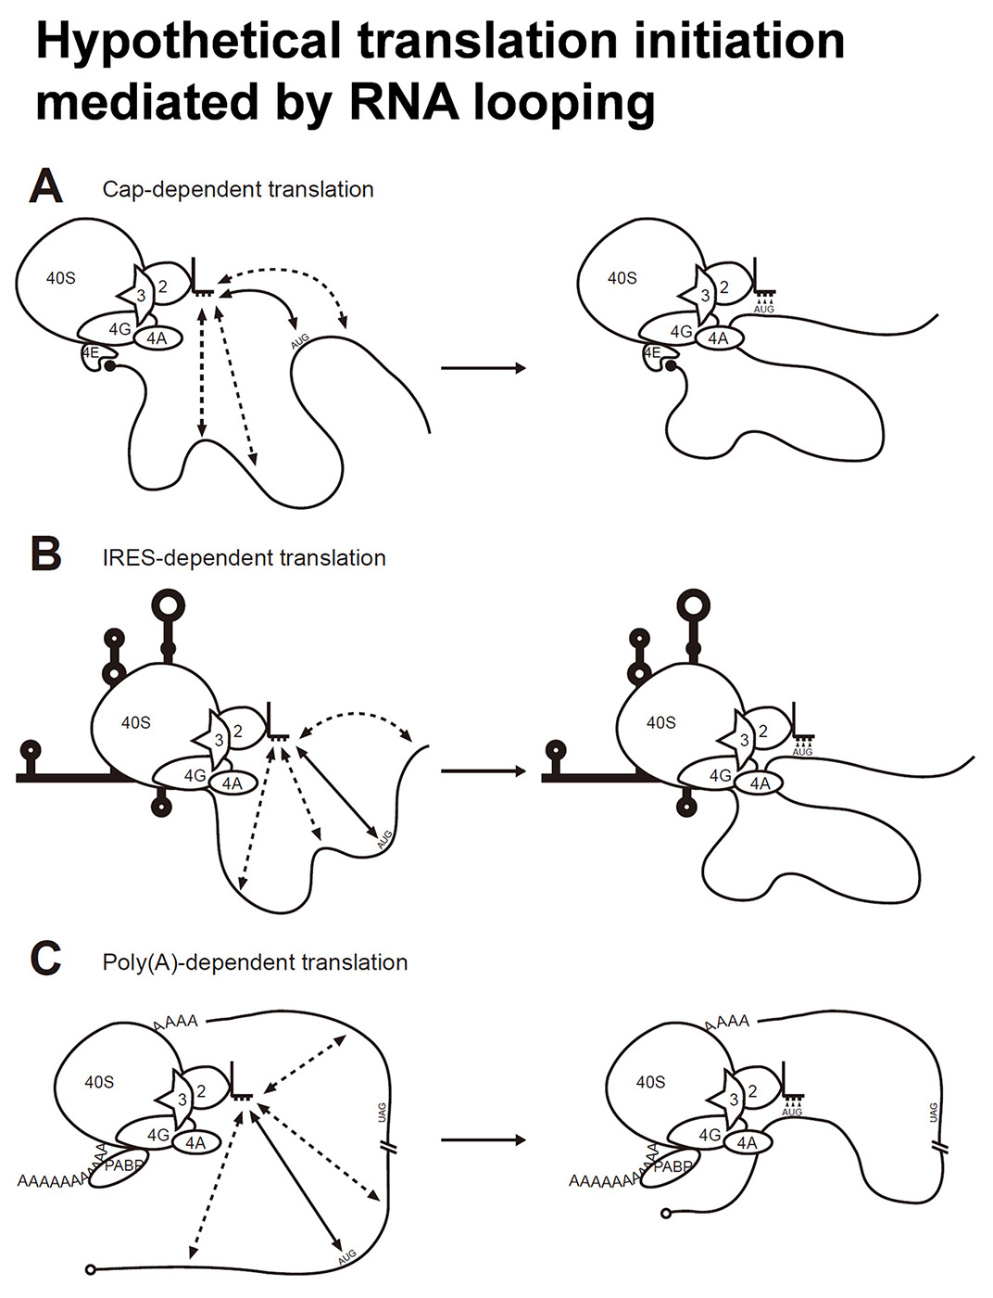
Basic question: How do euk ribosomes find start codon?
Authors propose RNA-looping finds initiator AUG
proteins which bind near initiator AUG guide initiation complex

Slide 21
Basic question: How do euk ribosomes find start codon?
Authors propose RNA-looping finds initiator AUG
proteins which bind near initiator AUG guide initiation complex
Tested by making constructs containing internal RNA-binding protein sites and measuring effect on translation

Slide 22
Authors propose RNA-looping finds initiator AUG
proteins which bind near initiator AUG guide initiation complex
Tested by making constructs containing internal RNA-binding protein sites and measuring effect on translation
Made a fusion between eIF4G and the MS2-RNAbp, and then added MS2 binding sites at various places

Slide 23
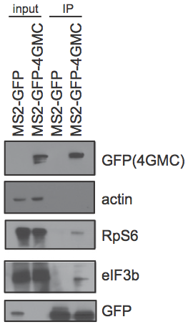
Made a fusion between eIF4G and the MS2-RNAbp, and then added MS2 binding sites at various places
eIF4G was mutated so it can’t bind eIF4E & PABP, yet it still associated with eIF3 & the 40S subunit

Slide 24
Made a fusion between eIF4G and the MS2-RNAbp, and then added MS2 binding sites at various places
eIF4G was mutated so it can’t bind eIF4E & PABP, yet it still associated with eIF3 & the 40S subunit
Capped the mRNA with A to ensure
no eIF4E binding

Slide 25
Authors propose RNA-looping finds initiator AUG
Made a fusion between eIF4G and the MS2-RNAbp, and then added MS2 binding sites at various places w/in mRNA encoding luciferase
Assayed by transfection into HEK293 cells, then measuring firefly luciferase/Renilla luciferase activity 4 hours later

Slide 26
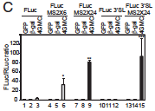
Assayed by transfection into HEK293 cells, then measuring firefly luciferase/Renilla luciferase activity
No activity w/o eIF4G
& MS2 binding site
Stem-loop (which
blocks back-tracking)
had no effect

Slide 27
Assayed by transfection into HEK293 cells, then measuring firefly luciferase/Renilla luciferase activity
No activity w/o eIF4G
& MS2 binding site
Stem-loop (which
blocks back-tracking)
had no effect

Slide 28
Assayed by transfection into HEK293 cells, then measuring firefly luciferase/Renilla luciferase activity
No activity w/o eIF4G
& MS2 binding site
Stem-loop (which
blocks back-tracking)
had no effect
Concluded that eIF4G
bound to the mRNA was
sufficient to guide 40S to
the start codon

Slide 29
Next tested effect of the eIF4G binding on a downstream ORF
Put Renilla luciferase & firefly Luciferase CDS on same mRNA

Slide 30
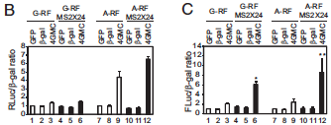
Put Renilla luciferase & firefly Luciferase CDS on same mRNA
FLuc depended on eIF4G binding
G-capped RLuc did not, but A-capped RLuc did

Slide 31
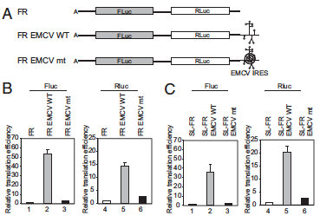
Put Renilla & firefly Luciferase CDS on same mRNA
Observed same effect with the encephalomyocarditis virus (EMCV) IRES

Slide 32
Put Renilla & firefly Luciferase CDS on same mRNA
Observed same effect with the encephalomyocarditis virus (EMCV) IRES
Overall conclusion: RNA binding proteins that can interact with the 40S complex allow it to find the start codon by looping the RNA

Slide 33
How to bioengineer a gene to function in a new host?
1. Must be able to transform engineered DNA into new host.
2. Sequences must function in the new host
Must be replicated
Either insert into chromosome, or replicate extrachromasomally (i.e. as a plasmid)
Must have origin of replication that functions in new host (highly species-specific in bacteria)

Slide 34
How to bioengineer a gene to function in a new host?
2. Sequences must function in the new host
Must be replicated
New host must be able to “read” the sequence

Slide 35
How to bioengineer a gene to function in a new host?
2. Sequences must function in the new host
Must be replicated
New host must be able to “read” the sequence
Promoters = binding sites for transcription factors
Fairly simple for prokaryotes
Need binding sites for RNA polymerase and for proteins that determine when it should act

Slide 36
How to bioengineer a gene to function in a new host?
New host must be able to “read” the sequence
Promoters = binding sites for transcription factors
Fairly simple for prokaryotes
Need binding sites for RNA polymerase and for proteins that determine when it should act
Repressors bind DNA & prevent transcription unless conditions are right
Activators bind DNA & recruit RNA polymerase

Slide 37
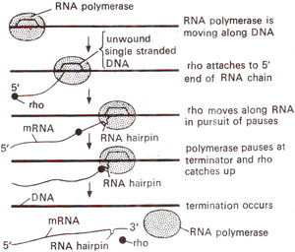
How to bioengineer a gene to function in a new host?
New host must be able to “read” the sequence
Terminators tell RNA polymerase where to stop
1) ~50% of E.coli genes require a termination factor called “rho”
2) Most of the rest use “intrinsic” termination
Caused solely by interactions between DNA & nascent RNA with RNA polymerase

Slide 38
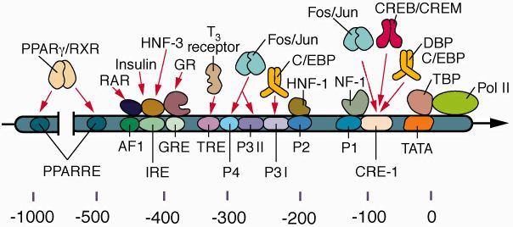
How to bioengineer a gene to function in a new host?
New host must be able to “read” the sequence
Promoters = binding sites for transcription factors
Fairly simple for prokaryotes
Far more complex for eukaryotes
Need binding sites for RNA polymerase and for proteins that determine when it should act

Slide 39
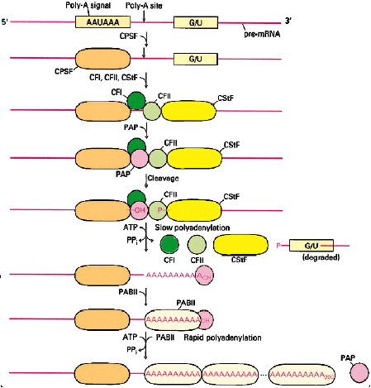
How to bioengineer a gene to function in a new host?
2. Sequences must function in the new host
Must be replicated
New host must be able to “read” the sequence
Promoters
Terminators = Poly-A sites in eukaryotes

Slide 40
How to bioengineer a gene to function in a new host?
2. Sequences must function in the new host
Must be replicated
New host must be able to “read” the sequence
Promoters
Terminators
Capping and Splicing

Slide 41
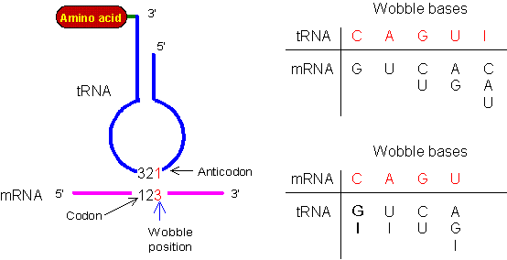
How to bioengineer a gene to function in a new host?
2. Sequences must function in the new host
Codon usage : related to pools of tRNAs
bacteria have 40 or less (bare minimum is 31 + initiator tRNA)
Eukaryotes have ~ 50

Slide 42
How to bioengineer a gene to function in a new host?
2. Sequences must function in the new host
Must be replicated
New host must be able to “read” the sequence
Promoters
Terminators
Splicing
Codon usage
3. Protein must function in the new host

Slide 43
How to bioengineer a gene to function in a new host?
2. Sequences must function in the new host
Must be replicated
New host must be able to “read” the sequence
Promoters
Terminators
Splicing
Codon usage
3. Protein must function in the new host
Must be translated

Slide 44
How to bioengineer a gene to function in a new host?
3. Protein must function in the new host
Must be translated
Must be modified correctly

Slide 45
How to bioengineer a gene to function in a new host?
3. Protein must function in the new host
Must be translated
Must be modified correctly
Glycosylation

Slide 46
How to bioengineer a gene to function in a new host?
3. Protein must function in the new host
Must be translated
Must be modified correctly
Glycosylation
Fatty-acylation

Slide 47
How to bioengineer a gene to function in a new host?
3. Protein must function in the new host
Must be translated
Must be modified correctly
Glycosylation
Fatty-acylation
proteolysis

Slide 48
How to bioengineer a gene to function in a new host?
3. Protein must function in the new host
Must be translated
Must be modified correctly
Glycosylation
Fatty-acylation
Proteolysis
Must go to right organelle

Slide 49
How to bioengineer a gene to function in a new host?
3. Protein must function in the new host
Must be translated
Must be modified correctly
Glycosylation
Fatty-acylation
Proteolysis
Must go to right organelle
Must survive!

Slide 50
How to bioengineer a gene to function in a new host?
3. Protein must function in the new host
Must be translated
Must be modified correctly
Glycosylation
Fatty-acylation
Proteolysis
Must go to right organelle
Must survive!
4. Identify suitable gene(s), then obtain by PCR or have synthesized, add suitable promoters and terminators, then transform into new host.

Slide 51
How to bioengineer a gene to function in a new host?
3. Protein must function in the new host
Must be translated
Must be modified correctly
Glycosylation
Fatty-acylation
Proteolysis
Must go to right organelle
Must survive!
4. Identify suitable gene(s), then obtain by PCR or have synthesized, add suitable promoters and terminators, then transform into new host.
5. Also need to add selectable marker, or way to recognize hosts that have taken it up.

Slide 52
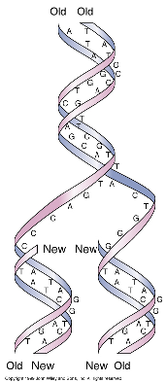
DNA REPLICATION
WC: DNA replication is
semi-conservative
strands melt: form templates
for copy
Copy is reverse &
complement of template
Copy of other strand

Slide 53
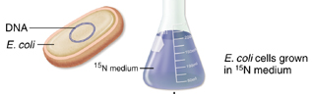
Meselson & Stahl
proved DNA replication is semi-conservative
grew E. coli on ¹⁵N to tell new DNA from old
make dense DNA

Slide 54
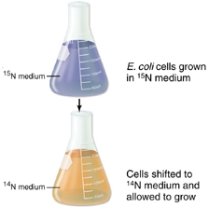
Meselson & Stahl
1) grew E. coli on ¹⁵N to tell new DNA from old
make dense DNA
2) Xfer to ¹⁴N

Slide 55
Meselson & Stahl
1) grew E. coli on ¹⁵N to tell new DNA from old
make dense DNA
2) Xfer to ¹⁴N
new DNA is light

Slide 56
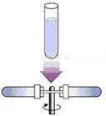
Meselson & Stahl
1) grew E.coli on ¹⁵N to
tell new DNA from old
make dense DNA
2) Xfer to ¹⁴N
new DNA is light
3) measure ρ of F1 & F2 DNA by
centrifuging in CsCl

Slide 57
Meselson & Stahl
measure r of F1 & F2 DNA
by centrifuging in CsCl
forms ρ gradients when spun
@500,000 x g

Slide 58
Meselson & Stahl
measure ρ of F1 & F2 DNA
by centrifuging in CsCl
forms ρ gradients when spun
@500,000 x g
DNA bands where ρ is same as CsCl

Slide 59
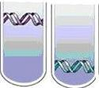
Meselson & Stahl
Results
F0 DNA forms HH band control Parental

Slide 60
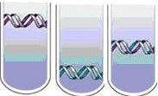
Meselson & Stahl
F0 DNA forms HH band
F1 DNA forms one higher band
Control Parental F1

Slide 61
Meselson & Stahl
F0 DNA forms HH band
F1 DNA forms one higher band
Control Parental F1

Slide 62
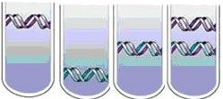
Meselson & Stahl
F0 DNA forms HH band
F1 DNA forms one higher band: HL
F2 DNA forms 2 bands: #1 same as F1
#2 same as ¹⁴N DNA
Control Parental F1 F2

Slide 63
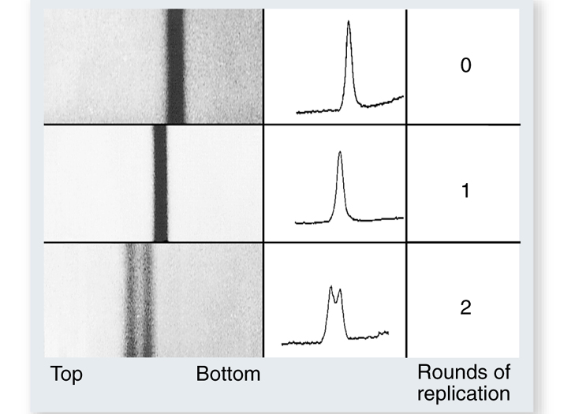
Meselson & Stahl
F2 DNA forms 2 bands: # 1 same as F1
#2 same as ¹⁴N DNA
# 1 = HL
# 2 = LL : DNA replication is semiconservative

Slide 64
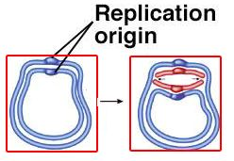
DNA replication
1) Replication begins at origins of replication

Slide 65
DNA replication
1) Replication begins at origins of replication
Polymerases are dumb!

Slide 66
DNA replication
1) Replication begins at origins of replication
DNA polymerases are dumb!
other proteins tell where to start

Slide 67
DNA replication
1) where to begin?
2) “melting” DNA

Slide 68
DNA replication
1) where to begin?
2) “melting” DNA
must melt DNA @ physiological T

Slide 69
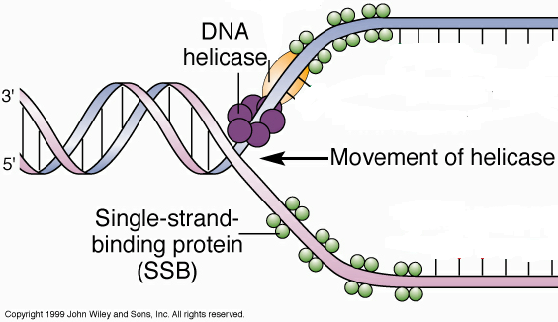
DNA replication
must melt DNA @ physiological T
Helicase melts DNA

Slide 70
DNA replication
must melt DNA @ physiological T
Helicase melts DNA
Forms “replication bubble”

Slide 71
DNA replication
helicase melts DNA
Forms “replication bubble”
SSB proteins separate strands until they are copied

Slide 72
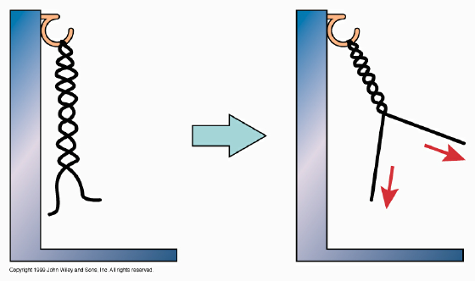
DNA replication
helicase melts DNA
unwinding DNA increases supercoiling elsewhere

Slide 73
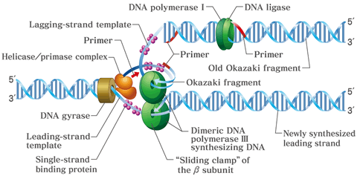
DNA replication
helicase melts DNA
unwinding DNA increases supercoiling elsewhere
DNA gyrase relieves supercoiling

Slide 74
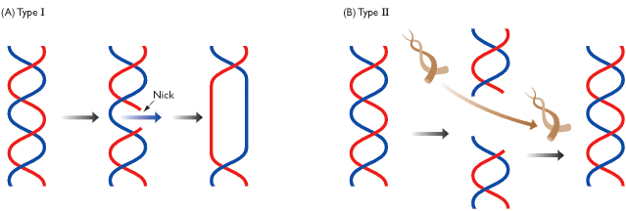
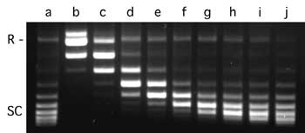
DNA replication
DNA gyrase relieves supercoiling
Topoisomerases : enzymes that untie knots in DNA
Type I nick backbone & unwind once as strand rotates
Type II cut both strands: relieve two supercoils/rxn

Slide 75
DNA replication
1) where to begin?
2) “melting”
3) “priming”
DNA polymerase can only add

Slide 76
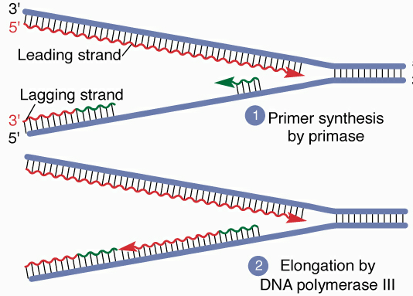
DNA replication
“priming”
DNA polymerase can only add
primase makes short RNA primers

Slide 77
DNA replication
“priming”
DNA polymerase can only add
primase makes short RNA primers
DNA polymerase adds to primer

Slide 78
DNA replication
“priming”
DNA polymerase can only add
primase makes short RNA primers
DNA polymerase adds to primer
later replace primers with DNA

Slide 79
DNA replication
1) where to begin?
2) “melting”
3) “priming”
4) DNA replication

Slide 80
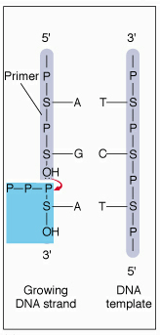
DNA replication
4) add bases bonding 5’ P to 3’ OH @ growing end

Slide 81
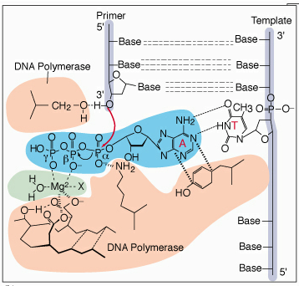
DNA replication
4) add bases bonding 5’ P to 3’ OH @ growing end
Template holds next base until make bond

Slide 82
DNA replication
Template holds next base
until make bond
only correct base fits

Slide 83
DNA replication
Template holds next base
until make bond
only correct base fits
- energy comes from 2 PO₄

Slide 84
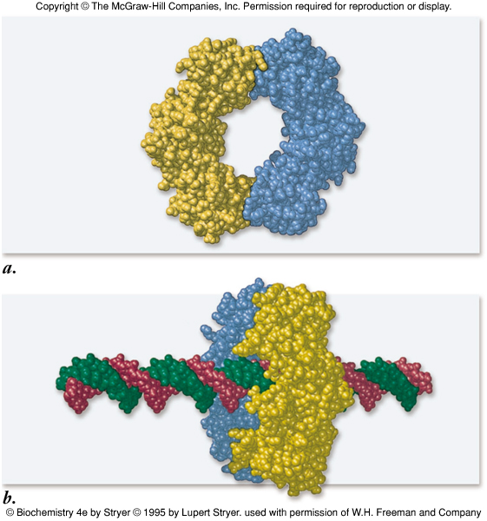
DNA replication
energy comes from 2 PO₄
"Sliding clamp" keeps polymerase from falling off

Slide 85
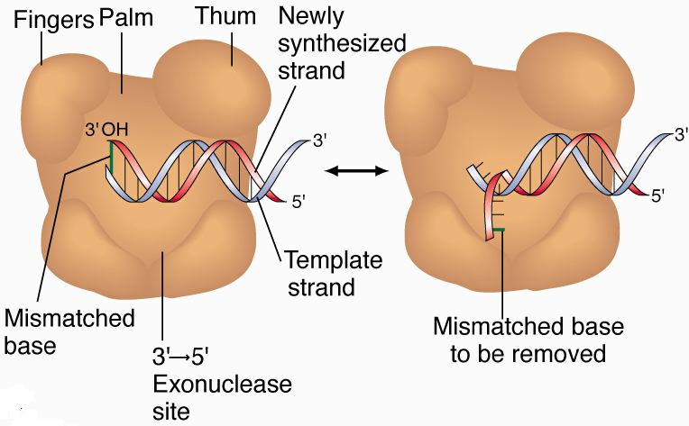
DNA replication
energy comes from 2 PO₄
"Sliding clamp" keeps polymerase from falling off
Proof-reading: only correct DNA can exit

Slide 86
DNA replication
Proof-reading: only correct DNA can exit
Remove bad bases & try again

Slide 87
DNA replication
Only make DNA
5’ -> 3’

Slide 88
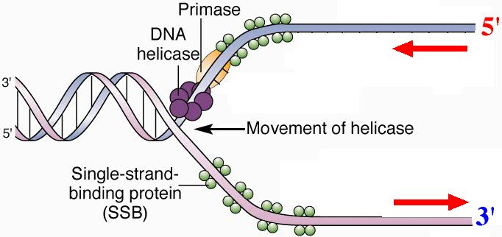
Leading and Lagging Strands
Only make DNA 5’ -> 3’
strands go both ways!

Slide 89
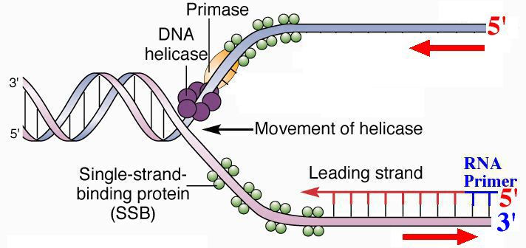
Leading and Lagging Strands
Only make DNA 5’ -> 3’
strands go both ways!
Make leading strand continuously

Slide 90
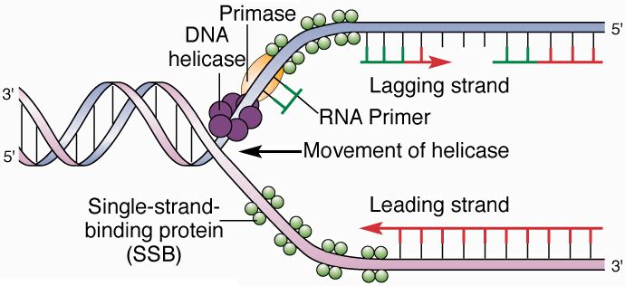
Leading and Lagging Strands
Only make DNA 5’ -> 3’
strands go both ways!
Make leading strand continuously
Make lagging strand opposite way

Slide 91
Leading and Lagging Strands
Make leading strand continuously
Make lagging strand opposite way
wait for DNA to melt, then make Okazaki fragments

Slide 92
Leading and Lagging Strands
Make lagging strand opposite way
wait for DNA to melt, then make Okazaki fragments
each Okazaki fragment has its own primer
made discontinuously

Slide 93
Leading and Lagging Strands
each Okazaki fragment has its own primer
made discontinuously
DNA replication is semidiscontinuous

Slide 94
Leading and Lagging Strands
each Okazaki fragment has its own primer
made discontinuously
DNA replication is semidiscontinuous
Okazaki fragments grow until hit one in front

Slide 95
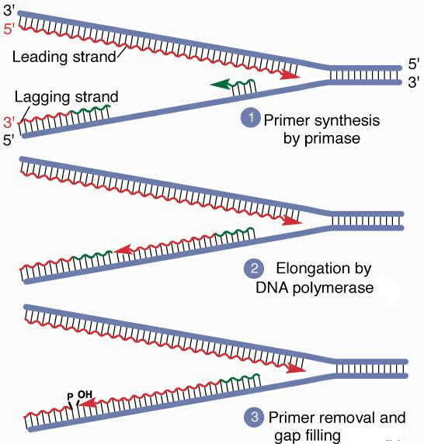
Okazaki fragments grow until hit one in front
RNAse H removes primer & gap is filled

Slide 96
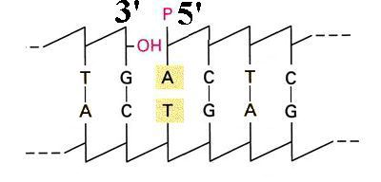
Okazaki fragments grow until hit one in front
RNAse H removes primer & gap is filled
DNA ligase joins fragments

Slide 97
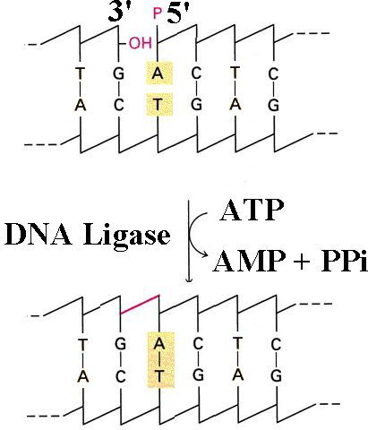
Okazaki fragments grow until hit one in front
RNAse H removes
primer & gap is filled
DNA ligase
joins fragments
Energy comes
from ATP-> AMP

Slide 98
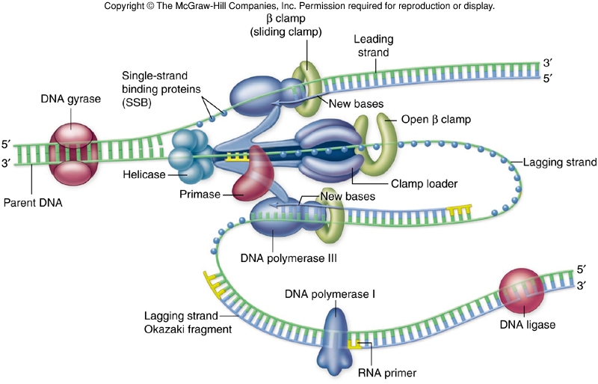
DNA replication
Real process is far more complicated!
Proteins replicating both strands are in replisome

Slide 99
DNA replication
Real process is far more complicated!
Proteins replicating both strands are in replisome: feed DNA through it

Slide 100
DNA replication
Proteins replicating both strands are in replisome: feed DNA through it
lagging strand loops out so make both strands in same direction

Slide 101
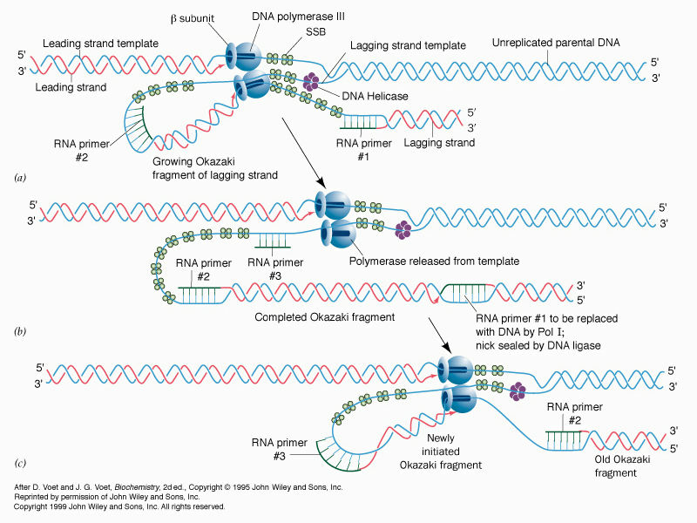
lagging strand loops out so make both strands in same direction
DNA pol detaches when hits previous primer, reattaches at next primer

Slide 102
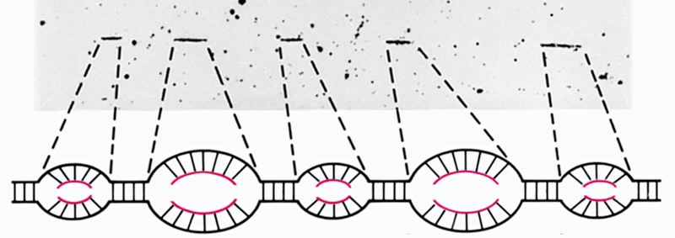
Bacterial DNA has one origin
Euk have ARS ~ every 100,000 bp
- speed DNA replication

Slide 103
Euk have ARS ~ every 100,000 bp
- speed DNA replication
ORC (Origin Recognition Complex) binds ARS
A
B1
B2
B3

Slide 104
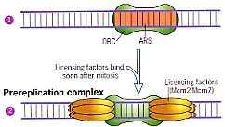
ORC binds ARS
licensing factors ensure each ARS is only replicated once/S
fall off when ARS is replicated, don't reattach until G1

Slide 105
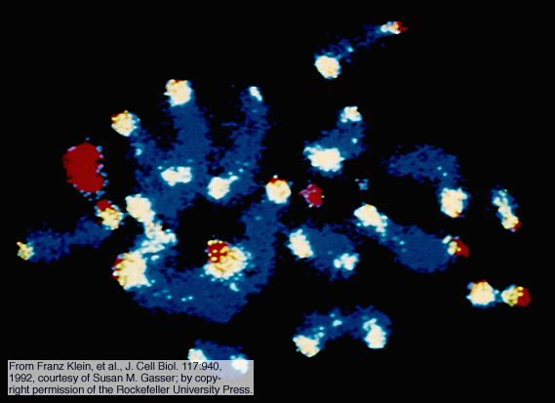
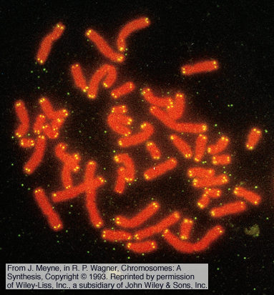
Telomeres
sequences at chromosome ends
humans have 250-7,000 repeats of CCCTAA
special proteins bind them

Slide 106
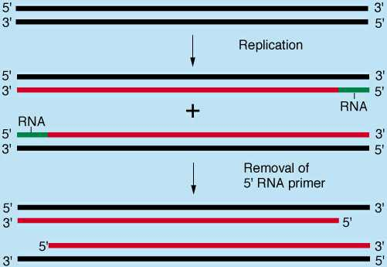
Telomeres
sequences at chromosome ends
humans have 250-7,000 repeats of CCCTAA
special proteins bind them
can't replicate 5' end of lagging strand since remove primer

Slide 107
Telomeres
can't replicate 5' end of lagging strand since remove primer
telomeres lose ~ 200 bp each S

Slide 108
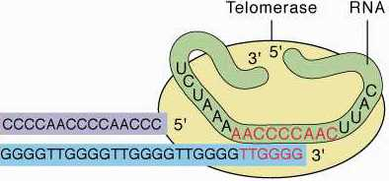
Telomeres
can't replicate 5' end of lagging strand since remove primer
telomeres lose ~ 200 bp each S
telomerase replaces missing bases

Slide 109
Telomerase
telomeres lose ~ 200 bp each S
telomerase replaces missing bases
reverse transcriptase with attached RNA template

Slide 110
Telomerase
telomeres lose ~ 200 bp each S
telomerase replaces missing bases
reverse transcriptase with attached RNA template
1) RNA bonds leading strand

Slide 111
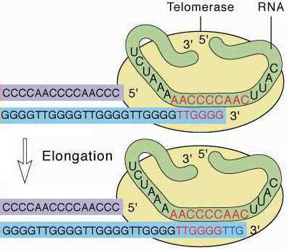
Telomerase
reverse transcriptase with attached RNA template
RNA bonds leading strand
2) Forms template to extend leading strand

Slide 112
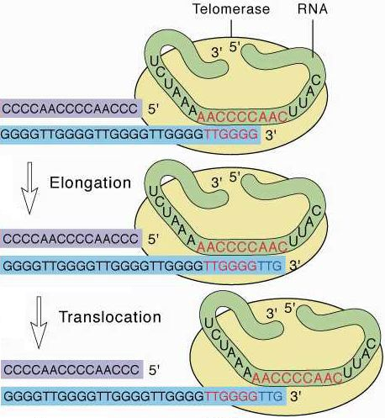
Telomerase
reverse transcriptase with attached RNA template
RNA bonds leading strand
2) Forms template to extend leading strand
3) Translocates 6 bases & repeats

Slide 113
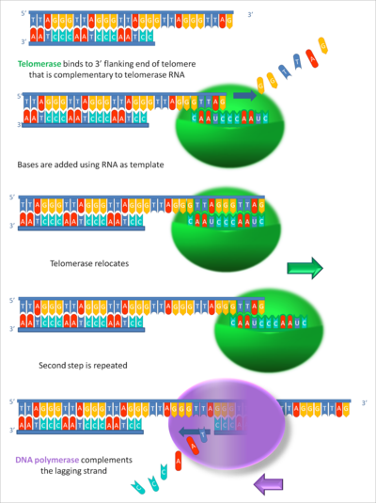
Telomerase
RNA bonds leading strand
2) Forms template to
extend leading strand
3) Translocates
6 bases & repeats
4) Extend lagging strand
with primer & DNA pol

Slide 114
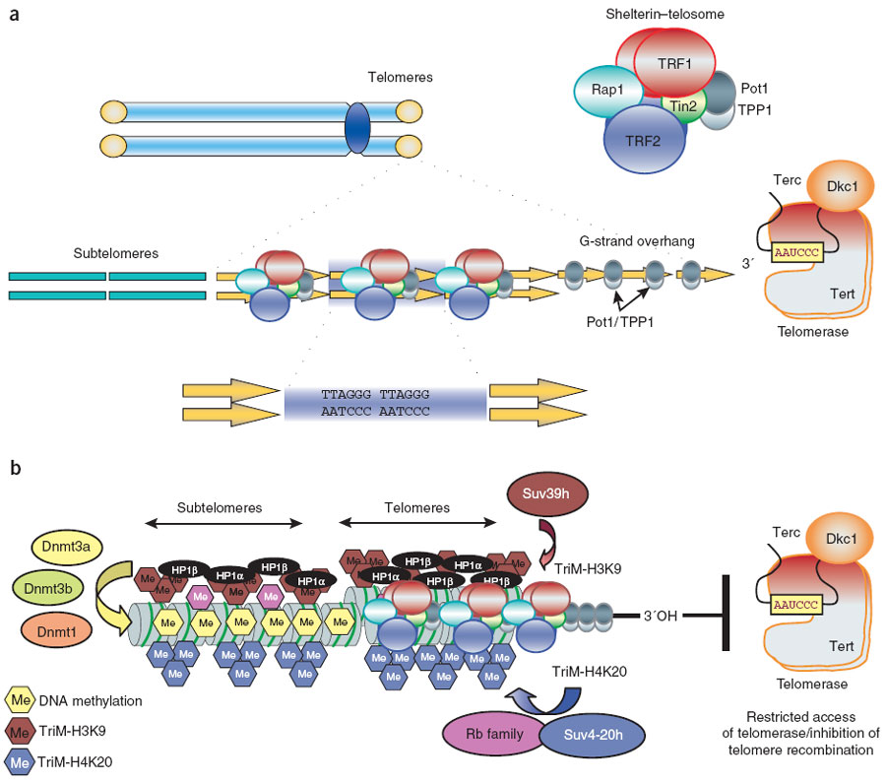
Telomere structure
Bound by complex called the telosome

Slide 115
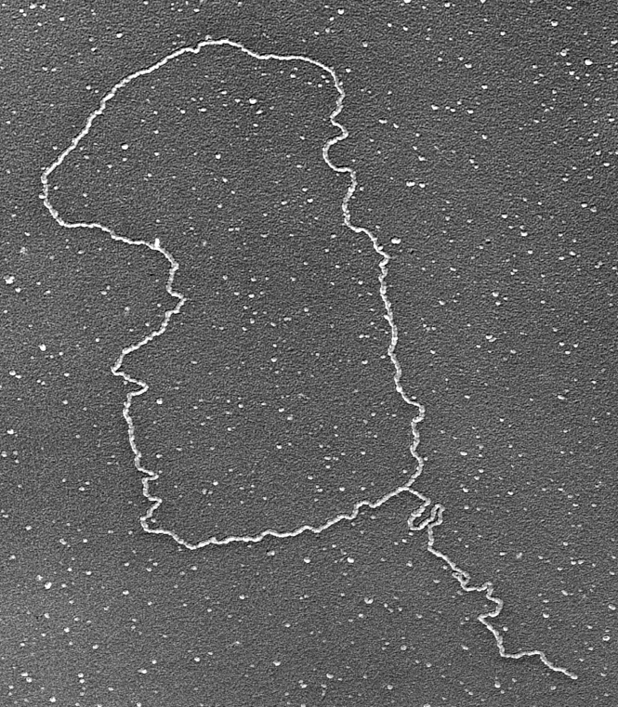
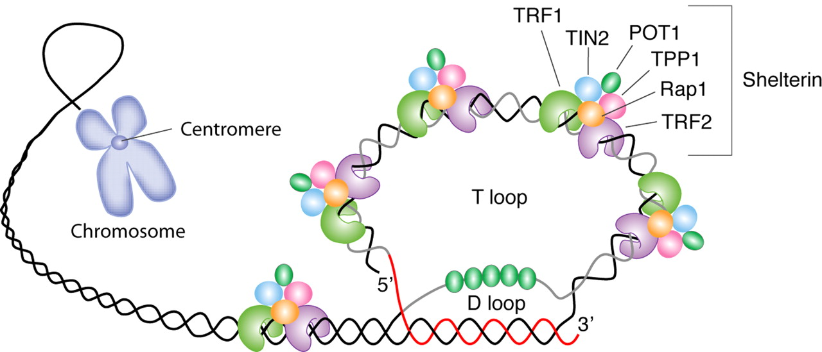
Telomere structure
Bound by complex called the telosome
Proposed to form T-loop structure IF
long enough

Slide 116
Telomere structure
Bound by complex called the telosome
Proposed to form T-loop structure IF
long enough
G-rich SS-DNA invades and displaces
C-rich strand

Slide 117
Telomere structure
Bound by complex called the telosome
Proposed to form T-loop structure IF
long enough
G-rich SS-DNA invades and displaces
C-rich strand
POT1 binds & protects D-loop

Slide 118
Telomere structure
Bound by complex called the telosome
Proposed to form T-loop structure IF
long enough
G-rich SS-DNA invades and displaces
C-rich strand
POT1 binds & protects D-loop
If can’t form T-loop trigger apoptosis

Slide 119
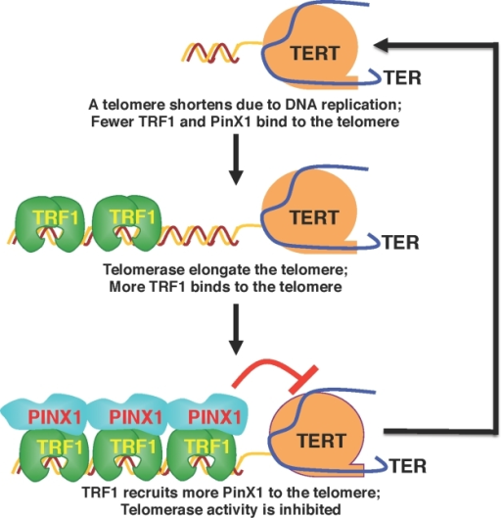
Telomere Length Maintenance
Bound by complex called the telosome
Proposed to form T-loop structure IF long enough
If can’t form T-loop trigger apoptosis
Telomere length proposed to be regulated
by TRF1 & PINX1

Slide 120
Telomere Length Maintenance
Telomere length proposed to be regulated by TRF1 & PINX1
If too short, not enough TRF1
bind so telomerase is active

Slide 121
Telomere Length Maintenance
Telomere length proposed to be regulated by TRF1 & PINX1
If too short, not enough TRF1
bind so telomerase is active
Once long enough TRF1 binds
telomere

Slide 122
Telomere Length Maintenance
Telomere length proposed to be regulated by TRF1 & PINX1
If too short, not enough TRF1
bind so telomerase is active
Once long enough TRF1 binds
telomere
PINX1 then binds TRF1 &
stops telomerase

Slide 123
Telomeres
Aging theory:” mature” cells lose telomerase
lose DNA each S

Slide 124
Telomeres
Aging theory:” mature” cells lose telomerase
lose DNA each S
Die when lose too much: Hayflick limit ~50 divisions for 1˚ cultures

Slide 125
Telomeres
Aging theory:” mature” cells lose telomerase
lose DNA each S
Die when lose too much: Hayflick limit ~50 divisions for 1˚ cultures
Ramunas et al (2015) DOI: 10.1096/fj.14-259531 found that transient expression of TERT in cultured cells added 1000 bp to telomeres and allowed 28 x more divisions in fibroblasts

Slide 126
Telomeres
Aging theory:” mature” cells lose telomerase
lose DNA each S
Die when lose too much: Hayflick limit ~50 divisions for 1˚ cultures
Ramunas et al (2015) DOI: 10.1096/fj.14-259531 found that transient expression of TERT in cultured cells added 1000 bp to telomeres and allowed 28 x more divisions in fibroblasts
Cancer cells must maintain telomere length
90% reactivate telomerase

Slide 127
Telomeres
Cancer cells must maintain telomere length
90% reactivate telomerase
[serum telomerase] can diagnose cancer

Slide 128
Telomeres
Cancer cells must maintain telomere length
90% reactivate telomerase
[serum telomerase] can diagnose cancer
Inhibiting telomerase kills most cancer cells; shows promise for treating melanomas that don’t respond to other treatments

Slide 129
Telomeres
Cancer cells must maintain telomere length
90% reactivate telomerase
[serum telomerase] can diagnose cancer
Inhibiting telomerase kills most cancer cells
Telomerase is symptom cf cause of cancer
not viewed as good target for cancer therapy

Slide 130
Telomeres
90% of cancer cells reactivate telomerase
[serum telomerase] can diagnose cancer
Inhibiting telomerase kills most cancer cells
Telomerase is symptom cf cause of cancer
10 % of cancer cells lengthen telomeres by alternative mechanism involving homologous recombination

Slide 131
Telomeres
10 % of cancer cells lengthen telomeres by alternative mechanism involving homologous recombination
normally inactive: therefore good target for cancer therapy

Slide 132
Telomeres
10 % of cancer cells lengthen telomeres by alternative mechanism involving homologous recombination
normally inactive: therefore good target for cancer therapy
See high frequency
of SCE at telomeres
in ALT cells

Slide 133
Telomeres
10 % of cancer cells lengthen telomeres by alternative mechanism involving homologous recombination
normally inactive: therefore good target for cancer therapy
See high frequency of SCE at telomeres in ALT cells
Also see high frequency of telomere fragments
Substrates for HR and telomere elongation

Slide 134
Telomeres
10 % of cancer cells lengthen telomeres by alternative mechanism involving homologous recombination
See high frequency of SCE at telomeres in ALT cells
Also see high frequency of telomere fragments
Substrates for HR and telomere elongation
Key common feature = chromatin remodeling allowing HR
Perhaps due to depletion of shelterin, especially TRF2

