Slide 1
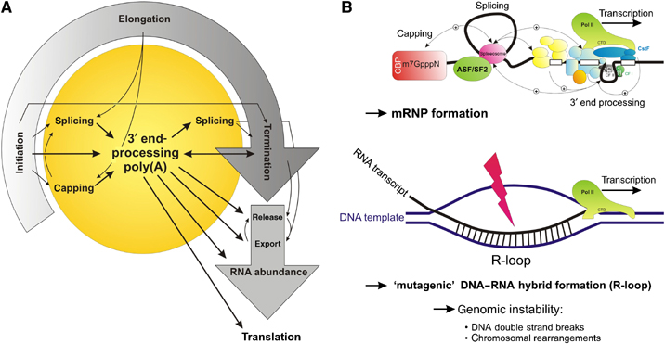
mRNA PROCESSING
Primary transcript is hnRNA
undergoes 3 processing reactions before export to cytosol
All three are coordinated with transcription & affect gene expression: enzymes piggy-back on POLII

Slide 2
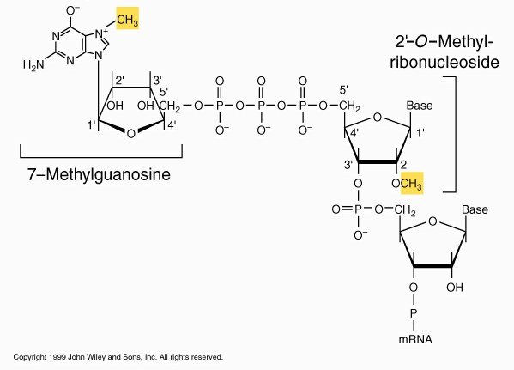
mRNA PROCESSING
Primary transcript is hnRNA
undergoes 3 processing reactions before export to cytosol
1) Capping addition of 7-methyl G to 5’ end
identifies it as mRNA: needed for export & translation
Catalyzed by CEC attached to POLII

Slide 3
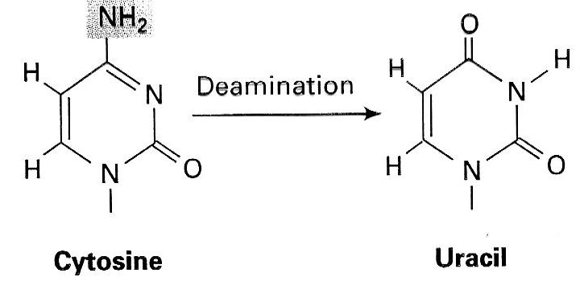
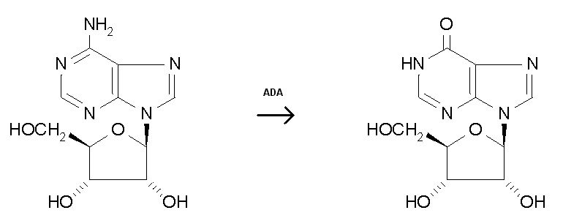
mRNA Processing: RNA editing
Two types: C->U and A->I

Slide 4
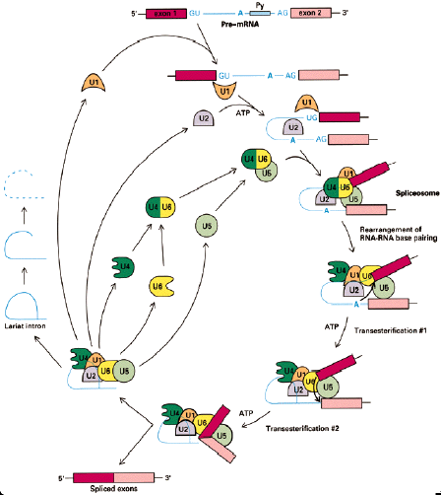
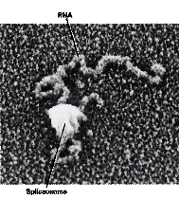
Splicing:The spliceosome cycle

Slide 5
mRNA Processing: Polyadenylation
Addition of 200- 250 As to end of mRNA
Why bother?
helps identify as mRNA
required for translation
way to measure age of mRNA
->mRNA s with < 200 As have short half-life
>50% of human mRNAs have alternative polyA sites!

Slide 6
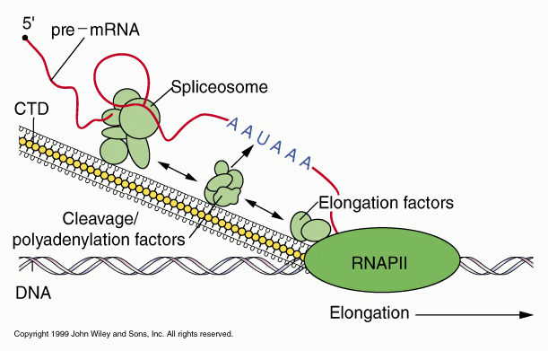
Coordination of mRNA processing
Splicing and polyadenylation factors bind CTD of RNA Pol II-> mechanism to coordinate the three processes Capping, Splicing and Polyadenylation all start before transcription is done!

Slide 7
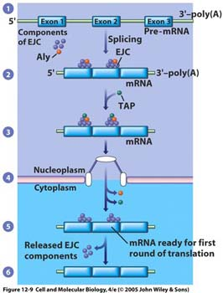
Post-transcriptional regulation
1) mRNA processing
2) export from nucleus
Occurs through nuclear pores
anything > 40 kDa needs exportin protein bound to 5’ cap

Slide 8
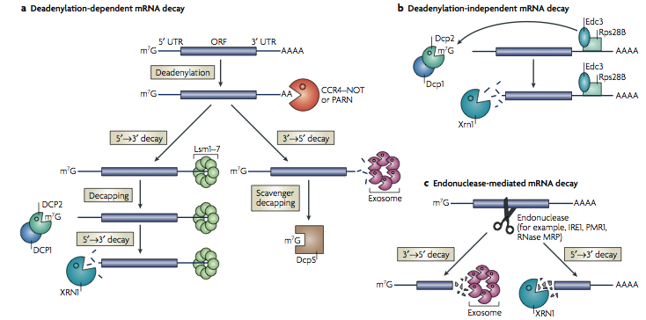
Post-transcriptional regulation
1) mRNA processing
2) export from nucleus
3) mRNA degradation
mRNA lifespan varies 100x
Highly regulated! > 30 RNAses in Arabidopsis!

Slide 9
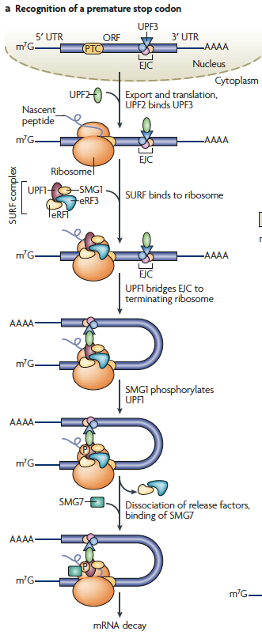
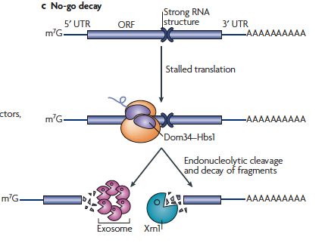
Post-transcriptional regulation
mRNA degradation: mRNA is checked &
defective transcripts are degraded
= mRNA surveillance
Nonsense-mediated decay: EJC @ each splice junction is displaced by ribosome. If EJC is left means ribosome stopped early so mRNA is cut
Non-stop decay: Ribosome goes to end
& cleans off PABP
3.No-go decay: cut RNA 3’ of stalled ribosomes

Slide 10
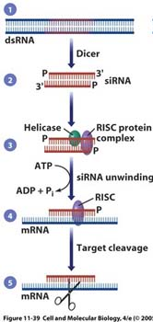
Other mRNA are targeted by
small interfering RNA
defense against RNA viruses
DICERs cut dsRNA into 21-28 bp

Slide 11
Other mRNA are targeted by
small interfering RNA
defense against RNA viruses
DICERs cut dsRNA into 21-28 bp
helicase melts dsRNA

Slide 12
Other mRNA are targeted by
small interfering RNA
defense against RNA viruses
DICERs cut dsRNA into 21-28 bp
helicase melts dsRNA
- RNA binds RISC

Slide 13
Other mRNA are targeted by
small interfering RNA
defense against RNA viruses
DICERs cut dsRNA into 21-28 bp
helicase melts dsRNA
- RNA binds RISC
complex binds target

Slide 14
Other mRNA are targeted by
small interfering RNA
defense against RNA viruses
DICERs cut dsRNA into 21-28 bp
helicase melts dsRNA
- RNA binds RISC
complex binds target
target is cut, then digested by XRN1 & exosome

Slide 15
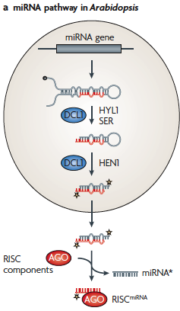
Small RNA regulation
siRNA: target RNA viruses (& transgenes)
miRNA: arrest translation of targets
created by digestion of foldback
Pol II RNA with mismatch loop

Slide 16
Small RNA regulation
siRNA: target RNA viruses (& transgenes)
miRNA: arrest translation of targets
created by digestion of foldback
Pol II RNA with mismatch loop
Mismatch is key difference:
generated by different Dicer

Slide 17
Small RNA regulation
siRNA: target RNA viruses (& transgenes)
miRNA: arrest translation of targets
created by digestion of foldback
Pol II RNA with mismatch loop
Mismatch is key difference:
generated by different Dicer
Arrest translation in animals,
target degradation in plants

Slide 18
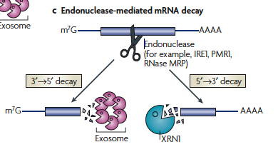
small interfering RNA mark specific
targets
once cut they are removed by
endonuclease-mediated decay

Slide 19
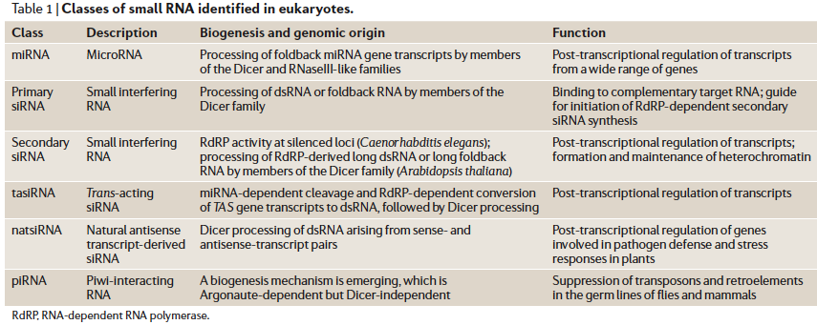

Slide 20
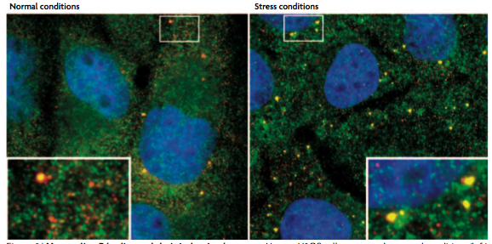
Most RNA degradation occurs in P bodies
recently identified cytoplasmic sites where exosomes & XRN1 accumulate when cells are stressed

Slide 21
Most RNA degradation occurs in P bodies
recently identified cytoplasmic sites where exosomes & XRN1 accumulate when cells are stressed
Also where AGO & miRNAs accumulate

Slide 22
Most RNA degradation occurs in P bodies
recently identified cytoplasmic sites where exosomes & XRN1 accumulate when cells are stressed
Also where AGO & miRNAs accumulate
w/o miRNA P bodies dissolve!

Slide 23
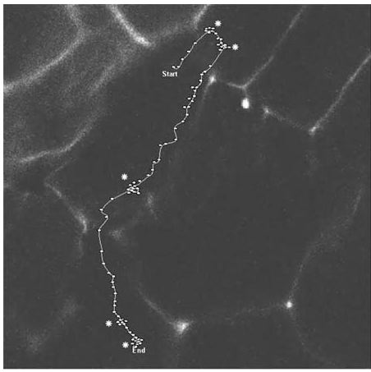
Post-transcriptional regulation
1) mRNA processing
2) export from nucleus
3) mRNA degradation
4) mRNA localization
RNA-binding proteins
link it to cytoskeleton:
bring it to correct site
or store it

Slide 24
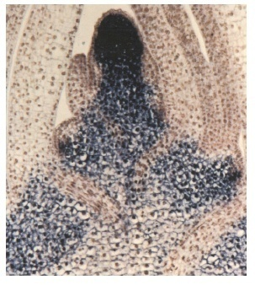
4) mRNA localization
RNA-binding proteins link it to cytoskeleton:bring it to correct site or store it
Some RNA (eg Knotted) are transported into neighboring cells

Slide 25
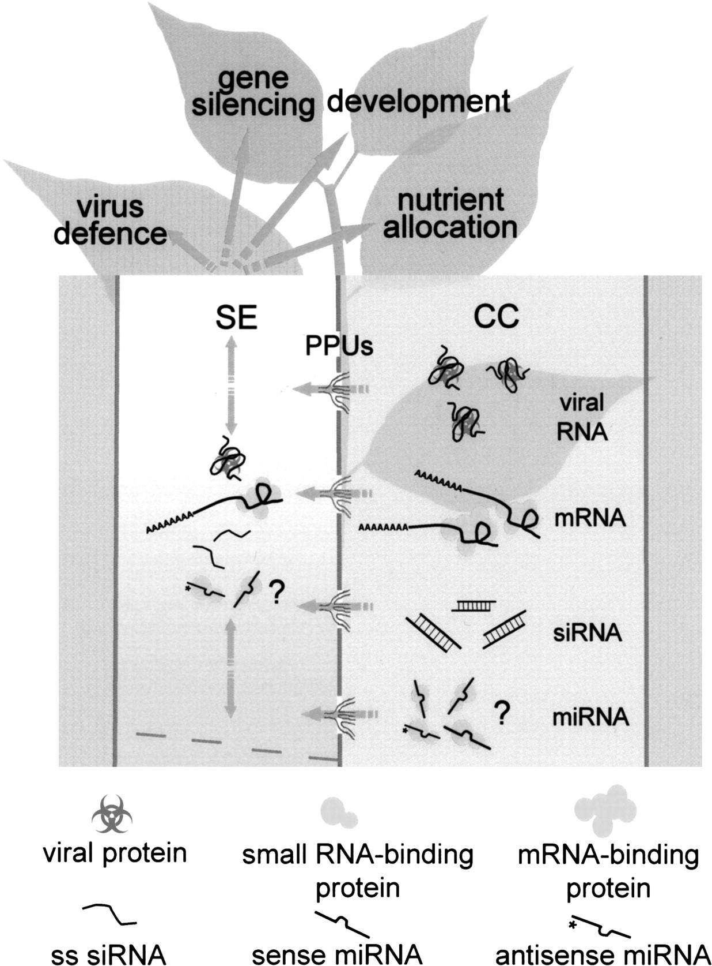
4) mRNA localization
RNA-binding proteins link it to cytoskeleton:bring it to correct site or store it
Some RNA are transported
into neighboring cells
Others are transported t/o the
plant in the phloem (SUT1, KN1)

Slide 26
4) mRNA localization
RNA-binding proteins link it to cytoskeleton:bring it to correct site or store it
Some RNA are transported
into neighboring cells
Others are transported t/o the
plant in the phloem (SUT1, KN1)
Also some siRNA & miRNA!

Slide 27
4) mRNA localization
RNA-binding proteins link it to cytoskeleton:bring it to correct site or store it
Some RNA are transported
into neighboring cells
Others are transported t/o the
plant in the phloem (SUT1, KN1)
Also some siRNA & miRNA!
siRNA mediate silencing
Especially of viruses & TE

Slide 28
4) mRNA localization
RNA-binding proteins link it to cytoskeleton:bring it to correct site or store it
Some RNA are transported
into neighboring cells
Others are transported t/o the
plant in the phloem (SUT1, KN1)
Also some siRNA & miRNA!
siRNA mediate silencing
MiR399 moves to roots to
destroy PHO2 mRNA upon Pi stress
PHO2 negatively regulates
Pi uptake

Slide 29
Post-transcriptional regulation
RNA in pollen controls first division after fertilization!

Slide 30
Post-transcriptional regulation
RNA in pollen controls first division after fertilization!
Delivery by pollen ensures correct development doesn’t happen unless egg is fertilized by pollen

Slide 31
Post-transcriptional regulation
4) mRNA localization
RNA-binding proteins link it to cytoskeleton: bring it to correct site or store it
many are stored in P-bodies! More than just an RNA-destruction site

Slide 32
Post-transcriptional regulation
4) mRNA localization
RNA-binding proteins link it to cytoskeleton: bring it to correct site or store it
many are stored in P-bodies! More than just an RNA-destruction site
Link with initiation of translation

Slide 33
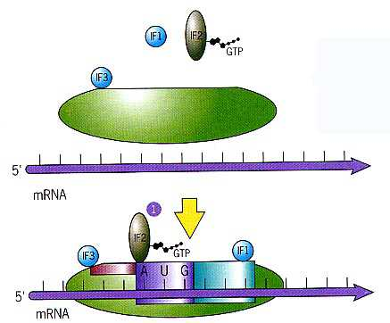
Initiation in Prokaryotes
1) IF1 & IF3 bind 30S subunit, complex binds 5' mRNA

Slide 34
Initiation in Prokaryotes
IF1 & IF3 bind 30S subunit, complex binds 5' mRNA
Complex scans down until finds Shine-Dalgarno sequence, 16S rRNA binds S-D

Slide 35
Initiation in Prokaryotes
IF1 & IF3 bind 30S subunit, complex binds 5' mRNA
Complex scans down until finds Shine-Dalgarno sequence, 16S rRNA binds S-D
Next AUG is Start codon, must be w/in 7-13 bases

Slide 36
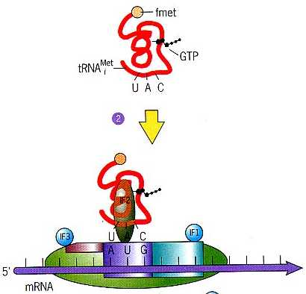
Initiation in Prokaryotes
IF1 & IF3 bind 30S subunit, complex binds 5' mRNA
Complex scans down until finds Shine-Dalgarno sequence, 16S rRNA binds S-D
IF2-GTP binds tRNA_{i}^{fMet}
complex binds start codon

Slide 37
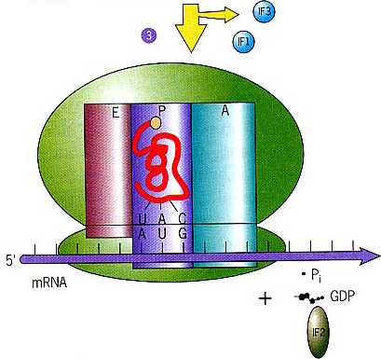
Initiation in Prokaryotes
IF1 & IF3 bind 30S subunit, complex binds 5' mRNA
Complex scans down until finds Shine-Dalgarno sequence, 16S rRNA binds S-D
IF2-GTP binds tRNA_{i}^{fMet}
complex binds start codon
Large subunit binds
IF2-GTP -> IF2-GDP
tRNA_{i}^{fMet} is in P site
IFs fall off

Slide 38
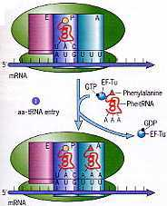
Elongation
1) EF-Tu brings charged tRNA into A site

Slide 39
Elongation
1) EF-Tu brings charged tRNA into A site
anticodon binds
mRNA codon, EF-Tu-GTP -> EF-Tu-GDP

Slide 40
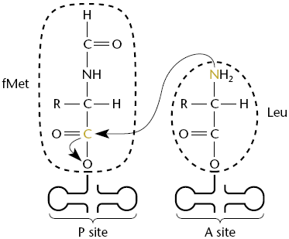
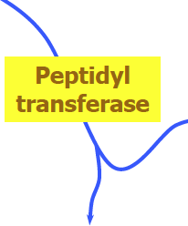
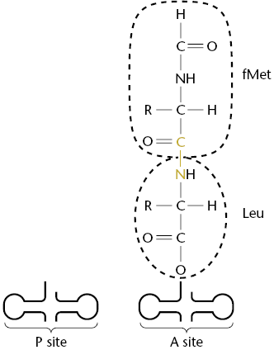
Elongation
1) EF-Tu brings charged tRNA into A site
anticodon binds codon, EF-Tu-GTP -> EF-Tu-GDP
2) ribosome bonds growing peptide on tRNA at P site to a.a. on tRNA at A site

Slide 41
Elongation
1) EF-Tu brings charged tRNA into A site
anticodon binds codon, EF-Tu-GTP -> EF-Tu-GDP
2) ribosome bonds growing peptide on tRNA at P site to a.a. on tRNA at A site
peptidyl transferase is 23S rRNA!

Slide 42
Elongation
3) ribosome translocates one codon
old tRNA moves to E site & exits
new tRNA moves to P site
A site is free for next tRNA
energy comes from
EF-G-GTP -> EF-G-GDP+ Pi

Slide 43
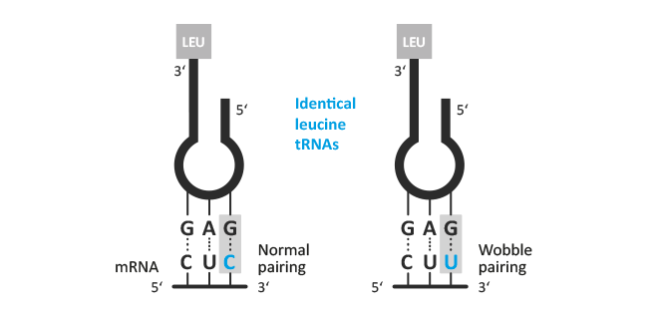
Wobbling
1st base of anticodon can form unusual pairs with 3rd base of codon

Slide 44
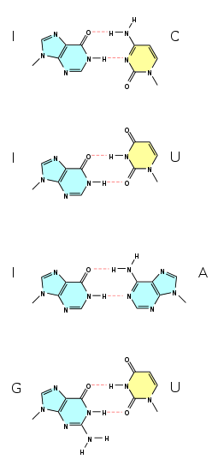
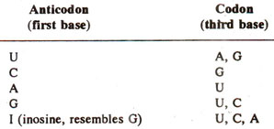
Wobbling
1st base of anticodon can form unusual
pairs with 3rd base of codon

Slide 45
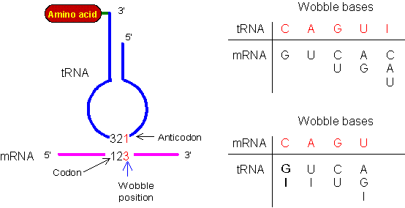
Wobbling
1st base of anticodon can form unusual pairs with 3rd base of codon
Reduces # tRNAs needed:
bacteria have 40 or less (bare minimum is 31 + initiator tRNA)
Eukaryotes have ~ 50

Slide 46
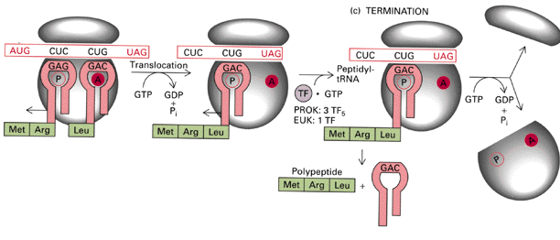
Termination
1) Process repeats until a stop codon is exposed
2) release factor binds nonsense codon
3 stop codons = 3 RF in prokaryotes (1 RF binds all 3 stop codons in euk)

Slide 47
Termination
1) Process repeats until a stop codon is exposed
2) release factor binds nonsense codon
3 stop codons = 3 RF in prokaryotes (1 RF binds all 3 stop codons in euk)
3) Releases peptide from tRNA at P site
4) Ribosome falls apart

Slide 48
Poisons
Initiation: streptomycin, kanamycin
Elongation:
peptidyl transferase:
chloramphenicol (prok)
cycloheximide (euk)
translocation
erythromycin (prok)
diptheria toxin (euk)
Puromycin causes premature termination

Slide 49
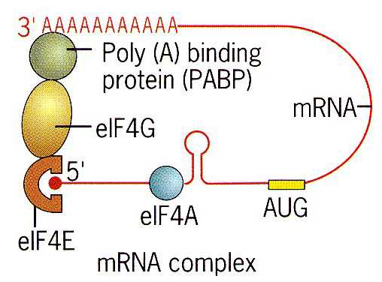
Initiation in Eukaryotes
eIF4E binds mRNA cap
Won’t bind unless 5’cap is methylated

Slide 50
Initiation in Eukaryotes
eIF4E binds mRNA cap
Won’t bind unless 5’cap is methylated

Slide 51
Initiation in Eukaryotes
eIF4E binds mRNA cap
Won’t bind unless 5’cap is methylated
eIF4E & PABP protect RNA from degradation

Slide 52
Initiation in Eukaryotes
eIF4E binds mRNA cap
Won’t bind unless 5’cap is methylated
eIF4E & PABP protect RNA from degradation
eIF4E must be kinased to be active

Slide 53
Initiation in Eukaryotes
eIF4E binds mRNA cap
Won’t bind unless 5’cap is methylated
eIF4E & PABP protect RNA from degradation
eIF4E must be kinased to be active
XS = cancer

Slide 54
Initiation in Eukaryotes
eIF4E binds mRNA cap
eIF4G binds eIF4E, eIF4A & PAB: complex = eIF4F

Slide 55
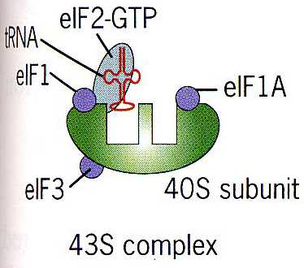
Initiation in Eukaryotes
eIF4E binds mRNA cap
eIF4G binds eIF4E, eIF4A & PAB: complex = eIF4F
_{i}tRNA^{:met} & eIF1, eIF2 & eIF3 bind 40S subunit

Slide 56
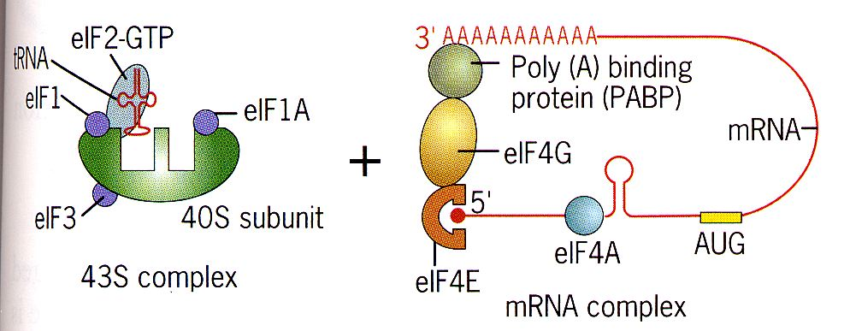
Initiation in Eukaryotes
_{i}tRNA^{:met} & eIF1, eIF2 & eIF3 bind 40S subunit
43S complex binds eIF4F
eIF4A & eIF4B scan down & melt mRNA (using ATP)

Slide 57
Initiation in Eukaryotes
_{i}tRNA^{:met} & eIF1, eIF2 & eIF3 bind 40S subunit
43S complex binds eIF4F
eIF4A & eIF4B scan down & melt mRNA (using ATP)
43S follows until finds Kozak sequence 5’-ACCAUG

Slide 58
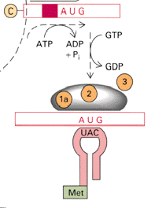
Initiation in Eukaryotes
7) initiator tRNA:met binds start codon (AUG), eIF2 hydrolyzes GTP

Slide 59
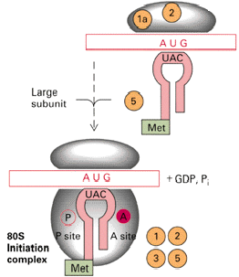
Initiation in Eukaryotes
8) 60S subunit binds
_{i}tRNA^{:met} is at P site
ribosome thinks it is a protein!
why 60S subunit doesn’t
bind until _{i}tRNA^{:met}
binds AUG
why have _{i}tRNA^{:met}

Slide 60
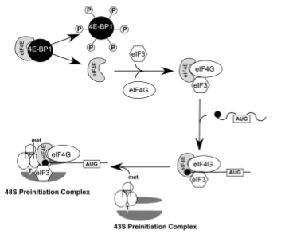
Regulation
Key step = eIF4E binds mRNA cap
Won’t bind unless 5’cap is methylated
eIF4E must be kinased to be active
4E-BP1 binds eIF4E & keeps it inactive until kinased

Slide 61
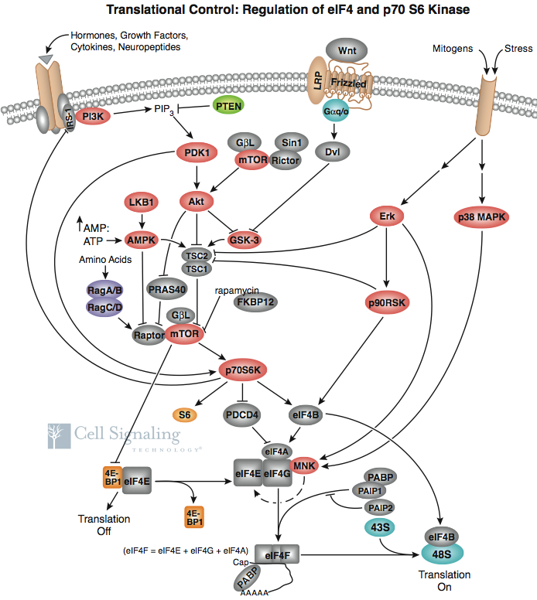
Regulating Translation
eIF4F is also
regulated many
other ways!

Slide 62
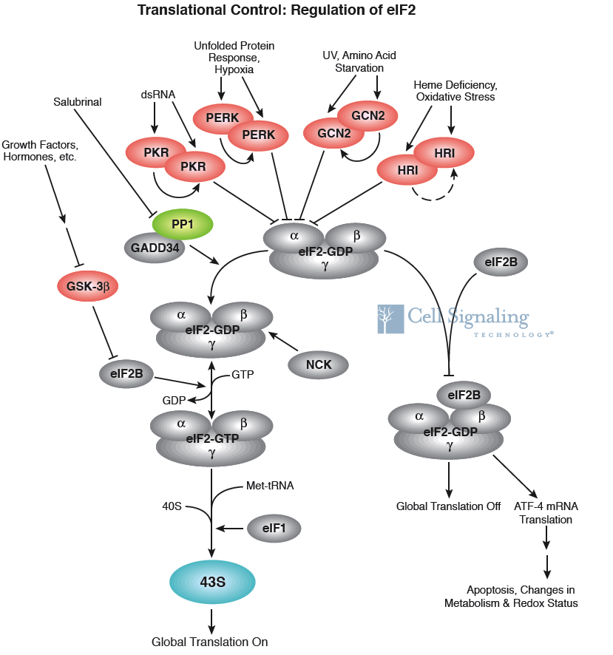
Post-transcriptional regulation
2) Other key step = eIF2

Slide 63
Post-transcriptional regulation
2) Other key step = eIF2
controls assembly of 43S

Slide 64
Post-transcriptional regulation
2) Other key step = eIF2
controls assembly of 43S
Highly regulated!

Slide 65
Post-transcriptional regulation
2) Other key step = eIF2
controls assembly of 43S
Highly regulated!
Inactive if kinased
= virus defence

Slide 66
Post-transcriptional regulation
initiation of translation varies >10x
5' UTR sequences also affect rate

Slide 67
Post-transcriptional regulation
initiation of translation varies >10x
5' UTR sequences also affect rate
some adopt 2˚ structures hard to melt

Slide 68
Post-transcriptional regulation
initiation of translation varies >10x
5' UTR sequences also affect rate
some adopt 2˚ structures hard to melt
proteins bind others, enhance or repress translation

Slide 69
Post-transcriptional regulation
initiation of translation varies >10x
5' UTR sequences also affect rate
some adopt 2˚ structures hard to melt
proteins bind others, enhance or repress translation
microRNA bind specific mRNA & block translation

Slide 70
Post-transcriptional regulation
initiation of translation varies >10x
5' UTR sequences also affect rate
some adopt 2˚ structures hard to melt
proteins bind others, enhance or repress translation
microRNA bind specific mRNA & block translation
Many bind 3’UTR!

Slide 71
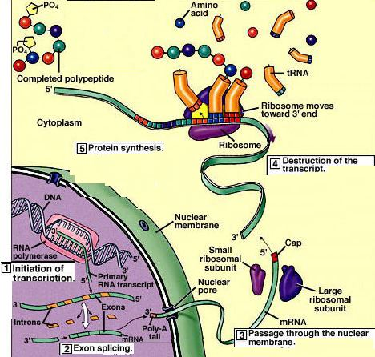
Post-transcriptional regulation
1) mRNA processing
2) export from nucleus
3) mRNA
degradation
4) mRNA localization
5) initiation of
translation
varies >10x
6) regulating
enzyme activity
activators
Inhibitors
Covalent mods

Slide 72
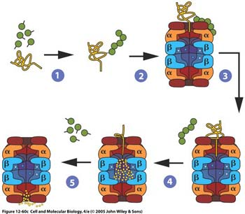
Post-transcriptional regulation
Protein degradation rate varies 100x
Some have motifs, eg Destruction box, marking them for polyubiquitination: taken to proteasome & destroyed

Slide 73
Post-transcriptional regulation
Protein degradation rate varies 100x
Some have motifs, eg Destruction box, marking them for polyubiquitination: taken to proteasome & destroyed
N-terminal rule: Proteins with N-terminal Phe, Leu, Asp, Lys, or Arg have half lives of 3 min or less.

Slide 74
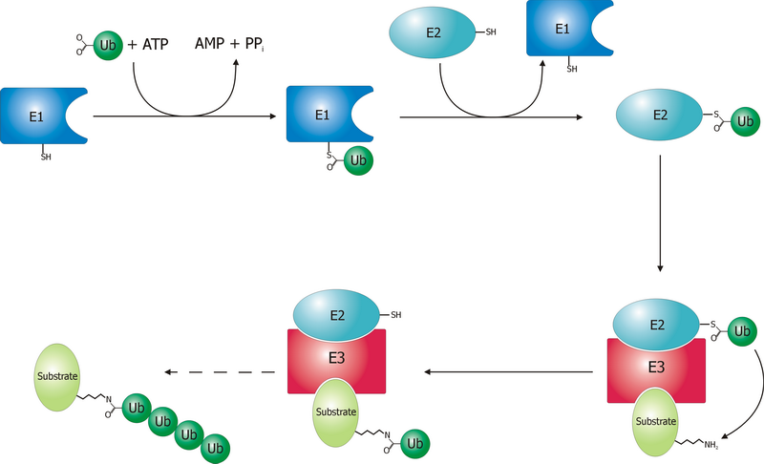
Protein degradation
Some have motifs marking them for polyubiquitination:
E1 enzymes activate ubiquitin
E2 enzymes conjugate ubiquitin
E3 ub ligases determine specificity, eg for N-terminus

Slide 75
Protein degradation
E3 ub ligases determine specificity
>1300 E3 ligases in Arabidopsis
4 main classes according to cullin scaffolding protein

Slide 76
E3 ubiquitin ligases determine specificity
>1300 E3 ligases in Arabidopsis
4 main classes according to cullin scaffolding protein
RBX1 (or similar) positions E2

Slide 77
E3 ubiquitin ligases determine specificity
>1300 E3 ligases in Arabidopsis
4 main classes according to cullin scaffolding protein
RBX1 (or similar) positions E2
Linker (eg DDB1) positions substrate receptor

Slide 78
E3 ubiquitin ligases determine specificity
>1300 E3 ligases in Arabidopsis
4 main classes according to cullin scaffolding protein
RBX1 (or similar) positions E2
Linker (eg DDB1) positions substrate receptor
Substrate receptor (eg DCAF/DWD) picks substrate
>100 DWD in Arabidopsis

Slide 79
E3 ubiquitin ligases determine specificity
>1300 E3 ligases in Arabidopsis
4 main classes according to cullin scaffolding protein
RBX1 (or similar) positions E2
Linker (eg DDB1) positions substrate receptor
Substrate receptor (eg DCAF/DWD) picks substrate
NOT4 is an E3 ligase & a component of the CCR4–NOT de-A complex

Slide 80
E3 ubiquitin ligases determine specificity
>1300 E3 ligases in Arabidopsis
4 main classes according to cullin scaffolding protein
RBX positions E2
DDB1 positions DCAF/DWD
DCAF/DWD picks substrate: >85 DWD in rice
NOT4 is an E3 ligase & a component of the CCR4–NOT de-A complex
CCR4–NOT de-A
Complex regulates pol II

Slide 81
E3 ubiquitin ligases determine specificity
>1300 E3 ligases in Arabidopsis
4 main classes according to cullin scaffolding protein
RBX positions E2
DDB1 positions DCAF/DWD
DCAF/DWD picks substrate
NOT4 is an E3 ligase & a component of the CCR4–NOT de-A complex
CCR4–NOT de-A
Complex regulates pol II
Transcription, mRNA
deg & prot deg are
linked!

Slide 82
E3 ubiquitin ligases determine specificity
Cell cycle: Anaphase Promoting Complex is an E3 ligase.
MPF induces APC
APC inactive until all kinetochores are bound
APC then tags securin to free
separase: cuts proteins linking
chromatids

Slide 83
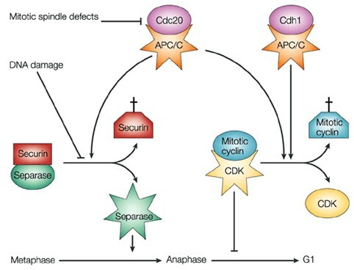
E3 ubiquitin ligases determine specificity
MPF induces APC
APC inactive until all kinetochores are bound
APC then tags securin to free separase: cuts proteins linking chromatids
APC next swaps Cdc20 for Cdh1 & tags cyclin B to enter G1

Slide 84
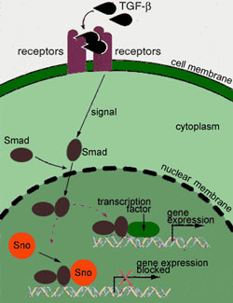
E3 ubiquitin ligases determine specificity
APC next tags cyclin B (destruction box) to enter G1
APC also targets Sno proteins in TGF-β signaling
Sno proteins prevent Smad from activating genes

Slide 85
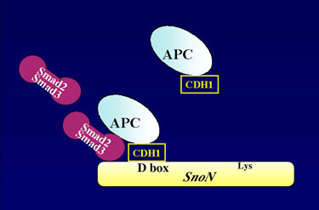
E3 ubiquitin ligases determine specificity
APC also targets Sno proteins in TGF-β signaling
Sno proteins prevent Smad from activating genes
APC/Smad2/Smad3 tags Sno for destruction

Slide 86
E3 ubiquitin ligases determine specificity
APC also targets Sno proteins in TGF-β signaling
Sno proteins prevent Smad from activating genes
APC/Smad2/Smad3 tags Sno for destruction
Excess Sno = cancer

Slide 87
E3 ubiquitin ligases determine specificity
APC also targets Sno proteins in TGF-β signaling
Sno proteins prevent Smad from activating genes
APC/Smad2/Smad3 tags Sno for destruction
Excess Sno = cancer
Angelman syndrome = bad UBE3A
Only express maternal allele because paternal allele is methylated

Slide 88
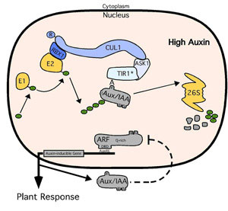
Auxin signaling
Auxin receptors eg TIR1 are E3 ubiquitin ligases
Upon binding auxin they activate complexes targeting AUX/IAA proteins for degradation

Slide 89
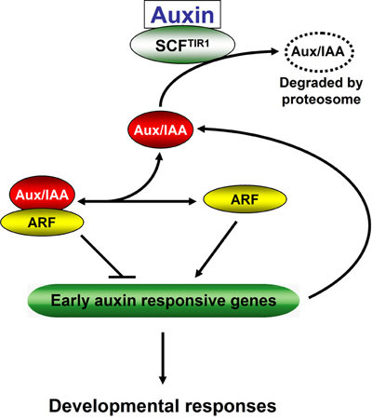
Auxin signaling
Auxin receptors eg TIR1 are E3 ubiquitin ligases!
Upon binding auxin they activate complexes targeting AUX/IAA proteins for degradation
AUX/IAA inhibit ARF transcription factors,
so this turns on
"early genes"

Slide 90
Auxin signaling
Auxin receptors eg TIR1 are E3 ubiquitin ligases!
Upon binding auxin they activate complexes targeting AUX/IAA proteins for degradation!
AUX/IAA inhibit ARF transcription factors,
so this turns on
"early genes"
Some early genes turn
on 'late genes" needed
for development

Slide 91
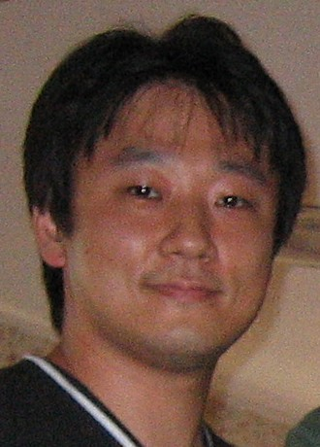
DWD Proteins
Jae-Hoon Lee’s research
putative substrate receptors for CUL4-based E3 ligases

Slide 92
DWD Proteins
Jae-Hoon Lee’s research
putative substrate receptors for CUL4-based E3 ligases
used bioinformatics to find all Arabidopsis & rice DWDs

Slide 93
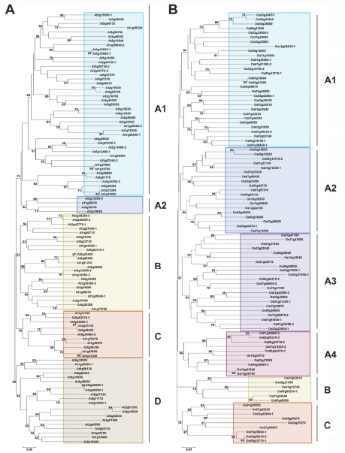
DWD Proteins
used bioinformatics to
find all Arabidopsis &
rice DWDs
Placed in subgroups
based on DWD sequence

Slide 94
DWD Proteins
used bioinformatics to
find all Arabidopsis &
rice DWDs
Placed in subgroups
based on DWD sequence
Tested members of each
subgroup for DDB1
binding

Slide 95
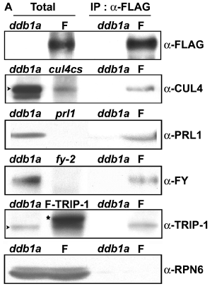
DWD Proteins
Tested members of each subgroup for DDB1 binding
co-immunoprecipitation

Slide 96
DWD Proteins
Tested members of each subgroup for DDB1 binding
co-immunoprecipitation
Two-hybrid: identifies
interacting proteins

Slide 97
DWD Proteins
Tested members of each subgroup for DDB1 binding
co-immunoprecipitation
Two-hybrid: identifies
interacting proteins
Only get transcription if
one hybrid supplies Act D
& other supplies DNA
Binding Domain

Slide 98
DWD Proteins
Tested members of each subgroup for DDB1 binding
co-immunoprecipitation
Two-hybrid: identifies
interacting proteins
Only get transcription if
one hybrid supplies Act D
& other supplies DNA BD
Other ways to show protein
Interactions:

Slide 99
DWD Proteins
Other ways to show protein interactions
FRET: Fluorescence resonance energy transfer

Slide 100
DWD Proteins
Other ways to show protein interactions:
FRET: Fluorescence resonance energy transfer
BiFC: Bimolecular fluorescence complementation
Notes:
Bimolecular fluorescence complementation

Slide 101
DWD Proteins
Other ways to show protein interactions:
FRET: Fluorescence resonance energy transfer
BiFC: Bimolecular fluorescence complementation
Split luciferase complementation
All rely on reporter proteins that can be split into N and C domains that regain function when reunited.
Fuse the N-domain to one potential interactor, C-domain to the other then look for restoration of function.
Notes:
Bimolecular fluorescence complementation

Slide 102
DWD Proteins
Two-hybrid libraries are used to screen for protein-protein interactions

Slide 103
DWD Proteins
Tested members of each subgroup for DDB1 binding
co-immunoprecipitation
Two-hybrid

Slide 104
DWD Proteins
Tested members of each subgroup for DDB1 binding
co-immunoprecipitation
Cul4cs &PRL1 (Pleiotropic
Regulatory Locus 1) had
Similar phenotypes

Slide 105
DWD Proteins
Cul4cs &PRL1 (PleiotropicRegulatory Locus 1) had
similar phenotypes
PRL1 may be receptor for
AKIN10 degradation
(involved in sugar sensing)

Slide 106
DWD Proteins
Found T-DNA insertions
3 were sensitive to ABA

Slide 107
DWD Proteins
Found T-DNA insertions
3 were sensitive to ABA
ABI5 was elevated in dwa mutants

Slide 108
DWD Proteins
Found T-DNA insertions
3 were sensitive to ABA
ABI5 was elevated in dwa mutants
ABI5 was degraded more slowly in dwa extracts

Slide 109
DWD Proteins
Found T-DNA insertions
3 were sensitive to ABA
ABI5 was elevated in dwa mutants
ABI5 was degraded more slowly in dwa extracts
DWA1 & DWA2 target ABI5 for degradation

Slide 110
Regulating E3 ligases
The COP9 signalosome (CSN), a complex of 8 proteins, regulates E3 ligases by removing Nedd8 from cullin

Slide 111
Regulating E3 ligases
The COP9 signalosome (CSN), a complex of 8 proteins, regulates E3 ligases by removing Nedd8 from cullin
CAND1 then blocks cullin

Slide 112
Regulating E3 ligases
The COP9 signalosome (CSN), a complex of 8 proteins, regulates E3 ligases by removing Nedd8 from cullin
CAND1 then blocks cullin
Ubc12 replaces Nedd8

Slide 113
Regulating E3 ligases
The COP9 signalosome (CSN), a complex of 8 proteins, regulates E3 ligases by removing Nedd8 from cullin
CAND1 then blocks cullin
Ubc12 replaces Nedd8
Regulates DNA-damage
response, cell-cycle
& gene expression

Slide 114
Regulating E3 ligases
The COP9 signalosome (CSN), a complex of 8 proteins, regulates E3 ligases by removing Nedd8 from cullin
CAND1 then blocks cullin
Ubc12 replaces Nedd8
Regulates DNA-damage
response, cell-cycle
& gene expression
Not all E3 ligases
associate with
Cullins!

Slide 115
COP1 is a non-cullin-associated E3 ligase
Protein degradation is important for light regulation
COP1/SPA1 tags transcription factors for degradation
W/O COP1 they act in dark
In light COP1 is exported to cytoplasm so TF can act

Slide 116
COP1 is a non-cullin-associated E3 ligase
Recent data indicates that COP1 may also associate with CUL4

Slide 117
Protein degradation rate varies 100x
Most have motifs marking them for polyubiquitination: taken to proteosome & destroyed
Other signals for selective degradation include PEST & KFERQ
PEST : found in many rapidly
degraded proteins
e.g. ABCA1 (which exports
cholesterol in association with
apoA-I) is degraded by calpain

Slide 118
Protein degradation rate varies 100x
Other signals for selective degradation include PEST & KFERQ
PEST : found in many rapidly degraded proteins
e.g. ABCA1 (which exports cholesterol in association with apoA-I) is degraded by calpain
Deletion increases t_{1/2} 10x, adding PEST drops t_{1/2} 10x

Slide 119
Protein degradation rate varies 100x
Other signals for selective degradation include PEST & KFERQ
PEST : found in many rapidly degraded proteins
e.g. ABCA1 (which exports cholesterol in association with apoA-I) is degraded by calpain
Deletion increases t_{1/2} 10x, adding PEST drops t_{1/2} 10x
Sometimes targets poly-Ub

Slide 120
Protein degradation rate varies 100x
Other signals for selective degradation include PEST & KFERQ
PEST : found in many rapidly degraded proteins
e.g. ABCA1 (which exports cholesterol in association with apoA-I) is degraded by calpain
Deletion increases t_{1/2} 10x, adding PEST drops t_{1/2} 10x
Sometimes targets poly-Ub
Recent yeast study doesn’t support general role

Slide 121
Protein degradation rate varies 100x
Other signals for selective degradation include PEST & KFERQ
PEST : found in many rapidly degraded proteins
e.g. ABCA1 (which exports cholesterol in association with apoA-I) is degraded by calpain
Deletion increases t_{1/2} 10x, adding PEST drops t_{1/2} 10x
Sometimes targets poly-Ub
Recent yeast study doesn’t support general role
KFERQ: cytosolic proteins with KFERQ are selectively taken up by lysosomes in chaperone-mediated autophagy under conditions of nutritional or oxidative stress.

Slide 122
Protein degradation in bacteria
Also highly regulated, involves chaperone-like proteins
Lon

Slide 123
Protein degradation in bacteria
Also highly regulated, involves chaperone-like proteins
Lon
Clp

Slide 124
Protein degradation in bacteria
Also highly regulated, involves chaperone-like proteins
Lon
Clp
FtsH in IM

