Slide 1
First assignment Wednesday Feb 20
pick a particular combination of biofuel, gene and treatment & convince the group in 5-10 minutes why your choice is best.
Suggestions
Drought/VPD/salinity
pCO₂
Temperature
Light
PFD (photonflux density) = intensity
Photoperiod (daylength) = duration
Quality = color
Nutrition
Macronutrients = N, P, K, S, Ca, Mg, Fe
Micronutrients, vitamins
Inhibitors
Cell wall
Fatty acid synthesis
Something else??

Slide 2
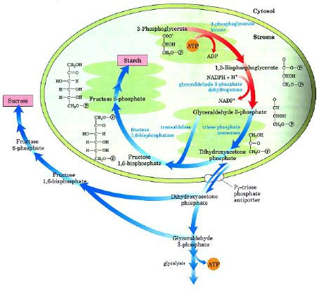
Manipulating Calvin Cycle
1 in 6 G3P becomes (CH₂O)_{n}
either becomes starch in chloroplast (to store in cell)
or is converted to
DHAP & exported
to cytoplasm to
make sucrose
Pi/triosePO₄
antiporter only
trades DHAP for Pi
mechanism to
regulate PS
Notes:
Reducing P might alter partitioning to starch vs sucrose
Might also alter partitioning to fats

Slide 3
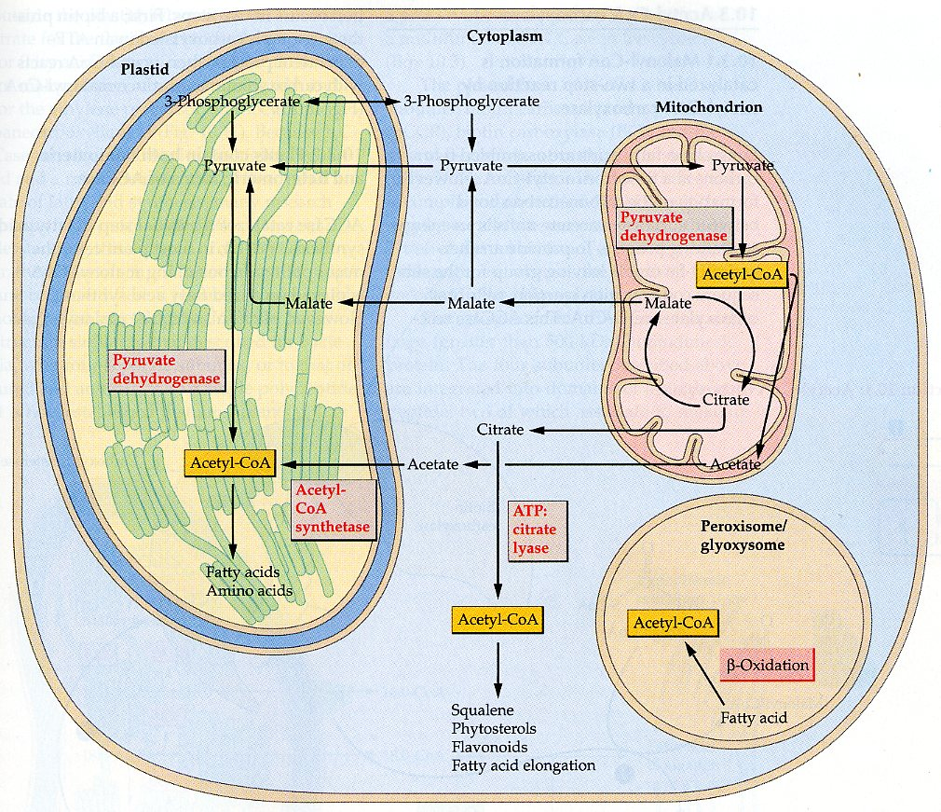
Manipulating fatty acid synthesis
Acetyl-CoA is key step
Used to make fatty acids
Also used to make sterols, some amino acids, stilbenes & others
Why ACCase is “committed step”
Notes:
Can be inhibited in grasses
Can inhibit sterols with statins

Slide 4
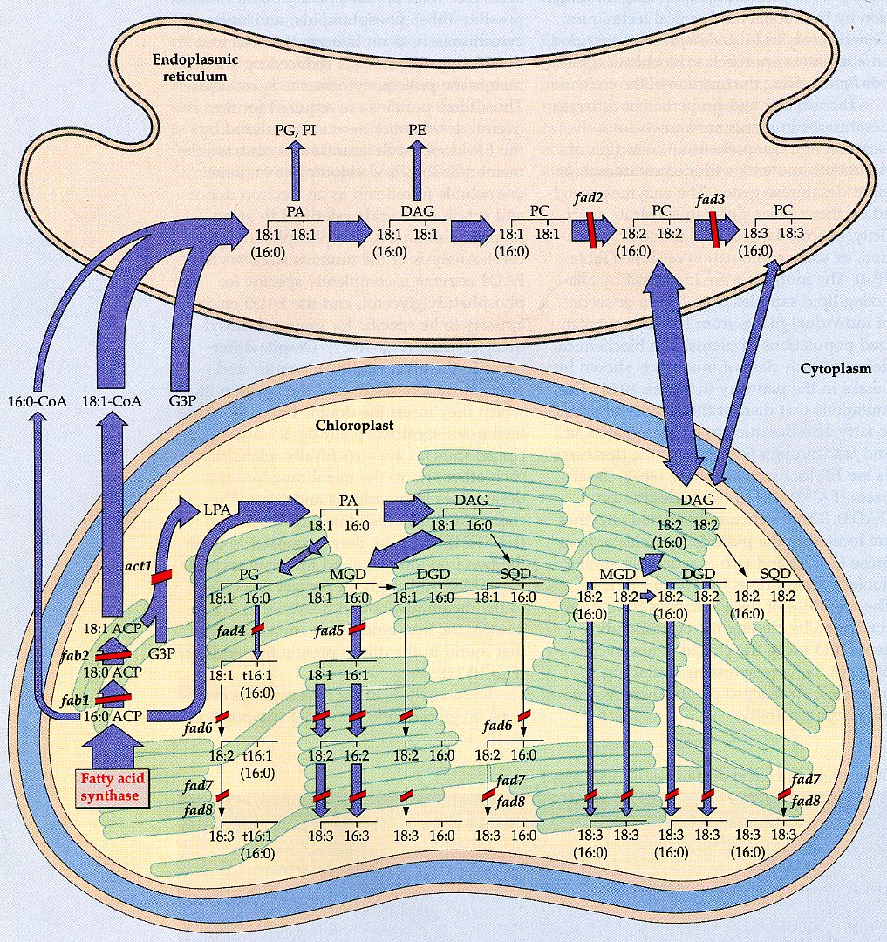
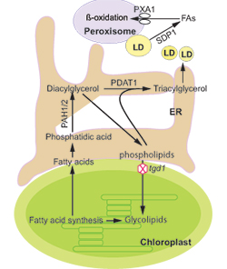
Manipulating lipid metabolism
P starvation should push to making galactolipids
S starvation should push to making phospholipids & oils
Mg starvation increased oil
in cyanobacteria
N starvation increased oil
in Chlorella & Dunaliella

Slide 5
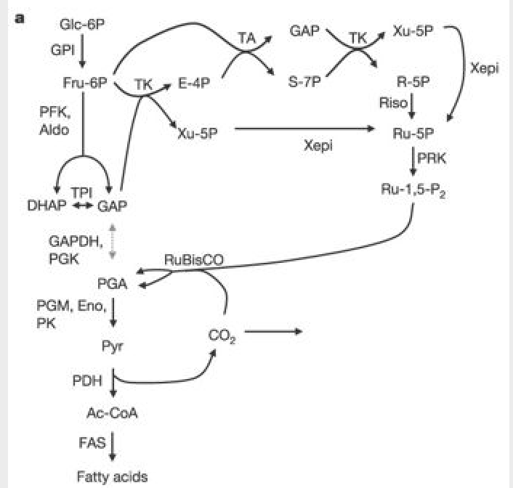
Manipulating lipid metabolism
In green seeds PGA formed by rubisco may be turned to pyruvate
PDH then turns it to Acetyl-CoA
Less CO₂ loss and more energy-efficient than via glycolysis
RuBP is regenerated via Pentose-phosphate pathway

Slide 6
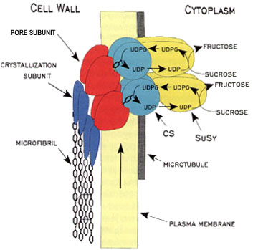
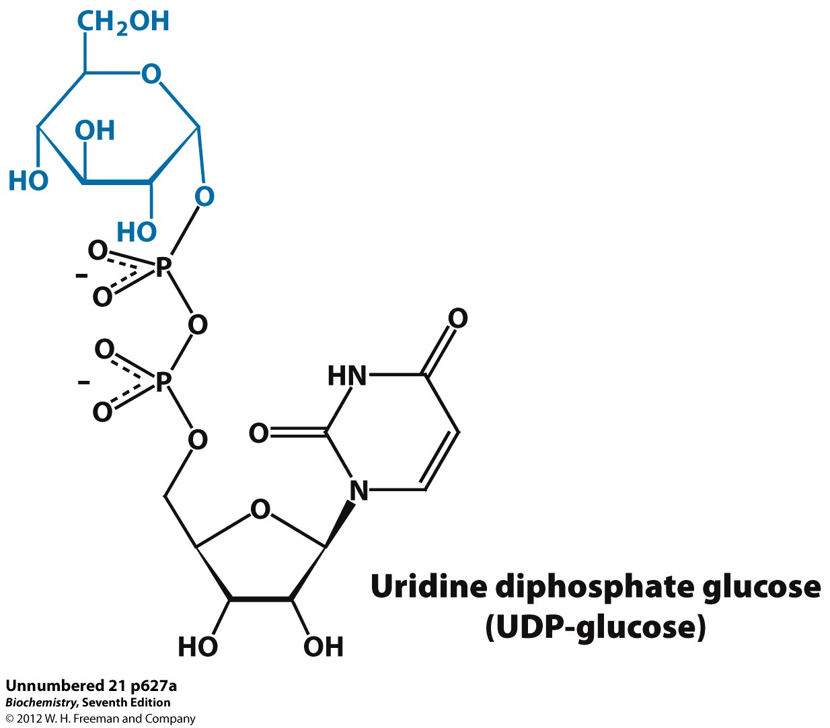
Manipulating cell wall carbohydrate synthesis

Slide 7
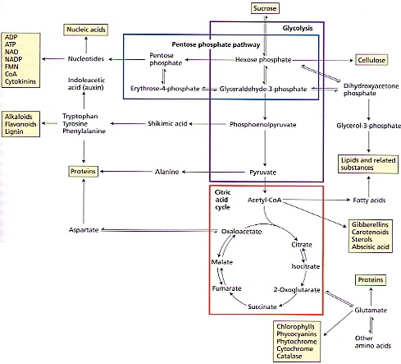
Manipulating respiration
Pyruvate oxidation & Krebs cycle in mito make Acetyl-CoA & others many Pentose phosphate shunt in cytosol or cp
makes NADPH & intermediates
Uses many Calvin Cycle enzymes
Makes nucleotide &
phenolic precursors
Affected by T, pCO₂
many others

Slide 8
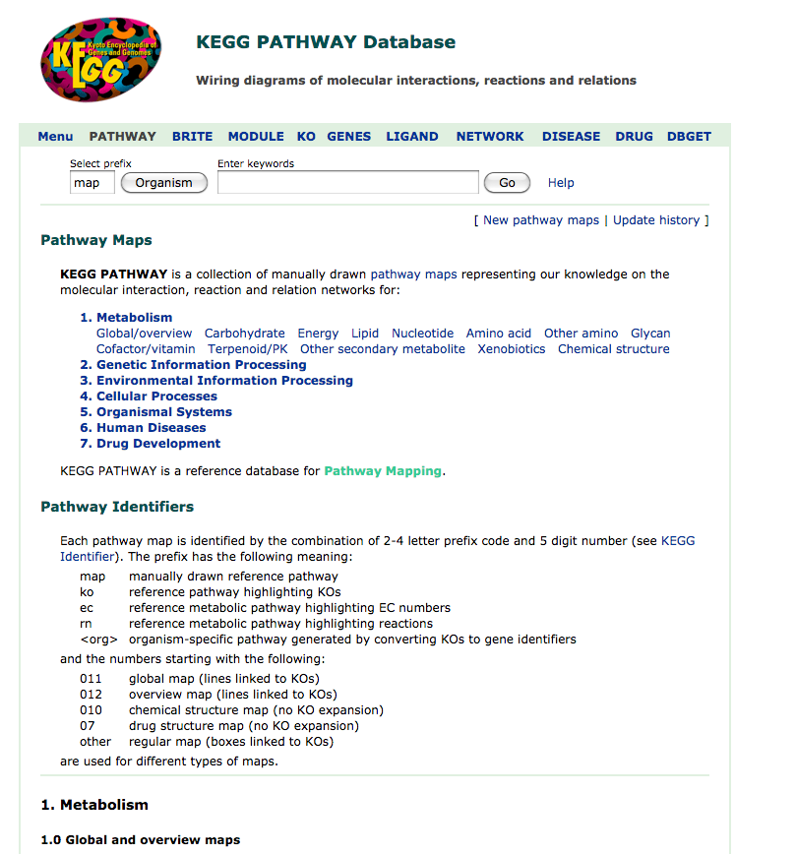
Finding candidates
KEGG pathways: https://www.genome.jp/kegg/pathway.html

Slide 9
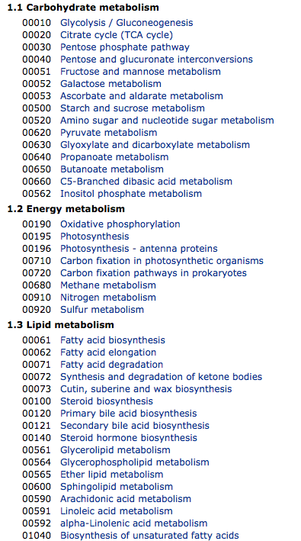
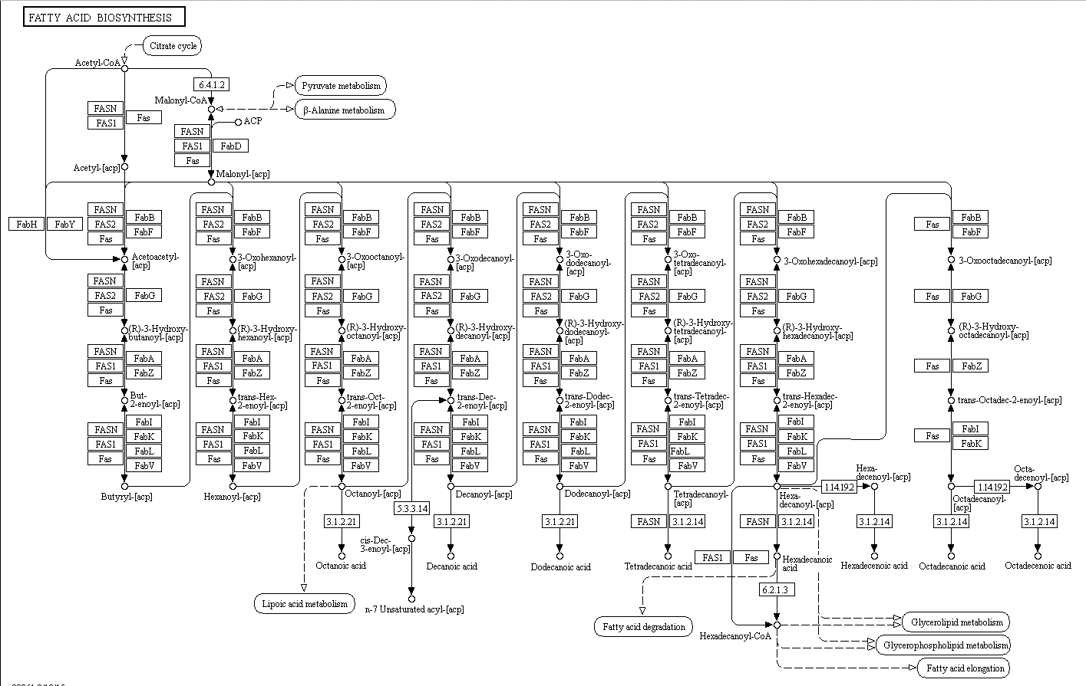
Finding candidates
KEGG pathways: https://www.genome.jp/kegg/pathway.html

Slide 10
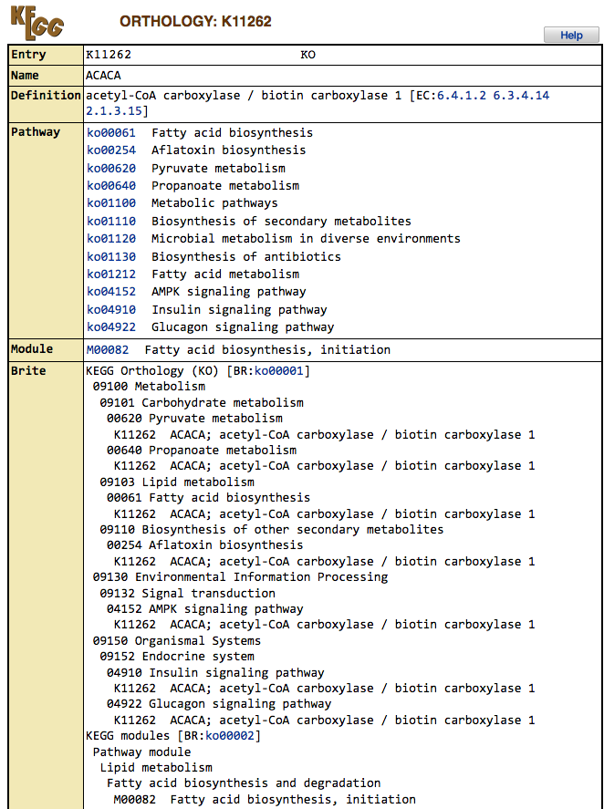
Finding candidates
KEGG pathways: https://www.genome.jp/kegg/pathway.html

Slide 11
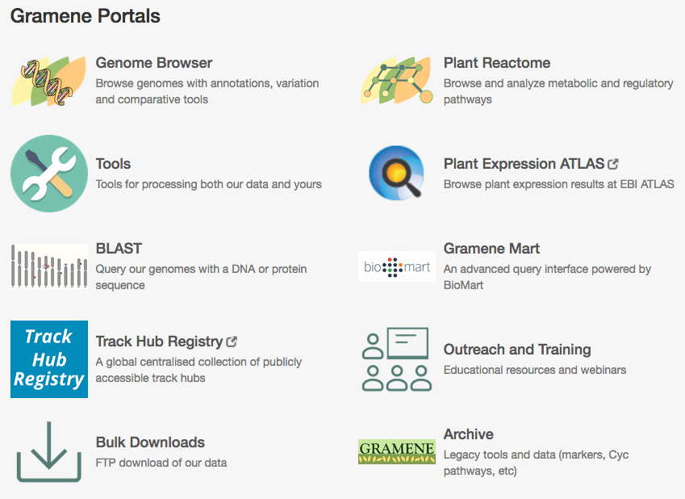
Finding candidates
KEGG pathways: https://www.genome.jp/kegg/pathway.html
Gramene: http://www.gramene.org/

Slide 12
Finding candidates
KEGG pathways: https://www.genome.jp/kegg/pathway.html
Gramene: http://www.gramene.org/

Slide 13
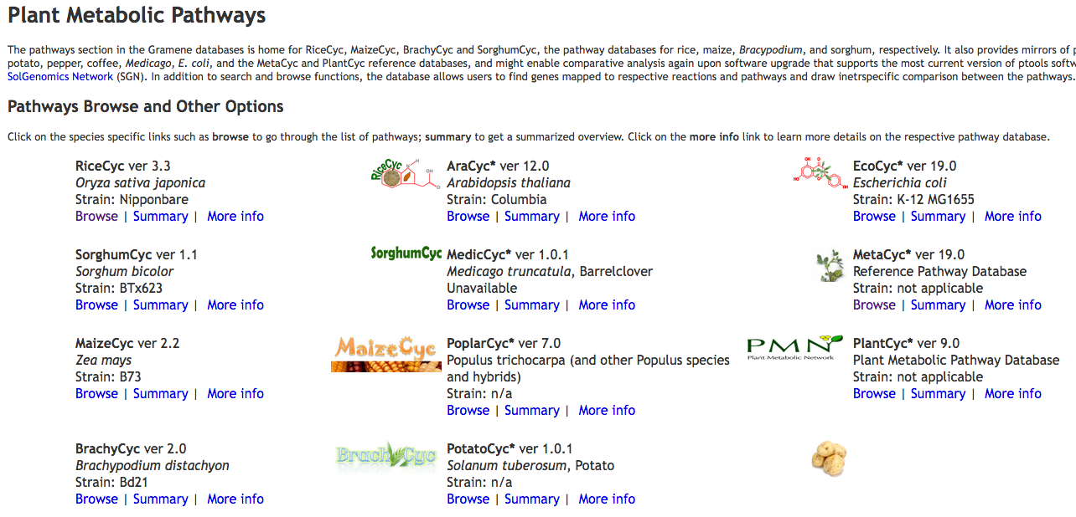
Finding candidates

Slide 14
Finding candidates

Slide 15
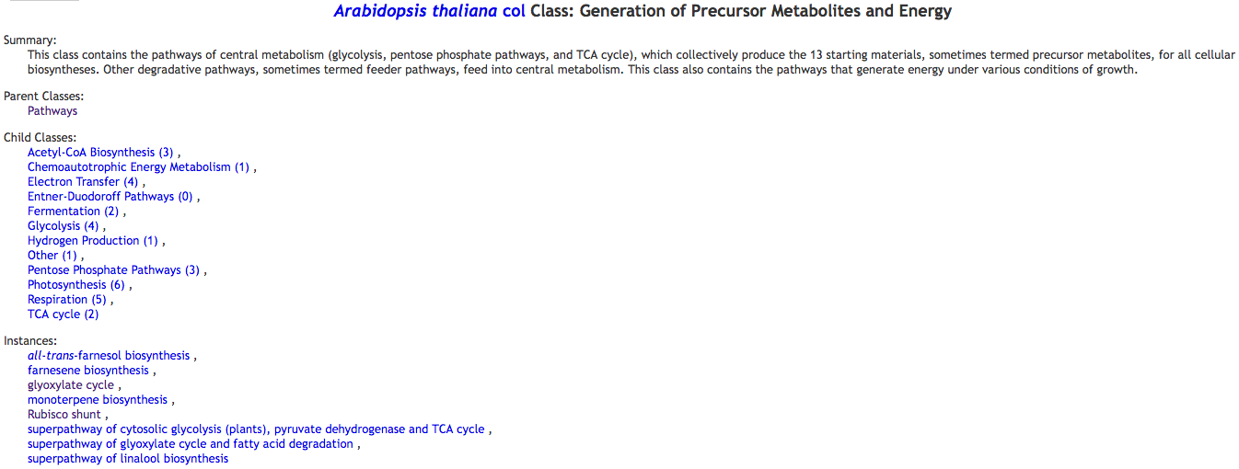
Finding candidates

Slide 16
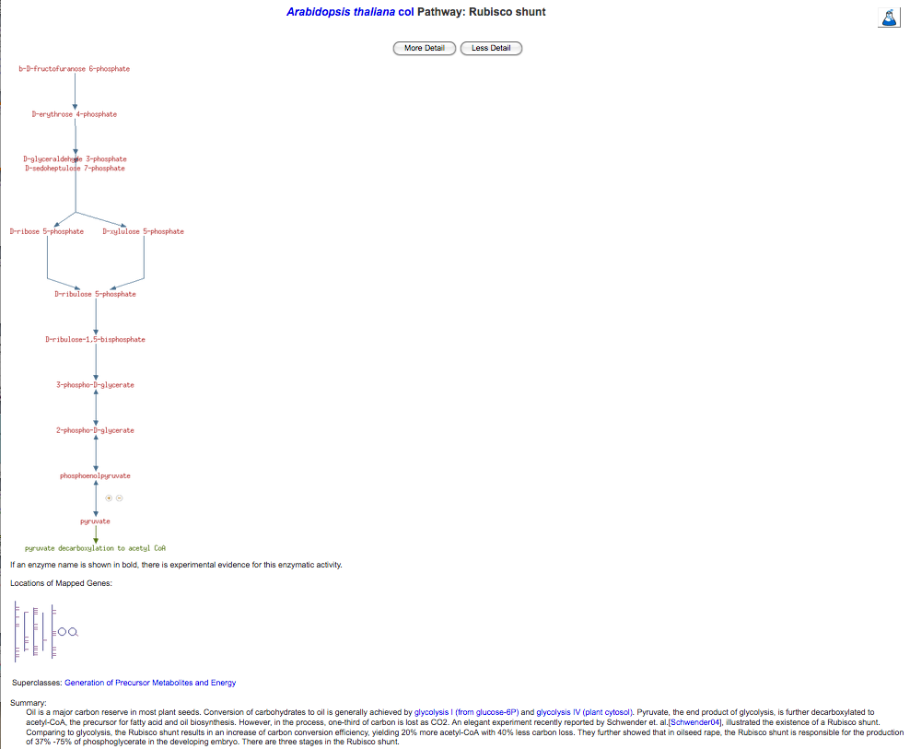

Slide 17
