Slide 1
Find ways to alter plant biofuel production
Ways to increase total photosynthesis
Light
pCO₂
Temp
Nutrition
Ways to alter allocation of photosynthate to biofuel production
Treatments
Environmental
Chemical (eg inhibitors of cell wall or lipid synthesis)
Growth regulators
Other???
Identify genes to study
Sucrose synthesis?
Lipid & oil synthesis?
Cell wall synthesis?
Compare predicted with observed effects on their expression
Compare predicted with observed effects on biofuel production

Slide 2
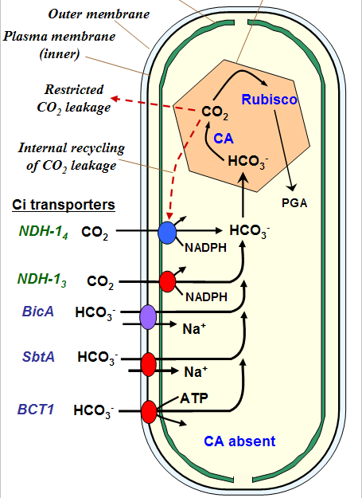
CO₂ concentrating mechanisms in Algae
Mechs to avoid p.r. and do Calvin cycle at low pCO₂
HCO₃⁻ uptake system
Increases internal C_{i} to levels
much higher than outside

Slide 3
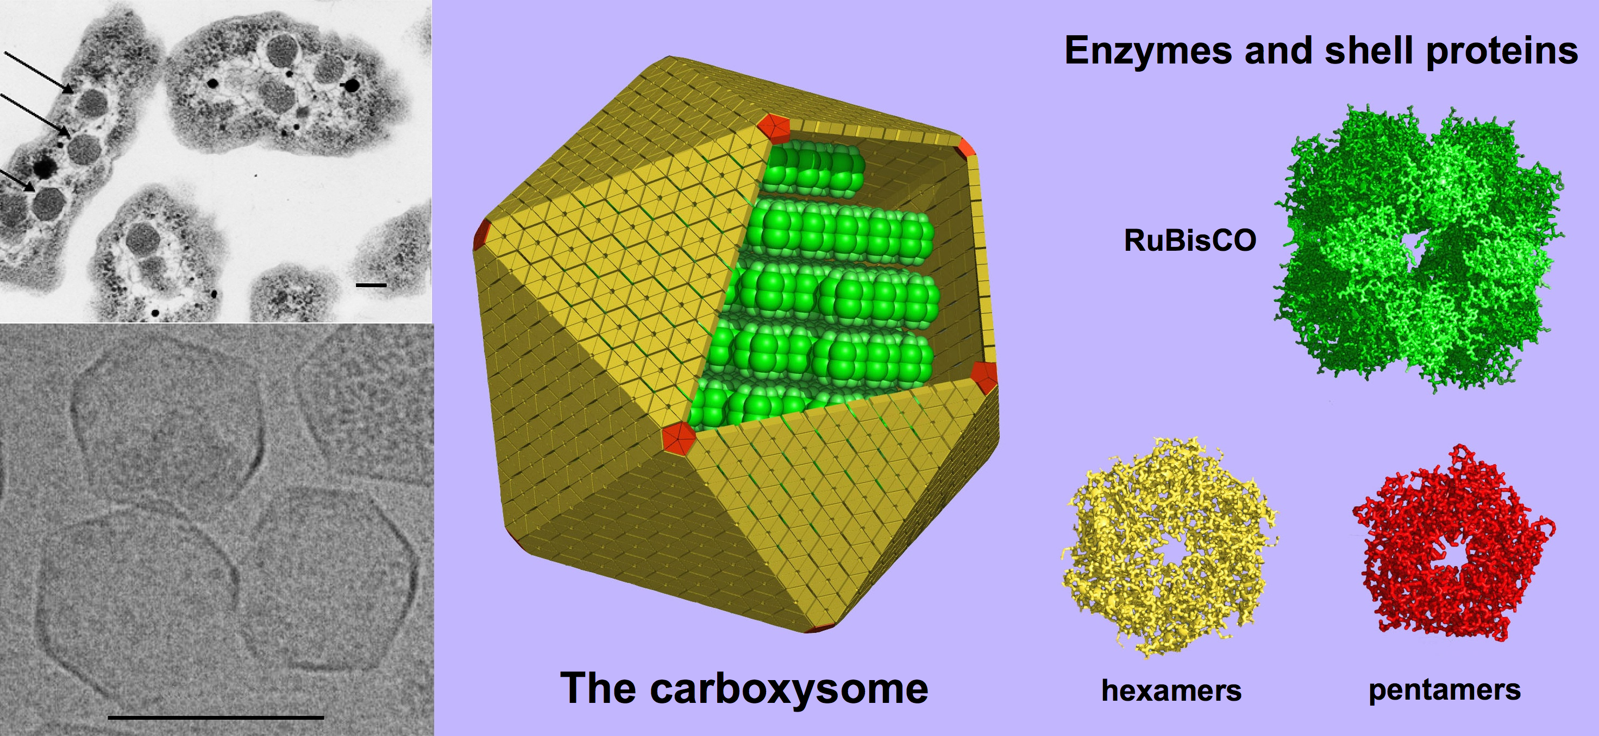
CO₂ concentrating mechanisms in Algae
Mechs to avoid p.r. and do Calvin cycle at low pCO₂
HCO₃⁻ uptake system
Increases internal C_{i} to levels
much higher than outside
2. Cyanobacteria sequester
carbonic anhydrase and rubisco
in carboxysomes: convert HCO₃⁻
to CO₂ @ rubisco

Slide 4
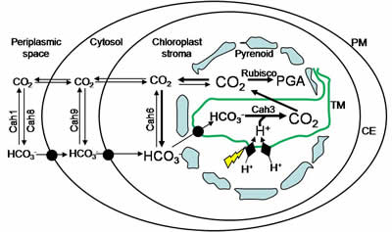
CO₂ concentrating mechanisms in Algae
Mechs to avoid p.r. and do Calvin cycle at low pCO₂
HCO₃⁻ uptake system
2. Cyanobacteria put carbonic anhydrase and rubisco in carboxysomes: convert HCO₃⁻ to CO₂ @ rubisco
3. Chlamydomonas puts carbonic anhydrase and rubisco in pyrenoids: convert HCO₃⁻ to CO₂ @ rubisco

Slide 5
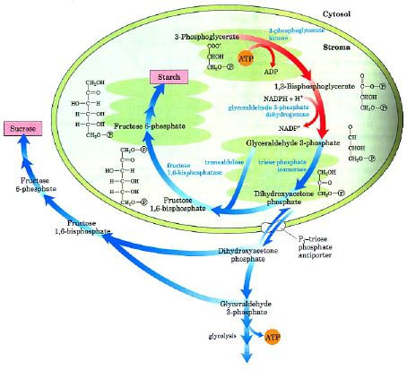
Manipulating Calvin Cycle
1 in 6 G3P becomes (CH₂O)_{n}
either becomes starch in chloroplast (to store in cell)
or is converted to
DHAP & exported
to cytoplasm to
make sucrose
Pi/triosePO₄
antiporter only
trades DHAP for Pi
mechanism to
regulate PS
Notes:
Reducing P might alter partitioning to starch vs sucrose
Might also alter partitioning to fats

Slide 6
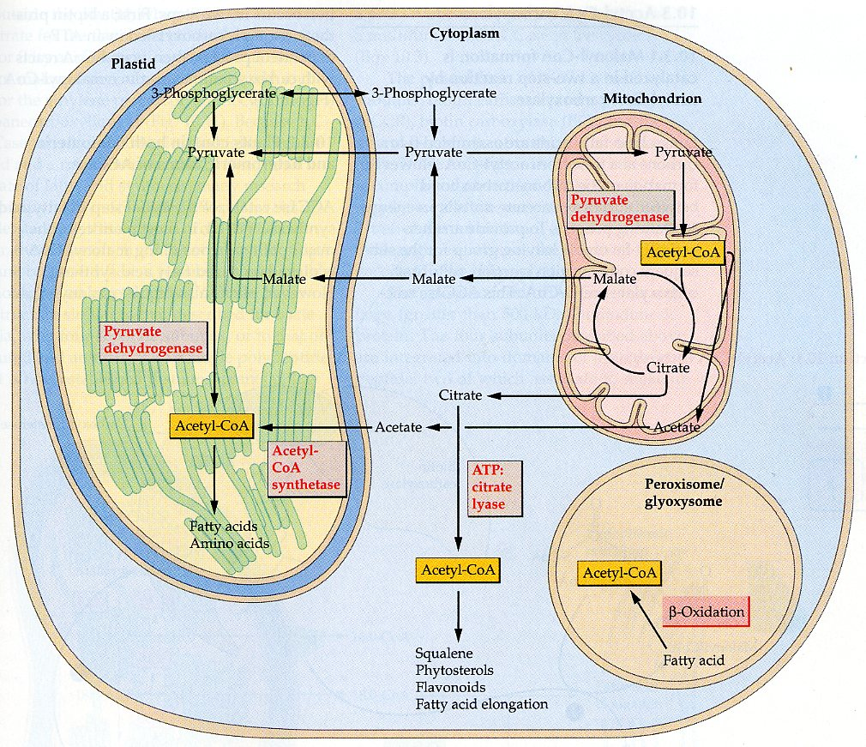
Manipulating fatty acid synthesis
Acetyl-CoA is key step
Used to make fatty acids
Also used to make sterols, some amino acids, stilbenes & others
Why ACCase is “committed step”
Notes:
Can be inhibited in grasses
Can inhibit sterols with statins

Slide 7
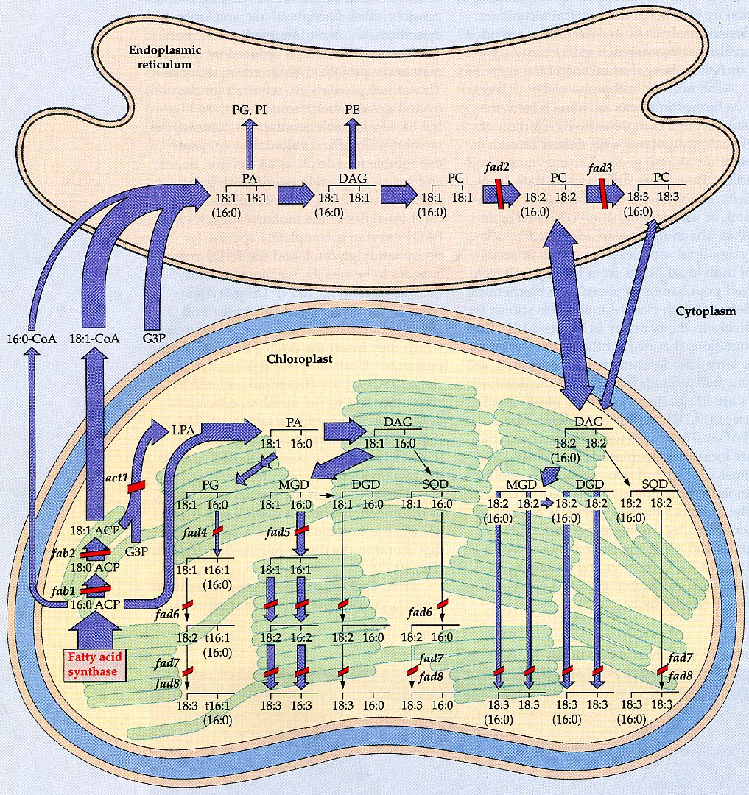
Manipulating lipid metabolism
P starvation should push to making galactolipids
S starvation should push to making phospholipids

Slide 8
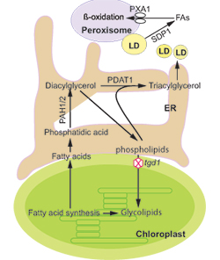
Manipulating lipid metabolism
P starvation should push to making galactolipids
S starvation should push to making phospholipids & oils
Mg starvation increased oil
in cyanobacteria
N starvation increased oil
in Chlorella & Dunaliella

Slide 9
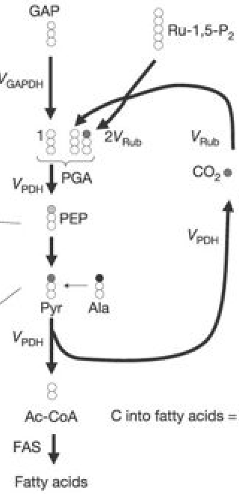
Manipulating lipid metabolism
In green seeds PGA formed by rubisco may be turned to pyruvate
PDH then turns it to Acetyl-CoA
Less CO₂ loss and more energy-efficient than via glycolysis

Slide 10
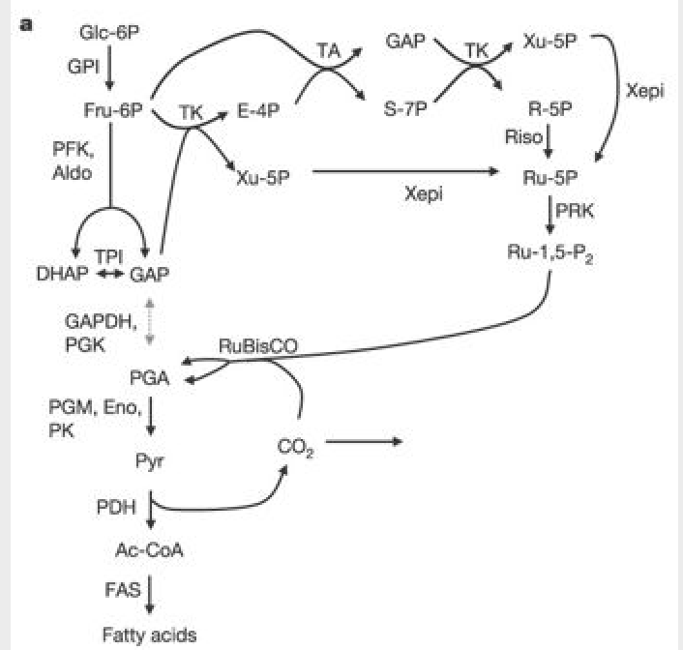
Manipulating lipid metabolism
In green seeds PGA formed by rubisco may be turned to pyruvate
PDH then turns it to Acetyl-CoA
Less CO₂ loss and more energy-efficient than via glycolysis
RuBP is regenerated via Pentose-phosphate pathway

Slide 11
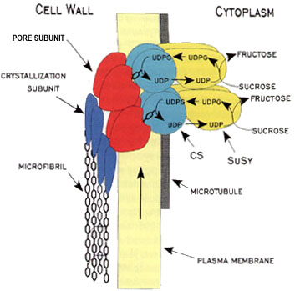
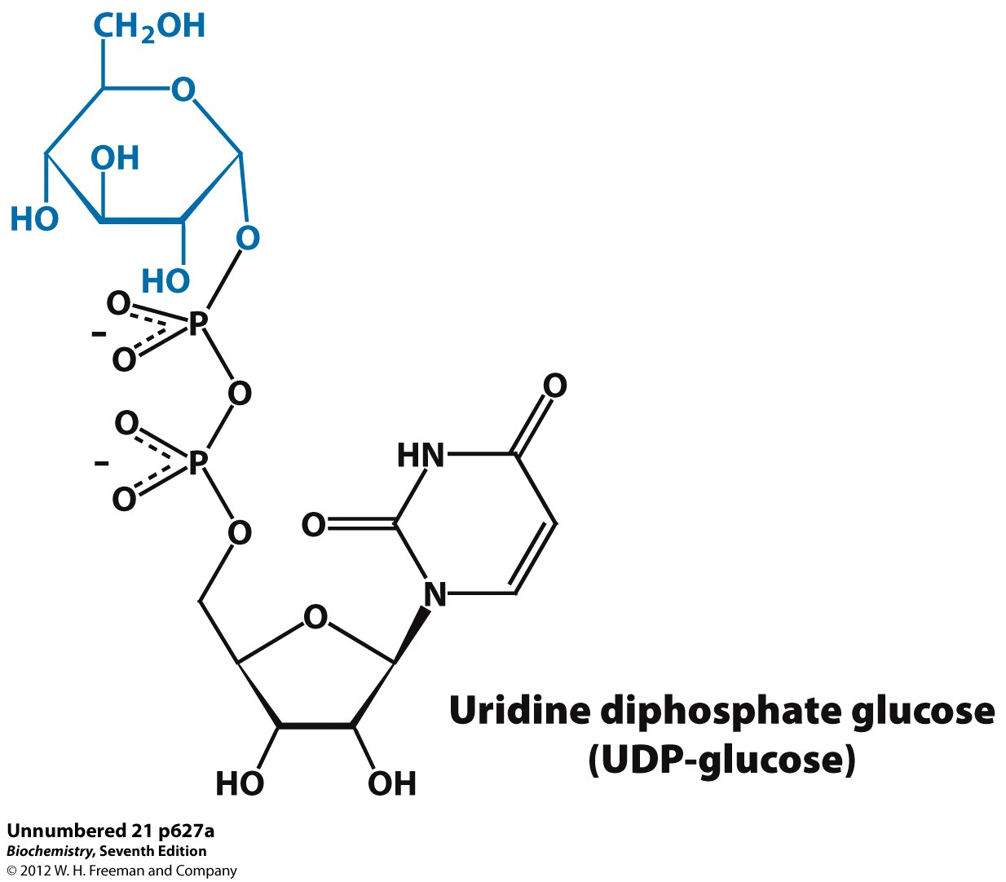
Manipulating cell wall carbohydrate synthesis

Slide 12
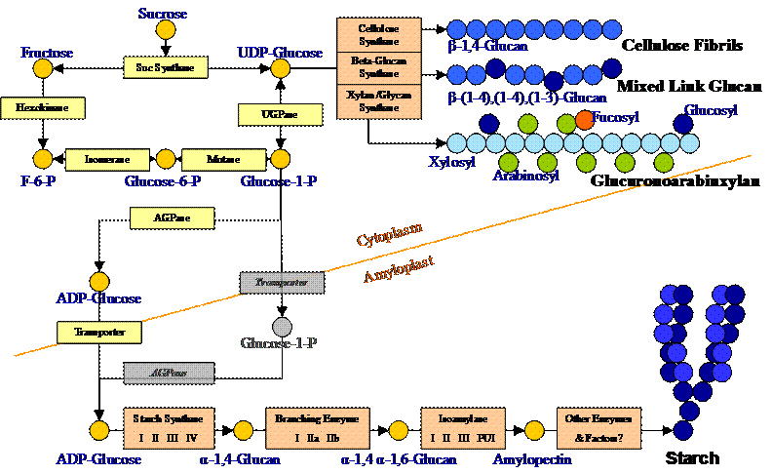
Manipulating cell wall carbohydrate synthesis

Slide 13
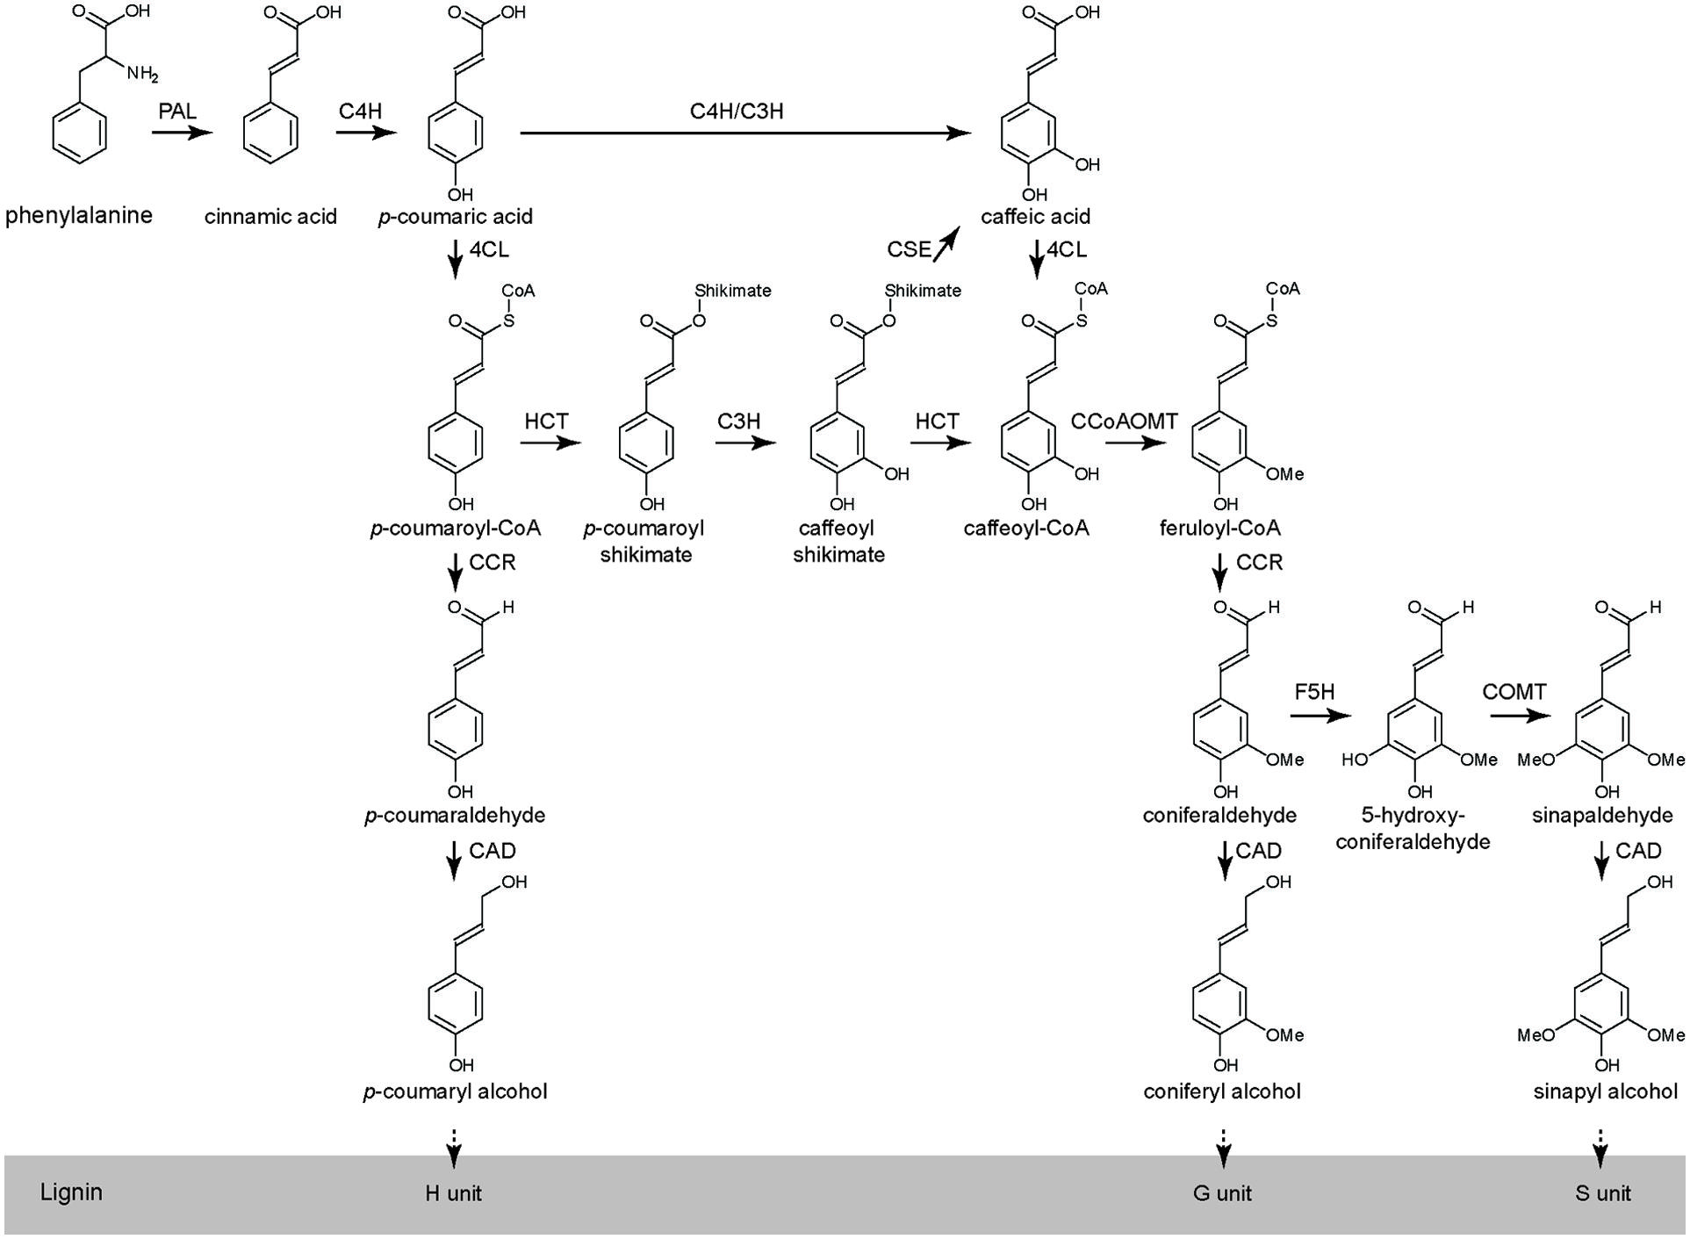
Manipulating cell wall lignin synthesis

Slide 14
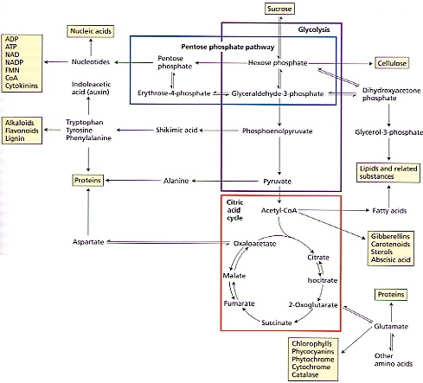
Manipulating respiration
Pyruvate oxidation & Krebs cycle in mito make Acetyl-CoA & others many Pentose phosphate shunt in cytosol or cp
makes NADPH & intermediates
Uses many Calvin Cycle enzymes
Makes nucleotide &
phenolic precursors
Affected by T, pCO₂
many others

Slide 15
First assignment Wednesday Feb 20
pick a particular combination of biofuel, gene and treatment & convince the group in 5-10 minutes why your choice is best.
Suggestions
Drought/VPD/salinity
pCO₂
Temperature
Light
PFD (photonflux density) = intensity
Photoperiod (daylength) = duration
Quality = color
Nutrition
Macronutrients = N, P, K, S, Ca, Mg, Fe
Micronutrients, vitamins
Inhibitors
Cell wall
Fatty acid synthesis
Something else??

Slide 16
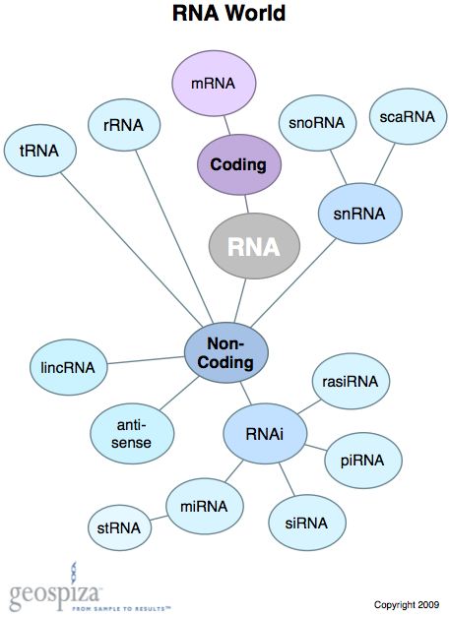
Surprises
Over half of human genome is transcribed even though only 1% is protein-coding sequence
98% of RNA made is non-coding

Slide 17
ncRNA
Structural
rRNA
tRNA
snRNA
snoRNA
cleavage: Rnases P & MRP, U3, snR30, etc
Regulatory
Small
siRNA
miRNA
Long
Activator
Enhancer
silencing

Slide 18
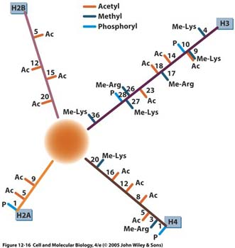
Using the genome
Epigenetics: various chromatin modifications are associated with activated & repressed genes
Acetylation, egH3K9Ac, is associated with active genes

Slide 19
Epigenetics
Many changes to chromatin alter how the DNA is read
Main change to DNA is C-methylation: often silences genes

Slide 20
Epigenetics
Many changes to chromatin alter how the DNA is read
Main change to DNA is C-methylation: often silences genes
Histones are altered in many ways
Some increase gene expression

Slide 21
Epigenetics
Many changes to chromatin alter how the DNA is read
Main change to DNA is C-methylation: often silences genes
Histones are altered in many ways
Some increase gene expression
Others slow it down

Slide 22
Epigenetics
Histones are altered in many ways
Some increase gene expression
Others slow it down
Always have pairs of activating/deactivating enzymes

Slide 23
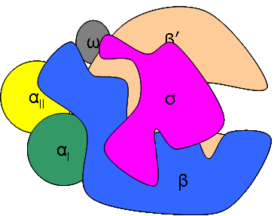
Transcription
Prokaryotes have one RNA polymerase
makes all RNA
core polymerase = complex of 5 subunits (α₁α_{ΙΙ}ββ’ω)

Slide 24
Transcription
Prokaryotes have one RNA polymerase
makes all RNA
core polymerase = complex of 5 subunits (α₁α_{ΙΙ}ββ’ω)
ω not absolutely needed, but cells lacking ω are very sick

Slide 25
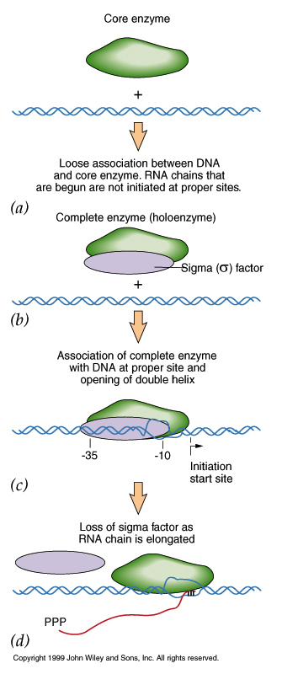
Initiating transcription in Prokaryotes
1) Core RNA polymerase is promiscuous

Slide 26
Initiating transcription in Prokaryotes
Core RNA polymerase is promiscuous
sigma factors provide specificity

Slide 27
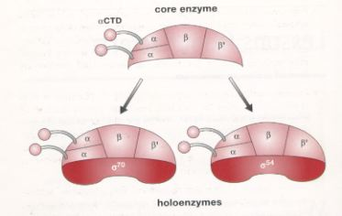
Initiating transcription in Prokaryotes
Core RNA polymerase is promiscuous
sigma factors provide specificity
Bind promoters

Slide 28
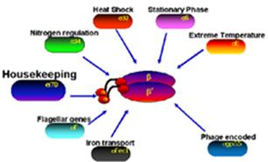
Initiating transcription in Prokaryotes
Core RNA polymerase is promiscuous
sigma factors provide specificity
Bind promoters
Different sigmas bind different promoters

Slide 29
Initiating transcription in Prokaryotes
Core RNA polymerase is promiscuous
sigma factors provide specificity
Bind promoters
3) Once bound, RNA polymerase
“melts” the DNA

Slide 30
Initiating transcription in Prokaryotes
3) Once bound, RNA polymerase
“melts” the DNA
4) rNTPs bind template

Slide 31
Initiating transcription in Prokaryotes
3) Once bound, RNA polymerase
“melts” the DNA
4) rNTPs bind template
5) RNA polymerase catalyzes phosphodiester bonds, melts and unwinds template

Slide 32
Initiating transcription in Prokaryotes
3) Once bound, RNA polymerase
“melts” the DNA
4) rNTPs bind template
5) RNA polymerase catalyzes phosphodiester bonds, melts and unwinds template
6) sigma falls off after ~10 bases are added

Slide 33
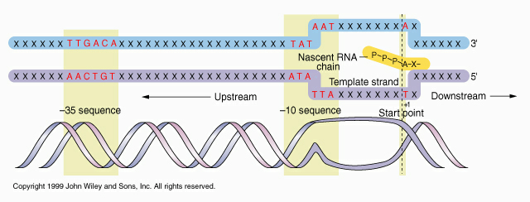
Structure of Prokaryotic promoters
Three DNA sequences (core regions)
1) Pribnow box at -10 (10 bp 5’ to transcription start)
5’-TATAAT-3’ determines exact start site: bound by σ factor

Slide 34
Structure of Prokaryotic promoters
Three DNA sequences (core regions)
1) Pribnow box at -10 (10 bp 5’ to transcription start)
5’-TATAAT-3’ determines exact start site: bound by σ factor
2)” -35 region” : 5’-TTGACA-3’ : bound by σ factor

Slide 35
Structure of Prokaryotic promoters
Three DNA sequences (core regions)
1) Pribnow box at -10 (10 bp 5’ to transcription start)
5’-TATAAT-3’ determines exact start site: bound by σ factor
2)” -35 region” : 5’-TTGACA-3’ : bound by σ factor
3) UP element : -57: bound by α factor

Slide 36
Structure of Prokaryotic promoters
Three DNA sequences (core regions)
1) Pribnow box at -10 (10 bp 5’ to transcription start)
5’-TATAAT-3’ determines exact start site: bound by σ factor
2)” -35 region” : 5’-TTGACA-3’ : bound by σ factor
3) UP element : -57: bound by α factor

Slide 37
Structure of Prokaryotic promoters
Three DNA sequences (core regions)
1) Pribnow box at -10 (10 bp 5’ to transcription start)
5’-TATAAT-3’ determines exact start site: bound by σ factor
2)” -35 region” : 5’-TTGACA-3’ : bound by σ factor
3) UP element : -57: bound by α factor
Other sequences also often influence transcription! Eg Trp operator

Slide 38
Prok gene regulation
5 genes (trp operon) encode trp enzymes

Slide 39
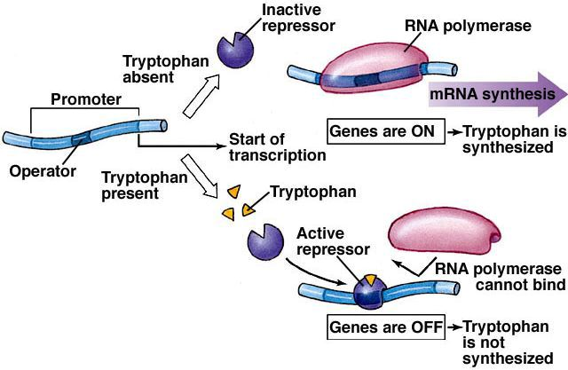
Prok gene regulation
Copy genes when no trp
Repressor stops operon if [trp]

Slide 40
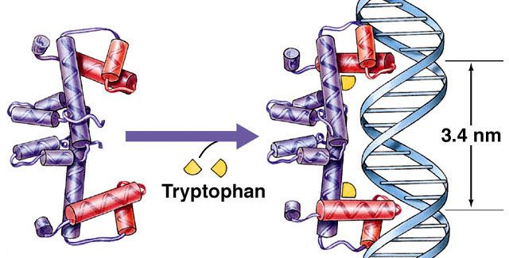
Prok gene regulation
Repressor stops operon if [trp]
trp allosterically regulates repressor
can't bind operator until 2 trp bind

Slide 41
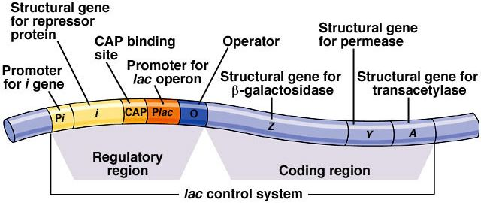
lac operon
Some operons use combined “on” & “off” switches
E.g. E. coli lac operon
Encodes enzymes to use lactose
lac Z = β-galactosidase
lac Y= lactose permease
lac A = transacetylase

Slide 42
lac operon
Make these enzymes only if:
1) - glucose

Slide 43
lac operon
Make these enzymes only if:
1) - glucose
2) + lactose

Slide 44
lac operon
Regulated by 2 proteins
1) CAP protein : senses [glucose]

Slide 45
lac operon
Regulated by 2 proteins
CAP protein : senses [glucose]
lac repressor: senses [lactose]

Slide 46
lac operon
Regulated by 2 proteins
CAP protein : senses [glucose]
lac repressor: senses [lactose]
encoded by lac i gene
Always on

Slide 47
lac operon
2 proteins = 2 binding sites
1) CAP site: promoter isn’t active until CAP binds

Slide 48
lac operon
2 proteins = 2 binding sites
CAP site: promoter isn’t active until CAP binds
Operator: repressor blocks transcription

Slide 49
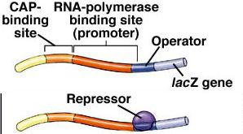
lac operon
Regulated by 2 proteins
1) CAP only binds if no glucose
-> no activation

Slide 50
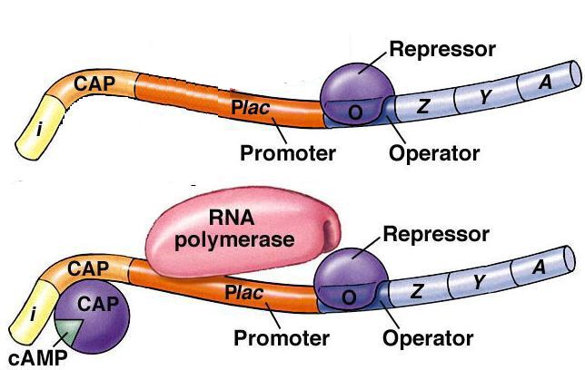
lac operon
Regulated by 2 proteins
1) CAP only binds if no glucose
-> no activation
2) Repressor blocks transcription if no lactose

Slide 51
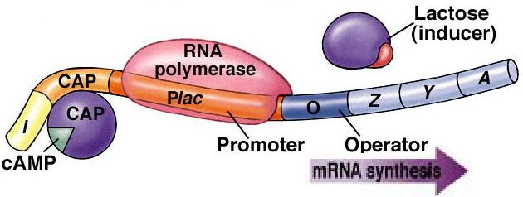
lac operon
Regulated by 2 proteins
CAP only binds if no glucose
Repressor blocks transcription if no lactose
3) Result: only make enzymes for using lactose if lactose is present and glucose is not

Slide 52
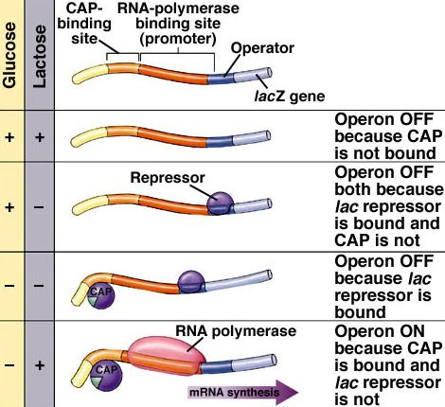

Slide 53
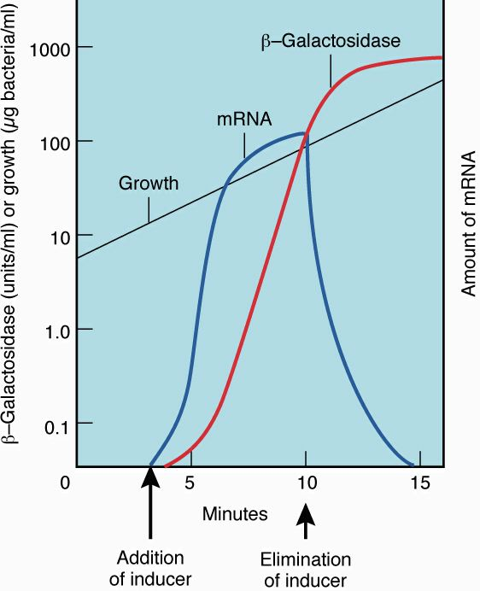
Result
[β-galactosidase]
rapidly rises if no
glucose & lactose
is present
W/in 10 minutes
is 6% of total
protein!

Slide 54
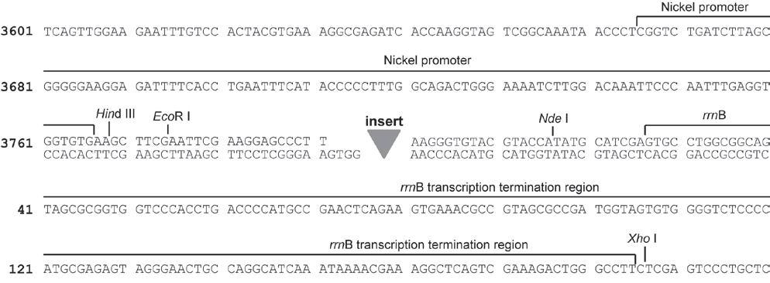
Structure of Prokaryotic promoters
Other sequences also often influence transcription! Bio502 plasmid contains the nickel promoter.

Slide 55
Structure of Prokaryotic promoters
Other sequences also often influence transcription! Bio502 plasmid contains the nickel promoter.
↵

Slide 56
Structure of Prokaryotic promoters
Other sequences also often influence transcription! Bio502 plasmid contains the nickel promoter.
nrsBACD encode nickel transporters

Slide 57
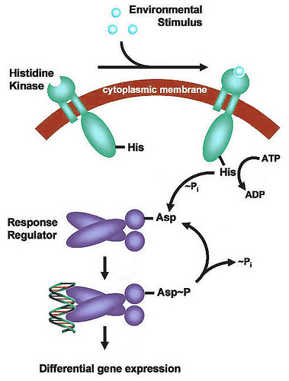
Structure of Prokaryotic promoters
Other sequences also often influence transcription! Bio502 plasmid contains the nickel promoter.
nrsBACD encode nickel transporters
nrsRS encode “two component” signal transducers
nrsS encodes a his kinase
nrsR encodes a response regulator

Slide 58
Structure of Prokaryotic promoters
nrsRS encode “two component” signal transducers
nrsS encodes a his kinase
nrsR encodes a response regulator
When nrsS binds Ni it kinases nrsR

Slide 59
Structure of Prokaryotic promoters
nrsRS encode “two component” signal transducers
nrsS encodes a his kinase
nrsR encodes a response regulator
When nrsS binds Ni it kinases nrsR
nrsR binds Ni promoter and activates
transcription of both operons

Slide 60
Termination of transcription in prokaryotes
1) Sometimes go until ribosomes fall too far behind

Slide 61
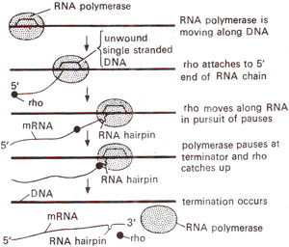
Termination of transcription in prokaryotes
1) Sometimes go until ribosomes fall too far behind
2) ~50% of E.coli genes require a termination factor called “rho”

Slide 62
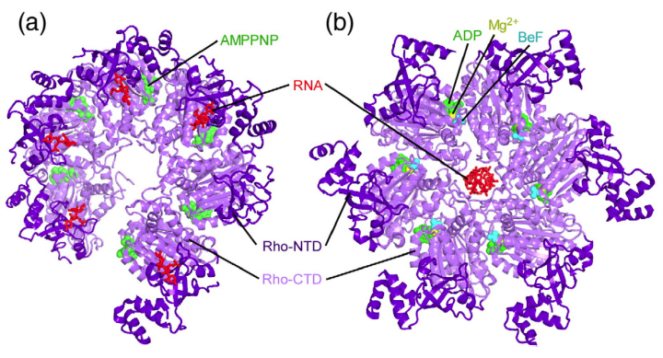
Termination of transcription in prokaryotes
~50% of E.coli genes require a termination factor called “rho”
An RNA helicase that uses ATP to thread the RNA through the central cavity

Slide 63
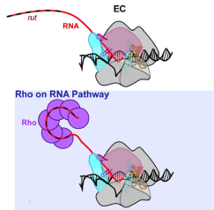
Termination of transcription in prokaryotes
~50% of E.coli genes require a termination factor called “rho”
An RNA helicase that uses ATP to thread the RNA through the central cavity
Three steps to Rho termination
Rho binds RNA at a rut (Rho utilization) site
C-rich, no consensus

Slide 64
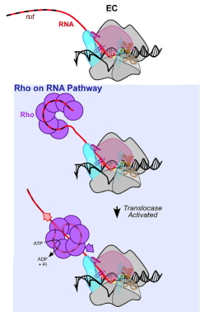
Termination of transcription in prokaryotes
Three steps to Rho termination
Rho binds RNA at a rut (Rho utilization) site
RNA translocation through Rho
Consumes ATP

Slide 65
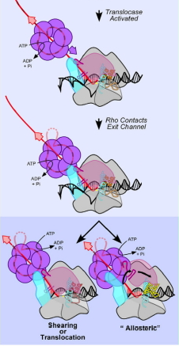
Termination of transcription in prokaryotes
Three steps to Rho termination
Rho binds RNA at a rut (Rho utilization) site
RNA translocation through Rho
Elongation complex pauses at
termination site
May 1st contact exit site
Termination mech uncertain

Slide 66
Termination of transcription in prokaryotes
1) ~50% of E.coli genes require a termination factor called “rho”
2) Most of the rest use “intrinsic” termination
Caused solely by interactions between DNA & nascent RNA with RNA polymerase
Three steps

Slide 67
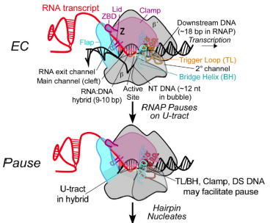
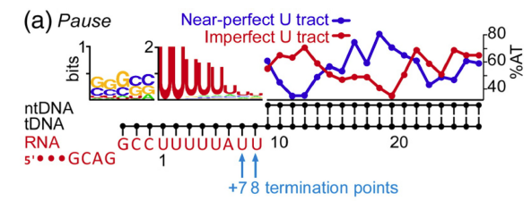
“intrinsic” termination
Three steps
Transcriptional pause: allows a stem-loop to form
Usually a GC-rich seq followed by poly-U

Slide 68
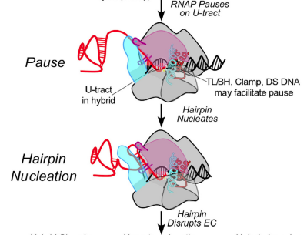
“intrinsic” termination
Three steps
Transcriptional pause: allows a stem-loop to form
Hairpin nucleation

Slide 69
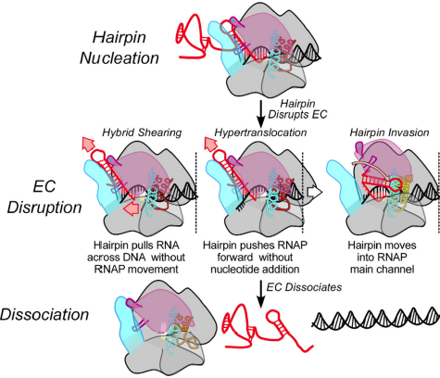
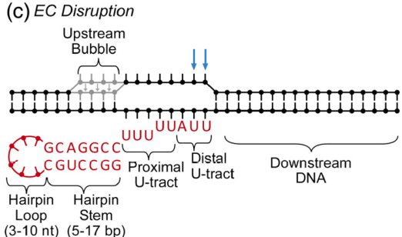
“intrinsic” termination
Three steps
Transcriptional pause: allows a stem-loop to form
Hairpin nucleation
EC disruption once hairpin extends < 8 nt from 3’ end

Slide 70
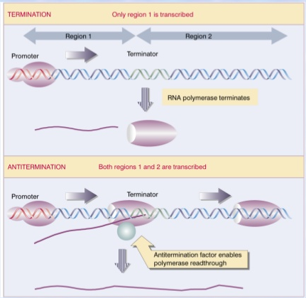
Some proteins cause “antitermination”
Way to control polycistronic operons, eg recent report that LoaP regulates antibioticgene clusters DOI: 10.1038/nmicrobiol.2017.3/

Slide 71
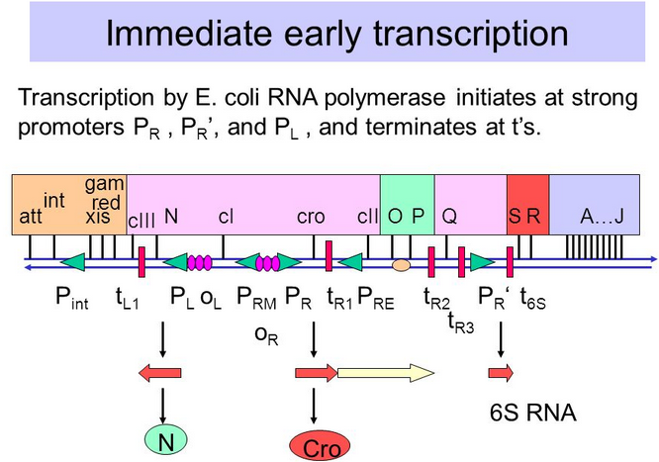
Some proteins cause “antitermination”
Way to control polycistronic operons, eg recent report that LoaP regulates antibioticgene clusters DOI: 10.1038/nmicrobiol.2017.3/
Also used by bacteriophage to regulate transitions from “early” to “late” gene expression, eg N protein of λ

Slide 72
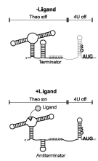
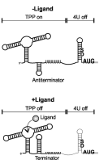
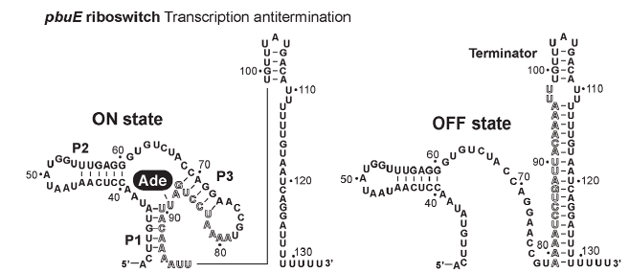
Some riboswitches work via “antitermination”
RNA stem-loop binds signal that changes its shape
Can be to either “on” or “off” shape

Slide 73
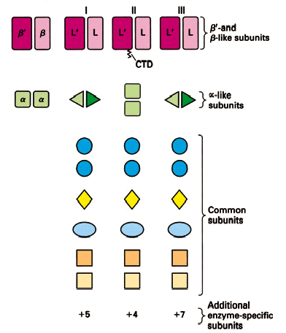
Transcription in Eukaryotes
3 RNA polymerases
all are multi-subunit
complexes
5 in common
3 very similar
variable # unique ones
Plants also have Pols IV & V
make siRNA

Slide 74
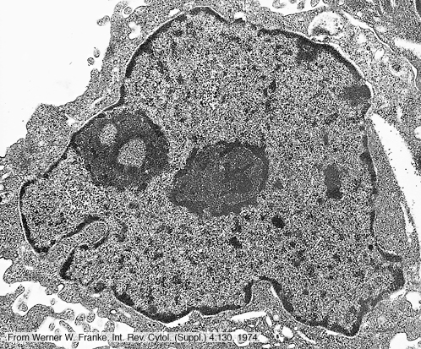
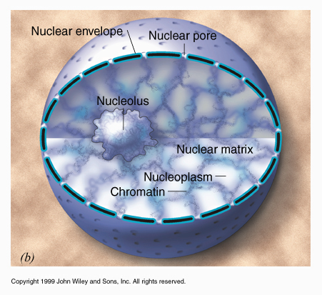
Transcription in Eukaryotes
RNA polymerase I: 13 subunits (5 + 3 + 5 unique)
acts exclusively in nucleolus to make 45S-rRNA precursor

Slide 75
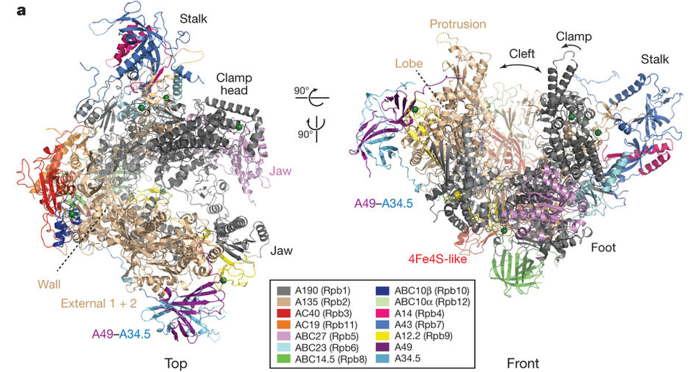
Transcription in Eukaryotes
Pol I: acts exclusively in nucleolus to make 45S-rRNA precursor
accounts for 50% of total RNA synthesis

Slide 76
Transcription in Eukaryotes
Pol I: acts exclusively in nucleolus to make 45S-rRNA precursor
accounts for 50% of total RNA synthesis
insensitive to -aminitin

Slide 77
Transcription in Eukaryotes
Pol I: only makes 45S-rRNA precursor
50 % of total RNA synthesis
insensitive to α-aminitin
Mg²⁺ cofactor
Regulated @ initiation frequency

Slide 78
RNA polymerase I
promoter is 5' to "coding sequence"
2 elements
1) essential core includes transcription start site
+1
-100
UCE
core
coding sequence

Slide 79
RNA polymerase I
promoter is 5' to "coding sequence"
2 elements
1) essential core includes transcription start site
2) UCE (Upstream Control Element) at ~ -100 stimulates transcription 10-100x
+1
-100
UCE
core
coding sequence

Slide 80
Initiation of transcription by Pol I
Order of events was determined by in vitro reconstitution
1) UBF (upstream binding factor) binds UCE and core element
UBF is a transcription factor: DNA-binding proteins which recruit polymerases and tell them where to begin

Slide 81
Initiation of transcription by Pol I
1) UBF binds UCE and core element
2) SL1 (selectivity factor 1) binds UBF (not DNA)
SL1 is a coactivator
proteins which
bind transcription
factors and
stimulate
transcription

Slide 82
Initiation of transcription by Pol I
1) UBF binds UCE and core element
2) SL1 (selectivity factor 1) binds UBF (not DNA)
SL1 is a coactivator
proteins which
bind transcription
factors and
stimulate
transcription

Slide 83
Initiation of transcription by Pol I
1) UBF binds UCE and core element
2) SL1 (selectivity factor 1) binds UBF (not DNA)
SL1 is a complex of
4 proteins including
TBP (TATAA-
binding protein)

Slide 84
Initiation of transcription by Pol I
1) UBF binds UCE and core element
2) SL1 (selectivity factor 1) binds UBF (not DNA)
3) complex recruits Pol I

Slide 85
Initiation of transcription by Pol I
1) UBF binds UCE and core element
2) SL1 (selectivity factor 1) binds UBF (not DNA)
3) complex recruits Pol I
4) Pol I transcribes until
it hits a termination site

Slide 86
Processing rRNA
~ 200 bases are methylated
Box C/D snoRNA picks sites

Slide 87
Processing rRNA
~ 200 bases are methylated
Box C/D snoRNA picks sites
One for each!

Slide 88
Processing rRNA
~ 200 bases are methylated
Box C/D snoRNA picks sites
One for each!
2) Another ~ 200 are pseudo-uridylated
Box H/ACA snoRNAs pick sites

Slide 89
Processing rRNA
~ 400 bases are methylated or pseudo-uridylated
snoRNAs pick sites
One for each!
2) 45S pre-rRNA is cut into 28S, 18S and 5.8S products

Slide 90
Processing rRNA
~ 200 bases are methylated
2) 45S pre-rRNA is cut into 28S,
18S and 5.8S products
3) Ribosomes are assembled w/in nucleolus

Slide 91
RNA Polymerase III
Reconstituted in vitro
makes ribosomal 5S and tRNA
(+ some snRNA & scRNA)

Slide 92
RNA Polymerase III
makes ribosomal 5S and tRNA
(+ some snRNA & scRNA)
>100 different kinds of genes
~10% of all RNA synthesis

Slide 93
RNA Polymerase III
makes ribosomal 5S and tRNA
(+ some snRNA & scRNA)
>100 different kinds of genes
~10% of all RNA synthesis
Cofactor = Mn²⁺ cf Mg²⁺

Slide 94
RNA Polymerase III
makes ribosomal 5S and tRNA
(+ some snRNA & scRNA)
>100 different kinds of genes
~10% of all RNA synthesis
Cofactor = Mn²⁺ cf Mg²⁺
sensitive to high [α-aminitin]

Slide 95
RNA Polymerase III
makes ribosomal 5S and tRNA (also some snRNA and some scRNA)
Has 17 (the most) subunits

Slide 96
RNA Polymerase III
makes ribosomal 5S and tRNA (also some snRNA and some scRNA)
Has 17 (the most) subunits
Regulated @
initiation frequency

Slide 97
Initiation of transcription by Pol III
promoter is often w/in "coding" sequence!

Slide 98
Initiation of transcription by Pol III
promoter is w/in "coding" sequence!
5S & tRNA promoters differ
5S has single “C” box

Slide 99
Initiation of transcription by Pol III
1) TFIIIA binds C box in 5S
2) recruits TFIIIC

Slide 100
Initiation of transcription by Pol III
TFIIIA binds C box
recruits TFIIIC
3) TFIIIB binds
TBP & 2 others

Slide 101
Initiation of Pol III transcription
1) TFIIIA binds C box
2) recruits TFIIIC
3) TFIIIB binds
4) Complex recruits Pol III

Slide 102
Initiation of Pol III transcription
1) TFIIIA binds C box
2) recruits TFIIIC
3) TFIIIB binds
4) Complex recruits Pol III
5) Pol III goes until
hits > 4 T's

Slide 103
Initiation of transcription by Pol III
promoter is w/in coding sequence!
5S & tRNA promoters differ
tRNA genes have “A” & “B” boxes

Slide 104
Initiation of transcription by Pol III
tRNA genes have “A” and “B” boxes
1) TFIIIC binds B box

Slide 105
Initiation of transcription by Pol III
tRNA genes have “A” and “B” boxes
1) TFIIIC binds B box
2) recruits TFIIIB

Slide 106
Initiation of transcription by Pol III
1) TFIIIC binds box B
2) recruits TFIIIB
3) complex recruits Pol III

Slide 107
Initiation of transcription by Pol III
1) TFIIIC binds box B
2) recruits TFIIIB
3) complex recruits Pol III
4) Pol III runs until
hits > 4 Ts

Slide 108
Processing tRNA
tRNA is trimmed
5’ end by RNAse P
(contains RNA)
3’ end by RNAse Z
Or by exonucleases

Slide 109
Processing tRNA
tRNA is trimmed
Transcript is spliced
Some tRNAs are
assembled from 2 transcripts

Slide 110
Processing tRNA
tRNA is trimmed
Transcript is spliced
CCA is added to 3’ end
By tRNA nucleotidyl
transferase (no template)
tRNA +CTP -> tRNA-C + PPi tRNA-C +CTP--> tRNA-C-C + PPi tRNA-C-C +ATP -> tRNA-C-C-A + PPi

Slide 111
Processing tRNA
tRNA is trimmed
Transcript is spliced
CCA is added to 3’ end
Many bases are modified
Significance unclear

Slide 112
Processing tRNA
tRNA is trimmed
Transcript is spliced
CCA is added to 3’ end
Many bases are modified
No cap! -> 5’ P
(due to 5’ RNAse P cut)

