Slide 1
Using the genome
Studying expression of all genes simultaneously
Microarrays: “reverse Northerns”
High-throughput sequencing
“Re-sequencing” to detect variation
Sequencing all mRNA to quantitate gene expression
Sequencing all mRNA to identify and quantitate splicing variants
Sequencing all RNA to identify and quantitate ncRNA
Surprises
Over half of human genome is transcribed even though only 1% is protein-coding sequence

Slide 2
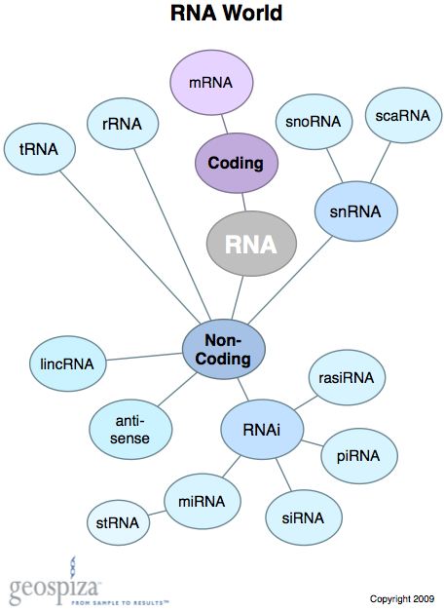
Surprises
Over half of human genome is transcribed even though only 1% is protein-coding sequence
98% of RNA made is non-coding

Slide 3
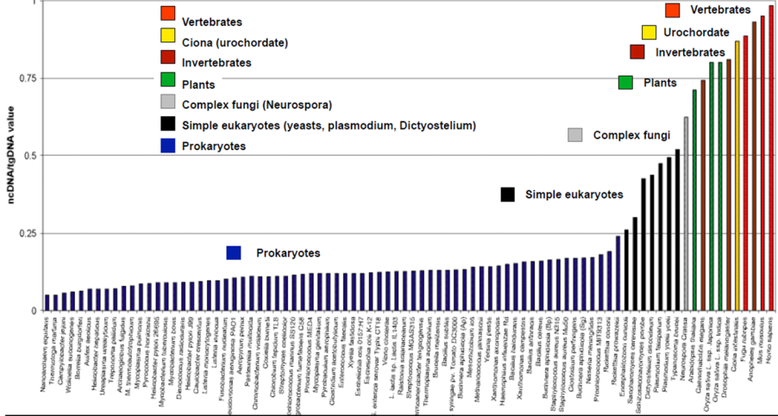
Surprises
Over half of human genome is transcribed even though only 1% is protein-coding sequence
98% of RNA made is non-coding
Fraction increases with organism’s complexity

Slide 4
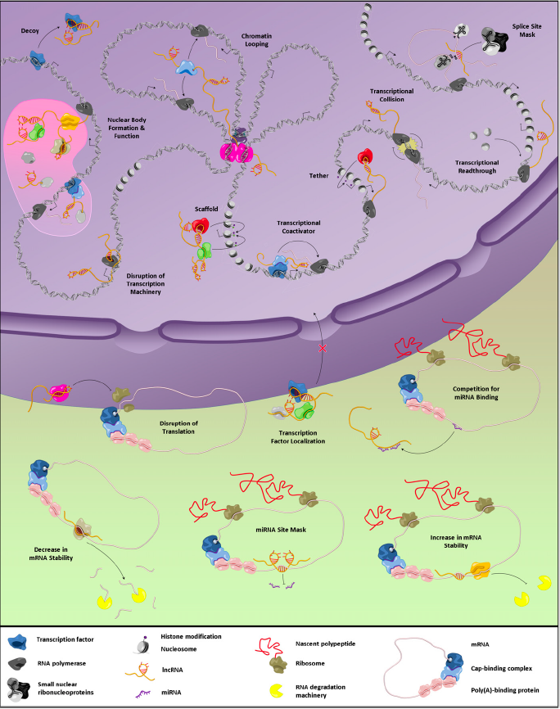
Surprises
Over half of human genome is transcribed even though only 1% is protein-coding sequence
98% of RNA made is non-coding
Fraction increases with organism’s complexity
Incredible diversity of functions!

Slide 5
ncRNA
Structural
rRNA
tRNA
snRNA
snoRNA
cleavage: Rnases P & MRP, U3, snR30, etc
Regulatory
Small
siRNA
miRNA
Long
Activator
Enhancer
silencing

Slide 6
Surprises
Over half of human genome is transcribed even though only 1% is protein-coding sequence
At least 10% of human genes have anti-sense copies

Slide 7
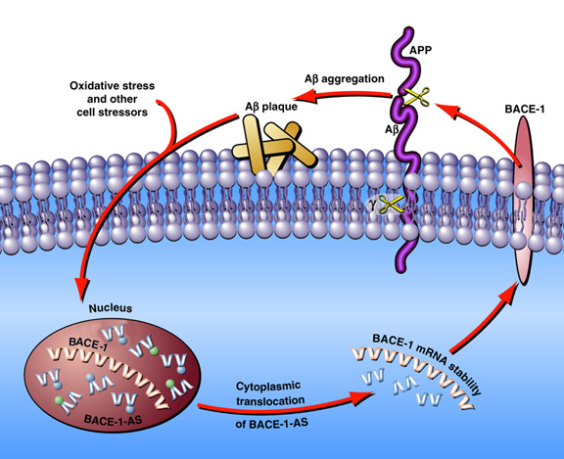
Surprises
Over half of human genome is transcribed even though only 1% is protein-coding sequence
At least 10% of human genes have anti-sense copies
BACE-1 AS may contribute to Alzheimer’s by increasing production of Aβ
Notes:
BACE 1 beta-site amyloid precursor protein cleaving enzyme 1 is an aspartic-acid protease important in the formation of myelin sheaths
First step in forming A-beta implicated in Alzheimers (gamma-secretase finishes the job of forming the 40 aa peptide)

Slide 8
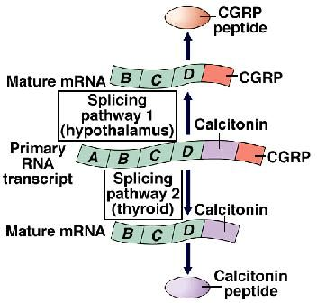
Surprises
Over half of human genome is transcribed even though only 1% is protein-coding sequence
At least 10% of human genes have anti-sense copies
Nearly every gene that can be is alternatively spliced in some tissue or condition.
~ 400 genes were spliced differently in male
& female human brains

Slide 9
Surprises
Over half of human genome is transcribed even though only 1% is protein-coding sequence
At least 10% of human genes have anti-sense copies
Nearly every gene that can be alternatively spliced is alternatively spliced in some tissue or condition.
Many genes have RNA polymerase II paused about 100 bp from the start

Slide 10
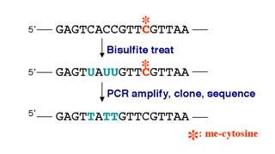
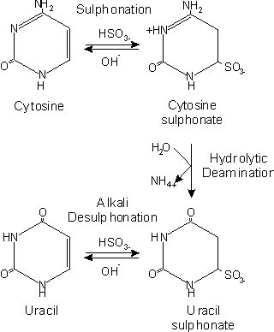
Using the genome
Studying expression of all genes simultaneously
Epigenetics: modifications to DNA that alter gene expression
Bisulfite sequencing to detect C methylation

Slide 11
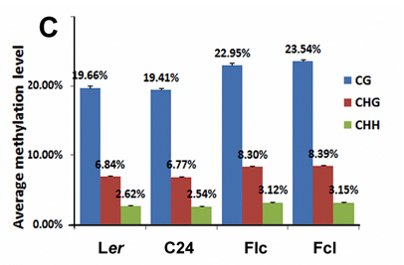
Using the genome
Bisulfite sequencing to detect C methylation

Slide 12
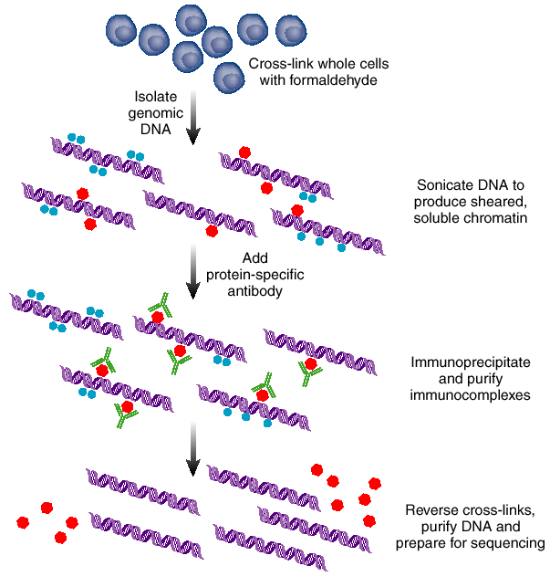
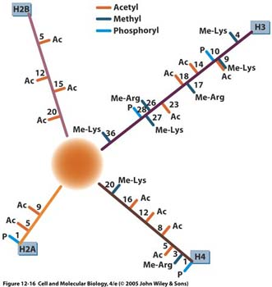
Using the genome
Bisulfite sequencing to detect C methylation
ChIP-chip or ChIP-seq to detect chromatin modifications
17 mods are associated with active genes in CD-4 T cells

Slide 13
Using the genome
Epigenetics: various chromatin modifications are associated with activated & repressed genes
Acetylation, egH3K9Ac, is associated with active genes

Slide 14
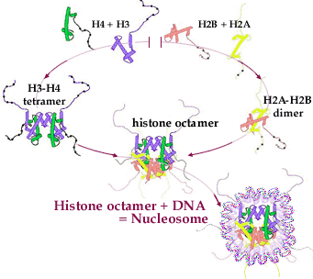
Using the Genome
various chromatin modifications are associated with activated & repressed genes
Acetylation, egH3K9Ac, is associated with active genes
Phosphorylation of H2aS1, H2aT119, H3T3, H3S10 & H3S28 shows condensation

Slide 15
Using the Genome
Phosphorylation of H2aS1, H2aT119, H3T3, H3S10 & H3S28 shows condensation
Phosphorylation of Histone H3 correlates with activation of heat shock genes!

Slide 16
Using the Genome
Acetylation, egH3K9Ac, is associated with active genes
Phosphorylation = condensation
Ubiquitination of H2A and H2B (mostly) = repression
Methylation is more complex
H3K36me3 = on
H3K27me3 = off

Slide 17
Using the Genome
Methylation is more complex:
H3K36me3 = on
H3K27me3 = off
H3K4me1 = off
H3K4me2 = primed
H3K4me3 = on

Slide 18
Histone code
Modifications tend to group together: genes with H3K4me3 also have H3K9ac

Slide 19
Histone code
Modifications tend to group together: genes with H3K4me3 also have H3K9ac
Cytosine methylation is also associated with repressed genes

Slide 20
Generating the histone code
Histone acetyltransferases add acetic acid

Slide 21
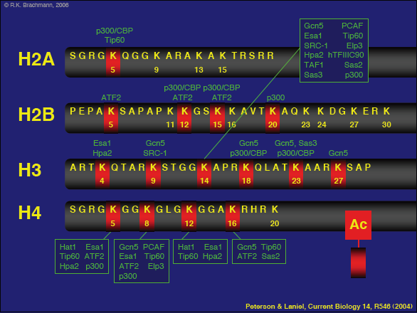
Generating the histone code
Histone acetyltransferases add acetic acid
Many HAT proteins: mutants are very sick!

Slide 22
Generating the histone code
Histone acetyltransferases add acetic acid
Many HAT proteins: mutants are very sick!
HATs are part of many complexes

Slide 23
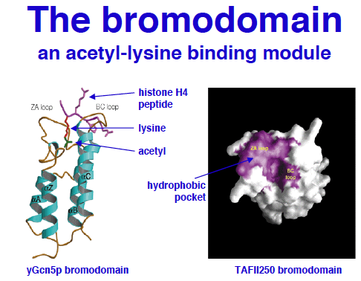
Generating the histone code
Bromodomains specifically bind acetylated lysines

Slide 24
Generating the histone code
Bromodomains specifically bind acetylated lysines
Found in transcriptional activators & general TFs

Slide 25
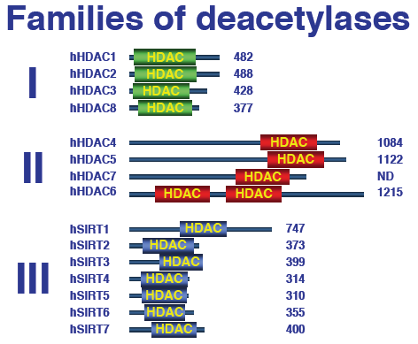
Generating the histone code
acetylated lysines
Deacetylases “reset” by removing the acetate

Slide 26
Generating the histone code
acetylated lysines
Deacetylases “reset” by removing the acetate
Deacetylase mutants are sick!

Slide 27
Generating the histone code
Deacetylases “reset” by removing the acetate
Deacetylase mutants are sick!
Many drugs are histone deacetylase inhibitors

Slide 28
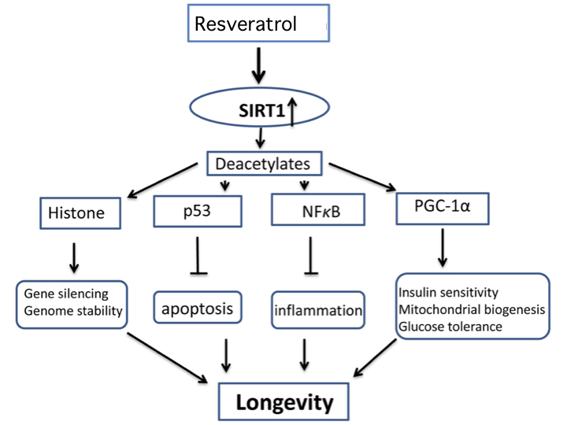
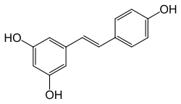
Generating the histone code
Many drugs affect histone deacetylases
Resveratrol activates Sirtuin 1

Slide 29
Generating the histone code
Many drugs affect histone deacetylases
Resveratrol activates Sirtuin 1
Many drugs are histone deacetylase inhibitors
SAHA = suberanilohydroxamic acid = vorinostat
Merck calls it Zolinza, treats cutaneous T cell lymphoma

Slide 30
Generating the histone code
Many drugs affect histone deacetylases
Resveratrol activates Sirtuin 1
Many drugs are histone deacetylase inhibitors
SAHA = suberanilohydroxamic acid = vorinostat
Merck calls it Zolinza, treats cutaneous T cell lymphoma
Binds HDAC active site & chelates Zn²⁺

Slide 31
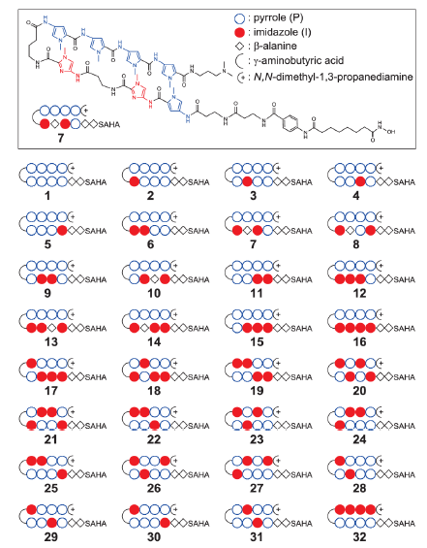
Generating the histone code
When coupled SAHA to
PIPS (pyrrole-imidazole
Polyamides) got gene-
specific DNA binding &
gene activation

Slide 32
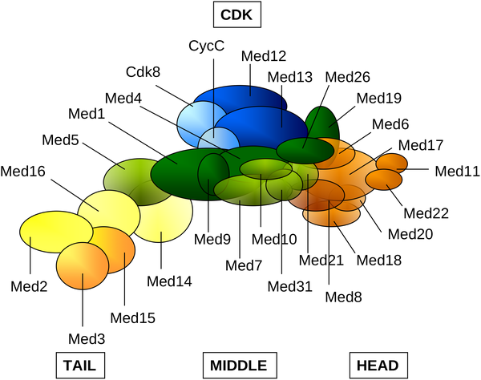
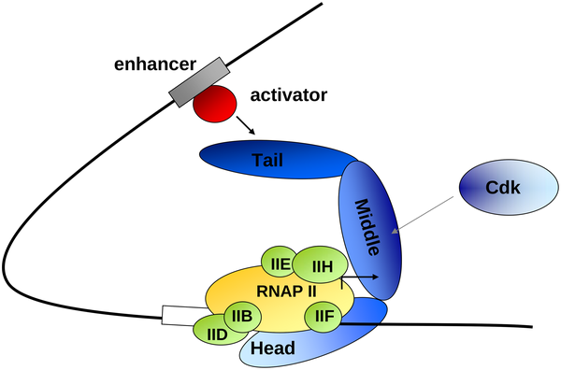
Generating the histone code
CDK8 kinases histones to repress transcription

Slide 33
Generating the histone code
CDK8 kinases histones to repress transcription
Appears to interact with mediator to block transcription

Slide 34
Generating the histone code
CDK8 kinases histones to repress transcription
Appears to interact with mediator to block transcription
Phosphorylation of Histone H3 correlates with activation of heat shock genes!

Slide 35
Generating the histone code
CDK8 kinases histones to repress transcription
Appears to interact with mediator to block transcription
Phosphorylation of Histone H3 correlates with activation of heat shock genes!
Phosphatases reset the genes

Slide 36
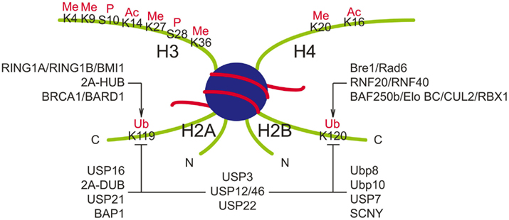
Generating the histone code
Acetylation, egH3K9Ac, is associated with active genes
Phosphorylation shows condensation
Ubiquitination of H2A and H2B shows repression & marks DNA damage

Slide 37
Generating the histone code
Ubiquitination of H2A and H2B shows repression & marks DNA damage
Rad6 proteins ubiquitinate histone H2B to repress transcription

Slide 38
Generating the histone code
Rad6 proteins ubiquitinate histone H2B to repress transcription
Other proteins ubiquitinate H2B to enhance transcription!

Slide 39
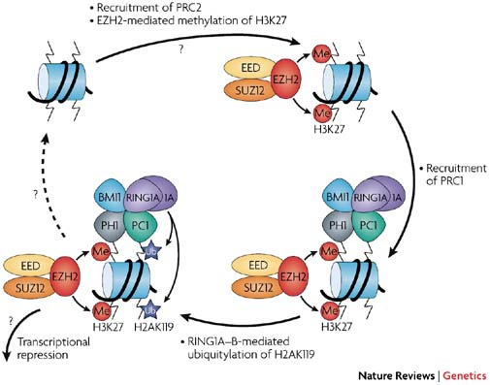
Generating the histone code
Rad6 proteins ubiquitinate histone H2B to repress transcription: others enhance it!
Polycomb proteins ubiquitinate histone H2A to silence genes

Slide 40
Generating the histone code
Rad6 proteins ubiquitinate histone H2B to repress transcription: others enhance it!
Polycomb proteins ubiquitinate H2A to silence genes
Multiple de-ubiquitinases have been identified

Slide 41
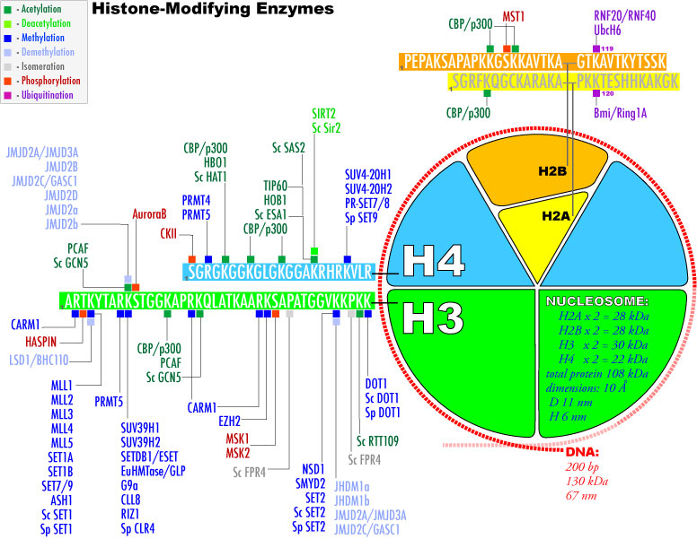
Generating the histone code
Many proteins methylate histones: highly regulated!

Slide 42
Generating the histone code
Many proteins methylate histones: highly regulated!
Methylation status determines gene activity

Slide 43
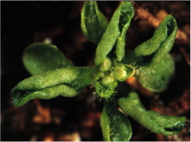
Generating the histone code
Many proteins methylate histones: highly regulated!
Methylation status determines gene activity
Mutants (eg Curly leaf) are unhappy!

Slide 44
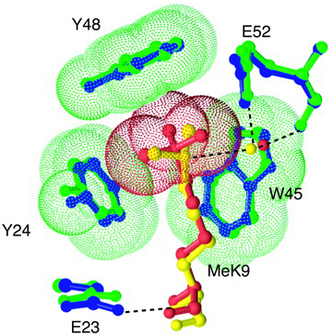
Generating the histone code
Many proteins methylate histones: highly regulated!
Methylation status determines gene activity
Mutants (eg Curly leaf) are unhappy!
Chromodomain protein HP1 can tell the difference between H3K9me2 (yellow) & H3K9me3 (red)

Slide 45
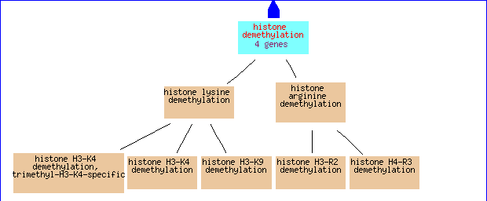
Generating the histone code
Chromodomain protein HP1 can tell the difference between H3K9me2 (yellow) & H3K9me3 (red)
Histone demethylases have been recently discovered

Slide 46
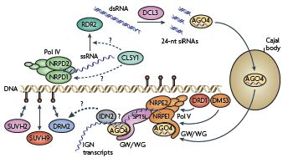
Generating methylated DNA
Si RNA are key: RNA Pol IV generates antisense or foldback RNA, often from TE

Slide 47
Generating methylated DNA
Si RNA are key: RNA Pol IV generates antisense or foldback RNA, often from TE
RDR2 makes it DS, 24 nt siRNA are generated by DCL3

Slide 48
Generating methylated DNA
RDR2 makes it DS, 24 nt siRNA are generated by DCL3
AGO4 binds siRNA, complex binds target & Pol V

Slide 49
Generating methylated DNA
RDR2 makes it DS, 24 nt siRNA are generated by DCL3
AGO4 binds siRNA, complex binds target & Pol V
Pol V makes intergenic RNA, associates with AGO4-siRNA to recruit “silencing Complex” to target site

Slide 50
Generating methylated DNA
RDR2 makes it DS, 24 nt siRNA are generated by DCL3
AGO4 binds siRNA, complex binds target & Pol V
Pol V makes intergenic RNA, associates with AGO4-siRNA to recruit “silencing Complex” to target site
Amplifies signal!
extends meth-
ylated region

