Slide 1
Provide a genuine experience in using cell and molecular biology to learn about a fundamental problem in biology.
Rather than following a set series of lectures, study a problem and see where it leads us.
Lectures & presentations will relate to current status
Some class time will be spent in lab & vice-versa
we may need to come in at other times as well

Slide 2
Pick a problem
Design some experiments
See where they lead us

Slide 3
GRADING?
Combination of papers and presentations
First presentation: 5 points
Research presentation: 10 points
Final presentation: 15 points
Assignments: 5 points each
Poster: 10 points
Intermediate report 10 points
Final report: 30 points
Alternatives
Paper(s) instead of 1 or two presentations
Research proposal instead of a presentation
One or two exams?

Slide 4
Topics?
Studying ncRNA
Studying signaling in ncRNA mutants
Bioremediation
Resveratrol production
Making Antifreeze proteins
Making algae that bypass Rubisco to fix CO₂
Making novel biofuels
blue-green algae that generate electricity
Plants/algae that make methane or hydrogen
Biodiesel
8. Using Crispr/Cas9 to make mutants
9. Other ideas?

Slide 5
Assignments?
identify a gene and design primers
presentation on new sequencing tech
designing a protocol to verify your clone
presentations on gene regulation
presentation on applying mol bio
Other work
draft of report on cloning & sequencing
poster for symposium
final gene report
draft of formal report
formal report

Slide 6
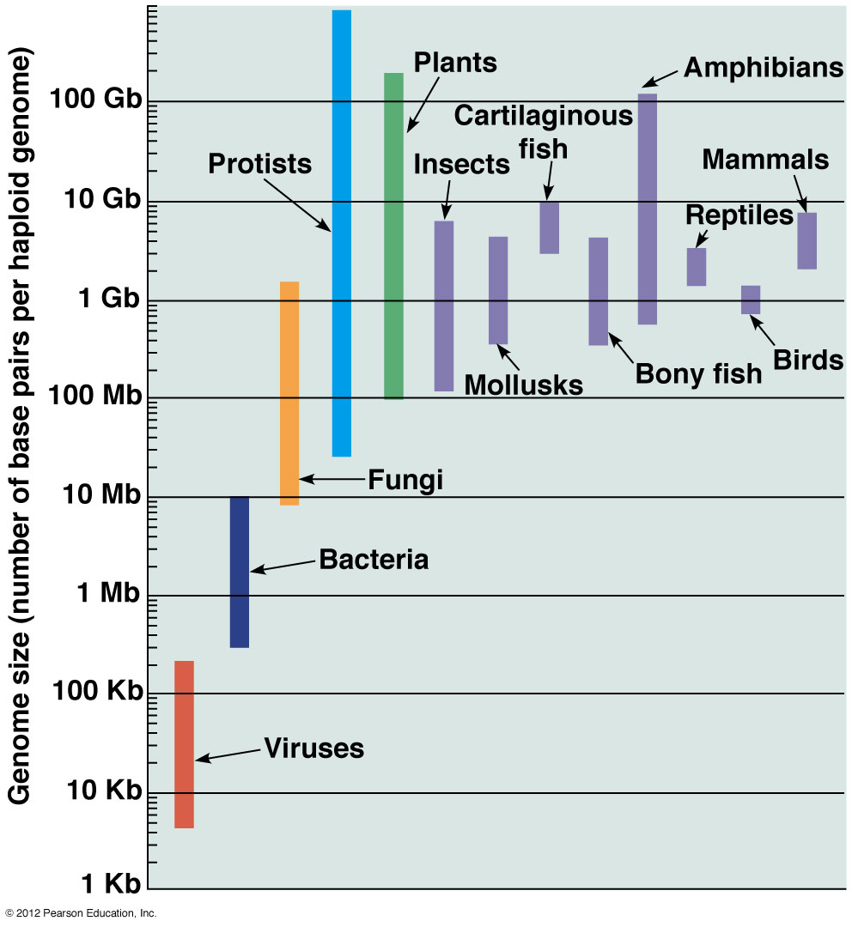
Genome Projects
Studying structure & function of genomes
Sequence first
Then location and function of every part
C-value paradox: DNA content/haploid genome varies widely w/o correlation with complexity

Slide 7
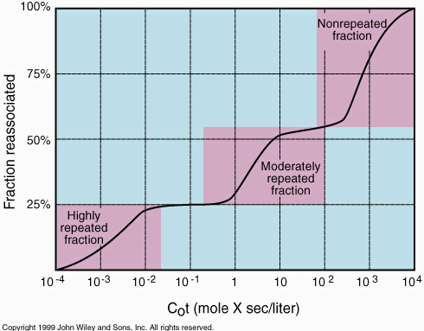
Cot curves
eucaryotes show 3 step curves
Step 1 renatures rapidly: “highly repetitive”
Step 2 is intermediate: “moderately repetitive”
Step 3 is ”unique"

Slide 8
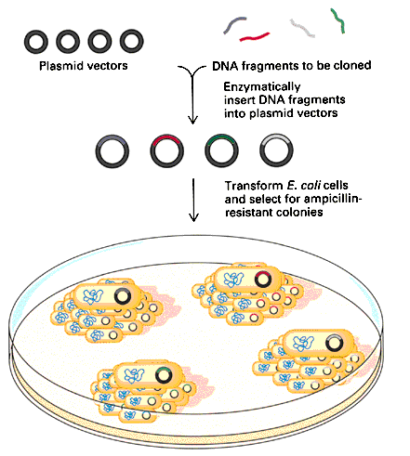
Molecular cloning
How?
1) create recombinant DNA
2) transform recombinant molecules into suitable host
3) identify hosts which have taken up your recombinant molecules
4) Extract DNA

Slide 9
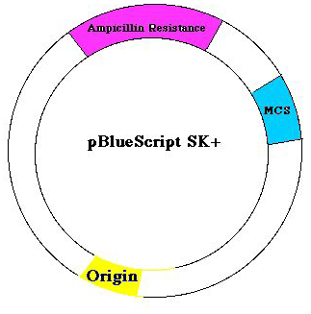
Vectors
Solution: insert DNA into a vector
General requirements:
1) origin of replication
2) selectable marker
3) cloning site: region
where foreign DNA
can be inserted

Slide 10
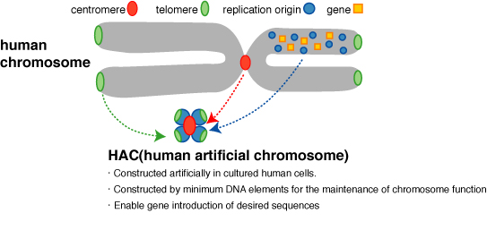
Vectors
Plasmids
Viruses
artificial chromosomes
YACs (yeast artificial chromosomes)
BACs (bacterial artificial chromosomes)
HACs: human artificial chromosomes

Slide 11
Libraries
a collection of clones representing the entire complement of sequences of interest
1) entire genome for genomic libraries
2) all mRNA for cDNA

Slide 12
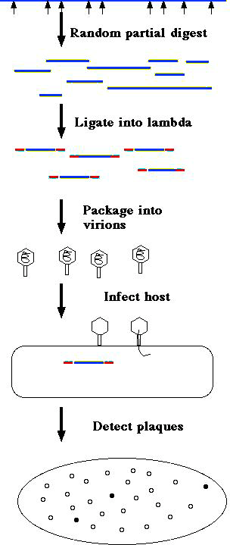
Detecting your clone
All the volumes of the library look the same
trick is figuring out what's inside
usually done by “screening” the library with a suitable probe
identifies clones containing the desired sequence

Slide 13
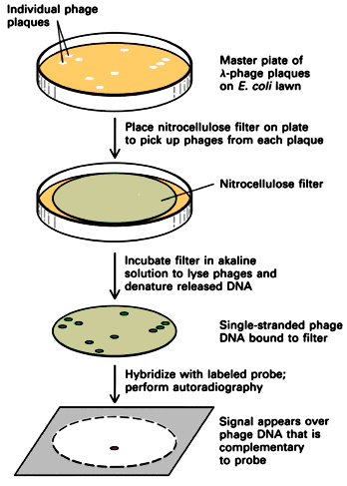
Detecting your clone by
membrane hybridization
Denature
Transfer to a filter
3) probe with complementary
labeled sequences
4) Detect
radioactivity -> detect by
Autoradiography

Slide 14
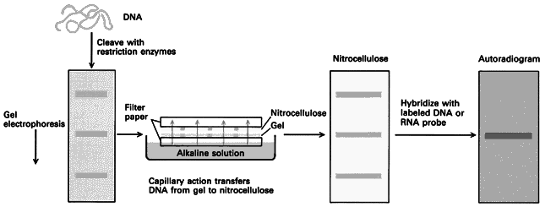
Southern analysis
1) digest genomic DNA with restriction enzymes
2) separate fragments using gel electrophoresis
3) transfer & fix to a membrane
4) probe with your clone

Slide 15
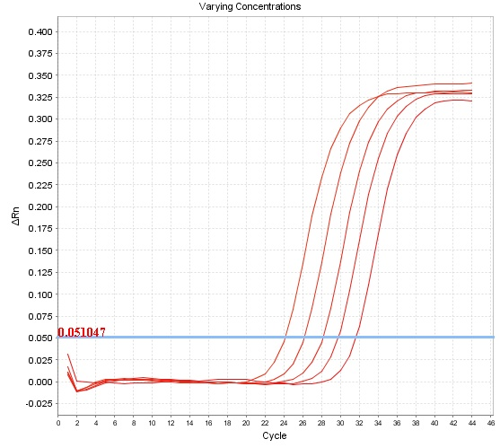
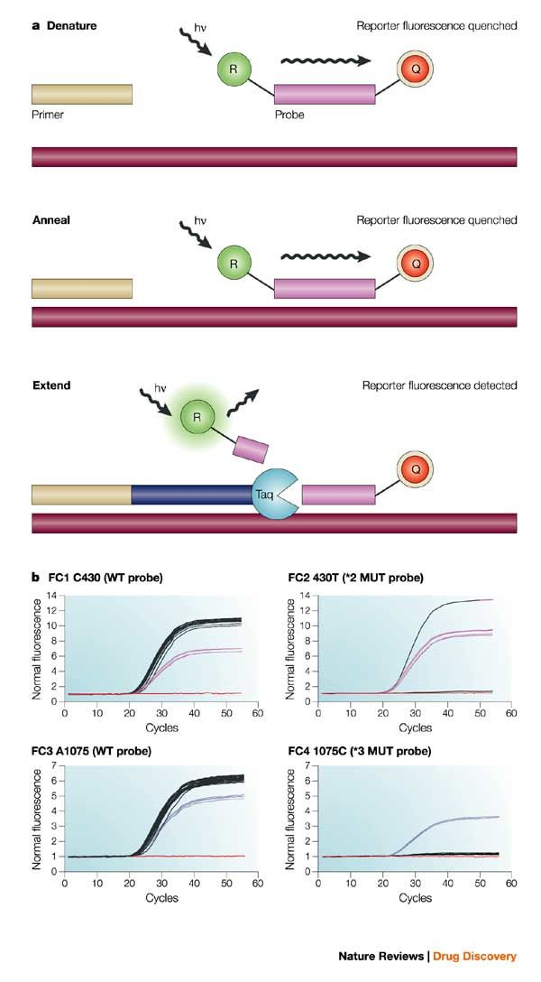
Quantitative (real-time) RT-PCR
First reverse-transcribe RNA, then amplify by PCR
Measure number of cycles to cross threshold. Fewer cycles = more starting copies
Detect using fluorescent probes
Can multiplex by making gene-specific probes different colors

Slide 16
Western analysis
1) Separate Proteins by polyacrylamide gel electrophoresis
2) transfer & fix to a membrane
3) probe with suitable antibody (or other probe)
4) determine # & sizes of detected bands

Slide 17
DNA Sequencing
Sanger (di-deoxy chain termination)
anneal primer to template
2) elongate with DNA polymerase
3) terminate chain with di-deoxy nucleotides
4) separate by size
Read sequence by climbing the ladder

Slide 18
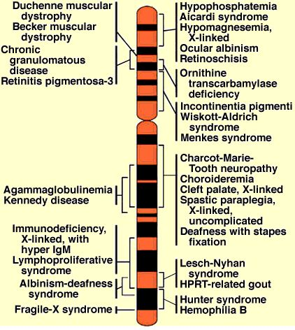
Genome projects
1) Prepare map of genome

Slide 19
Genome projects
1) Prepare map of genome
To find genes must know their location

Slide 20
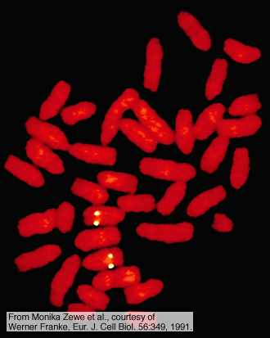
Sequencing Genomes
1) Map the genome
2) Prepare an AC library
3) Order the library
FISH to find their
chromosome

Slide 21
Sequencing Genomes
1) Map the genome
2) Prepare an AC library
3) Order the library
FISH to find their chromosome
identify overlapping AC using ends as probes
assemble contigs until chromosome is covered

Slide 22
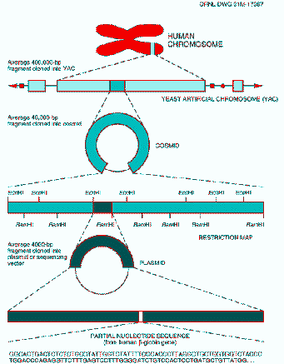
Sequencing Genomes
1) Map the genome
2) Prepare an AC library
3) Order the library
4) Subdivide each AC into lambda contigs

Slide 23
Sequencing Genomes
1) Map the genome
2) Prepare an AC library
3) Order the library
4) Subdivide each AC into lambda contigs
5) Subdivide each lambda into plasmids
6) sequence the plasmids

Slide 24
Sequencing Genomes
1) Map the genome
2) Prepare an AC library
3) Order the library
4) Subdivide each AC into lambda contigs
5) Subdivide each lambda into plasmids
6) sequence the plasmids
With Next Generation Sequencing can sequence an entire library and then assemble the sequence by computer

Slide 25
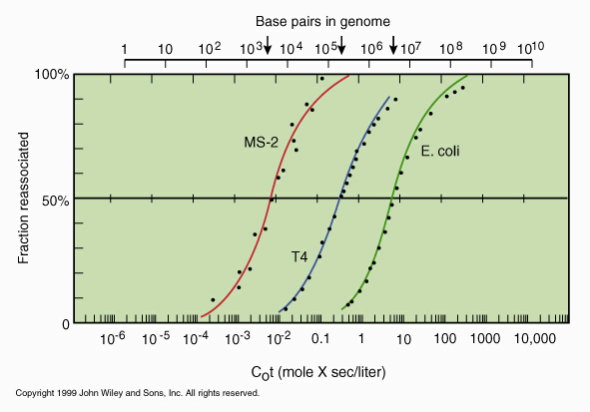
Sequencing Genomes
With Next Generation Sequencing can sequence an entire library and then assemble the sequence by computer
Works well for bacteria

Slide 26
Sequencing Genomes
With Next Generation Sequencing can sequence an entire library and then assemble the sequence by computer
Works well for bacteria
Very badly for eukaryotes

Slide 27
Sequencing Genomes
With Next Generation Sequencing can sequence an entire library and then assemble the sequence by computer
Works well for bacteria
Very badly for eukaryotes
Can’t tell where
repeated sequences
come from

Slide 28
Sequencing Genomes
With Next Generation Sequencing can sequence an entire library and then assemble the sequence by computer
Works well for bacteria
Very badly for eukaryotes
Can’t tell where
repeated sequences
come from
Solve with
longer reads

Slide 29
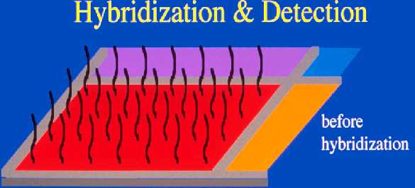
Using the genome
Studying expression of all genes simultaneously
Microarrays (reverse Northerns)
Attach probes that detect genes to solid support
cDNA or oligonucleotides

Slide 30
Using the genome
Studying expression of all genes simultaneously
Microarrays (reverse Northerns)
Attach probes that detect genes to solid support
cDNA or oligonucleotides
Tiling path = probes for entire genome

Slide 31
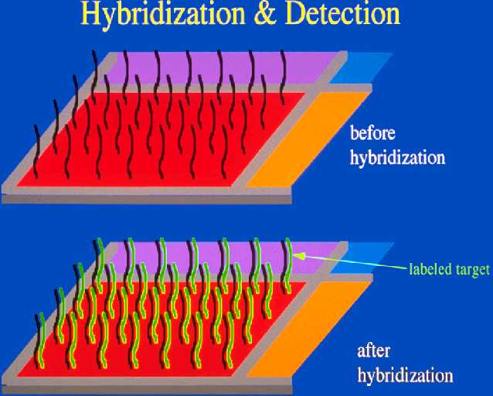
Microarrays (reverse Northerns)
Attach probes that detect genes to solid support
cDNA or oligonucleotides
Tiling path = probes for entire genome
Hybridize with labeled targets

Slide 32
Microarrays
Attach cloned genes to solid support
Hybridize with labeled targets
Measure amount of target bound to each probe

Slide 33
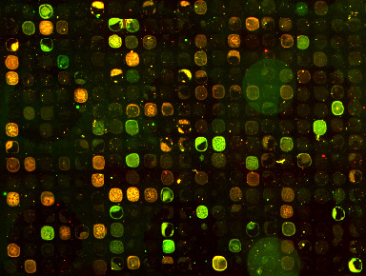
Microarrays
Measure amount of probe bound to each clone
Use fluorescent dye : can quantitate light emitted

Slide 34
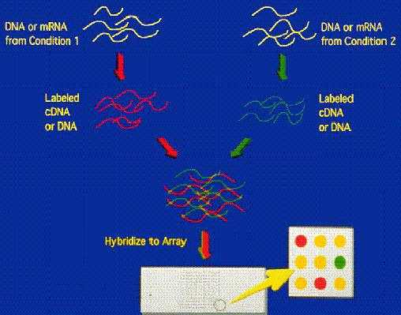
Microarrays
Compare amounts of mRNA in different tissues or treatments by labeling each “target” with a different dye

Slide 35
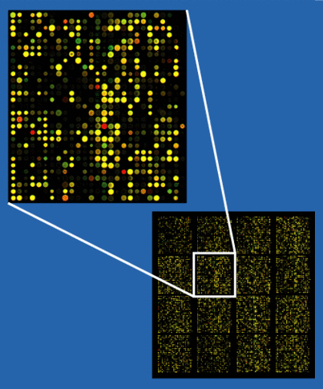
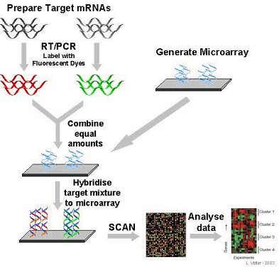
Using the genome
Studying expression of all genes simultaneously
Microarrays: “reverse Northerns”
Fix probes to slide at known locations, hyb with labeled targets, then analyze data

Slide 36
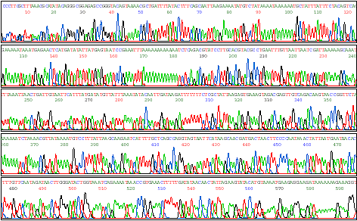
Using the genome
Studying expression of all genes simultaneously
Microarrays: “reverse Northerns”
High-throughput sequencing

Slide 37
Using the genome
Studying expression of all genes simultaneously
Microarrays: “reverse Northerns”
High-throughput sequencing
“Re-sequencing” to detect variation

Slide 38
Using the genome
Studying expression of all genes simultaneously
Microarrays: “reverse Northerns”
High-throughput sequencing
“Re-sequencing” to detect variation
Sequencing all mRNA to quantitate gene expression

Slide 39
Using the genome
Studying expression of all genes simultaneously
Microarrays: “reverse Northerns”
High-throughput sequencing
“Re-sequencing” to detect variation
Sequencing all mRNA to quantitate gene expression
Sequencing all mRNA to identify and quantitate splicing variants

Slide 40
Using the genome
Studying expression of all genes simultaneously
Microarrays: “reverse Northerns”
High-throughput sequencing
“Re-sequencing” to detect variation
Sequencing all mRNA to quantitate gene expression
Sequencing all mRNA to identify and quantitate splicing variants
Sequencing all RNA to identify and quantitate ncRNA

Slide 41
Using the genome
Studying specific genes identified by WEB search
Using Polymerase Chain Reactions (PCR) to focus on specific genes/conditions

Slide 42
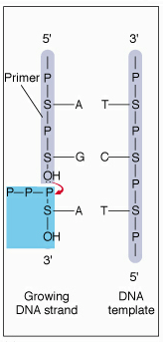
Polymerase Chain Reaction (PCR)
Making multiple identical copies of a DNA
DNA polymerase can only add to 3’OH at
end of chain using template to tell it which
base to add

Slide 43
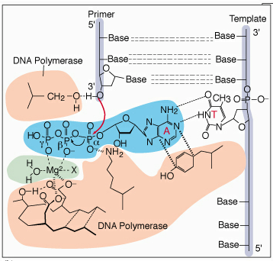
PCR
DNA polymerase can only add to 3’OH at end of chain using template to tell it which base to add
Template holds next base until make bond

Slide 44
PCR
DNA polymerase can only add to 3’OH at end of chain using template to tell it which base to add
Template holds next base until make bond
only correct base fits
- energy comes from 2 PO₄

Slide 45
PCR
DNA polymerase can only add to 3’OH at end of chain using template to tell it which base to add
Template holds next base until make bond
only correct base fits
energy comes from 2 PO₄
Can specify which sequence to copy by adding suitable primers

Slide 46
PCR
Can specify which sequence to copy by adding suitable primers
One binds 5’ end, other 3’ end of target

Slide 47
PCR
Can specify which sequence to copy by adding suitable primers
One binds 5’ end, other 3’ end of target
Start by melting DNA, then adding primers and allowing them to anneal to target.

Slide 48
PCR
Can specify which sequence to copy by adding suitable primers
One binds 5’ end, other 3’ end of target
Start by melting DNA, then adding primers and allowing them to anneal to target.
Next warm to 72˚C to allow Taq polymerase to copy template

Slide 49
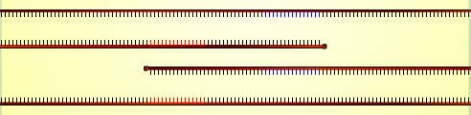
PCR
Can specify which sequence to copy by adding suitable primers
One binds 5’ end, other 3’ end of target
Start by melting DNA, then adding primers and allowing them to anneal to target.
Next warm to 72˚C to allow Taq polymerase to copy template
Finish cycle by heating to DNA melting T

Slide 50
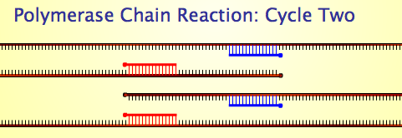
PCR
Can specify which sequence to copy by adding suitable primers
One binds 5’ end, other 3’ end of target
Start by melting DNA, then adding primers and allowing them to anneal to target.
Next warm to 72˚C to allow Taq polymerase to copy template
Finish cycle by heating to DNA melting T
Repeat: now have 2 targets for each primer

Slide 51
PCR
Can specify which sequence to copy by adding suitable primers
One binds 5’ end, other 3’ end of target
Start by melting DNA, then adding primers and allowing them to anneal to target.
Next warm to 72˚C to allow Taq polymerase to copy template
Finish cycle by heating to DNA melting T
Repeat: now have 2 targets for each primer

Slide 52
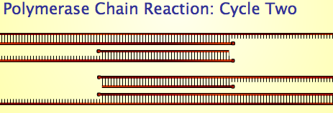
PCR
Can specify which sequence to copy by adding suitable primers
One binds 5’ end, other 3’ end of target
Start by melting DNA, then adding primers and allowing them to anneal to target.
Next warm to 72˚C to allow Taq polymerase to copy template
Finish cycle by heating to DNA melting T
Repeat: now have 2 targets for each primer
Make products that start at one primer, end at other.

Slide 53
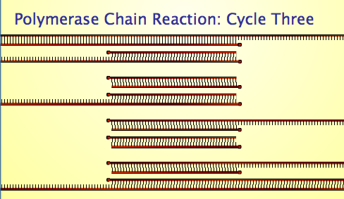
PCR
Start by melting DNA, then adding primers and allowing them to anneal to target.
Next warm to 72˚C to allow Taq polymerase to copy template
Finish cycle by heating to DNA melting T
Repeat: now have 2 targets for each primer
Make products that start at one primer, end at other.
These grow exponentially starting at cycle 3.

Slide 54
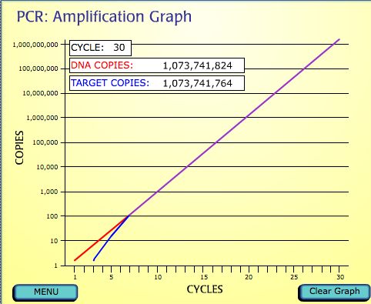
PCR
Make products that start at one primer, end at other.
These grow exponentially starting at cycle 3.
After 30 cycles have 10¹⁰ copies of target: enough to study!

Slide 55
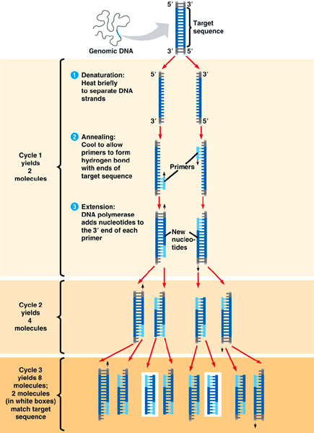
Polymerase Chain Reaction (PCR)
Making multiple identical copies of a DNA
http://www.dnalc.org/view/15924-Making-many-copies-of-DNA.html

