Slide 1

Bio324/BEGR 424 Molecular Biology
William Terzaghi
Spring, 2019

Slide 2
BEGR424- Resource and Policy Information
Instructor: Dr. William Terzaghi
Office: CSC228
Office hours: MWF 11-12,TR 2-3 in CSC228 or by appointment
Phone: (570) 408-4762
Email: terzaghi@wilkes.edu

Slide 3
BEGR424- Resource and Policy Information
Instructor: Dr. William Terzaghi
Office: CSC228
Office hours: MWF 11-12,TR 2-3 in CSC228 or by appointment
Phone: (570) 408-4762
Email: terzaghi@wilkes.edu
Course webpage: http://staffweb.wilkes.edu/william.terzaghi/BEGR424.html

Slide 4
BEGR424- Resource and Policy Information
Instructor: Dr. William Terzaghi
Office: CSC228
Office hours: MWF 11-12,TR 2-3 in CSC228 or by appointment
Phone: (570) 408-4762
Email: terzaghi@wilkes.edu
Course webpage: http://staffweb.wilkes.edu/william.terzaghi/BEGR424.html
Course assistant: Austin Ford
Austin.Ford@wilkes.edu

Slide 5
Plan A
Standard lecture course, except:
Last lectures will be chosen by you -> electives

Slide 6
Plan A
Standard lecture course, except:
Last lectures will be chosen by you -> electives
Last 4 labs will be an independent research project

Slide 7
Plan A
Standard lecture course, except:
Last lectures will be chosen by you -> electives
Last 4 labs will be an independent research project
20% of grade will be “elective”
  Paper
  Talk
  Research proposal
  Poster
  Exam

Slide 8
Plan A schedule- Spring 2019
  Date TOPIC
JAN 15 General Introduction, Genome projects, Cloning & libraries: why and how
22 Studying DNA, DNA sequencing
29 Using the genome, epigenetics
FEB 5 Exam 1, Transcription and its regulation
12 Gene regulation, RNA processing,
19 Post-transcriptional gene regulation, translation
26 Organelle molecular biology
Mar 5 Spring Break
12 Aging, Programmed cell death
19 Exam 2, Cell cycle & DNA replication
26 DNA repair, mutations, cancer
Apr 2 Elective
9 Elective
16 Elective
23 Elective

Slide 9
Lab Schedule
Date TOPIC
Jan 16 DNA extraction and analysis
23 BLAST, etc, primer design
30 PCR
Feb 6 RNA extraction and analysis
13 RT-PCR
20 qRT-PCR
24 cloning PCR fragments
Mar 6 Spring Break
13 Northern analysis
20 Induced protein expression
27 Western analysis
  Apr 3 Independent project
10 Independent project
    17 Independent project
  25 Independent project

Slide 10
Plan B
Provide a genuine experience in using cell and molecular biology to learn about a fundamental problem in biology.

Slide 11
Provide a genuine experience in using cell and molecular biology to learn about a fundamental problem in biology.
Rather than following a set series of lectures, study a problem and see where it leads us.

Slide 12
Provide a genuine experience in using cell and molecular biology to learn about a fundamental problem in biology.
Rather than following a set series of lectures, study a problem and see where it leads us.
Lectures & presentations will relate to current status

Slide 13
Provide a genuine experience in using cell and molecular biology to learn about a fundamental problem in biology.
Rather than following a set series of lectures, study a problem and see where it leads us.
Lectures & presentations will relate to current status
Some class time will be spent in lab & vice-versa
  we may need to come in at other times as well

Slide 14
Pick a problem

Slide 15
Pick a problem
Design some experiments

Slide 16
Pick a problem
Design some experiments
See where they lead us

Slide 17
Pick a problem
Design some experiments
See where they lead us
Grading?
Combination of papers and presentations

Slide 18
GRADING?
Combination of papers and presentations
  First presentation: 5 points
  Research presentation: 10 points
  Final presentation: 15 points
  Assignments: 5 points each
  Poster: 10 points
  Intermediate report 10 points
  Final report: 30 points
Alternatives
Paper(s) instead of 1 or two presentations
Research proposal instead of a presentation
One or two exams?

Slide 19
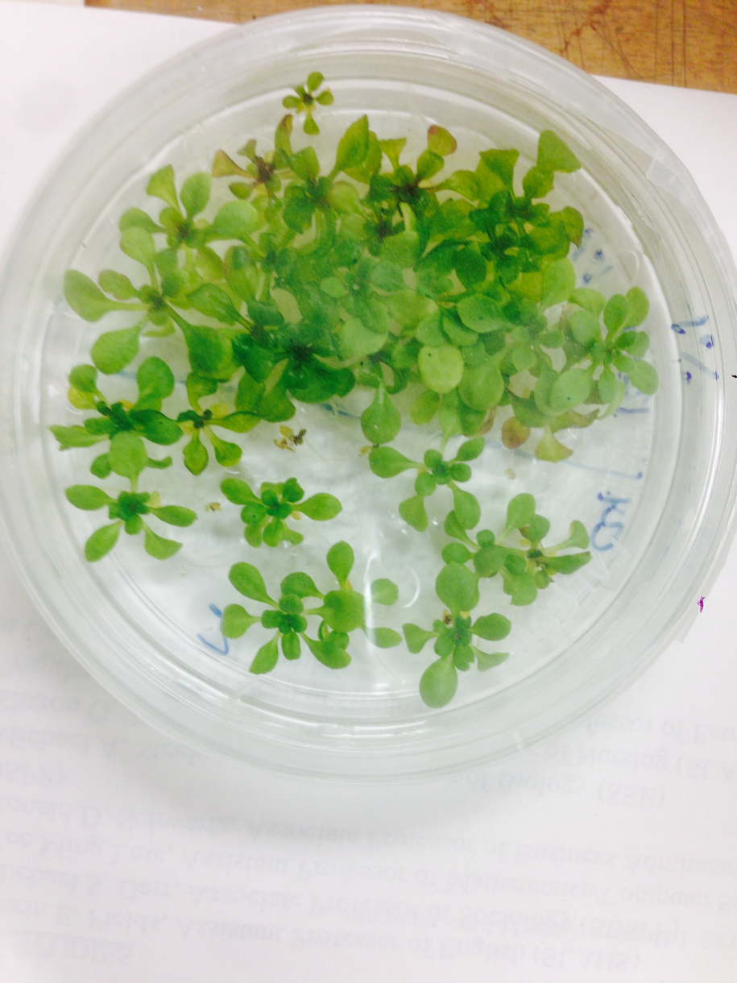
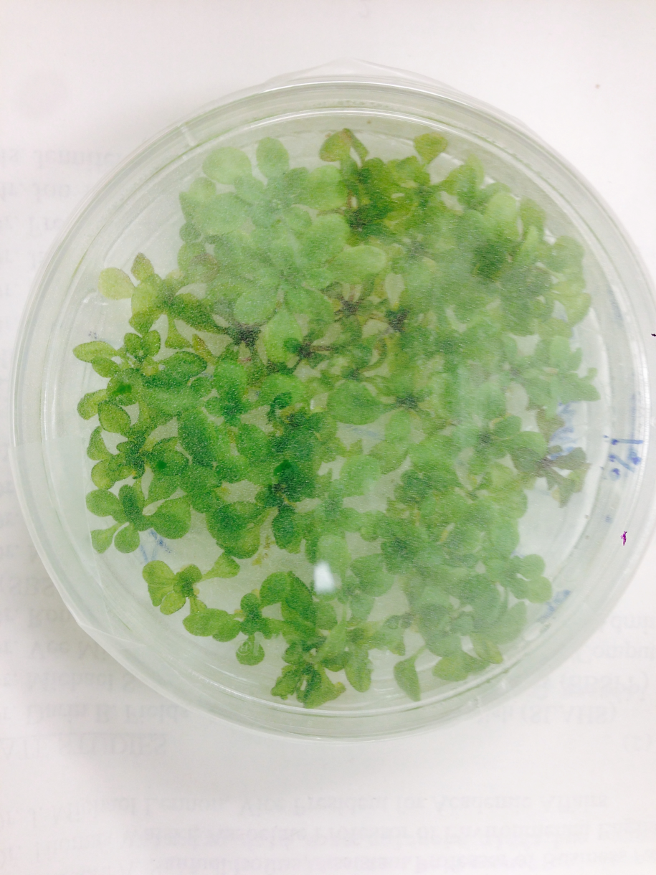
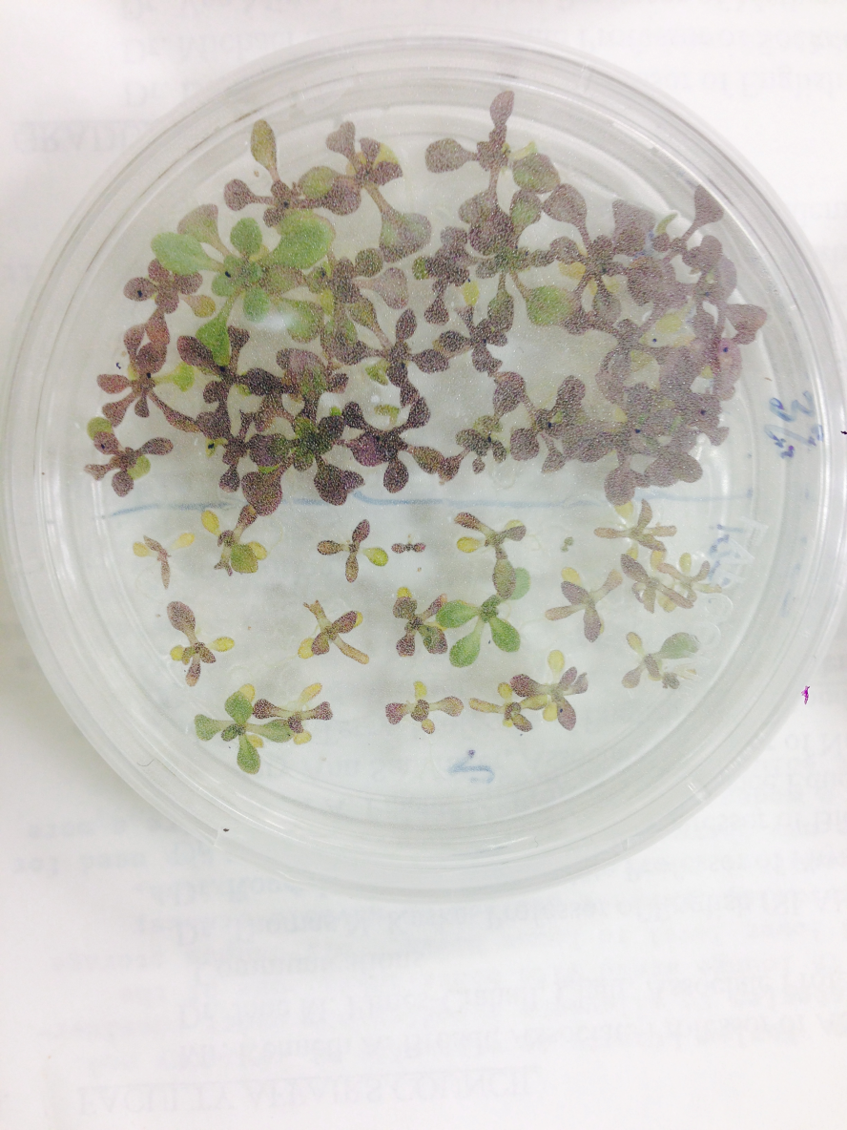
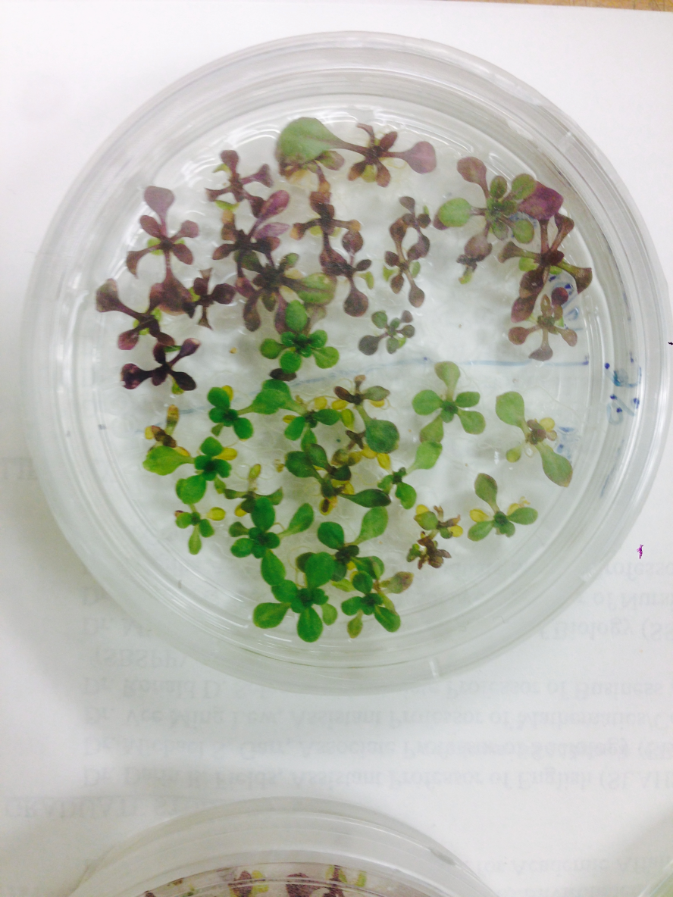
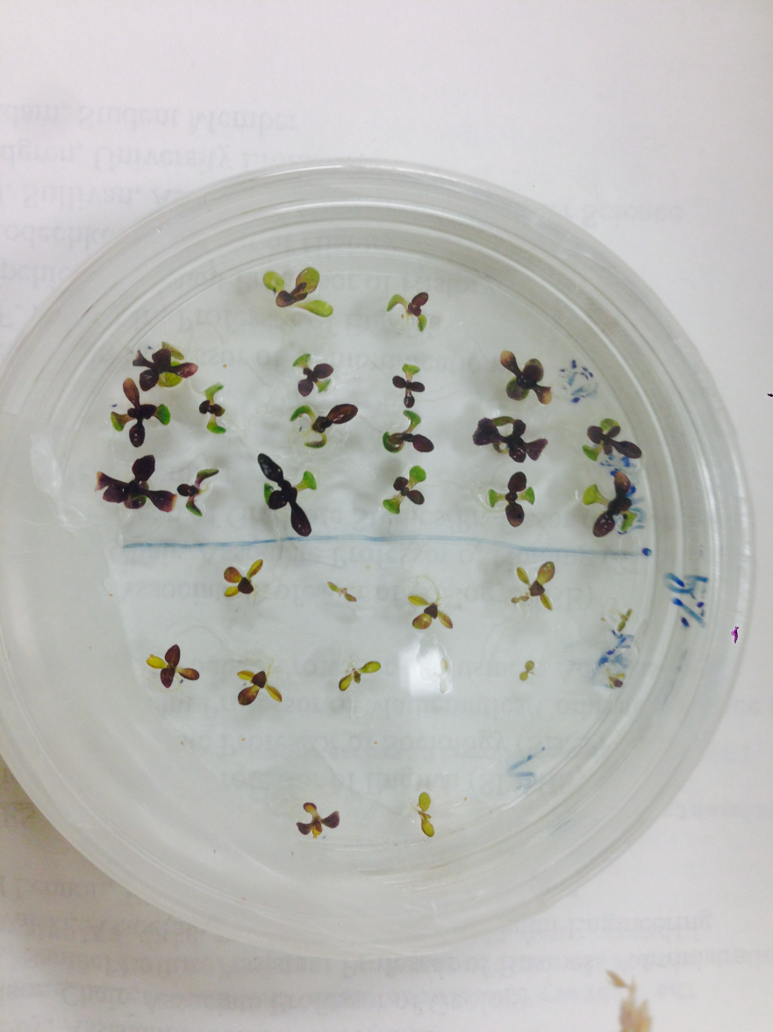
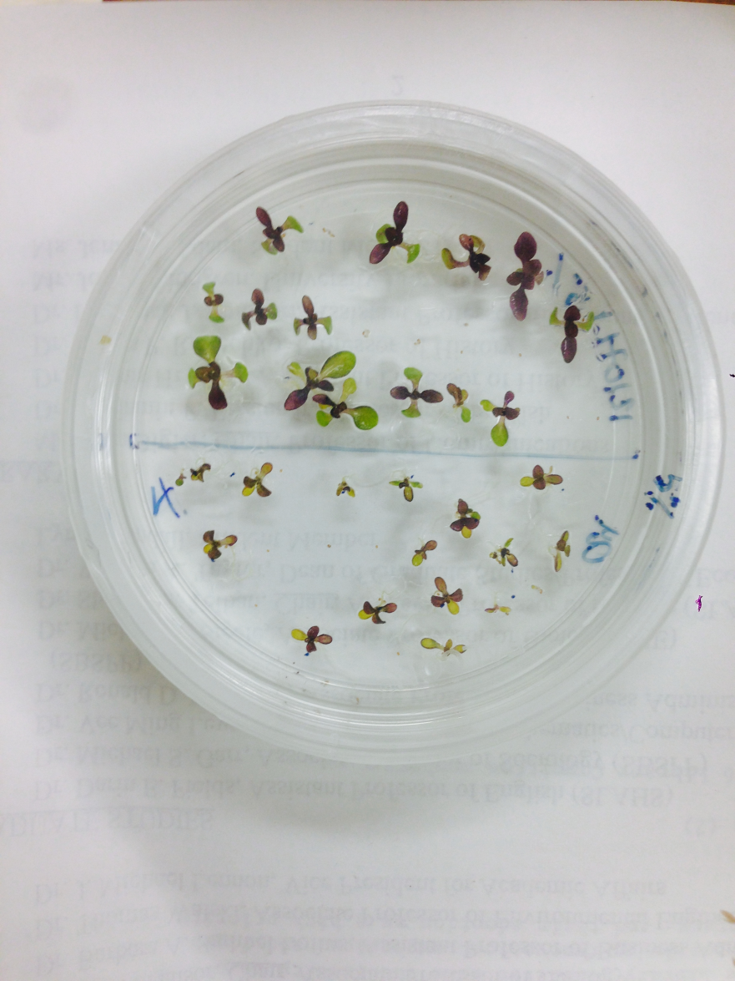
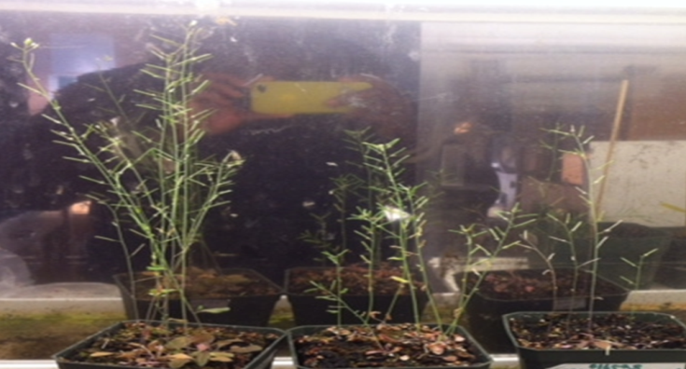
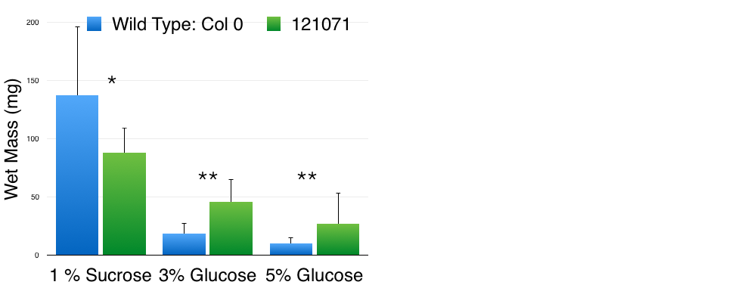
Topics?
Studying ncRNA
  Studying their expression
  Studying expression of genes that may be affected
1% Sucrose
3% Glucose

Slide 20
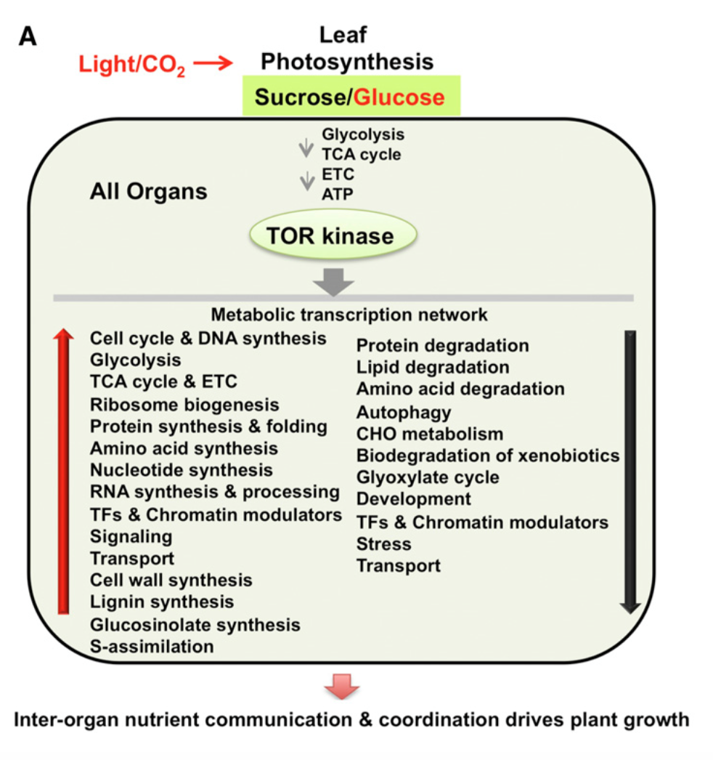
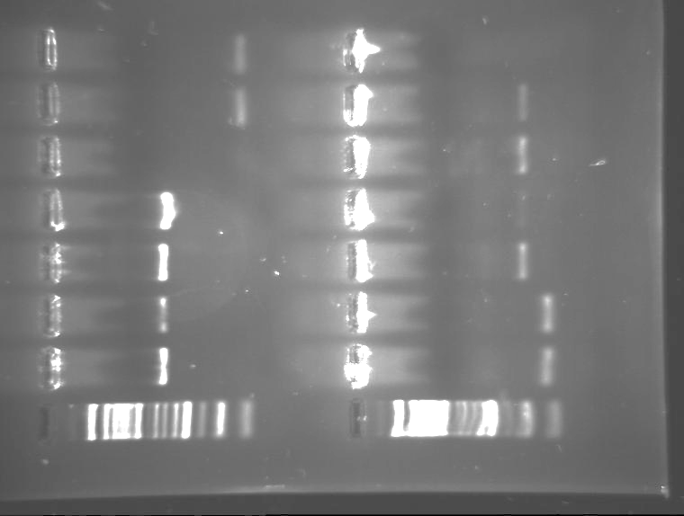
Topics?
Studying ncRNA
Studying sugar signaling
Comparing expression of genes in Bryant’s mutants vs wt under various conditions
Hexokinase
YLS8
1%
Col
5%
Col
1%
Col
5%
Col
1%
121
5%
121

Slide 21
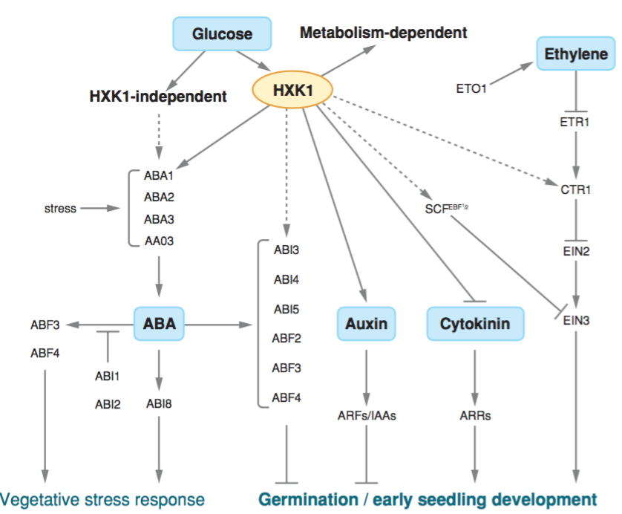
Topics?
Studying ncRNA
Studying sugar signaling
Comparing expression of genes in Bryant’s mutants vs wt under various conditions

Slide 22
Topics?
Studying ncRNA
Studying sugar signaling
Comparing expression of genes in Mike Yuhas’s mutant vs wt under various conditions

Slide 23
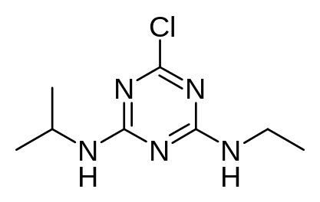
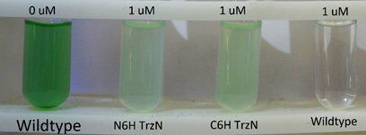
Topics?
Studying ncRNA
Studying signaling in ncRNA mutants
Bioremediation
  Atrazine
    Studying expression and localization of TrzN in transgenic Arabidopsis

Slide 24
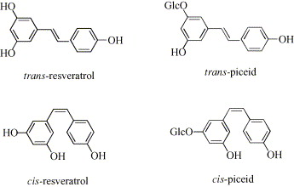
Topics?
Studying ncRNA
Studying signaling in ncRNA mutants
Bioremediation
Studying resveratrol production
  Factors that induce STS gene expression in Japanese knotweed

Slide 25
Topics?
Studying ncRNA
Studying signaling in ncRNA mutants
Bioremediation
Studying resveratrol production
  Factors that induce STS gene expression in Japanese knotweed
  Consequences of resveratrol production by Japanese knotweed and transgenic Arabidopsis

Slide 26
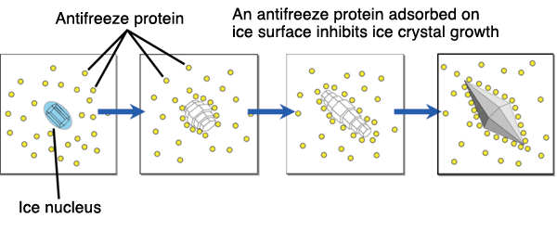
Topics?
Studying ncRNA
Studying signaling in ncRNA mutants
Bioremediation
Resveratrol production
Making Antifreeze proteins

Slide 27
Topics?
Studying ncRNA
Studying signaling in ncRNA mutants
Bioremediation
Resveratrol production
Making Antifreeze proteins
Making algae that bypass Rubisco to fix CO₂

Slide 28
Topics?
Studying ncRNA
Studying signaling in ncRNA mutants
Bioremediation
Resveratrol production
Making Antifreeze proteins
Making algae that bypass Rubisco to fix CO₂
Making novel biofuels
  blue-green algae that generate electricity
  Plants/algae that make methane or hydrogen
  Biodiesel

Slide 29
Topics?
Studying ncRNA
Studying signaling in ncRNA mutants
Bioremediation
Resveratrol production
Making Antifreeze proteins
Making algae that bypass Rubisco to fix CO₂
Making novel biofuels
  blue-green algae that generate electricity
  Plants/algae that make methane or hydrogen
  Biodiesel
8. Using Crispr/Cas9 to make mutants
9. Other ideas?

Slide 30
Assignments?
identify a gene and design primers
presentation on new sequencing tech
designing a protocol to verify your clone
presentations on gene regulation
presentation on applying mol bio
Other work
draft of report on cloning & sequencing
poster for symposium
final gene report
draft of formal report
formal report

Slide 31
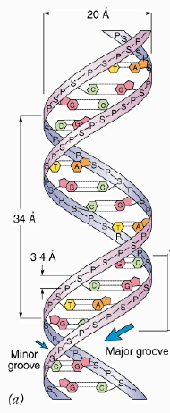
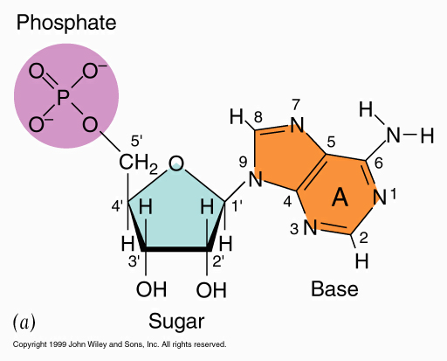
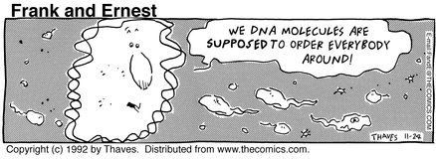
DNA
Nucleotide polymer
Fn = info storage

Slide 32
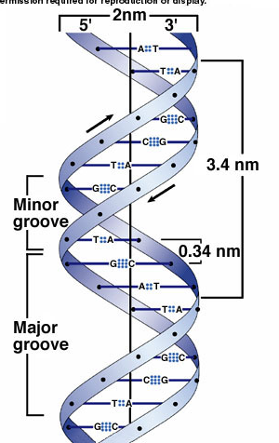
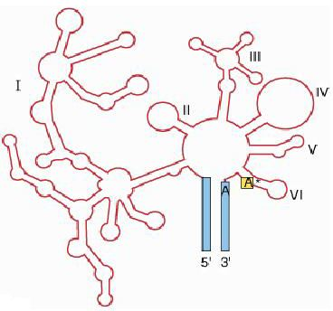
Nucleic acids
Nucleotide polymers
Fn = info storage & retrieval
  DNA = master -> storage
  RNA = copies -> retrieval

Slide 33
Nucleotides
1. 5C sugar
  a) DNA = deoxyribose
  b) RNA = ribose
2. PO₄ on 5' C
3. base on 1' C

Slide 34
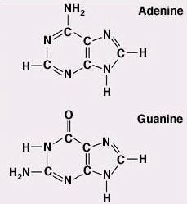
Bases
Purines
  adenine (A)
  guanine (G)

Slide 35
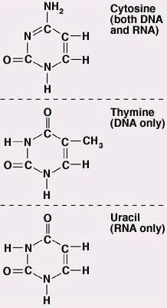
Bases
Purines
  adenine (A)
  guanine (G)
2. Pyrimidines
  cytosine (C)
  thymine (T) (DNA)
  or uracil (U) (RNA)

Slide 36
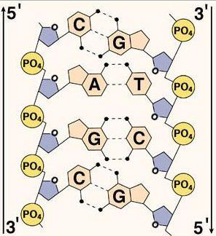
Bases
bases H-bond with others
1. A : T (or U)
2. G : C
  Strands must go
  opposite ways!

Slide 37
Bases
bases H-bond with others
1. A : T (or U)
2. G : C
Info is stored in
base sequence

Slide 38
Genome Projects
Studying structure & function of genomes

Slide 39
Genome Projects
Studying structure & function of genomes
Sequence first

Slide 40
Genome Projects
Studying structure & function of genomes
Sequence first
Then location and function of every part

Slide 41
Genome Projects
How much DNA is there?
SV40 has 5000 base pairs
E. coli has 5 x 10⁶
    Yeast has 2 x 10⁷
    Arabidopsis has 10⁸
    Rice has 5 x 10⁸
    Humans have 3 x 10⁹
    Soybeans have 3 x 10⁹
    Toads have 3 x 10⁹
    Salamanders have 8 x 10¹⁰
    Lilies have 10¹¹

Slide 42
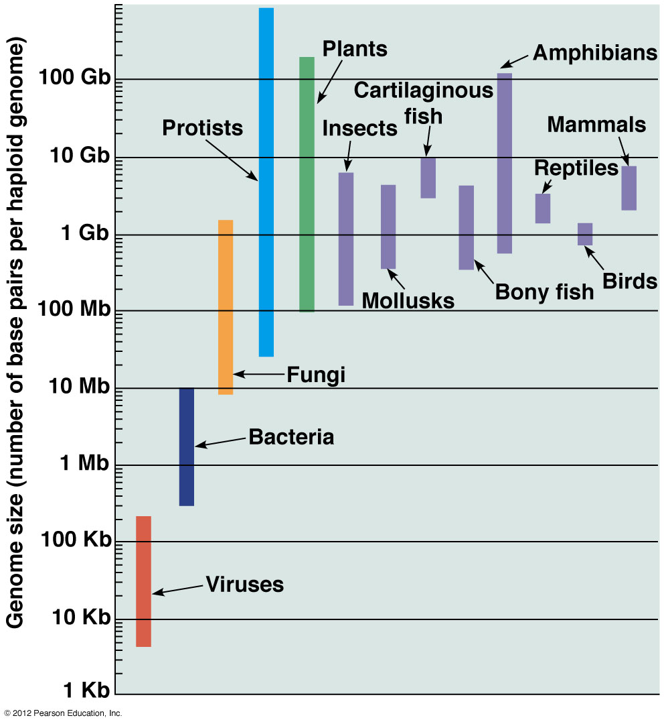
C-value paradox
  C-value paradox: DNA content/haploid genome varies widely

Slide 43
Genome Projects
  C-value paradox: DNA content/haploid genome varies widely
  Some phyla show little variation: birds all have ~10⁹ bp

Slide 44
Genome Projects
  C-value paradox: DNA content/haploid genome varies widely
  Some phyla show little variation: birds all have ~10⁹ bp
    mammals all have ~ 3 x 10⁹ bp

Slide 45
Genome Projects
  C-value paradox: DNA content/haploid genome varies widely
  Some phyla show little variation: birds all have ~10⁹ bp
    mammals all have ~ 3 x 10⁹ bp
  Other phyla are all over
  Insects vary 100 x

Slide 46
Genome Projects
  C-value paradox: DNA content/haploid genome varies widely
  Some phyla show little variation: birds all have ~10⁹ bp
    mammals all have ~ 3 x 10⁹ bp
  Other phyla are all over
  Insects vary 100 x
  flowering plants
  vary 1000x

Slide 47
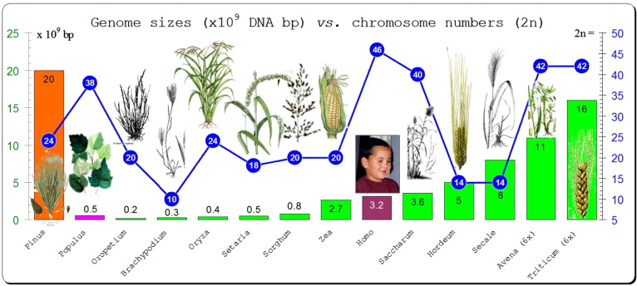
C-value paradox
One cause = variations in chromosome #
2C chromosome numbers vary widely
  Haplopappus has 2

Slide 48
C-value paradox
One cause = variations in chromosome #
2C chromosome numbers vary widely
  Haplopappus has 2
  Arabidopsis has 10

Slide 49
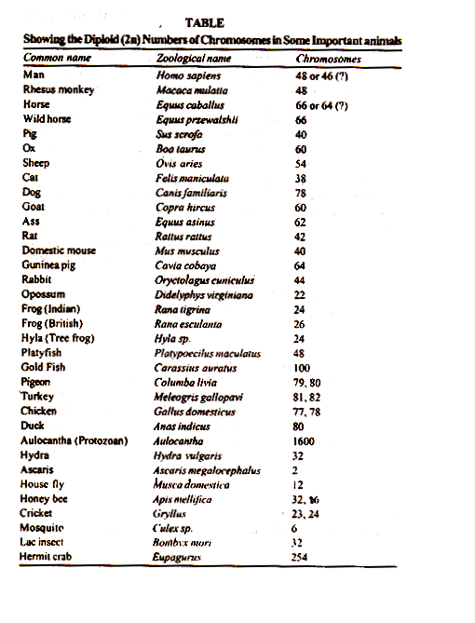
C-value paradox
One cause = variations in
chromosome #s & ploidy
  2C chromosome #s vary widely
  Haplopappus has 2
  Arabidopsis has 10
  Rice has 24
  Humans have 46
  Tobacco (6n) has 72
  Kiwifruit (8n) have 196

Slide 50
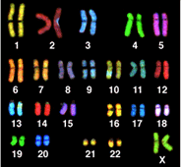
C-value paradox
Chromosome numbers vary
So does chromosome size!

Slide 51
C-value paradox
Chromosome numbers vary
So does chromosome size!
Reason = variation in amounts of repetitive DNA

Slide 52
C-value paradox
Chromosome numbers vary
So does chromosome size!
Reason = variation in amounts of repetitive DNA
first demonstrated using Cot curves

Slide 53
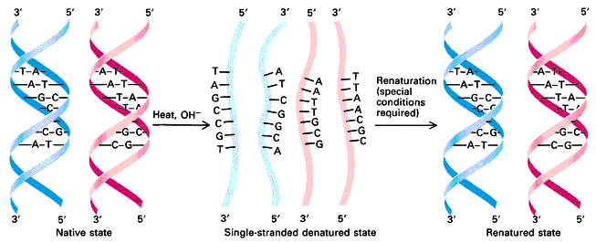
Cot curves
  denature (melt) DNA by heating

Slide 54
Cot curves
  denature (melt) DNA by heating
    dissociates into two single strands

Slide 55
Cot curves
  denature (melt) DNA by heating
  Cool DNA

Slide 56
Cot curves
  denature (melt) DNA by heating
  Cool DNA: complementary strands find each other & anneal

Slide 57
Cot curves
  denature (melt) DNA by heating
  Cool DNA: complementary strands find each other & anneal
    hybridize

Slide 58
Cot curves
  denature (melt) DNA by heating
  Cool DNA: complementary strands find each other & anneal
    Hybridize: don't have to be the same strands

Slide 59
Cot curves
  denature (melt) DNA by heating
  Cool DNA: complementary strands find each other & anneal
    Hybridize: don't have to be the same strands
  Rate depends on [complementary strands]

Slide 60
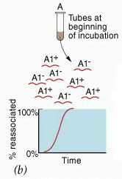
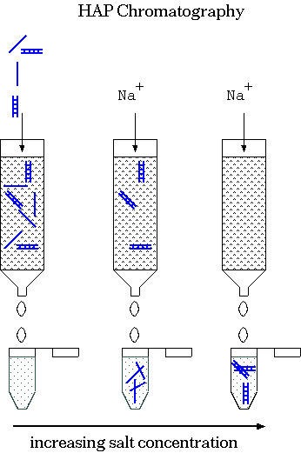
Cot curves
  1) denature DNA
  2) cool DNA
  3) at intervals measure [single-stranded DNA]

Slide 61
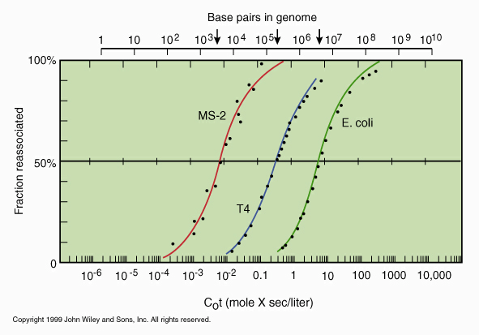
Cot curves
viruses & bacteria show simple curves
Cot is inversely proportional to genome size

Slide 62
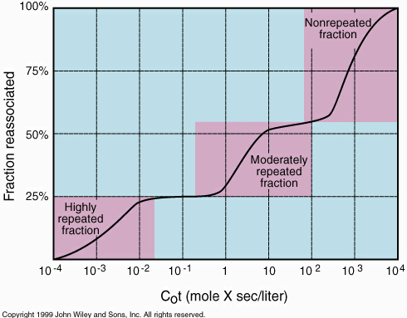
Cot curves
eucaryotes show 3 step curves
Step 1 renatures rapidly: “highly repetitive”

Slide 63
Cot curves
eucaryotes show 3 step curves
Step 1 renatures rapidly: “highly repetitive”
Step 2 is intermediate: “moderately repetitive”

Slide 64
Cot curves
eucaryotes show 3 step curves
Step 1 renatures rapidly: “highly repetitive”
Step 2 is intermediate: “moderately repetitive”
Step 3 is ”unique"

Slide 65
Molecular cloning
To identify the types of DNA sequences found within each class they must be cloned

Slide 66
Molecular cloning
To identify the types of DNA sequences found within each class they must be cloned
  Force host to make millions of copies of a specific sequence

Slide 67
Molecular cloning
To identify the types of DNA sequences found within each class they must be cloned
Why?
  To obtain enough copies of a specific sequence to work with!
  typical coding sequences are 1,000 bp cf haploid human genome is 3,000,000,000 bp
  average gene is < 1/1,000,000 of total genome

Slide 68
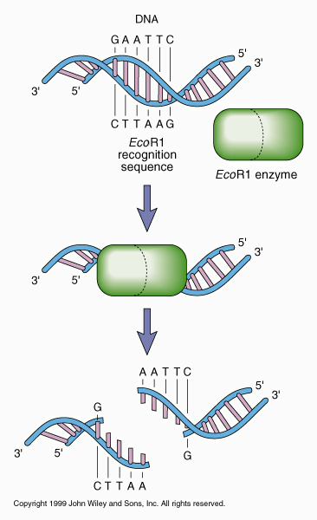
Recombinant DNA
Arose from 2 key discoveries in the 1960's
1) Werner Arber: enzymes which cut DNA at specific sites
  called "restriction enzymes” because restrict host range for certain bacteriophage

Slide 69
Recombinant DNA
Restriction enzymes cut DNA at specific sites
bacterial” immune system”: destroy “non-self” DNA

Slide 70
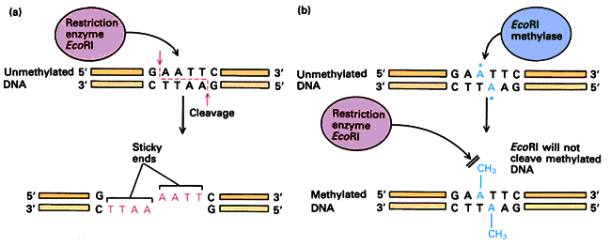
Recombinant DNA
Restriction enzymes cut DNA at specific sites
bacterial” immune system”: destroy “non-self” DNA
methylase recognizes same sequence & protects it by methylating it
Restriction/modification systems

Slide 71
    Recombinant DNA
Restriction enzymes create unpaired "sticky ends” which anneal with any complementary sequence

Slide 72
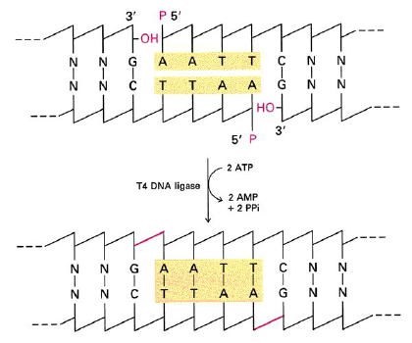
Recombinant DNA
Arose from 2 key discoveries in the 1960's
1) restriction enzymes
2) Weiss: DNA ligase
-> enzyme which glues
DNA strands together
seals "nicks" in DNA backbone

Slide 73
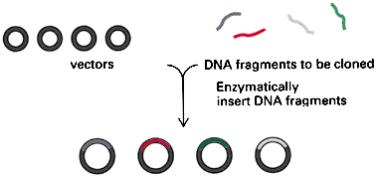
Molecular cloning
How?
1) introduce DNA sequence into a vector
  Cut both DNA & vector with restriction enzymes, anneal & join with DNA ligase
  create a recombinant DNA molecule

Slide 74
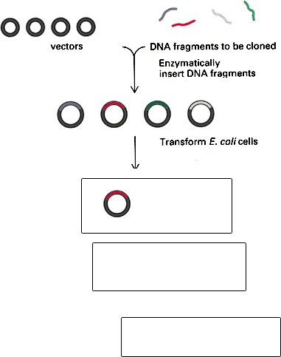
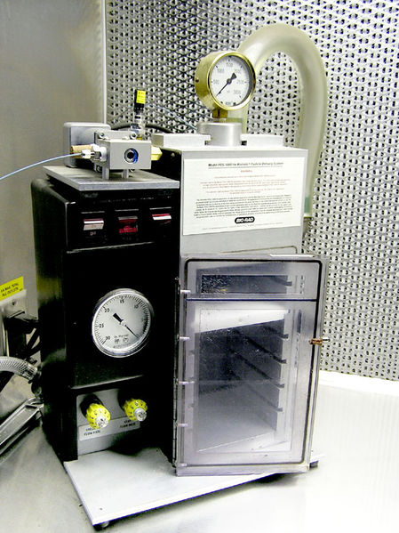
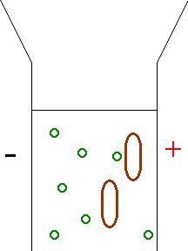
Molecular cloning
How?
1) create recombinant DNA
2) transform recombinant
molecules into suitable host

Slide 75
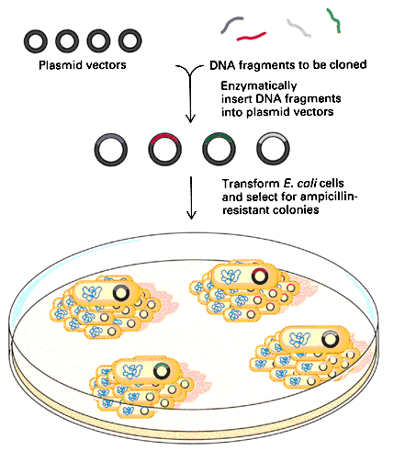
Molecular cloning
How?
1) create recombinant DNA
2) transform recombinant molecules into suitable host
3) identify hosts which have taken up your recombinant molecules

Slide 76
Molecular cloning
How?
1) create recombinant DNA
2) transform recombinant molecules into suitable host
3) identify hosts which have taken up your recombinant molecules
4) Extract DNA

Slide 77
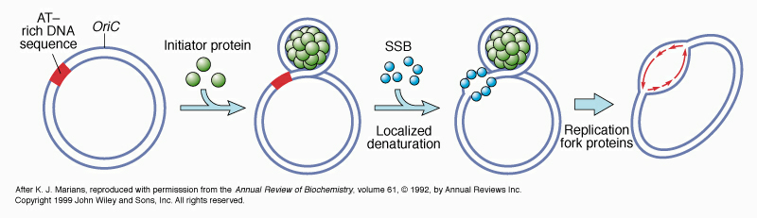
Vectors
Problem: most DNA will not be propagated in a new host
  1) lacks origin of replication that functions in that host

Slide 78
Vectors
Problem: most DNA will not be propagated in a new host
  lacks origin of replication that functions in that host
  lacks reason for host to keep it
  DNA is expensive!
    synthesis consumes 2 ATP/base
    stores one ATP/base

Slide 79
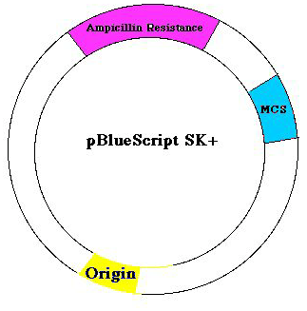
Vectors
Solution: insert DNA into a vector
General requirements:
  1) origin of replication
  2) selectable marker
  3) cloning site: region
  where foreign DNA
  can be inserted

Slide 80
Vectors
1) plasmids: circular pieces of”extrachromosomal” DNA propagated inside host
origin of replication
selectable marker
(usually a drug
resistance gene)
Multiple cloning site
  Upper limit:
~10,000 b.p. inserts
Transform into host

Slide 81
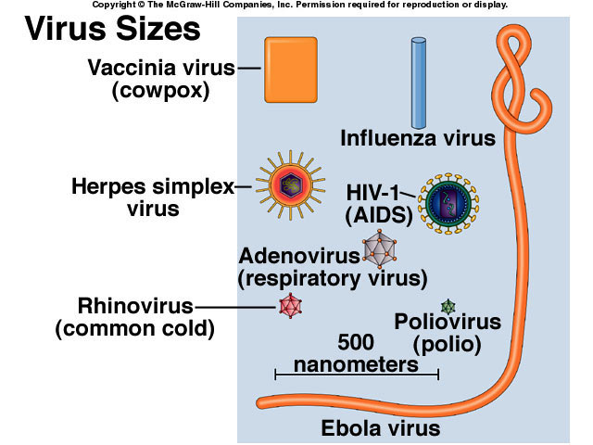
Vectors
1) Plasmids
2) Viruses
must have a
dispensable region

Slide 82
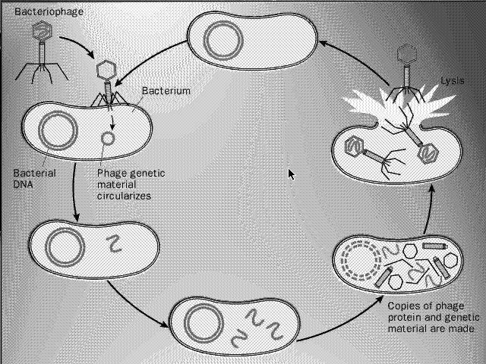
Viral Vectors
find viruses with a dispensable region
Replace with new DNA
Package recombinant genome into capsid
Infect host

Slide 83
Viral Vectors
viruses are very good at infecting new hosts
  transfect up to 50% of recombinant molecules into host
  (cf < 0.01% for transformation)

Slide 84
Viral Vectors
viruses are very good at infecting new hosts
  transfect up to 50% of recombinant molecules into host
  (cf < 0.01% for transformation)
2) viruses are very good at forcing hosts to replicate them
  may not need a selectable marker

Slide 85
Viral Vectors
viruses are very good at infecting new hosts
  transfect up to 50% of recombinant molecules into host
  (cf < 0.01% for transformation)
2) viruses are very good at forcing hosts to replicate them
  may not need a selectable marker
Disadvantage
Viruses are much harder to work with than plasmids

Slide 86
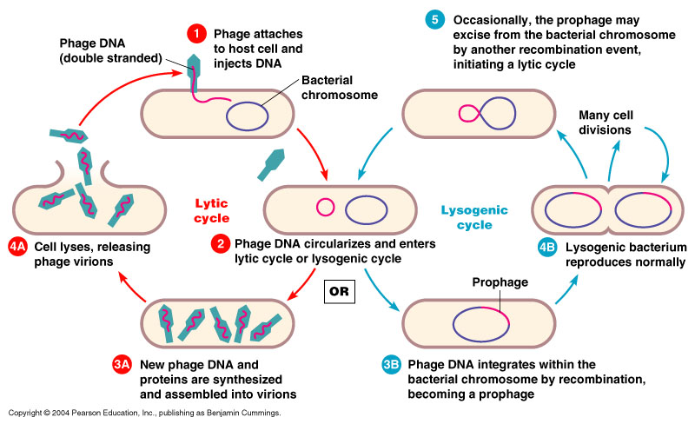
Vectors
Viruses
  Lambda: can dispense with 20 kb needed for lysogeny

Slide 87
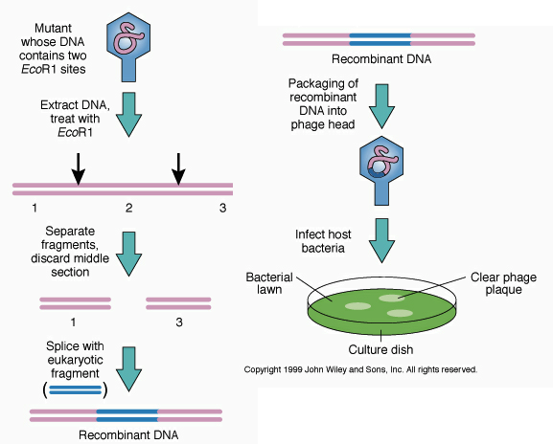
Vectors
Viruses
Replace "lysogenic genes "with foreign DNA then package in vitro

Slide 88
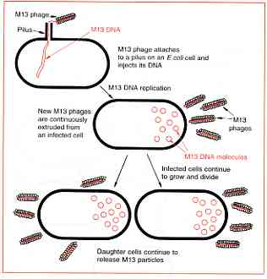
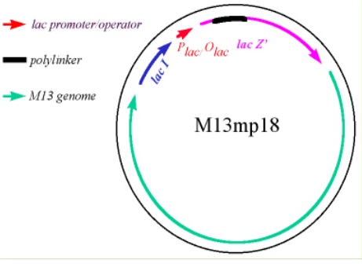
Vectors
Viruses
  Lambda: can dispense with 20 kb
  M13: makes single-stranded DNA, but can clone into DS replicative form

Slide 89
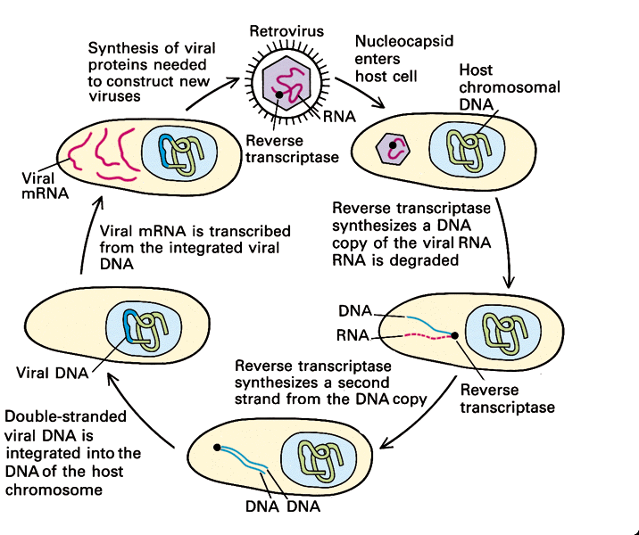
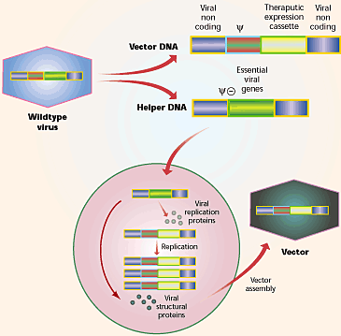
Vectors
Viruses
  Lambda: can dispense with 20 kb
  M13: makes single-stranded DNA
  disarmed retroviruses to transform animals

Slide 90

Other viruses
adenoviruses or herpes viruses for gene therapy
  Treating patients with engineered viruses that furnish missing genes to specific tissues

Slide 91

Other viruses
adenoviruses or herpes viruses for gene therapy
Adeno-associated viruses
Small (20nm) ssDNA viruses (4.7 kB)
Can’t replicate by themselves

Slide 92

Adeno-associated viruses
Can’t replicate by themselves
With helper reproduce lytically & release 1000s
w/o helper integrate into host genome: allows control

Slide 93

Adeno-associated viruses
Can’t replicate by themselves
With helper reproduce lytically & release 1000s
w/o helper integrate into host genome: allows control
Replace DNA between LTRs with gene 4.5 kb max

Slide 94

Other Viruses
Adeno-associated viruses
vaccinia for making vaccines

Slide 95
Vectors
Artificial chromosomes
  Lambda can only carry 20,000 bp

Slide 96
Vectors
Artificial chromosomes
  Lambda can only carry 20,000 bp = 1/150,000 human genome

Slide 97
Vectors
Artificial chromosomes
  Lambda can only carry 20,000 bp = 1/150,000 human genome
  need > 750,000 different lambda to clone 95% of entire human genome

Slide 98
Artificial chromosomes
1) YACs (yeast artificial chromosomes) can carry > 1,000,000 b.p.
  developed for genome projects, but also taught about genome structure

Slide 99

YACs
found eukaryotic origins
of replication using
“cloning by complementation”

Slide 100
YACs
found eukaryotic origins
of replication using
“cloning by complementation”
randomly add yeast sequences to a
selectable marker and transform

Slide 101
YACs
found eukaryotic origins
of replication using
“cloning by complementation”
randomly add yeast sequences to a
selectable marker and transform
only cells which took up plasmid
containing marker and origin grew

Slide 102
YACs
found eukaryotic origins
of replication using
“cloning by complementation”
randomly add yeast sequences to a
selectable marker and transform
only cells which took up plasmid
containing marker and origin grew
call eukaryotic origins ARS
= autonomously replicating
sequences

Slide 103

YACs (yeast artificial chromosomes)
found yeast centromeres
by “complementation
cloning ”
randomly add yeast
sequences to marker &
ARS and transform
only cells which took up
plasmid containing marker,
ARS and centromere
grew fast

Slide 104

YACs (yeast artificial chromosomes)
Yeast do not propagate
circles > 100 kB
found yeast telomeres by
“complementation cloning ”
randomly add yeast
sequences to linear DNA
with marker, ARS
& centromere
only cells which took up
linear molecules containing
telomere grew

Slide 105
Artificial chromosomes
YACs can carry >1,000,000 b.p.
  contain yeast centromeres so that will be transmitted at mitosis
  contain ARS = origins of replication
  contain telomeres so that don’t lose ends
  contain a selectable marker
  (usually a gene for amino acid or nucleoside biosynthesis)

Slide 106
YACs (yeast artificial chromosomes)
problems with YACs
  1) DNA is unstable
    gets deleted
    gets rearranged
  2) Yeast is harder to work with

Slide 107


Artificial chromosomes
1) YACs (yeast artificial chromosomes)
2) BACs (bacterial artificial chromosomes)
  based on the E.coli F’ plasmid
  take up to 500 kb
  Grow in mutant E.coli
  that can’t recombine

Slide 108

Artificial chromosomes
3) PACs (P1 derived artificial chromosomes)
    modified bacteriophage P1 takes up to 100 kb
    much more efficient at infecting hosts

Slide 109

Artificial chromosomes
YACs,BACs, PACs
HACs: human artificial chromosomes
Constructed in cultured human cells by adding YACs containing human telomeres, ARS and “alphoid” (centromeric) DNA

Slide 110

Artificial chromosomes
YACs,BACs, PACs
HACs: human artificial chromosomes
Constructed in cultured human cells by adding YACs containing human telomeres, ARS and “alphoid” (centromeric) DNA
Can also be made “top-down” by transforming telomeres into chromosome 21 that insert near centromere

Slide 111
Molecular cloning
Which fragment to clone?

Slide 112
Molecular cloning
usually no way to pick which fragment to clone
solution: clone them all, then identify the clone which contains your sequence
construct a library, then screen it to find your clone

Slide 113
Libraries
a collection of clones representing the entire complement of sequences of interest
  1) entire genome for genomic libraries
  2) all mRNA for cDNA

Slide 114
Libraries
Why?
  Genomes are too large to deal with:
    break into manageable “volumes”

Slide 115
Libraries
How?
randomly break DNA
into vector-sized pieces
& ligate into vector
1) partial digestion
with restriction enzymes

Slide 116
Libraries
How?
randomly break DNA
into vector-sized pieces
& ligate into vector
1) partial digestion
with restriction enzymes
2) Mechanical shearing

Slide 117

        Libraries
How?
B) make cDNA from mRNA
reverse transcriptase makes
DNA copies of all mRNA
molecules present

Slide 118
        Libraries
How?
B) make cDNA from mRNA
reverse transcriptase makes
DNA copies of all mRNA
molecules present
mRNA can’t be cloned, DNA can

Slide 119

Detecting your clone
“grow” your library on a suitable host
result
  colonies for plasmids or YACs
  plaques (clear areas where hosts are dead) for viruses

Slide 120
Detecting your clone
All the volumes of the library look the same
  trick is figuring out what's inside
  usually done by “screening” the library with a suitable probe
  identifies clones containing the desired sequence

Slide 121
Detecting your clone
Probes = molecules which specifically bind to your clone
  Usually use nucleic acids homologous to your desired clone

Slide 122
Detecting your clone
Probes = molecules which specifically bind to your clone
  Usually use nucleic acids homologous to your desired clone
    Sequences cloned from related organisms

Slide 123

Detecting your clone
Probes = molecules which specifically bind to your clone
Usually use nucleic acids homologous to your desired clone
  Sequences cloned from related organisms or made by PCR
  http://www.dnalc.org/view/15924-Making-many-copies-of-DNA.html

Slide 124
Detecting your clone
Probes = molecules which specifically bind to your clone
  Usually use nucleic acids homologous to your desired clone
    Sequences cloned from related organisms or made by PCR
    Make them radioactive, fluorescent, or “tagged” some other way so they can be detected

Slide 125
Detecting your clone by
membrane hybridization
1) Denature

Slide 126
Detecting your clone by
membrane hybridization
Denature
Transfer to a filter
immobilizes it at fixed location
makes it accessible to probe

Slide 127
Detecting your clone by
membrane hybridization
Denature
Transfer to a filter
3) probe with complementary
labeled sequences
Will bind your clone

Slide 128

Detecting your clone by
membrane hybridization
Denature
Transfer to a filter
3) probe with complementary
labeled sequences
4) Detect
radioactivity -> detect by
Autoradiography

Slide 129
Detecting your clone by
membrane hybridization
Denature
Transfer to a filter
3) probe with complementary
labeled sequences
4) Detect
radioactivity -> detect by
autoradiography
biotin -> detect enzymatically

Slide 130

Analyzing your clone
FISH (fluorescent in situ hybridization) to metaphase chromosomes to find location of your clone

Slide 131

Analyzing your clone
1) FISH
2) “Restriction mapping”
  a) determine sizes of fragments obtained with different enzymes

Slide 132
Analyzing your clone
1) FISH
2) “Restriction mapping”
  a) determine sizes of fragments obtained with different enzymes
  b) “map” relative positions by double digestions

Slide 133

Analyzing your clone
1) FISH
2) “Restriction mapping”
3) Southern analysis
  used to determine organization & copy # of your sequence

Slide 134
Southern analysis
1) digest genomic DNA with restriction enzymes

Slide 135
Southern analysis
1) digest genomic DNA with restriction enzymes
2) separate fragments by gel electrophoresis

Slide 136
Southern analysis
1) digest genomic DNA with restriction enzymes
2) separate fragments by gel electrophoresis
3) transfer & fix to a membrane

Slide 137
Southern analysis
1) digest genomic DNA with restriction enzymes
2) separate fragments using gel electrophoresis
3) transfer & fix to a membrane
4) probe with your clone

Slide 138
Northern analysis
Similar technique used to analyze RNA

Slide 139
Northern analysis
1) Separate by gel electrophoresis

Slide 140
Northern analysis
1) Separate by gel electrophoresis
2) transfer & fix to a membrane

Slide 141
Northern analysis
1) Separate by gel electrophoresis
2) transfer & fix to a membrane
3) probe with your clone

Slide 142
Northern analysis
1) fractionate by size using gel electrophoresis
2) transfer & fix to a membrane
3) probe with your clone
4) determine # & sizes of detected bands

Slide 143
Northern analysis
determine # & sizes of detected bands
  tells size
  tells which tissues or conditions it is expressed in

Slide 144
Northern analysis
determine # & sizes of detected bands
  tells size
  tells which tissues or conditions it is expressed in
  intensity tells how abundant it is

Slide 145
RT-PCR
First reverse-transcribe RNA, then amplify by PCR
Can make cDNA of all RNA using poly-T and/or random hexamer primers

Slide 146
RT-PCR
First reverse-transcribe RNA, then amplify by PCR
Can make cDNA of all RNA using poly-T and/or random hexamer primers
Can do the reverse transcription with gene-specific primers.

Slide 147

Quantitative (real-time) RT-PCR
First reverse-transcribe RNA, then amplify by PCR
Measure number of cycles to cross threshold. Fewer cycles = more starting copies

Slide 148
Quantitative (real-time) RT-PCR
First reverse-transcribe RNA, then amplify by PCR
Measure number of cycles to cross threshold. Fewer cycles = more starting copies
Detect using fluorescent probes

Slide 149
Quantitative (real-time) RT-PCR
Detect using fluorescent probes
Sybr green detects dsDNA

Slide 150

Quantitative (real-time) RT-PCR
Detect using fluorescent probes
Sybr green detects dsDNA
Others, such as taqman, are gene-specific

Slide 151
Quantitative (real-time) RT-PCR
Detect using fluorescent probes
Sybr green detects dsDNA
Others, such as taqman, are gene-specific
  Can multiplex by making gene-specific probes different colors

Slide 152


Western analysis
Separate Proteins
by PAGE
2) transfer & fix to a
membrane

Slide 153

Western analysis
1) Separate Proteins by polyacrylamide gel electrophoresis
2) transfer & fix to a membrane
3) probe with suitable antibody (or other probe)

Slide 154
Western analysis
1) Separate Proteins by polyacrylamide gel electrophoresis
2) transfer & fix to a membrane
3) probe with suitable antibody (or other probe)
4) determine # & sizes of detected bands

Slide 155
Analyzing your clone
1) FISH
2) “Restriction mapping”
3) Southern analysis : DNA
4) Northern analysis: RNA
5) Sequencing

Slide 156

DNA Sequencing
Basic approach: create DNA molecules which start at fixed location and randomly end at known bases

Slide 157
DNA Sequencing
Basic approach: create DNA molecules which start at fixed location and randomly end at known bases
generates set of nested fragments

Slide 158
DNA Sequencing
Basic approach: create DNA molecules which start at fixed location and randomly end at known bases
generates set of nested fragments
separate these fragments on gels which resolve molecules differing in length by one base

Slide 159
DNA Sequencing
Basic approach: create DNA molecules which start at fixed location and randomly end at known bases
generates set of nested fragments
separate these fragments on gels which resolve molecules differing in length by one base
creates a ladder where each rung
is 1 base longer than the one below

Slide 160
DNA Sequencing
Basic approach: create DNA molecules which start at fixed location and randomly end at known bases
generates set of nested fragments
separate these fragments on gels which resolve molecules differing in length by one base
creates a ladder where each rung
is 1 base longer than the one below
read sequence by climbing the ladder

Slide 161


    DNA Sequencing
Sanger (di-deoxy chain termination)
1) anneal primer to template

Slide 162
    DNA Sequencing
Sanger (di-deoxy chain termination)
anneal primer to template
2) elongate with DNA polymerase

Slide 163
    DNA Sequencing
Sanger (di-deoxy chain termination)
anneal primer to template
2) elongate with DNA polymerase
3) terminate chain with di-deoxy nucleotides
will be incorporated but
cannot be elongated
4 separate reactions:
A, C, G, T

Slide 164
    DNA Sequencing
Sanger (di-deoxy chain termination)
anneal primer to template
2) elongate with DNA polymerase
3) terminate chain with di-deoxy nucleotides
will be incorporated but
cannot be elongated
4 separate reactions:
A, C, G, T

Slide 165
    DNA Sequencing
Sanger (di-deoxy chain termination)
anneal primer to template
2) elongate with DNA polymerase
3) terminate chain with di-deoxy nucleotides
4) separate by size
  Read sequence by climbing the ladder

Slide 166

Automated DNA
Sequencing
1) Use Sanger technique
2) label primers with
fluorescent dyes
Primer for each base is a different color!
A CGT
3) Load reactions in one lane
4) machine detects with laser & records order of elution

Slide 167

Genome projects
1) Prepare map of genome

Slide 168
Genome projects
1) Prepare map of genome
To find genes must know their location

Slide 169
Sequencing Genomes
1) Map the genome
2) Prepare an AC library
3) Order the library
FISH to find their
chromosome

Slide 170
Sequencing Genomes
1) Map the genome
2) Prepare an AC library
3) Order the library
FISH to find their chromosome
identify overlapping AC using ends as probes
assemble contigs until chromosome is covered

Slide 171

Sequencing Genomes
1) Map the genome
2) Prepare an AC library
3) Order the library
4) Subdivide each AC into lambda contigs

Slide 172
Sequencing Genomes
1) Map the genome
2) Prepare an AC library
3) Order the library
4) Subdivide each AC into lambda contigs
5) Subdivide each lambda into plasmids
6) sequence the plasmids

Slide 173
Sequencing Genomes
1) Map the genome
2) Prepare an AC library
3) Order the library
4) Subdivide each AC into lambda contigs
5) Subdivide each lambda into plasmids
6) sequence the plasmids
With Next Generation Sequencing can sequence an entire library and then assemble the sequence by computer

Slide 174
Sequencing Genomes
With Next Generation Sequencing can sequence an entire library and then assemble the sequence by computer
Works well for bacteria

Slide 175
Sequencing Genomes
With Next Generation Sequencing can sequence an entire library and then assemble the sequence by computer
Works well for bacteria
Very badly for eukaryotes

Slide 176
Sequencing Genomes
With Next Generation Sequencing can sequence an entire library and then assemble the sequence by computer
Works well for bacteria
Very badly for eukaryotes
  Can’t tell where
  repeated sequences
  come from

Slide 177
Sequencing Genomes
With Next Generation Sequencing can sequence an entire library and then assemble the sequence by computer
Works well for bacteria
Very badly for eukaryotes
  Can’t tell where
  repeated sequences
  come from
  Solve with
  longer reads

Slide 178

Using the genome
Studying expression of all genes simultaneously
Microarrays (reverse Northerns)
  Attach probes that detect genes to solid support
    cDNA or oligonucleotides

Slide 179
Using the genome
Studying expression of all genes simultaneously
Microarrays (reverse Northerns)
  Attach probes that detect genes to solid support
    cDNA or oligonucleotides
    Tiling path = probes for entire genome

Slide 180

Microarrays (reverse Northerns)
  Attach probes that detect genes to solid support
    cDNA or oligonucleotides
    Tiling path = probes for entire genome
  Hybridize with labeled targets

Slide 181
Microarrays
  Attach cloned genes to solid support
  Hybridize with labeled targets
  Measure amount of target bound to each probe

Slide 182

Microarrays
Measure amount of probe bound to each clone
Use fluorescent dye : can quantitate light emitted

Slide 183

Microarrays
Compare amounts of mRNA in different tissues or treatments by labeling each “target” with a different dye

Slide 184


Using the genome
Studying expression of all genes simultaneously
Microarrays: “reverse Northerns”
  Fix probes to slide at known locations, hyb with labeled targets, then analyze data

Slide 185

Using the genome
Studying expression of all genes simultaneously
Microarrays: “reverse Northerns”
High-throughput sequencing

Slide 186
Using the genome
Studying expression of all genes simultaneously
  Microarrays: “reverse Northerns”
  High-throughput sequencing
  “Re-sequencing” to detect variation

Slide 187
Using the genome
Studying expression of all genes simultaneously
Microarrays: “reverse Northerns”
High-throughput sequencing
“Re-sequencing” to detect variation
Sequencing all mRNA to quantitate gene expression

Slide 188
Using the genome
Studying expression of all genes simultaneously
Microarrays: “reverse Northerns”
High-throughput sequencing
“Re-sequencing” to detect variation
Sequencing all mRNA to quantitate gene expression
Sequencing all mRNA to identify and quantitate splicing variants

Slide 189
Using the genome
Studying expression of all genes simultaneously
Microarrays: “reverse Northerns”
High-throughput sequencing
“Re-sequencing” to detect variation
Sequencing all mRNA to quantitate gene expression
Sequencing all mRNA to identify and quantitate splicing variants
Sequencing all RNA to identify and quantitate ncRNA

Slide 190
Using the genome
Studying expression of all genes simultaneously
Microarrays: “reverse Northerns”
High-throughput sequencing
“Re-sequencing” to detect variation
Sequencing all mRNA to quantitate gene expression
Sequencing all mRNA to identify and quantitate splicing variants
Sequencing all RNA to identify and quantitate ncRNA
Surprizes
Over half of human genome is transcribed even though only 1% is protein-coding sequence

Slide 191
Using the genome
Studying expression of all genes simultaneously
Microarrays: “reverse Northerns”
High-throughput sequencing
“Re-sequencing” to detect variation
Sequencing all mRNA to quantitate gene expression
Sequencing all mRNA to identify and quantitate splicing variants
Sequencing all RNA to identify and quantitate ncRNA
Surprises
Over half of human genome is transcribed even though only 1% is protein-coding sequence

Slide 192

Surprises
Over half of human genome is transcribed even though only 1% is protein-coding sequence
  98% of RNA made is non-coding

Slide 193

Surprises
Over half of human genome is transcribed even though only 1% is protein-coding sequence
  98% of RNA made is non-coding
  Fraction increases with organism’s complexity

Slide 194

Surprises
Over half of human genome is transcribed even though only 1% is protein-coding sequence
  98% of RNA made is non-coding
  Fraction increases with organism’s complexity
  Incredible diversity of functions!

Slide 195



Surprises
Over half of human genome is transcribed even though only 1% is protein-coding sequence
At least 10% of human genes have anti-sense copies

Slide 196

Surprises
Over half of human genome is transcribed even though only 1% is protein-coding sequence
At least 10% of human genes have anti-sense copies
  BACE-1 AS may contribute to Alzheimer’s by increasing production of Aβ

Slide 197

Surprises
Over half of human genome is transcribed even though only 1% is protein-coding sequence
At least 10% of human genes have anti-sense copies
Nearly every gene that can be is alternatively spliced in some tissue or condition.
  ~ 400 genes were spliced differently in male
  & female human brains

Slide 198

Surprises
Over half of human genome is transcribed even though only 1% is protein-coding sequence
At least 10% of human genes have anti-sense copies
Nearly every gene that can be alternatively spliced is alternatively spliced in some tissue or condition.
Many genes have RNA polymerase II paused about 100 bp from the start

Slide 199


Using the genome
Studying expression of all genes simultaneously
Epigenetics: modifications to DNA that alter gene expression
  Bisulfite sequencing to detect C methylation

Slide 200

Using the genome
Bisulfite sequencing to detect C methylation

Slide 201


Using the genome
Bisulfite sequencing to detect C methylation
ChIP-chip or ChIP-seq to detect chromatin modifications
17 mods are associated with active genes in CD-4 T cells

Slide 202


Using the genome
Epigenetics: various chromatin modifications are associated with activated & repressed genes
Acetylation, egH3K9Ac, is associated with active genes

Slide 203

Using the Genome
various chromatin modifications are associated with activated & repressed genes
Acetylation, egH3K9Ac, is associated with active genes
Phosphorylation of H2aS1, H2aT119, H3T3, H3S10 & H3S28 shows condensation

Slide 204
Using the Genome
Phosphorylation of H2aS1, H2aT119, H3T3, H3S10 & H3S28 shows condensation
Phosphorylation of Histone H3 correlates with activation of heat shock genes!

Slide 205
Using the Genome
Acetylation, egH3K9Ac, is associated with active genes
Phosphorylation = condensation
Ubiquitination of H2A and H2B (mostly) = repression
Methylation is more complex
  H3K36me3 = on
  H3K27me3 = off

Slide 206
Using the Genome
Methylation is more complex:
  H3K36me3 = on
  H3K27me3 = off
  H3K4me1 = off
  H3K4me2 = primed
  H3K4me3 = on

Slide 207
Histone code
Modifications tend to group together: genes with H3K4me3 also have H3K9ac

Slide 208
Histone code
Modifications tend to group together: genes with H3K4me3 also have H3K9ac
Cytosine methylation is also associated with repressed genes

Slide 209
Generating the histone code
Histone acetyltransferases add acetic acid

Slide 210

Generating the histone code
Histone acetyltransferases add acetic acid
Many HAT proteins: mutants are very sick!

Slide 211

Generating the histone code
Histone acetyltransferases add acetic acid
Many HAT proteins: mutants are very sick!
HATs are part of many complexes

Slide 212

Generating the histone code
Bromodomains specifically bind acetylated lysines

Slide 213
Generating the histone code
Bromodomains specifically bind acetylated lysines
Found in transcriptional activators & general TFs

Slide 214

Generating the histone code
acetylated lysines
Deacetylases “reset” by removing the acetate

Slide 215
Generating the histone code
acetylated lysines
Deacetylases “reset” by removing the acetate
Deacetylase mutants are sick!

Slide 216
Generating the histone code
Deacetylases “reset” by removing the acetate
Deacetylase mutants are sick!
Many drugs are histone deacetylase inhibitors

Slide 217


Generating the histone code
Many drugs affect histone deacetylases
Resveratrol activates Sirtuin 1

Slide 218

Generating the histone code
Many drugs affect histone deacetylases
Resveratrol activates Sirtuin 1
Many drugs are histone deacetylase inhibitors
SAHA = suberanilohydroxamic acid = vorinostat
Merck calls it Zolinza, treats cutaneous T cell lymphoma

Slide 219
Generating the histone code
Many drugs affect histone deacetylases
Resveratrol activates Sirtuin 1
Many drugs are histone deacetylase inhibitors
SAHA = suberanilohydroxamic acid = vorinostat
Merck calls it Zolinza, treats cutaneous T cell lymphoma
Binds HDAC active site & chelates Zn²⁺

Slide 220

Generating the histone code
When coupled SAHA to
PIPS (pyrrole-imidazole
Polyamides) got gene-
specific DNA binding &
gene activation

Slide 221


Generating the histone code
CDK8 kinases histones to repress transcription

Slide 222
Generating the histone code
CDK8 kinases histones to repress transcription
Appears to interact with mediator to block transcription

Slide 223
Generating the histone code
CDK8 kinases histones to repress transcription
Appears to interact with mediator to block transcription
Phosphorylation of Histone H3 correlates with activation of heat shock genes!

Slide 224
Generating the histone code
CDK8 kinases histones to repress transcription
Appears to interact with mediator to block transcription
Phosphorylation of Histone H3 correlates with activation of heat shock genes!
Phosphatases reset the genes

Slide 225

Generating the histone code
Acetylation, egH3K9Ac, is associated with active genes
Phosphorylation shows condensation
Ubiquitination of H2A and H2B shows repression & marks DNA damage

Slide 226
Generating the histone code
Ubiquitination of H2A and H2B shows repression & marks DNA damage
Rad6 proteins ubiquitinate histone H2B to repress transcription

Slide 227
Generating the histone code
Rad6 proteins ubiquitinate histone H2B to repress transcription
Other proteins ubiquitinate H2B to enhance transcription!

Slide 228

Generating the histone code
Rad6 proteins ubiquitinate histone H2B to repress transcription: others enhance it!
Polycomb proteins ubiquitinate histone H2A to silence genes

Slide 229
Generating the histone code
Rad6 proteins ubiquitinate histone H2B to repress transcription: others enhance it!
Polycomb proteins ubiquitinate H2A to silence genes
Multiple de-ubiquitinases have been identified

Slide 230

Generating the histone code
Many proteins methylate histones: highly regulated!

Slide 231
Generating the histone code
Many proteins methylate histones: highly regulated!
Methylation status determines gene activity

Slide 232

Generating the histone code
Many proteins methylate histones: highly regulated!
Methylation status determines gene activity
Mutants (eg Curly leaf) are unhappy!

Slide 233

Generating the histone code
Many proteins methylate histones: highly regulated!
Methylation status determines gene activity
Mutants (eg Curly leaf) are unhappy!
Chromodomain protein HP1 can tell the difference between H3K9me2 (yellow) & H3K9me3 (red)

Slide 234

Generating the histone code
Chromodomain protein HP1 can tell the difference between H3K9me2 (yellow) & H3K9me3 (red)
Histone demethylases have been recently discovered

Slide 235

Generating methylated DNA
Si RNA are key: RNA Pol IV generates antisense or foldback RNA, often from TE

Slide 236
Generating methylated DNA
Si RNA are key: RNA Pol IV generates antisense or foldback RNA, often from TE
RDR2 makes it DS, 24 nt siRNA are generated by DCL3

Slide 237
Generating methylated DNA
RDR2 makes it DS, 24 nt siRNA are generated by DCL3
AGO4 binds siRNA, complex binds target & Pol V

Slide 238
Generating methylated DNA
RDR2 makes it DS, 24 nt siRNA are generated by DCL3
AGO4 binds siRNA, complex binds target & Pol V
Pol V makes intergenic RNA, associates with AGO4-siRNA to recruit “silencing Complex” to target site

Slide 239
Generating methylated DNA
RDR2 makes it DS, 24 nt siRNA are generated by DCL3
AGO4 binds siRNA, complex binds target & Pol V
Pol V makes intergenic RNA, associates with AGO4-siRNA to recruit “silencing Complex” to target site
Amplifies signal!
extends meth-
ylated region

Slide 240
Using the genome
Many sites provide gene expression data online
  NIH Gene expression omnibus http://www.ncbi.nlm.nih.gov/geo/ provides access to many different types of gene expression data

Slide 241
Using the genome
Many sites provide gene expression data online
  NIH Gene expression omnibus http://www.ncbi.nlm.nih.gov/geo/ provides access to many different types of gene expression data
Many different sites provide “digital Northerns” or other comparative analyses of gene expression
  http://cgap.nci.nih.gov/SAGE
  http://www.weigelworld.org/research/projects/geneexpressionatlas

