Slide 1
Creating Transgenic Synechococcus elongatus

Slide 2
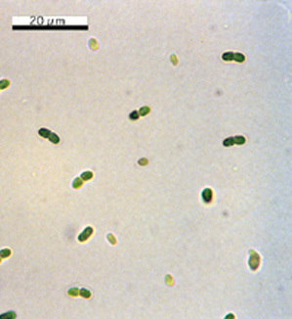
Synechococcus elongatus
Synechococcus elongatus PCC 7942
Unicellular cyanobacterium
Freshwater
https://microbewiki.kenyon.edu/index.php/Synechococcus

Slide 3
Why Synechococcus elongatus?
Advantages:
Small Circular chromosome of about 2.7 Mb
Sequenced Genome
Easier to manipulate than algae
Fast growth

Slide 4
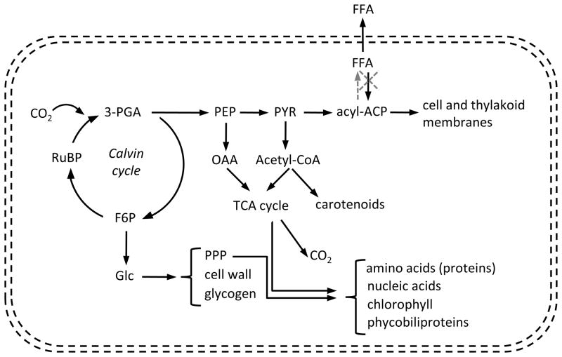
Synechococcus and Biofuel example
FFA important for membrane synthesis
Gene knockout of FFA-recycling enzyme acyl-ACP synthetase (dashed x)
Introduced a thioesterase (from E.coli) for the increased release of FFA by removing feedback inhibition of FA biosynthesis (dashed line)
http://www.ncbi.nlm.nih.gov/pmc/articles/PMC3428126/

Slide 5
Synechococcus and Biofuel example
FFA excreted on a dry cell weight basis
Cell growth
Photosynthetic yield measurements
● wild type (7942)
□ SE01 – just the acyl-ACP synthetase knockout
▲ SE02 - acyl-ACP synthetase knockout + thioesterase
✗ wild type (7942) with the addition of 100 μM of linolenic acid (unsaturated FA) at 100 h.
(Ruffing et al 2012)

Slide 6
Synechococcus and Biofuel example
Problems:
Yield too low for large scale
Reduction in photosynthetic yields
Chlorophyll-a degradation
Changes in the cellular localization of phycocyanin and allophycocyanin
Unsaturated FFA may be toxic to cells
Changes in the membrane (both cell and thylakoid) composition

Slide 7
Creating Transgenic Synechococcus
Add genes:
GeneArt® Synechococcus TOPO® Engineering Kit
Other options:
Knockout or replace genes in genome

Slide 8
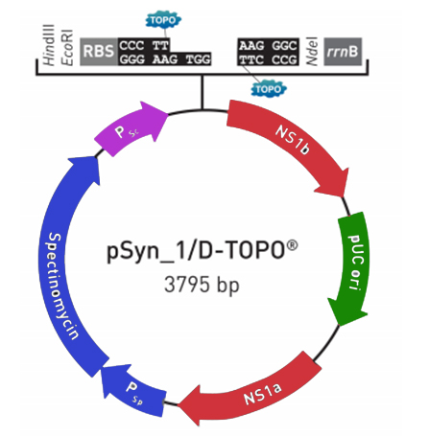
pSyn_1/D-TOPO® Vector
GeneArt® Synechococcus TOPO® Engineering Kit
Syn transformation vector
pUC ori – origin of replication in E. coli
Psp sp/ Spectinomycin – promoter and gene that
drives antibiotic resistance.
Psc – promoter driving gene of interest
NS1 a&b – Neutral sites
CS - Cloning site for Gene of interest
CS

Slide 9
NS1 a&b – Neutral site
Site also present on Synechococcus elongatus genome
Guide DNA between sites into genome
Homologous recombination

Slide 10
Homologous Recombination
Synechococcus
PCC 7942 genome:
Neutral site I
pSyn_1/D-TOPO® Vector:
P
P
Your GENE
pUC ori
NS1A
SPEC
NS1B
Synechococcus
PCC 7942 genome
After transformation:
NS1A
P
SPEC
P
Your GENE
NS1B

Slide 11
Cloning Site
RBS: Ribosomal Binding Site (Start of transcription)
rrnB: Transcriptional Terminator site
Gene inserted via Topoisomerase I
Directional cloning
Due to overhang
Very important :
Start codon must be within reach of RBS
CS
CS

Slide 12
Directional TOPO Cloning
TOPO
PCR Product
CCC TT GGG AA GTGG
AAG GGC TTC CCG
CACC ATG TCG ACC CCA CTT GAT TAG GTGG CTA ATC AAG TGG GGT CGA CAT
RBS
rrnB
TOPO
CCC TT GGG AA GTGG
CACC ATG TCG ACC CCA CTT GAT TAG CTA ATC AAG TGG GGT CGA CAT
AAG GGC TTC CCG
RBS
rrnB

Slide 13
Primer Design
Forward primer (5’):
Includes CACC overhang
Start codon (ATG) immediately after CACC
Reverse primer (3’):
Must either contain STOP codon or bind downstream from it
Must NOT contain the overhang sequence

Slide 14
Primer Design: PCR Review
5’
3’
Heat
Step 1: Denature DNA into two strands
5’
3’

Slide 15
Primer Design: PCR Review
5’
3’
Reverse Primer
5’
3’
5’
3’
Forward Primer
3’
5’
Step two: Anneal primers
Forward Primer binds to bottom strand
Reverse Primer binds to top strand

Slide 16
Primer Design: PCR Review
5’
3’
Polymerase
5’
5’
Polymerase
3’
5’
Step three: Elongate strand
Nucleotides (G,C,T,A) are added to the strand after the primer by polymerase in the 5’ to 3’ direction

Slide 17
Primer Design: PCR Review
Final Product
Yellow – Nucleotides added on by Primer
Red – Nucleotides added on by polymerase

Slide 18
Forward Primer Design example
Start codon
5’
3’
cacc
Forward Primer: caccATGGGCGCGCATATGCAT
Forward Primer Sequence is identical to the top strand
cacc overhand is added before the start codon (ATG)

Slide 19
Reverse Primer Design Example
Example 1:
Stop Codon
Remember: C -- G T --A
5’
3’
Top strand: GGATCCGGCTGCTAACAAAG Complement: CCTAGGCCGACGATTGTTTC
Reverse Primer: CTTTGTTAGCAGCCGGATCC
Must either include stop codon or bind AFTER stop codon
Reverse primer sequence is the REVERSE compliment of the top strand

Slide 20
Obtaining the Gene
Bioinformatics
Identify the source of Gene
Gene sequence
Obtain Template DNA
Isolate Gene
PCR
Clone into topo vector

Slide 21
Bioinformatics
What protein/enzyme?
What gene encodes for the protein?
What organism is it coming from?
What is its nucleotide sequence?

Slide 22
Identifying the Gene Example:
Find the pathway

Slide 23
Identifying the Gene Example:
Find the gene associated with the protein/enzyme
Example:
Ferredoxin (FD) is encoded by the PetF gene.

Slide 24
Identifying the Gene Example:
Find the organism under gene
Synechococcus elongatus PCC7942: Synpcc7942

Slide 25
Identifying the Gene Example:
Open Reading Frame: codes for the protein
Start codon: ATG
Stop codons: TAA, TAG, TGA

Slide 26
Primers Design
Manually design primers
optimal length of PCR primers is 18-25 bp
Melting temperature (Tm): ~60–64°C
https://www.idtdna.com/calc/analyzer

Slide 27
Primers Design
atggctacctatcaagtcgaagtcatctatcagggtcagtcccaaaccttcacggctgac tcagatcaaagtgttttggactcagcgcaagctgcgggcgttgatctgccggcctcttgc ttaactggagtctgtacaacctgtgccgcgcggattctcagcggtgaagtggatcagcca gatgccatgggggtagggcccgagcctgctaagcagggctacaccttactctgtgtggcc tatccgcgatcggacctgaagatcgagactcataaggaagacgaactctacgccctgcaatttggtcagcccggctga
Forward Primer:
Add “cacc”
ATGGCTACCTATCAAGTC
cacc ATGGCTACCTATCAAGTC
Reverse Primer:
ATTTGGTCAGCCCGGCTGA
TAAACCAGTCGGGCCGACT
TCAGCCGGGCTGACCAAAT
Complement
Reverse Complement

Slide 28
Primers: Reverse Complement Generator
http://www.bioinformatics.org/sms/rev_comp.html

Slide 29
Obtain Template DNA
Extract the Genomic DNA:
DNAeasy kit
Gene Blocks
Depends on size of gene and $$

Slide 30
Isolate the gene
Polymerase chain reaction (PCR) using Q5 polymerase
High-Fidelity DNA Polymerase
error rate > 100-fold lower than that of Taq
Template DNA: Genomic DNA
Flanking DNA
Target Gene
Flanking DNA
C
A
+
+
=
Target Gene
G
CACC
T
Genomic DNA
Primers
dNTPs and Polymerase

Slide 31
Topo Cloning
Verify PCR on gel
Quantify PCR

Slide 32
Topo Cloning
Leave at room temperature for 5 minutes or up to 30 minutes for genes > 1000bp

Slide 33
Verify
Transform topo product into E.coli
Select colonies and perform Colony PCR
Extract Plasmid DNA from E.coli

Slide 34
Transforming Synechococcus elongatus
Grow the cells until the culture reaches OD750 of ≥1 before transformation
** 0.7 - 0.8
Harvest: 1.5ml of cells by centrifuging at 14,000 rmp and decant supernatant
Wash Pellet: Resuspend pellet in 1ml of fresh BG11 medium
Harvest: cells by centrifuging at 14,000 rpm and decant supernatant
***Make sure to remove all supernatant***
Resuspend in 100ul of fresh BG11
Add DNA: at least 100ng of syn topo DNA
Water bath: Put tube in 34C water bath for 4 hours.
Plate cells: Using BG11 plates + spec

Slide 35
Plating out Cells
Preform dilutions to ensure single well spaced colonies.
Make a ~10x dilution by mixing 10ul of transformed cells into 100ul of fresh BG11 medium.
Section A: Plate out 50ul of transformed cells
Section B: Plate 100ul of the 10x dilution
Section C: Plate 10ul of 10x dilution
C
A
B

Slide 36
Verify via Colony PCR
Select 10 colonies and plate them on secondary BG-11 spec plate
Wait another 5-7 days to grow
Colony PCR – Taq polymerase
1
2
3
4
5
6
7
8
9
10

Slide 37
Expression

Slide 38
Expression
Induce with nickel sulfate
Increases the expression of the protein
Probably some background level of expression without nickel – Leaky expression
Concentration?
Recommended 5um : killed my cultures
1um – less toxic to wild type

Slide 39
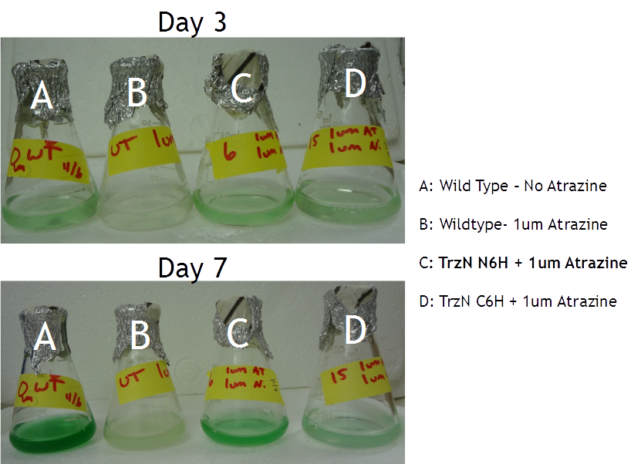
Atrazine Tolerance

Slide 40
Expression
When to induce?
At start of culture or When culture is grown

Slide 41
Other options
Knockout Gene
Replace Gene

Slide 42
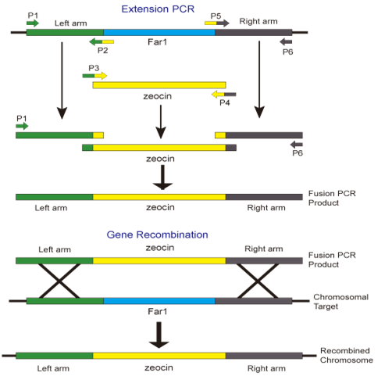
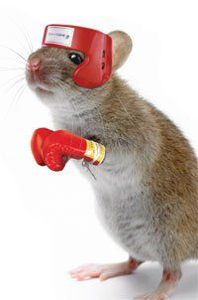
Knockout/Replace gene
Homologous Recombination
http://2013.igem.org/wiki/index.php?title=Team:SCUT/Project/Odorant_sensing&oldid=236502
Zeocin = antibiotic

